Slide 1
DO NOW
Pick up notes and Review #12
Turn in vocabulary or crossword puzzle if you finished it.

Slide 2
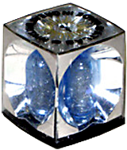
REVIEW
A million-million years from now alien archaeologists find a fossil of the item shown to the right.
What is its importance?
What does it tell them about the age of the rock layer?

Slide 3
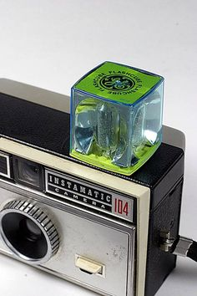
IT’S A FLASHCUBE!
A plastic cube containing four flashbulbs that fits into the top of a camera and revolves after each shot.
This space-aged, flash photography device was revolutionary in 1965 and nearly obsolete by 1975.
The flash cube is an ideal example of an index fossil.
WHAT makes it an example of an index fossil?

Slide 4
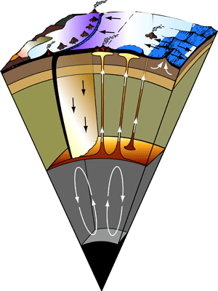
READING THE STORY IN ROCKS:
INTERPRETING THE PAST
Rocks
Plate Tectonics
Weathering
Erosion
Fossils
Cross Section Stratigraphy
Geologic Maps
SES4. Students will understand how rock relationships and fossils are used to reconstruct the Earth’s past.

Slide 5
REMEMBER THE ROCK TYPES?
IGNEOUS
From lava or magma
Intrusive – Granite
Extrusive - Basalt
METAMORPHIC
Heat / Pressure
Convection zones deep in crust
Phyllite, Gneiss, Marble, Slate
SEDIMENTARY
Product of weathering, erosion and deposition
Shale, Sandstone, Limestone

Slide 6
WHAT DO IGNEOUS AND METAMORPHIC ROCKS SHOW?
Igneous rock
Evidence of volcanism or intrusion
Metamorphic Rock
Evidence of subduction
At the surface? Uplifted!

Slide 7
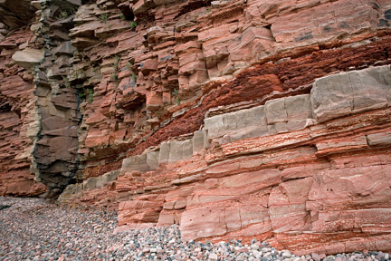
WHAT DO SEDIMENTARY ROCKS SHOW?
80% of Earth’s Surface:
Weathering
Erosion
Deposition
Tell about the environment by:
  Composition
  Clast Size

Slide 8
SEDIMENTARY CLAST SIZE:
CLUES TO PAST ENVIRONMENTS
Glacial Drift/Till
Mixed sizes
Pushed in front of slow moving ice and deposited when ice melts
Limestone
Marine or Ocean
Made of shells and/or sediment
Shale
Fine Grained
Low energy, wet
Calm marine or muddy environment

Slide 9
SEDIMENTARY CLAST SIZE:
CLUES TO PAST ENVIRONMENTS
Conglomerate
Large Chunks
High Energy Environment
Fast moving water
Sandstone
Mid-energy / Slow water or windy
Beach or desert

Slide 10
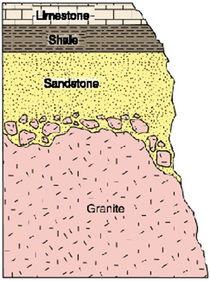
CROSS SECTIONS REVEAL ROCKS
Law of Superposition – Bottom is oldest
Rock type can tell you:
What was this environment like FIRST?
Then what happened?
What happened next?
What was it like at the END?
Ocean
Calm Ocean or Mud
Beach or desert
Volcanic Activity

Slide 11
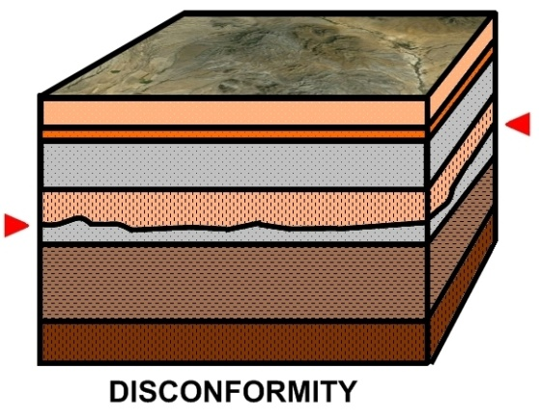
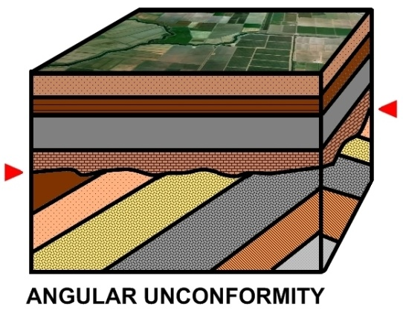
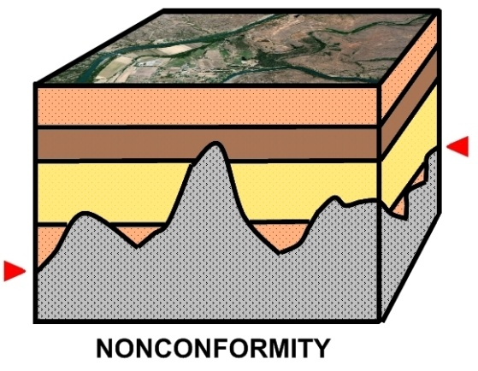
ALSO SHOWN:
WHEN CHANGES OCCURRED

Slide 12
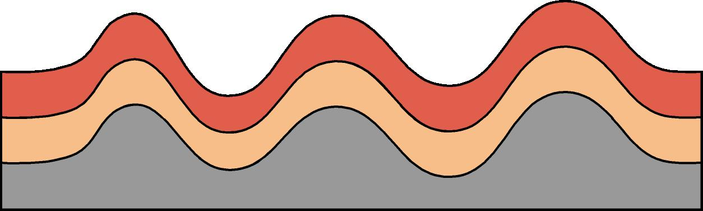
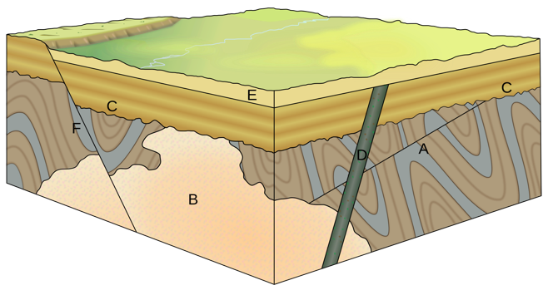
SHOWS WHEN FOLDING AND FAULTING HAPPENED
Record of
Plate Tectonics

Slide 13
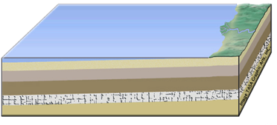
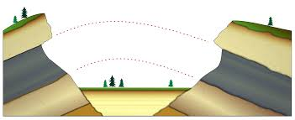
LAYERS OF EARTH
Sediments is deposited in layers:
  Original Horizontality
When erosion splits layers, you can match them up on both sides of a split:
  Lateral Continuity

Slide 14
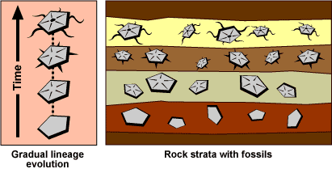
FOSSILS ADD TO THE STORY
Record of life
Clues to Past Environment
Relative age – order they appear in
Absolute age – index fossils
How life changed over time
Major extinction events

Slide 15
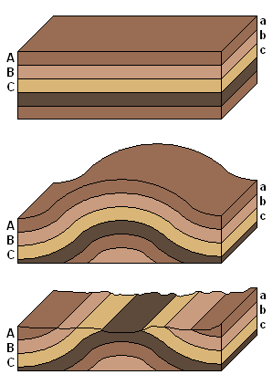
GETTING THE STORY
Sometimes the surface tells the story.
Sometimes you have to “cut” into it.

Slide 16
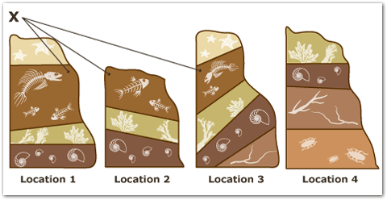
PUT IT ALL TOGETHER
You get the story of Earth’s History.

Slide 17
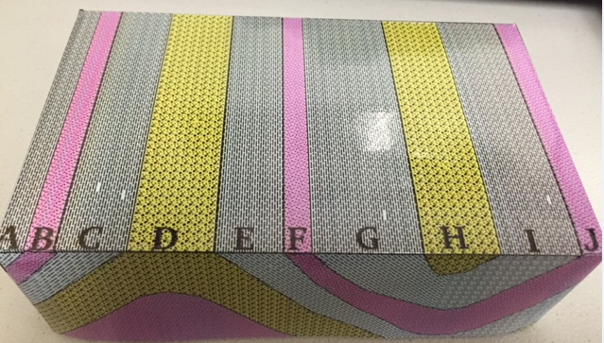
BOX MODELS
Box models are tools used to show both the side and the top of a geologic area.
  The top represents what you’d see in a geologic map.
  The side represents what you’d see in a cross section.
They allow you to see both views at the same time.

Slide 18
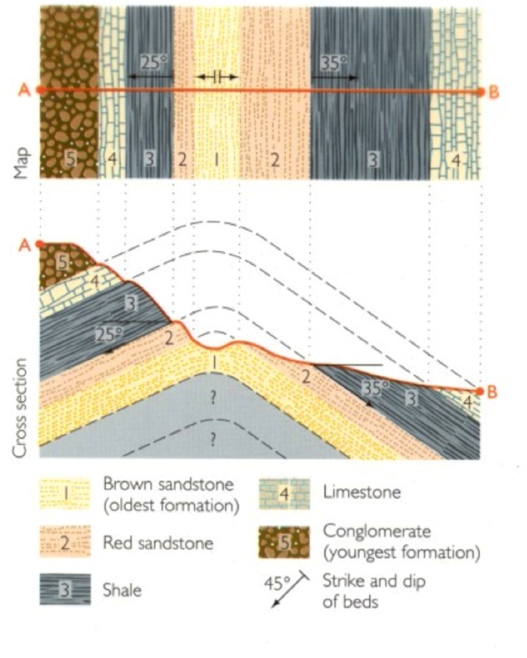
REVIEW
What type of environment was this region LAST?
Beach
Swamp
Marine
Glacier

Slide 19
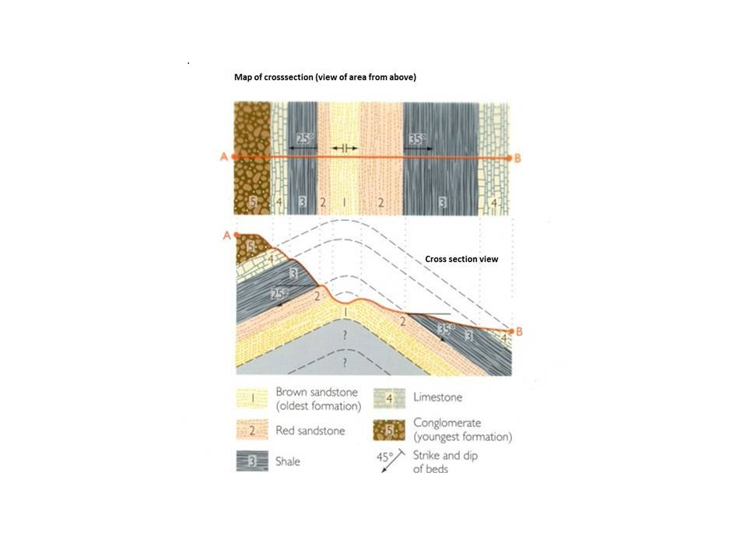
LET’S READ SOME ROCKS!
What does each type of rock tell you about the environment? Energy?
  Sandstone?
  Limestone?
  Shale?
  Conglomerate?
TEST QUESTIONS COME FROM HERE!

Slide 21
LET’S READ SOME ROCKS!
What does the order tell you?
  First to last?
Why do the layers slope?
Why are there missing sections of rock?
TEST QUESTIONS COME FROM HERE!

Slide 22
TO DO
Work on Review #12

