Slide 1
DO NOW
Turn in Review #10.
Pick up notes and Review #11.

Slide 2
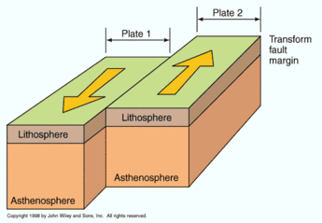
REVIEW
What type of:
Stress?
Force?
Fault?
Landform?
Shear
Neutral
Slip-Strike
Offset Geology

Slide 3
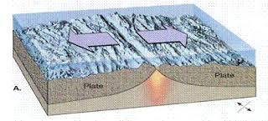
SEAFLOOR SPREADING
SES2. Students will understand how plate tectonics creates certain geologic features, materials, and hazards.
a. Distinguish among types of plate tectonic settings produced by plates diverging, converging, and sliding past each other.
b. Relate modern and ancient geologic features to each kind of plate tectonic setting.

Slide 4
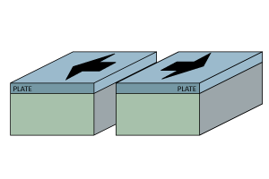
REVIEW: DIVERGENT PLATE BOUNDARIES
Plate separates; tension stress; normal fault
Landforms Created:
  Rift Valleys
  Fault-block Mountains
  Mid-Ocean Ridges
Constructive Force – creates new plates where magma rises.

Slide 5
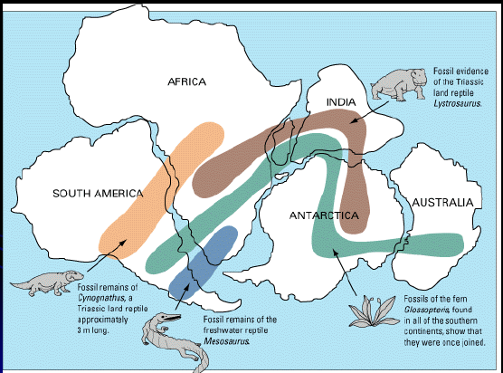
REVIEW: PLATE TECTONICS THEORY
Alfred Wegner
Theory of Plate Tectonics.
Early 20th Century.
Evidence
Geographic fit
Fossils
Rock formations
Not fully accepted until 1960’s!

Slide 6
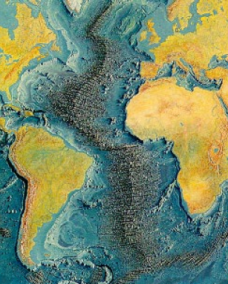

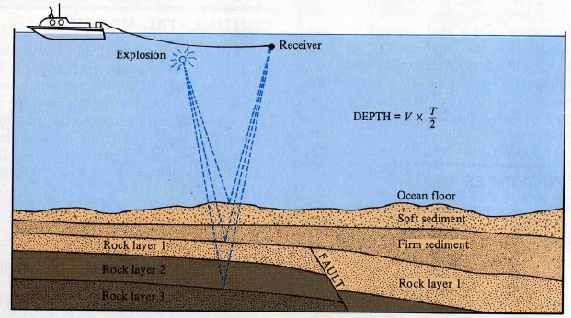
HESS: MAPPING THE OCEAN FLOOR
Harry Hammond Hess provided evidence to support the theory.
Echo Soundings Revealed:
Central Mountain Ranges
Trenches
Mid-Atlantic Ridge
Lava at center of ridge.
Younger rock near ridge.
Older rock outward.
Sediments deeper farther out from ridge.

Slide 7
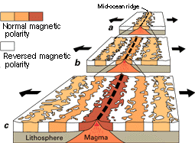
GEOMAGNETIC REVERSALS
RECORDED IN ROCK
Rocks record of Earth’s magnetic pole reversals.
As rocks solidify minerals align with poles.
When poles reverse, the alignment is opposite.

Slide 8
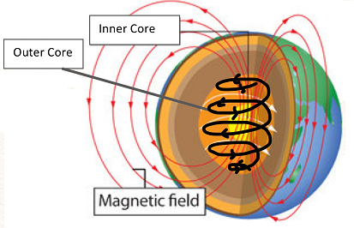
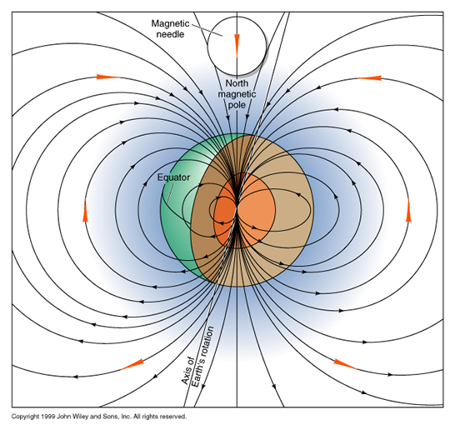
EARTH’S MAGNETIC FIELD
Caused by movement of conducting material inside Earth's core.
Creates magnetic field around planet (magnetosphere).
Protects from solar wind.
Creates magnetic poles (North and South).

Slide 9
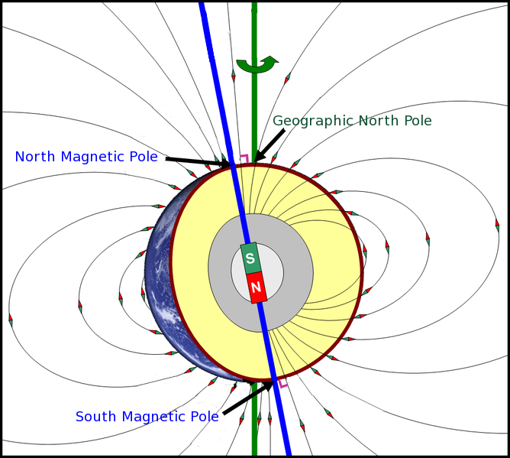
GEOGRAPHIC VS. MAGNETIC POLES
Geographic pole: Center of rotation – shown on maps.
Magnetic pole: the point where the planet's magnetic field points vertically downward – where a compass points.
These locations are not the same.

Slide 10
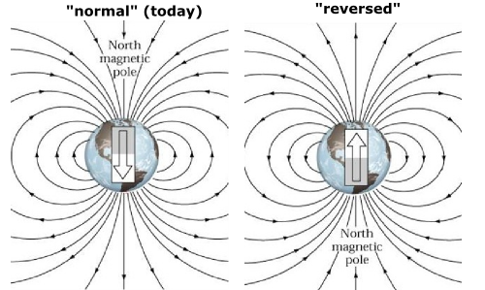
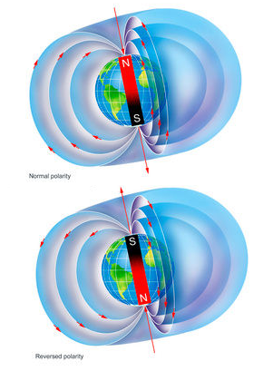
POLE REVERSALS
North and South poles flip.
This is a common occurrence .
It happens gradually.
Pattern about every 200,000 to 300,000 years.
Last pole reversal approximately 780,000 years ago.

Slide 11
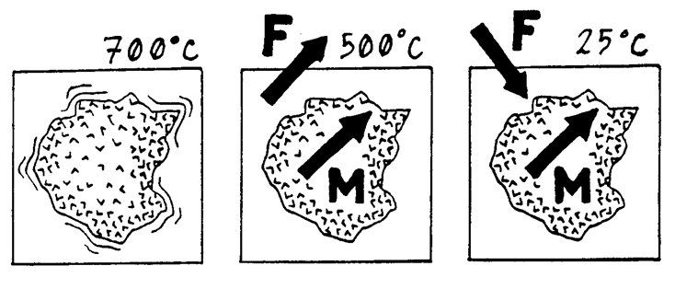
RECORD OF MAGNETIC POLES IN ROCK
Some rocks have iron-bearing minerals that act as tiny magnets.
As magma or lava cool, these minerals begin to form.

Slide 12
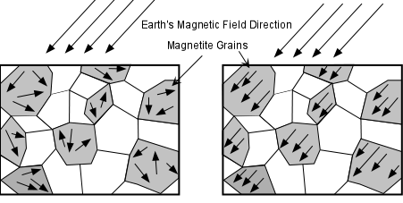

RECORD OF MAGNETIC POLES IN ROCK
Magnetic minerals in the molten rock become aligned to the magnetic field.
When the rock solidifies, minerals lock in the magnetic field like many tiny compasses.

Slide 13
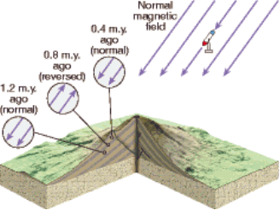
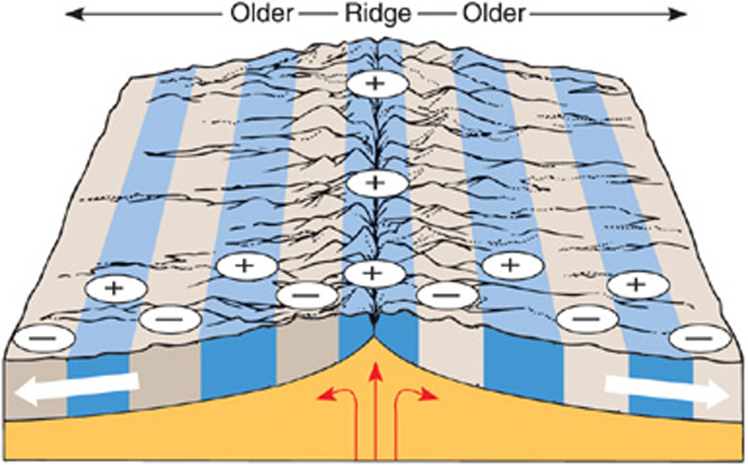
MAGNETIC REVERSALS RECORDED
IN ROCK
Rocks formed over long periods of time retain record of pole reversals.
Record of pole reversals can appear in:
  Mountain building
  Sea Floor spreading

Slide 14
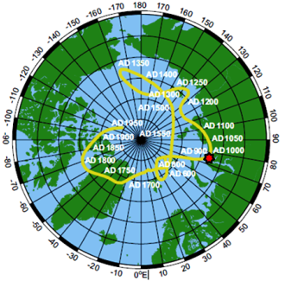
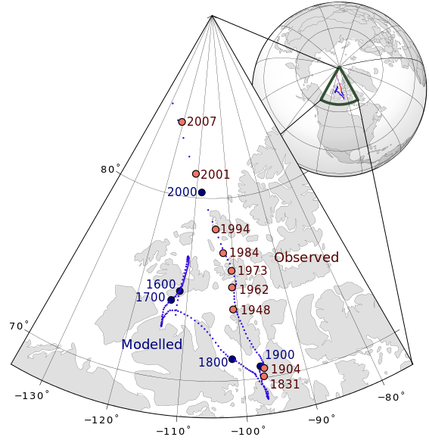
POLE WANDERING
Magnetic poles move.
Thought to be caused by currents in Earth’s molten outer core.
Current North pole moving toward Siberia at about 40 miles per year.
Moving faster than before – 100 years ago only moving 10 miles per year.

Slide 15
SOMETHING TO THINK ABOUT….
What scientist first developed the theory of plate tectonics?
What scientist found evidence for the theory of seafloor spreading?
A. Harry Hess
B. Albert Einstein
C. Lord Kelvin
D. Alfred Wegener
D
A

Slide 16
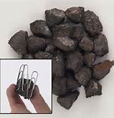
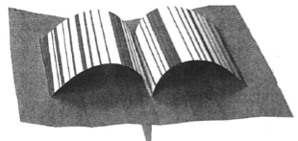
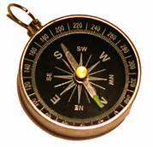
MAGNETIC EARTH
Paleomagnetism Video

Slide 17
TO DO
Work on your Rock lab.
Review #11 due tomorrow.

