Slide 1
DO NOW
Pick up notes and Review #33.

Slide 2
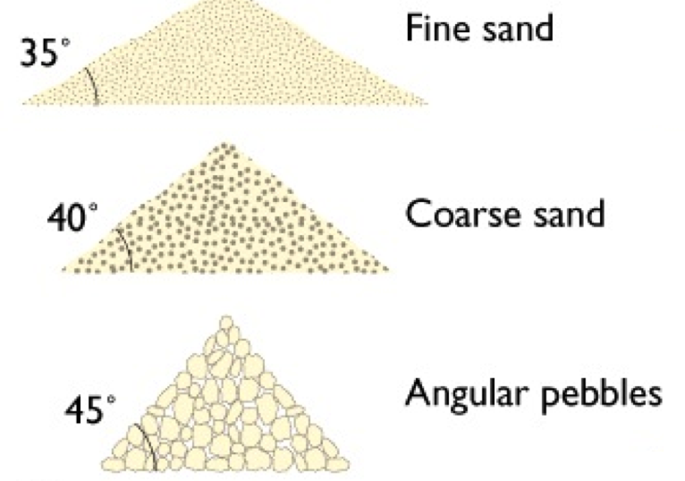
REVIEW
What did you learn from your lab about the angle of repose and the size of sediment?
Why is the angle of repose smaller for fine sand than it is for coarse sand or angular pebbles?
The bigger the grain, the larger the angle.
The bigger the grain, the more friction helps.

Slide 3
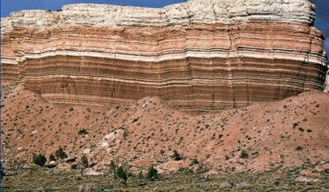
SEDIMENTATION AND SEDIMENTARY ROCKS
SES1e: Identify the transformations and major reservoirs that make up the rock cycle (and other geochemical cycles).
SES3e:. Explain the processes that transport and deposit material in terrestrial and marine sedimentary basins, which result, over time, in sedimentary rock.

Slide 4
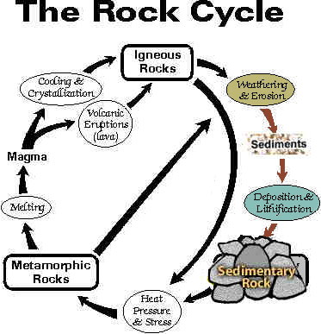
THE ROCK CYCLE
Igneous: Formed by fire – from magma or lava.
Metamorphic: Formed from heat and pressure deep within Earth’s crust.
Sedimentary: Formed at or near surface from products of weathering and erosion.

Slide 5
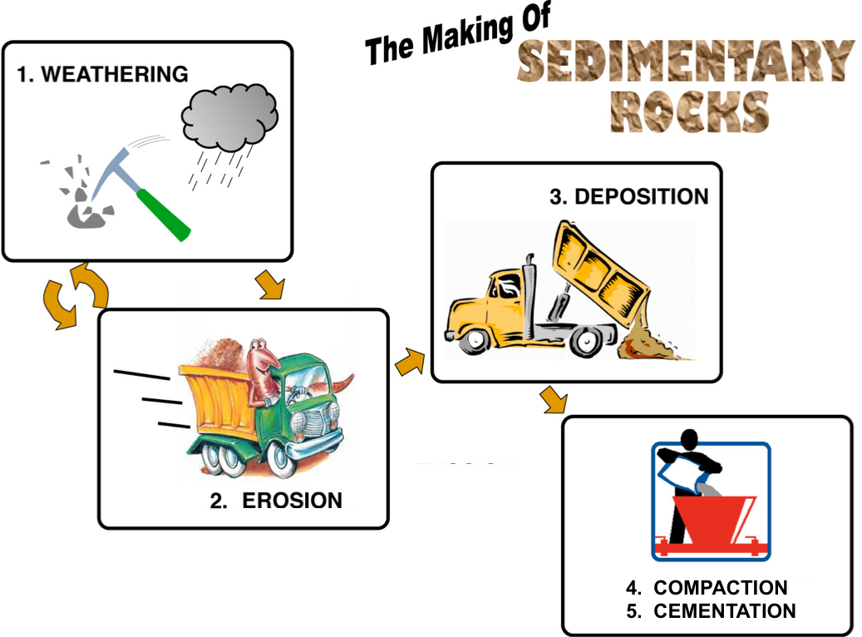
FORMATION PROCESS
Weathering ✔
Erosion ✔
Deposition ✔
Lithification ✔
- Comes from Compaction and Cementation

Slide 6
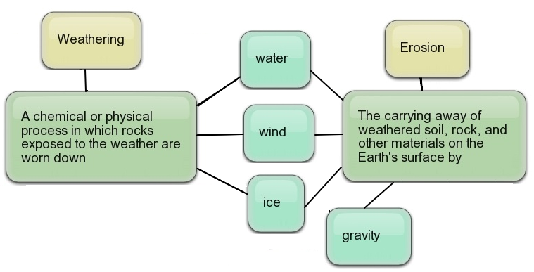
WEATHERING AND EROSION

Slide 7
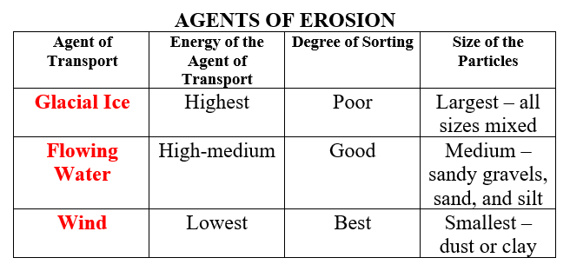
EROSION AND SEDIMENTATION
Sorting and size of particles provide clues to agent of transport.

Slide 8
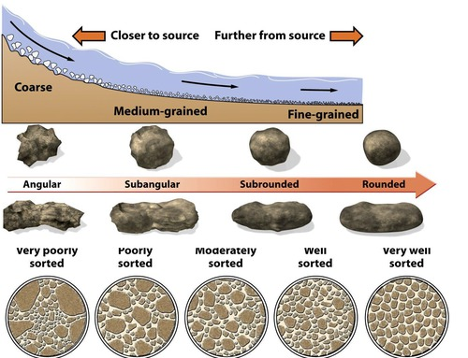
DEPOSITION AND SORTING
Clast: Rock fragment
Sediment is deposited based on how far and fast it is transported.
Degree of sorting and size of sediment tells about the environment rocks formed in.

Slide 9
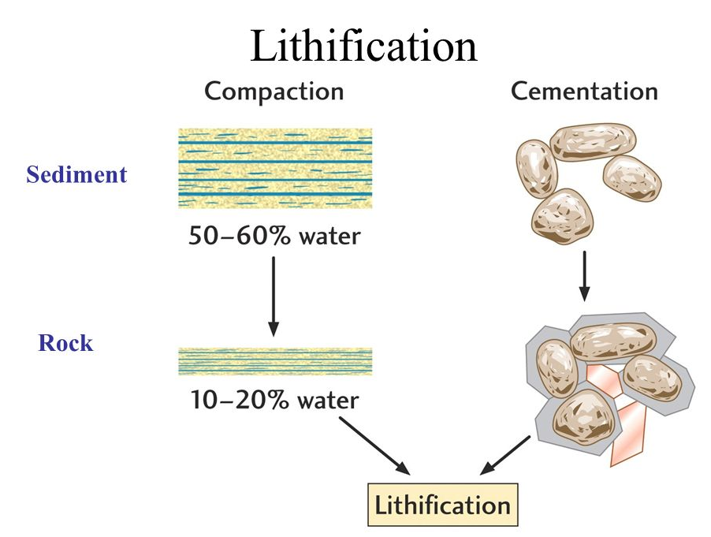
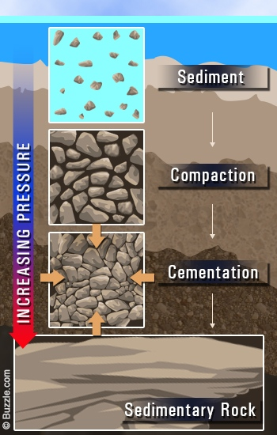
Lithification: Compaction and Cementation
Compaction from increasing pressure.
Cementation from dissolved minerals.

Slide 10
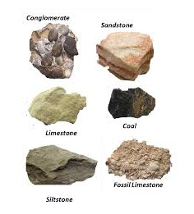
TYPES OF SEDIMENTARY ROCK
A. Clastic:
Accumulations of clasts (little pieces of broken up rock) which have piled up and been lithified by compaction and cementation.
  Sandstone, conglomerate
B. Chemical:
Forms when standing water evaporates, leaving dissolved minerals behind.
  Gypsum, halite
C. Organic:
An accumulation of sedimentary debris caused by organic processes; shells, bones, plant matter, etc.
  Coal, limestone

Slide 11
ROCKS FROM CLASTS (CLASTIC)
Breccia
Angular Clasts – very little weathering with minimal transport
Conglomerate
Rounded Clasts transported farther with more weathering
Sandstone
Rough, gritty feel
Deposited from current transport
Tend to be porous
Shale
Smallest particles – formed in water calm enough for clay particles to settle
2. CONGLOMERATE
1. BRECCIA
3. SANDSTONE
4. SHALE
HIGH ENERGY ENVIRONMENTS

Slide 12
ROCKS FROM EVAPORATES (CHEMICAL)
Halite
Forms when oceans and seas dry up;
Natural Rock salt and
Calcium Chloride (NaCl)
Gypsum
Deposited rom lake and sea water;
Contains calcium, sulfate, and water;
Crystal formations called “Desert Rose”
Chert
Microcrystals of silicon dioxide grow within soft sediments that will eventually become limestone
1. HALITE
2. GYPSUM
3. CHERT

Slide 13
Rocks from Organics (Organic)
Coal
Swamp and Marsh Environments
Limestone
Remains of marine animals, coral, and shells
Coquina
Remains of shells – forms near shore – well sorted by waves
1. COAL
2. LIMESTONE
3. COQUINA

Slide 14
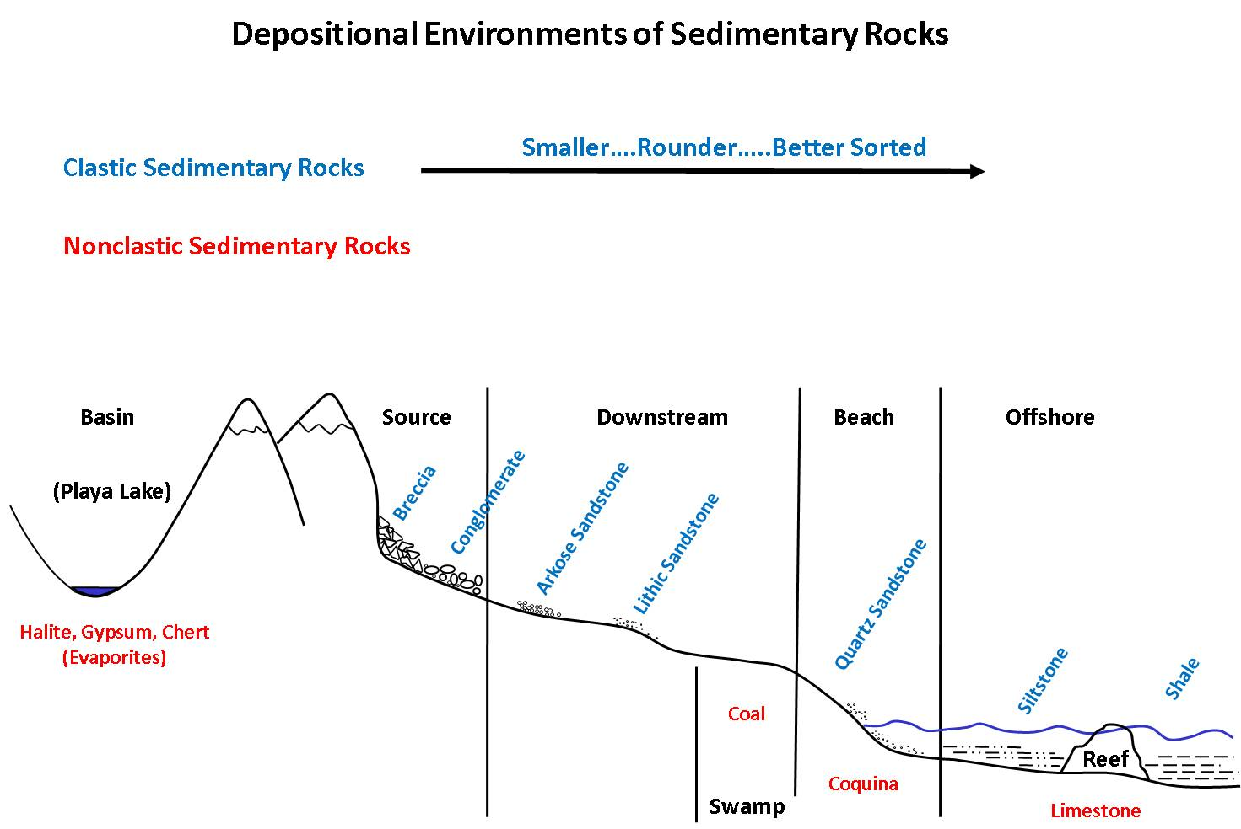
DEPOSITION ENVIRONMENTS

Slide 15
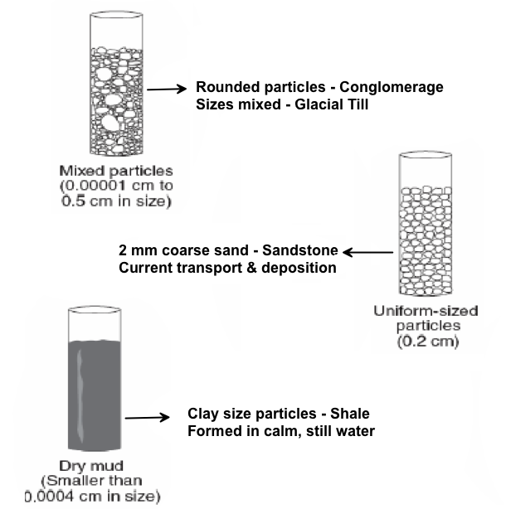
Environmental Clues from Sediment Size

Slide 16
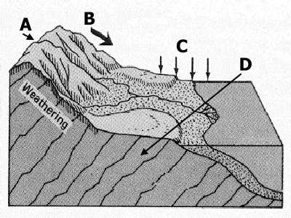
REVIEW
Where does each of the following occur?
Erosion?
Transportation?
Deposition?
Lithification?
A
B
C
D

Slide 17
TO DO
Review #33 due tomorrow.
Work on Mass Wasting lab.

