Slide 1
DO NOW
Turn in Review #17
Pick up notes and Review #18.

Slide 2
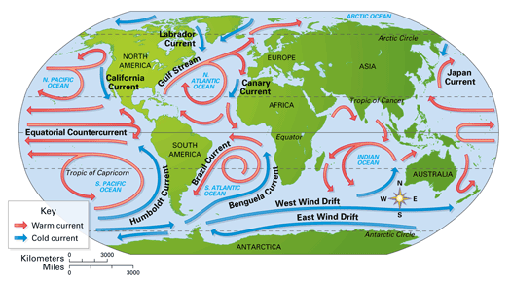
REVIEW
What effect do ocean currents have on climate and weather?
Which current carries warm water north along the US east coast?

Slide 3

UNEVEN HEATING AND COOLING OF LAND AND WATER
SES5. Students will investigate the interaction of insolation and Earth systems to produce weather and climate.
b. Explain the relationship between air masses and the surfaces over which they form.
c. Relate weather patterns to interactions among ocean currents, air masses, and topography.

Slide 4

HEATING EARTH’S SURFACE
Ever notice how the sand gets so hot in the summer at the beach that it can burn your feet but the water stays nice and cool?
WHY?

Slide 5
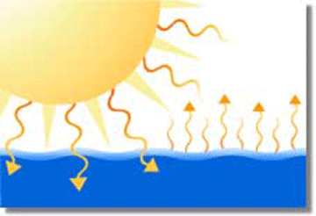
WATER REFLECTS SOLAR ENERGY
Much of the solar radiation that reaches the ocean is reflected back to the atmosphere.

Slide 6
WATER MIXES SOLAR ENERGY
Water has a higher heat capacity than land - it takes more heat to raise the temperature of one gram of water by one degree than it does to raise the temperature of land.
  1 calorie of solar energy will warm one gram of water by 1°C.
Energy that is absorbed by water at the surface is mixed with deeper layers.

Slide 7
WATER MIXES SOLAR ENERGY
Heat is lost through evaporation.
Water absorbs solar energy slowly.
Water releases thermal energy slowly.

Slide 8
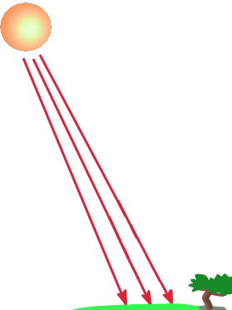
LAND ABSORBS AND RADIATES SOLAR ENERGY
Land reflects less solar energy than water during the day.
Land has a lower heat capacity than water - it takes less heat to raise the temperature of one gram of land by one degree than it does to raise the temperature of land.
  0.20 calorie of solar energy will warm one gram of granite by 1°C.

Slide 9
LAND ABSORBS AND RADIATES SOLAR ENERGY
Absorbs energy – stays at surface (doesn’t mix with deeper layers).
Heat is not lost from evaporation.
Land retains heat during day.
Land loses heat more quickly at night.

Slide 10
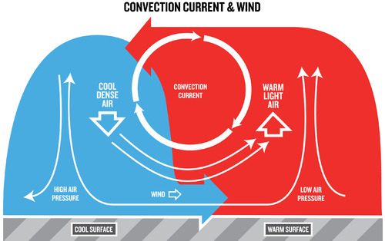
CONVECTION CURRENT FROM DIFFERENTIAL HEATING AND COOLING

Slide 11
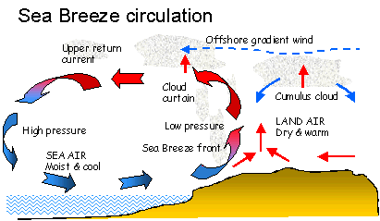
SEA BREEZES
Air over the land is warmer than air over the water.
Low pressure forms over the land.
Air rises over the land.
Clouds form.

Slide 12
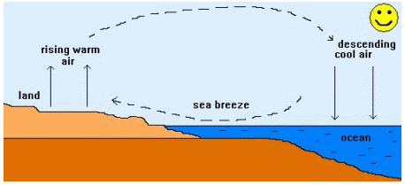
SEA BREEZES
Air pulled into low from water – sea breeze.
Convection current.
Occurs in the daytime in Summer.
Daytime storms are on the land where low pressure forms.

Slide 13
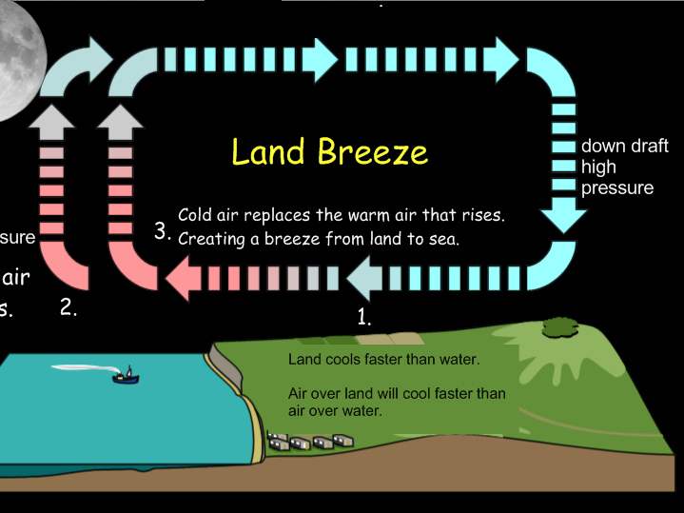
LAND BREEZES
Air over the water is warmer than air over the land.
Low pressure forms over the water.
Air rises over the water.
Clouds form.

Slide 14
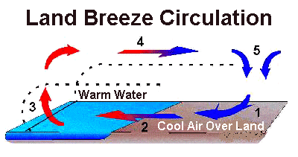
LAND BREEZES
Air is pulled into the low from land – land breeze.
Convection current.
Occurs in the nighttime in the Summer.
Nighttime storms over the water where low pressure forms.

Slide 15
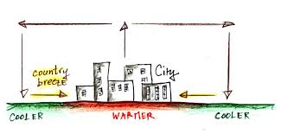
LOCAL CIRCULATION PATTERN
Convection current.
Local winds.
Works like Global Winds but on a smaller scale.
Same pattern can be seen around cities that trap heat in the summer.

Slide 16
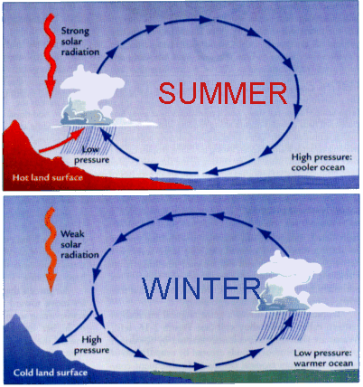
WINTER CIRCULATION
Where large bodies of water hold onto their heat in winter and cool slowly, the opposite pattern can emerge.
Water cools slowly.
Low pressure forms over water.
Air rises over water during day.
Land breeze forms during day.

Slide 17
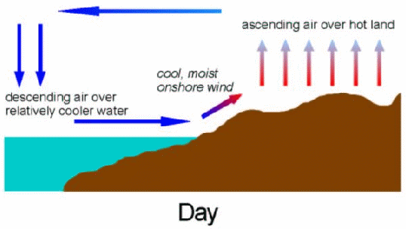
REVIEW
When land warms up faster than water during the day, what type of breeze is formed?
A. Land breeze
B. Mountain breeze
C. Low pressure breeze
D. Sea breeze

Slide 18

LAB: HEATING AND COOLING
The unequal heating of land and water surfaces is an important factor in the formation of large global weather systems.
This activity will help demonstrate this effect by measuring the temperature of water and sand while heating and cooling.

