Slide 1
DO NOW
Pick up notes and Review #17.

Slide 2
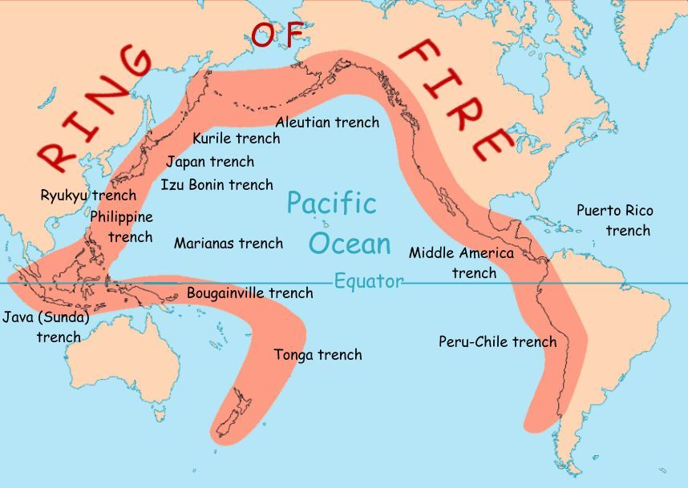
REVIEW
What is the Pacific Ring of Fire?
What type of Plate Boundary?
Ring of earthquakes and volcanoes around the Pacific Ocean.
Divergent

Slide 3
VOLCANOES
TEXTBOOK CORRELATION:
Chapter 13

Slide 4
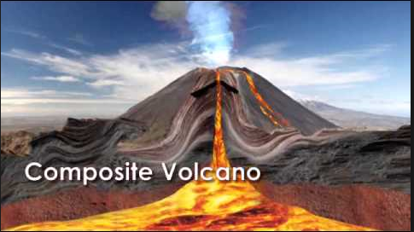
VOLCANO
A mountain, typically conical, having a crater or vent through which lava, rock fragments, hot vapor, and gas are being or have been erupted from the Earth's crust.

Slide 5
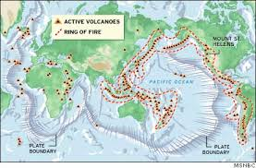
WHERE DO VOLCANOES FORM?
Volcano Zones
Subduction zones
Ocean trenches
Tectonic plate boundaries
Mid-ocean ridges
Fun fact: Ancient volcanoes existed in Georgia when Appalachian Mountains formed.
Pacific Ring of Fire:
Belt of volcanoes that encircles the Pacific Ocean.

Slide 6
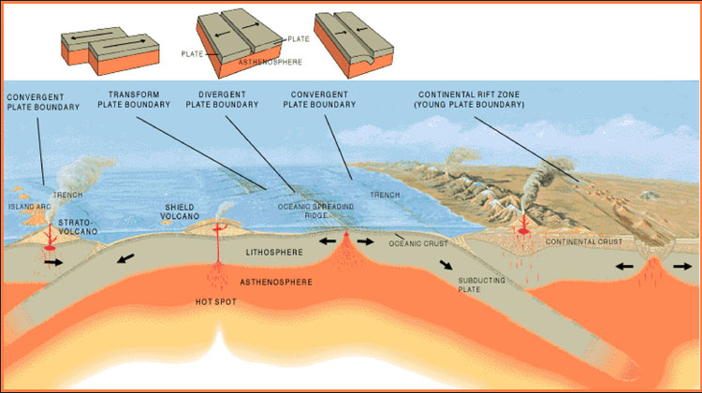
WHERE DO VOLCANOES FORM?

Slide 7
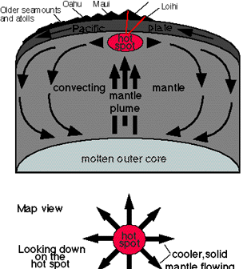
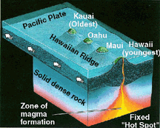
HOT SPOTS
Areas of volcanism within tectonic plates.
Mantle plumes develop.
Hot spots form above plumes.
Rock melts, lava forms.
Some not associated with plate boundaries.
Plates move, carrying cooled volcanoes.

Slide 8
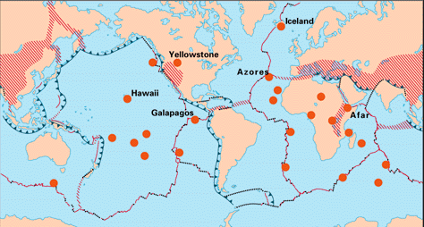
HOT SPOTS
Some of the hot spots around the world.
Many are not at plate boundaries.

Slide 9
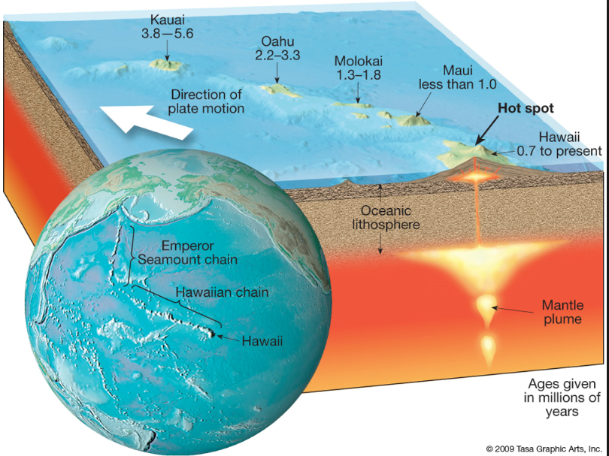
HOT SPOTS

Slide 10
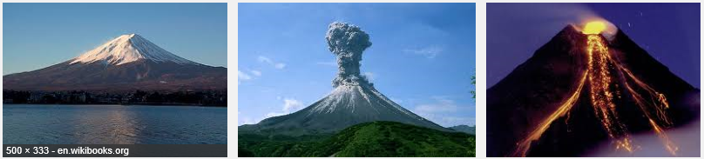
TYPES OF VOLCANOES
Composite
Built with layers of lava flows.
Steep-sided and symmetrical cones
Alternates eruptive explosions and quieter lava flows.
Also called a stratovolcano.
Example: Mount St. Helens

Slide 11
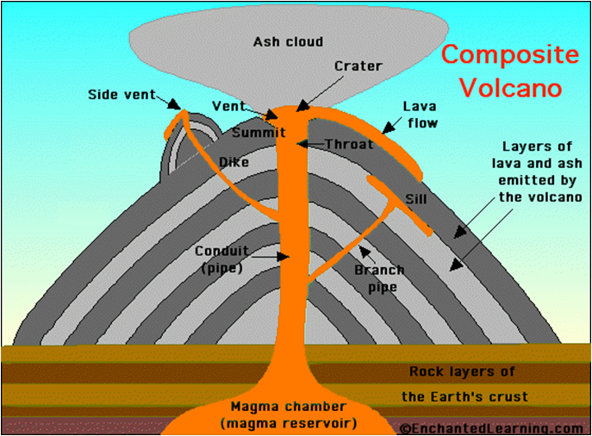
COMPOSITE VOLCANO

Slide 12
COMPOSITE VOLCANO
Vent – an opening in a volcano connecting the magma to the surface.
Side Vent - magma reaching the surface through another opening.
Magma Plume or Chamber - large underground pool of molten rock sitting underneath the Earth’s crust.
Crater – a bowl shaped area that forms around a volcano’s central opening.
Lava flow – magma that flows onto Earth’s surfaces.
Conduit or Pipe – the channel from the magma chamber to the vent to bring the magma to the surface.

Slide 13
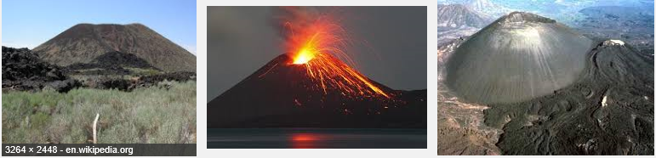
TYPES OF VOLCANOES
Cinder Cone
From explosive eruptions.
Made of pyroclastic materials.
Steep sides and a bowl-shaped crater.
Most common type of volcano.
Example: Parícutin in Mexico.

Slide 14
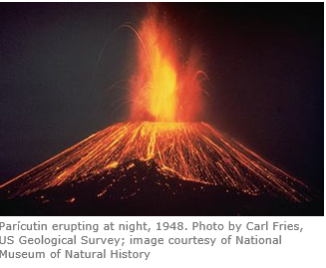
CINDER CONE VOLCANO
Parícutin: The Birth of a Volcano
On February 20, 1943, out of a cornfield owned by a Tarascan farmer named Dionisio Pulido, a great volcano began to emerge. For weeks the inhabitants of this village near Uruapan, about 200 miles west of Mexico City, had been experiencing tremors and deep rumblings from the earth. Pulido, his wife and child, and a farmhand were all working in the field nearby when the earth rose up some two meters (more than six feet), emitting ash and strong sulfurous vapors amidst loud hissing and explosions. By midnight a cone had developed and the eruption had begun in earnest.

Slide 15
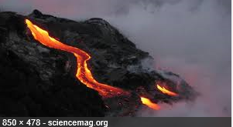
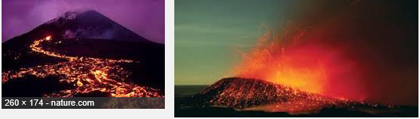
TYPES OF VOLCANOES
Shield
Built from fluid lava flows.
Gently sloping sides.
Broad base.
Example: Hawaiian Islands

Slide 16
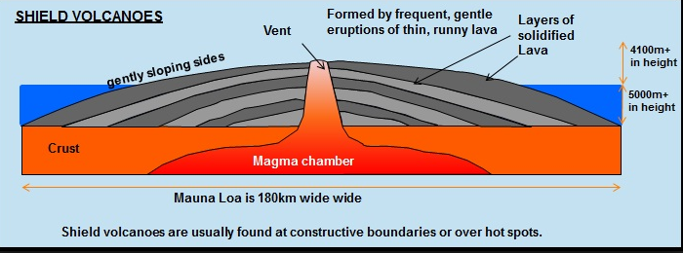
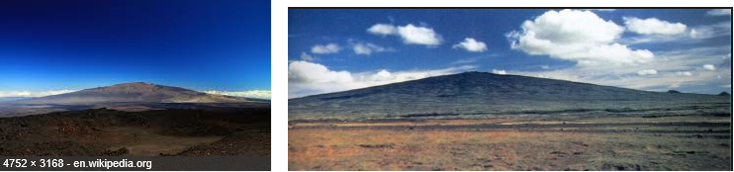
SHIELD VOLCANO

Slide 17
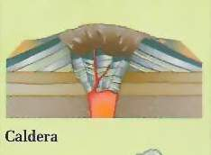
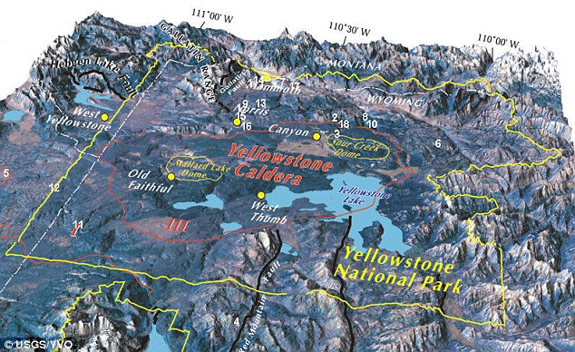
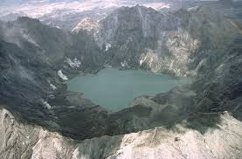
CALDERAS
Large, basin-shaped depression.
Formed by the collapse of a volcanic cone.
Can fill with water.

Slide 18
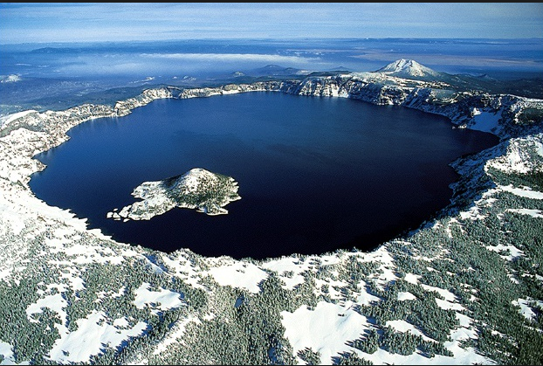
CALDERA
Crater Lake, Oregon

Slide 19
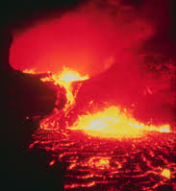
FORMATION OF MAGMA
Produced by partial melting of Earth’s mantle and crust.
Three conditions:
Temperature of rock rises above melting point.
Pressure removed, melting point decreases.
Addition of fluids (water) can decrease melting point.

Slide 20
FORMATION OF MAGMA
Gases in Lava:
Water vapor and Carbon Dioxide are the most common.

Slide 21
VOLCANO GASES
Volcano Tectonics Temperature | Kilauea Hot Spot 1170ºC | Erta Ale Divergent 1130ºC | Momotombo Convergent 820ºC | Average
H2O | 37.1% | 77.2% | 97.1% | 78%
CO2 | 48.95 | 11.3% | 1.44% | 12%
SO2 | 11.8% | 8.34% | 0.50% | 7%
H2 | 0.49% | 1.39% | 0.70% | 3%
CO | 1.51% | 0.44% | 0.01%
H2S | 0.04% | 0.68% | 0.23%
HCl | 0.08% | 0.42% | 2.89%
HF | 0.0% | 0.0% | 0.26%
Compare the gases from different types of volcanoes.
What gases are most common for all types?

Slide 22
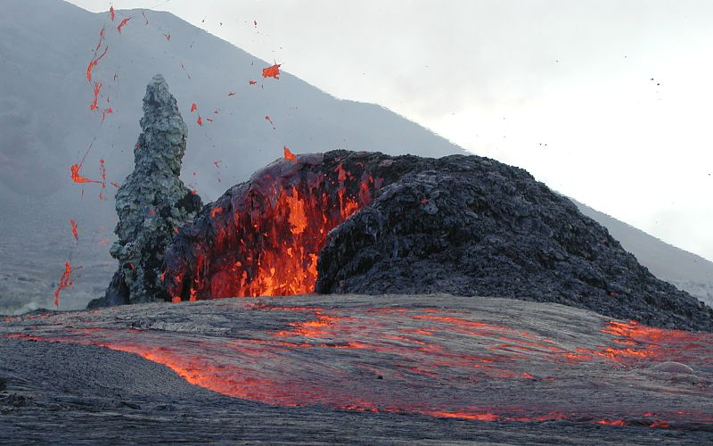
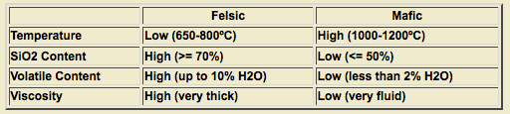
COMPOSITION OF MAGMA
Mafic magma is rich in magnesium and iron and generally dark in color - most common.
Felsic magma is rich in feldspar and silica.

Slide 23
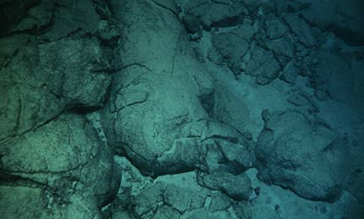
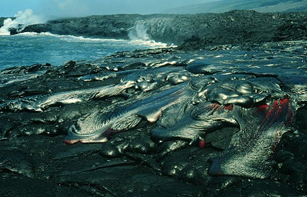
TYPES OF LAVA FLOWS
Pillow Lava - rapidly cooled and forms underwater at mid-ocean ridge.
Pahoehoe - smooth, billowy, or ropy surface, relatively thin – cools and moves quickly.

Slide 24
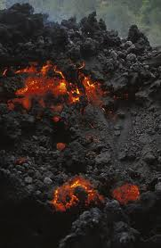
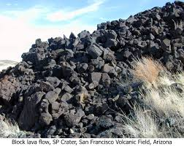
TYPES OF LAVA FLOWS
A’a - rough, jagged surface, thicker – cools and moves slowly.
Block - surface of large angular blocks, higher silica content.

Slide 25
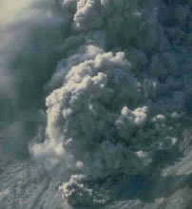
PYROCLASTIC MATERIALS
Volcanic Dust
< 0.25 mm
Smallest particles thrown into the air during an eruption
Volcanic Ash
0.25 –2 mm
Tiny particles of crushed volcanic rock and glass
Volcanic Bombs
Large blobs of lava ejected from a volcano
Lapilli
Rounded or spindle shaped pebble sized rock; falling out of the air.
Cloud of ash, lava fragments and vapor
from a volcanic explosion.

Slide 26
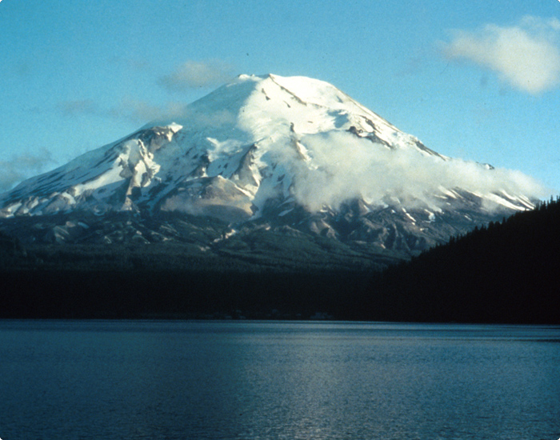
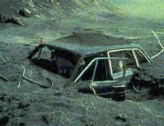
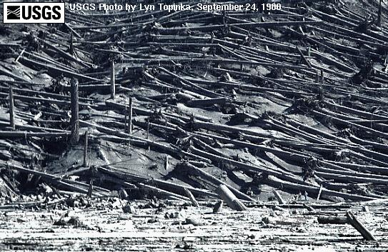
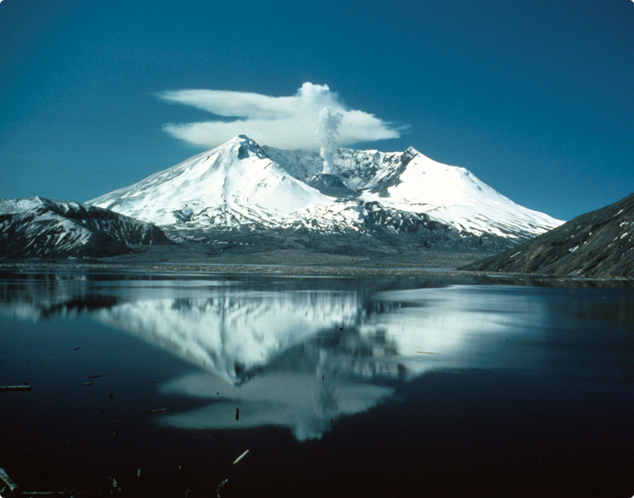
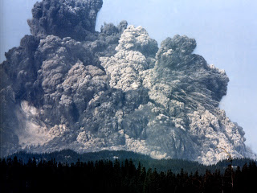
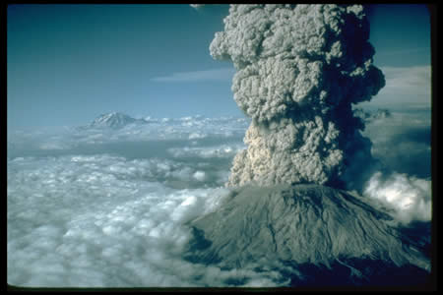
MOUNT ST. HELEN’S - WASHINGTON STATE
Before
During
After

Slide 27
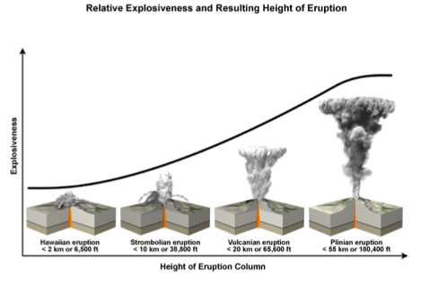
ERUPTIONS
The amount of dissolved gas in magma provides the driving force for explosive eruption.
More gas = more explosive eruption.

Slide 28
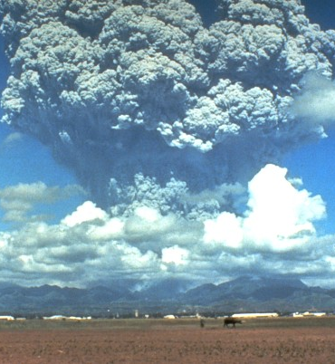
LASTING EFFECTS OF VOLCANOES
Volcanic eruptions can alter the climate of the Earth.
Particles block sunlight.
Cause cooling as cloud circles planet.
How can volcanic eruptions in other parts of the world affect us?

Slide 29
LASTING EFFECTS OF VOLCANOES
Examples:
Pinatubo eruption in 1991 cooled Earth by about 1°F for 1 - 2 years.
Tambora in Indonesia- eruption in 1815 - global temperatures fell by about 2°F for 1 - 2 years caused crop failures in northeastern USA.

Slide 30
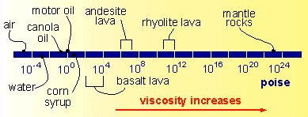
VISCOSITY OF LAVA
Property of fluids:
Viscosity = Resistance to flow
Liquid friction is another way to describe it.

Slide 31
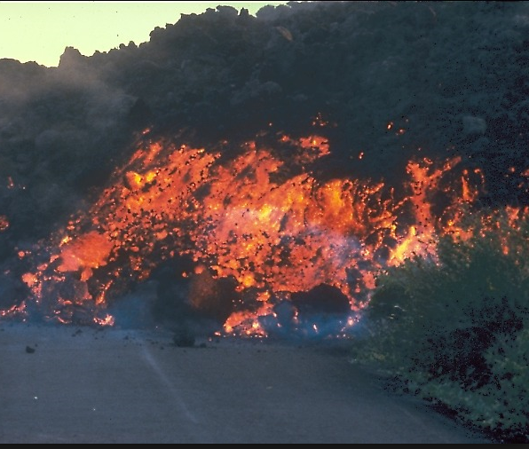
VISCOSITY OF LAVA
More viscous lavas:
Higher silica content.
More explosive eruptions.
Flow slower and thicker.
A’a lava
Felsic composition

Slide 32
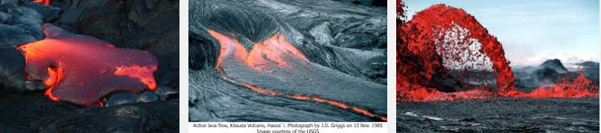
VISCOSITY OF LAVA
Less viscous lavas:
Low silica content.
Lava tends to ooze out.
Flow faster and thinner.
Pahoehoe lava
Mafic composition
Lava viscosity determines the force of a volcanic eruption!

Slide 33
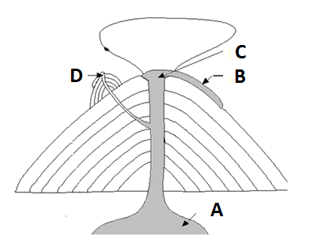
REVIEW
Which is the:
Side vent?
Lava flow?
Magma dome?
Crater?
D
B
A
C

Slide 34
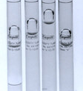
ACTIVITY: EXPLORING VISCOSITY
Each student will get one test tube with a fluid and a ball bearing.
You will determine the time it takes for the ball to fall from the top to the bottom once you invert the tube.
You will enter the time in your data table.

Slide 35
ACTIVITY: EXPLORING VISCOSITY
 | Green | Blue | Yellow | Red
Trial 1
Trial 2
Trial 3
Trail 4
Trial 5
AVERAGE

Slide 36
TO DO
Finish the Viscosity lab.
Do Review #17

