Slide 1
PHASES OF MATTER
AND ENERGY
TEST REVIEW

Slide 2
review
Explain the behavior of solids, liquids, and gases in terms of the kinetic theory.
  Know the three parts to the K-M theory.
All matter is composed of small particles.
The small particles are in constant, random motion.
All particles have perfectly elastic collisions – there is no change in total kinetic energy (KE).

Slide 3
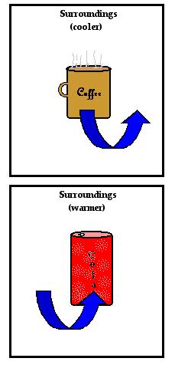
review
2. Relate temperature and energy transfer to molecular motion.
  Know how heat is transferred.
  Know the direction heat is transferred.
REMINDER
Temperature is a measure of the average kinetic energy of a substance.
Heat is the energy transferred from one substance to another.

Slide 4
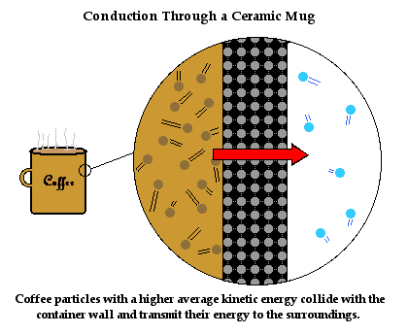
review
2. Relate temperature and energy transfer to molecular motion.
  Know how heat is transferred.
  Know the direction heat is transferred.

Slide 5
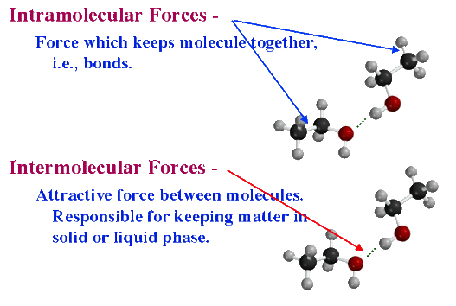
review
3. Differentiate between INTERmolecular and INTRAmolecular forces.
  INTERmolecular is between molecules.
  INTRAmolecular is between atoms in a molecule.

Slide 6
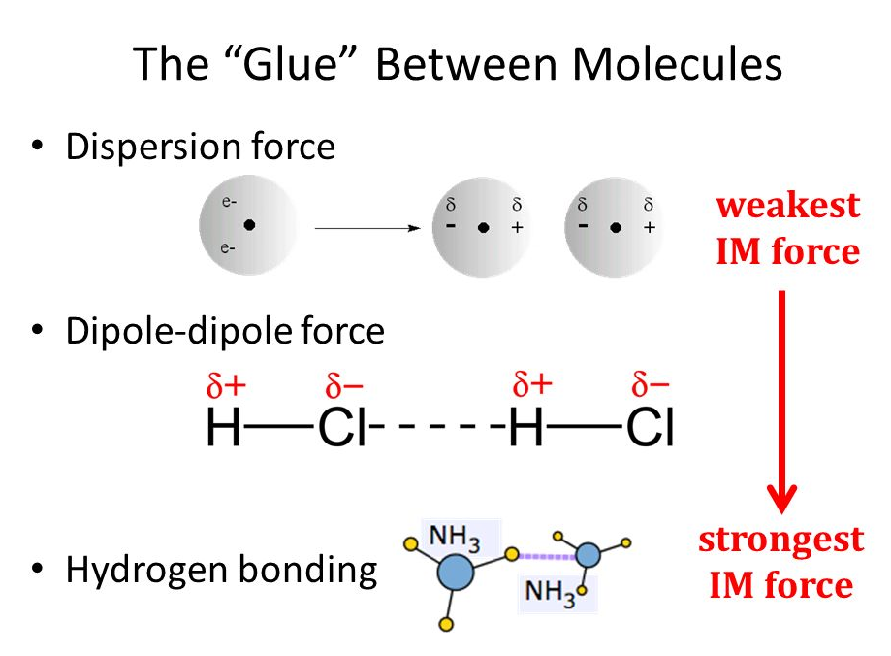
review
4. Describe the three intermolecular forces; compare and contrast to each other.
  Be able to describe dispersion forces, dipole-dipole forces, hydrogen bonding, and what a dipole is.

Slide 7
review
Differentiate between the four phases of matter.
  Know spacing, volume, shape, IMFs
 | Volume | Shape | Spacing | IMFs
SOLID | Definite | Definite | Vibrate along a fixed point | Stronger
LIQUID | Definite | No Definite | Slid past each other | Strong
GAS | No Definite | No Definite | Behave independently of each other | Very Weak
PLASMA | No Definite | No Definite | Electrons knocked off atom; behave independently of positive nucleus | Weakest

Slide 8
review
Describe solids by crystalline structure, energy, spacing, energy, and intermolecular forces.
  can have a crystalline structure or an amorphous structure.
  Solid atoms/molecules are very close together – high density.
  Solid particles vibrate around a fixed point.
  Have strong IMFs.

Slide 9
review
7. Describe liquids in terms of vapor pressure, density, spacing, energy, and intermolecular forces.
  High vapor pressure means high evaporation and low vapor pressure means low evaporation.
  Liquids have lower densities than solids.
  Increased spacing between atoms compared to solids.
  Liquid particles can slid past each other but remain bound.
  Have weaker IMFs than solids but much strong IMFs than gases.

Slide 10
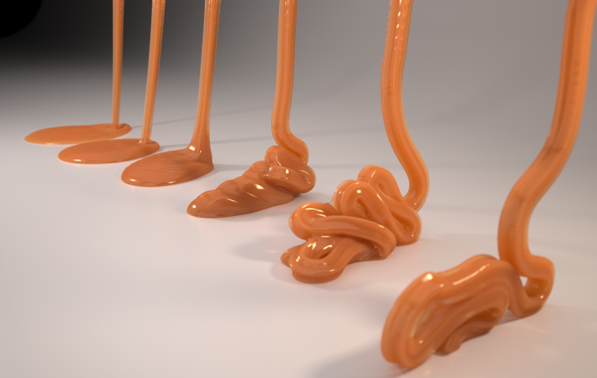
review
8. Discuss viscosity in terms of temperature and IMFs; discuss surface tension and capillary action in terms of IMFs; Discuss cohesion and adhesion.
  Viscosity – a measure of the resistance of a liquid to flow; determined by the intermolecular forces, shape of particles, and temperature.

Slide 11
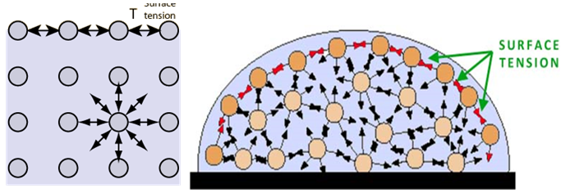
review
8. Discuss viscosity in terms of temperature and IMFs; discuss surface tension and capillary action in terms of IMFs; Discuss cohesion and adhesion.
  Surface tension – the energy required to increase the surface area of a liquid by a given amount; a measure of the inward pull by particles in the interior; Surfactants reduce surface tension.

Slide 12
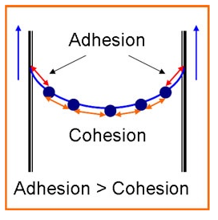
review
8. Discuss viscosity in terms of temperature and IMFs; discuss surface tension and capillary action in terms of IMFs; Discuss cohesion and adhesion.
  Cohesion = attraction to each other.
  Adhesion = attraction to another.

Slide 13
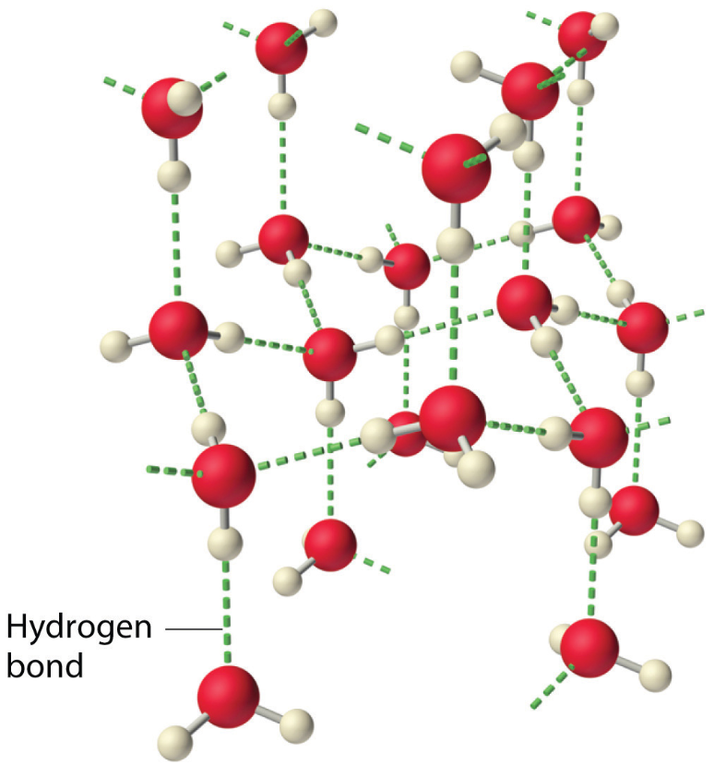
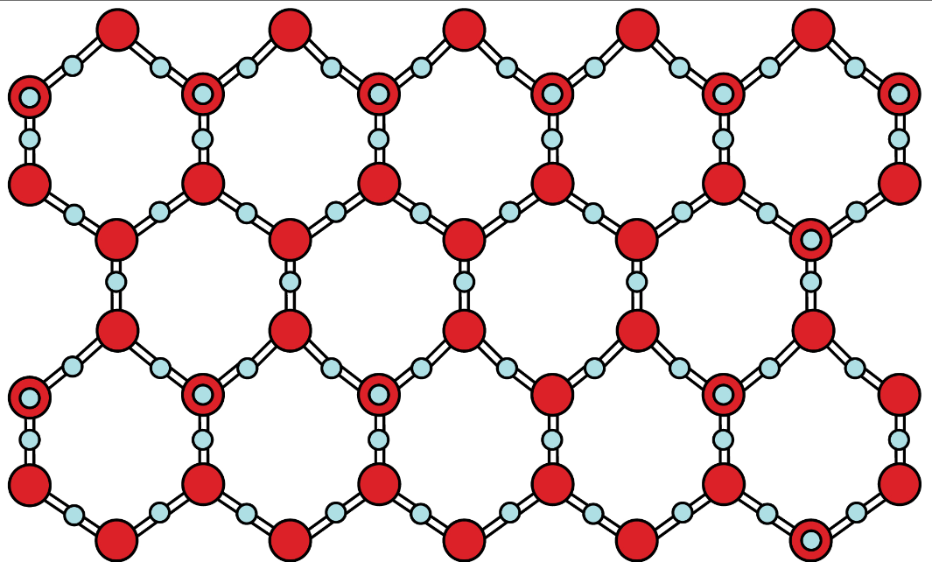
review
9. Use polarity, IMF, and molecular structure to explain the unique properties of water.
  Water is a highly polar molecule, bent shaped.
  Exhibits hydrogen bonding – strongest IMF.
  Solid is less dense than liquid due to solid’s open crystalline structure.

Slide 14
review
10. Describe the vapor pressure of a liquid and its relationship to the temperature of the liquid.
Strong IMFs
nonvolatile
low evaporation rates
high boiling point
low vapor pressure at room temperature
Example: H₂O, Hg
Weak IMFs
volatile
high evaporation rates
low boiling point
high vapor pressures at room temperature
Example: acetone, alcohol

Slide 15
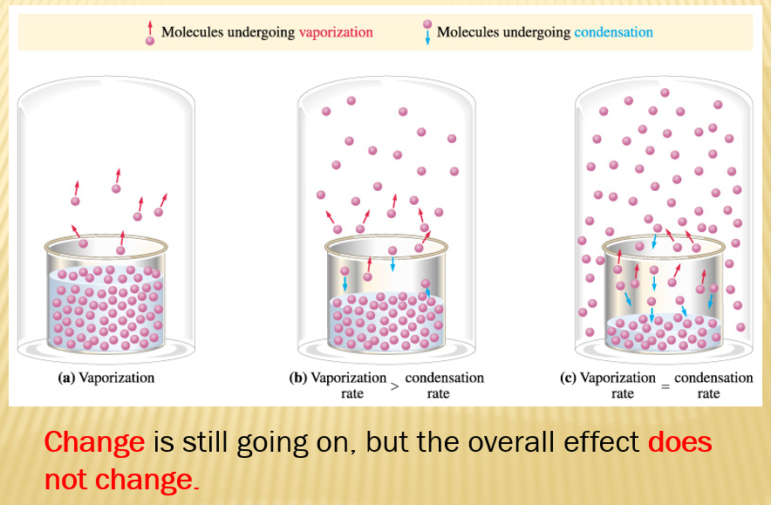
review
10. Describe the vapor pressure of a liquid and its relationship to the temperature of the liquid.

Slide 16
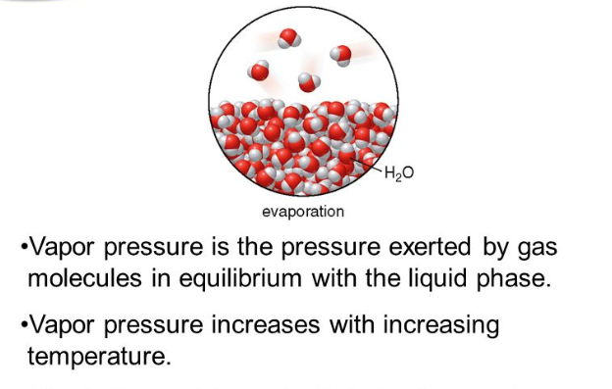
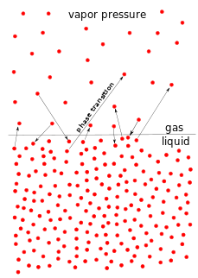
review
10. Describe the vapor pressure of a liquid and its relationship to the temperature of the liquid.
The vapor pressure is caused by the gas molecules hitting the top of the liquid.

Slide 17
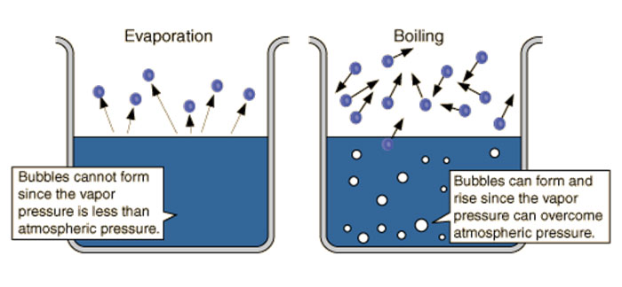
review
11. Describe the process of boiling as it relates to the vapor pressure of the liquid and atmospheric pressure.
  Boiling is when vapor pressure is equal to atmospheric pressure.

Slide 18
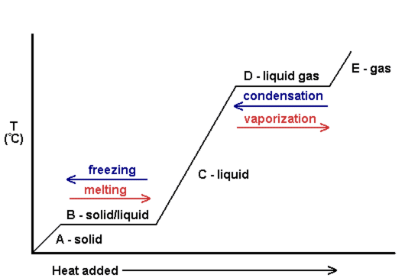
REVIEW
12. Discuss a heating curve as a substance is taken from a solid to the vapor state.
  Know what happens on the diagonal as well as the plateaus to temperature and heat energy.
  Know what is on the X and Y axes.
A graph of temperature and energy
Depicts four phase changes – melting, freezing, vaporization, and condensation.

Slide 19
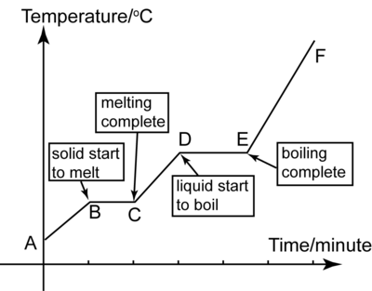
REVIEW
12. Discuss a heating curve as a substance is taken from a solid to the vapor state.
  Know what happens on the diagonal as well as the plateaus to temperature and heat energy.
  Know what is on the X and Y axes.
Diagonal: phase is warming or cooling
Plateau: all heat energy is being used the change the phase; to weaken the IMFs.
THERE IS NO TEMPERATURE CHANGE DURING A PHASE CHANGE.

Slide 20
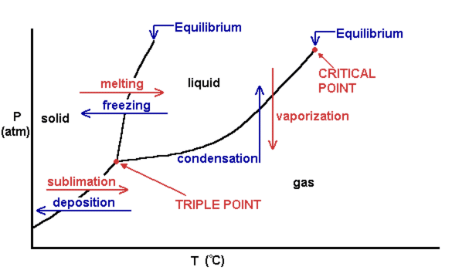
REVIEW
13. Discuss a phase diagram and understand the significance of the terms associated with it.
  Know what each equilibrium line is, where the triple point is, the critical point, normal boiling point, and normal melting point.
  Know what is on the X and Y axes.
A graph of temperature and pressure.
Depicts six phase changes – melting, freezing, vaporization, condensation, deposition, and sublimation.

Slide 21
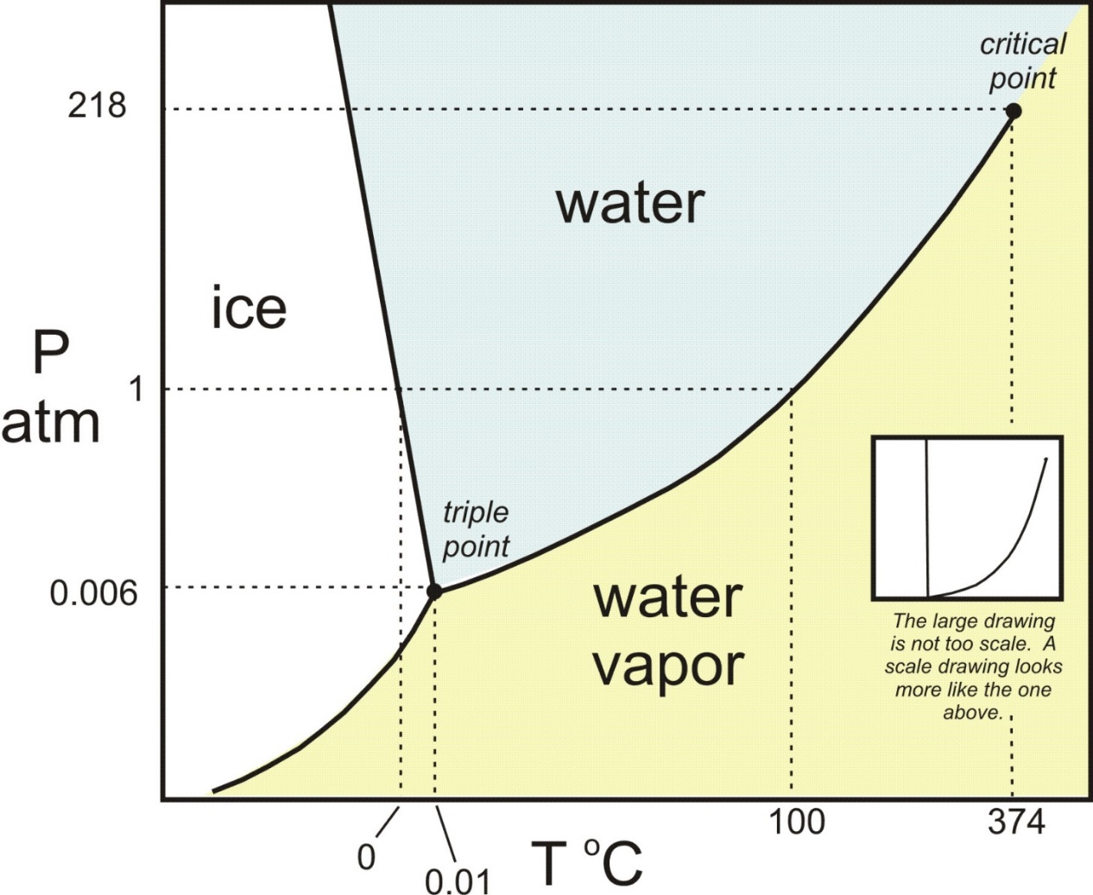
REVIEW
13. Discuss a phase diagram and understand the significance of the terms associated with it.

Slide 22
PHASE diagram vs heating curve
Phase diagram
Heating curve
Pressure – y axis
Temperature – x axis
Shows all 6 phase changes
Shows equilibrium temperatures and pressures for all phase changes
Temperature – y axis
Heat over time – x axis
Shows only 4 phase changes
Shows plateaus for the phase changes and diagonals for the changes in temperature.

Slide 23
REVIEW
14. Explain a phase change and interpret these changes based on graphs.
A phase change is an energy change that causes one phase to turn into another
 | Initial Phase | Final Phase | Energy Change | Energy is…
Melting | Solid | Liquid | Endothermic | Required
Freezing | Liquid | Solid | Exothermic | Released
Vaporization | Liquid | gas | Endothermic | Required
Condensation | Gas | Liquid | Exothermic | Released
Sublimation | Solid | Gas | Endothermic | Required
Deposition | Gas | Solid | Exothermic | Released

Slide 24
REVIEW
14. Explain a phase change and interpret these changes based on graphs.

Slide 25
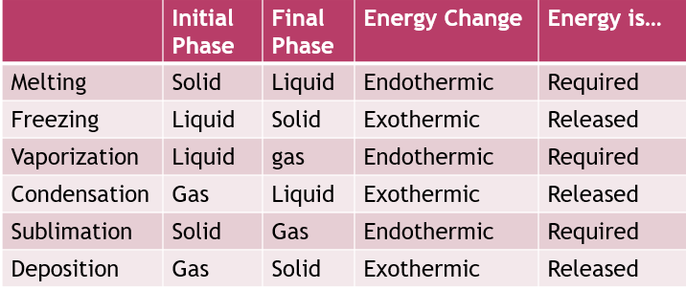
review
15. Determine the relationship between energy and change of state.
  Energy must be added or removed for a phase change to happen.

Slide 26
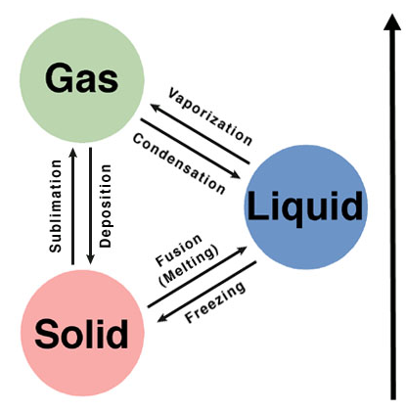
review
15. Determine the relationship between energy and change of state.
  Energy must be added or removed for a phase change to happen.

Slide 27
review
16. Be able to perform calculation for heat of fusion, heat of vaporization and heat changes.
  Must know the formulas. I will give you the specific heats, heat of fusion and heat of vaporization constants.
For Temperature Changes At a Phase Change
Q = m ΔT C_{p} Q = m ΔH
M = mass
ΔT = change in temperature
C_{p} = specific heat of the phase
ΔH = Heat of Fusion or Heat of Vaporization

Slide 28
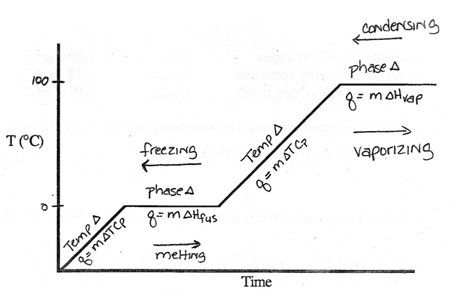
review
16. Be able to perform calculation for heat of fusion, heat of vaporization and heat changes.

Slide 29
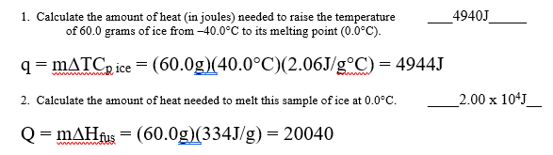
review
16. Be able to perform calculation for heat of fusion, heat of vaporization and heat changes.

Slide 30
TEST FORMAT
6 multiple choice questions
  7 short answer of which you must answer 5.
  5 questions concerning a heating curve.
  4 questions concerning a phase diagram.
  3 energy calculations – bring a calculator

