Slide 1
DO NOW
Pick up notes.
Get out Balancing and Classifying Chemical Reactions from Monday.
Word Equations: A Second Chance is due Friday – for a grade.
Types of Reactions lab is due Monday.

Slide 2
BALANCING AND CLASSIFYING CHEMICAL RXNS
1. Solid mercury (II) oxide breaks down when heated, forming the elements mercury and oxygen.
SKELETON EQN: HgO_{(s)} → Hg_{(l)} + O_{2(g)}
BALANCED EQN: 2HgO_{(s)} → 2Hg_{(l)} + O_{2(g)}
2. Sodium metal reacts with water vapor in air to form solid sodium hydroxide and hydrogen.
SKELETON EQN: Na_{(s)} + H₂O_{(g)} → NaOH_{(s)} + H_{2(g)}
BALANCED EQN: 2Na_{(s)} + 2H₂O_{(g)} → 2NaOH_{(s)} + H_{2(g)}

Slide 3
BALANCING AND CLASSIFYING CHEMICAL RXNS
3. In the first step of refining zinc metal from its zinc sulfide ore, the ore is heated with oxygen. The products are solid zinc oxide and sulfur dioxide gas.
SKELETON EQN: ZnS_{(s)} + O_{2(g)} → ZnO_{(s)} + SO_{2(g)}
BALANCED EQN: 2ZnS_{(s)} + 3O_{2(g)} → 2ZnO_{(s)} + 2SO_{2(g)}
4. The next step in refining zinc involves heating the zinc oxide with carbon. This reaction produces zinc vapor and carbon monoxide gas.
SKELETON EQN: ZnO_{(s)} + C_{(s)} → Zn_{(s)} + CO_{(g)}
BALANCED EQN: balanced

Slide 4
BALANCING AND CLASSIFYING CHEMICAL RXNS
5. Certain pollutants in the air react with water vapor to form acids. For example, sulfur trioxide reacts with water vapor to form sulfuric acid.
SKELETON EQN: SO_{3(g)} + H₂)_{(g)} → H₂SO_{4(aq)}
BALANCED EQN: balanced

Slide 5
BALANCING AND CLASSIFYING CHEMICAL RXNS
For the five reactions on the front side, indicate what type of reaction is occurring for each in the blanks below.
6. #1 Decomposition
7. #2 Single replacement
8. #3 none
9. #4 Single Replacement
10. #5 Synthesis

Slide 6
BALANCING AND CLASSIFYING CHEMICAL RXNS
16. Aluminum lawn furniture becomes coated with a layer of aluminum oxide when it sits out in air.
17. Chlorine gas is bubbled through a calcium bromide solution. The solution turns brown, the color of bromine.
18. Lime is added to acid water in a lake. Water and a salt are formed.
19. Propane is a common household fuel. When burned, water and carbon dioxide are produced.
20. Steel wool burns, forming an iron oxide.
21. When an electric current is passed through molten potassium bromide, potassium and bromine are formed.
22. When solutions of sodium iodide and lead (II) nitrate are combined, a yellow solid forms.

Slide 7
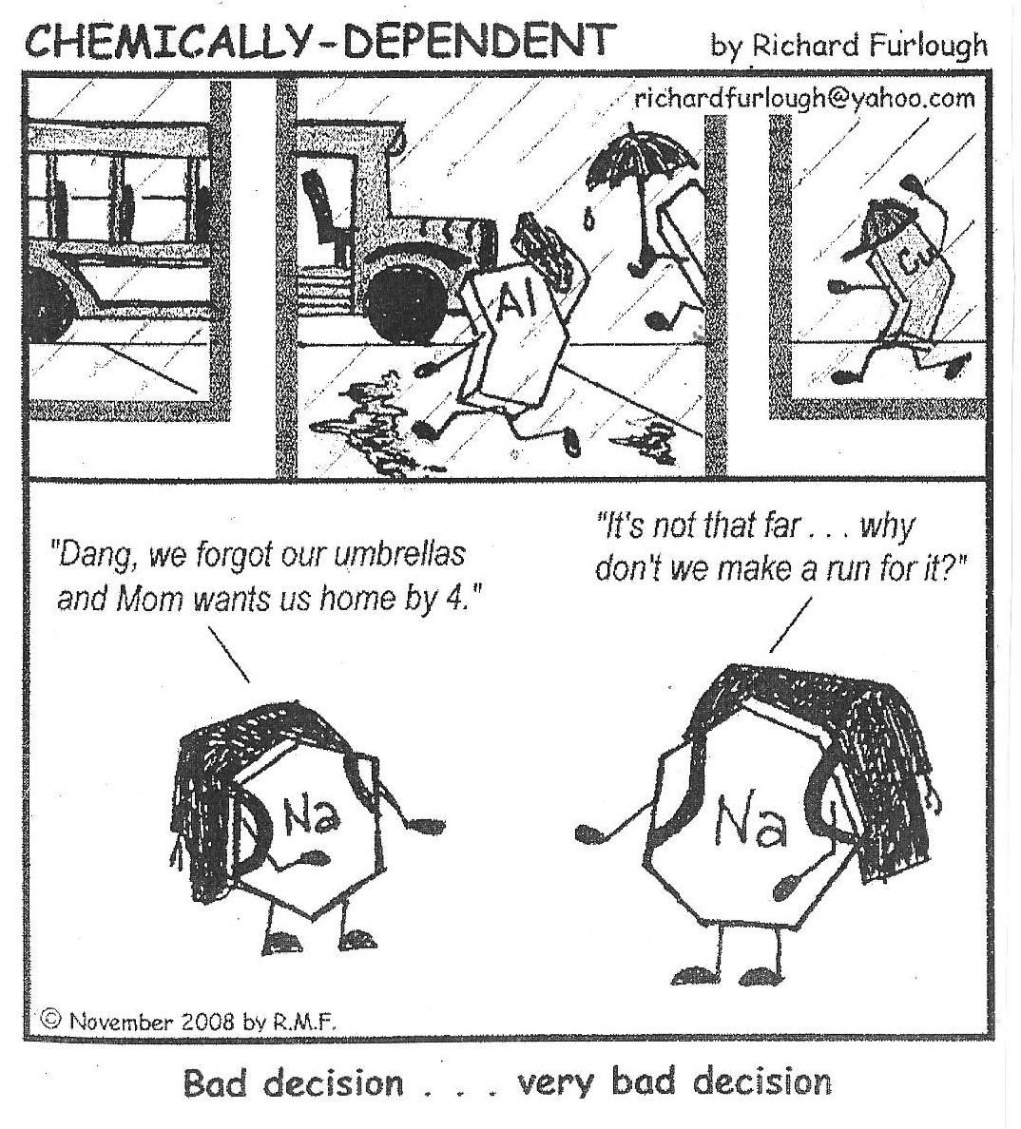

Slide 8
PREDICTING PRODUCTS
We will learn to predict the products of a few basic equations only.

Slide 9
SOLUBILITY RULES
Get out your green periodic table.
1. All common salts of the group 1A elements and ammonium are soluble.
2. All common acetates and nitrates are soluble.
3. All binary compounds of group 7A elements (other than F) with metals are soluble except those of silver, mercury (I), and lead.
4. All sulfates are soluble except those of barium, strontium, lead, calcium, silver, and mercury (I)
5. Except for those in rule 1, carbonates, hydroxides, oxides, sulfides, and phosphates are insoluble.

Slide 10
SINGLE REPLACEMENT
Activity
Series
Li
K
Ba
Sr
Na
Ca
Mg
Al
Mn
Zn
Cr
Fe
Cd
Co
Ni
Sn
Pb
H
Sb
As
Bi
Cu
Hg
Ag
Au
one element displaces another in a compound
1. Active metals replace less active metals or hydrogen from their compounds in an aqueous solution. Use the metal activity series to determine if it will replace something in the compound.
Mg _{(s)} + FeCl_{3(aq)} →
2. Active nonmetals replace less active nonmetals from their compounds in an aqueous solution. Use the nonmetal activity series to determine if it will replace something in the compound.
Cl_{2(q)} + KI_{(aq)} →
NON
Metal
Activity
Series
F
O
Cl
Br
I

Slide 11
Find Study Guide from Monday
11. Ca + H₂O →
12. Rb + LiCl →
13. K + Al₂O₃ →
14. F₂ + KI →
15. Cu + Fe₂(SO₄)₃ →

Slide 12
DOUBLE REPLACEMENT
Two compounds react to form two new compounds; all double replacement reactions must have a driving force that removes a pair of ions from solution.
1. Formation of a precipitate – a precipitate is an insoluble substance formed by the reaction of two aqueous substances. Two ions bond together so tightly that water cannot pull them apart.
KI _{(aq)} + Pb(NO₃)_{2 (aq)} →

Slide 13
DOUBLE REPLACEMENT
Formation of a gas – gases may form directly in a double replacement reaction or can form from the decomposition of a product such as carbonic acid.
HCl_{(aq)} + K₂CO_{3(aq)} →
Formation of a Molecular Substance – when a molecular substance such as water is formed, ions are removed from solution to form a molecular substance and the reaction “works”.
LiOH_{(aq)} + HBr_{(aq)} →

Slide 14
COMBUSTION
hydrocarbons combine with oxygen gas to form carbon dioxide gas and water vapor.
There will always be a hydrocarbon (carbon and hydrogen compound) and oxygen gas forming carbon dioxide and water.
CH_{4 (g)} + O_{2 (g)} →

Slide 15
TEST
You will be tested over the following:
Single Replacement
Double Replacement
Combustion
You will not be tested over decomposition and synthesis.

Slide 16
PREDICTING PRODUCTS
______ 1. Aqueous aluminum sulfate + aqueous calcium phosphate →
SKELETON:
EQN:
Concept Review due tomorrow.

Slide 17
DO NOW
Get out Predicting Products of Chemical Reactions (back side of yesterday’s notes).
Turn in Word Equations: A Second Chance.
Types of Reactions lab is due Monday.

Slide 18
PREDICTING PRODUCTS
Grab a white board and do the equation listed.
Find the group that has the same equation as you and work it together using all the space on the two-three boards.

Slide 19
TO DO
Complete The Nature of Chemical Reactions for Monday.
We will review on Monday
The test is Tuesday.

