Slide 1
DO NOW
Turn in Review #18.
Pick up Review #19 and the notes.

Slide 2
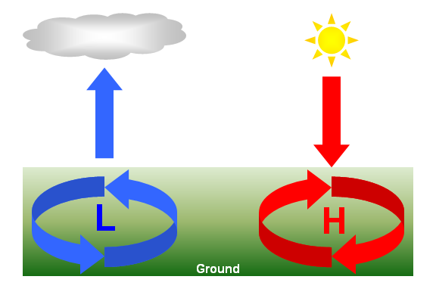
REVIEW
Why are clouds associated with low pressure?
How does air move around a low pressure system?
High pressure?
Air cools as it rises, which can cause water vapor in the air to condense, sometimes forming clouds and precipitation.
Counterclockwise
Clockwise

Slide 3

AIR PRESSURE AND WINDS
SES5b. Explain the relationship between air masses and the surfaces over which they form.

Slide 4
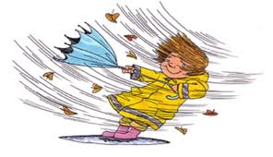
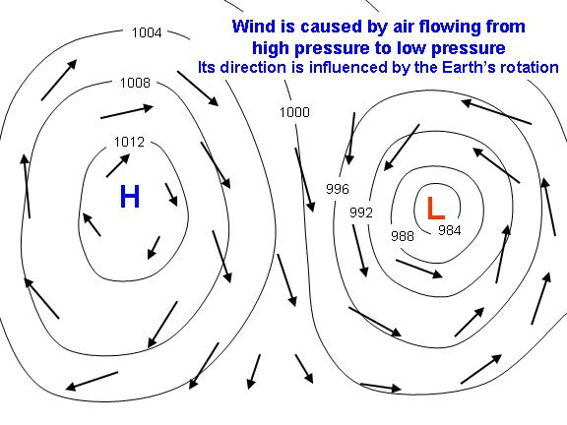
WIND: AIR MOVEMENT DUE TO PRESSURE DIFFERENCES
Air moves from high to low pressure
Atmosphere is attempting to balance – equilibrium
High Pressure – down, out, clockwise
Low Pressure – in, up, counterclockwise

Slide 5
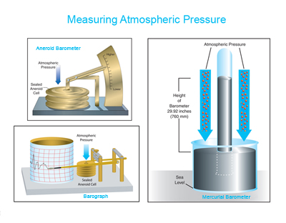
MEASURING AIR PRESSURE
Barometer measures changes.
Reported in Millibars.
Average pressure at sea level is 1013 millibars.
Old system: Sea level pressure is 29.92 inches.

Slide 6
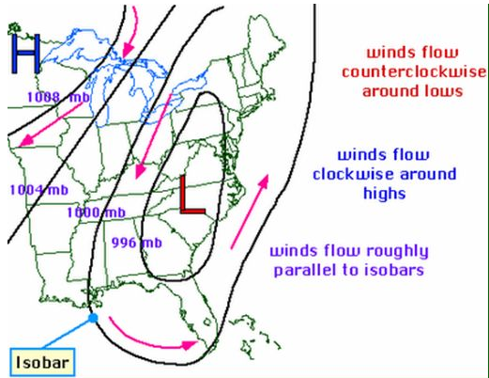
MEASURING AIR PRESSURE
Isobars are lines of constant pressure.
A line drawn on a weather map connecting points of equal pressure is called an isobar.
The isobars are generated from mean sea level pressure reports and the pressure values are given in millibars.

Slide 7
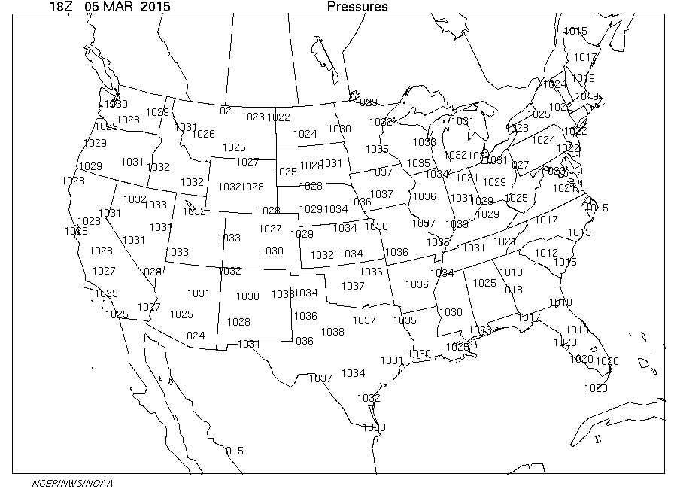
MAPPING AIR PRESSURE
Each number represents a pressure reading.

Slide 8
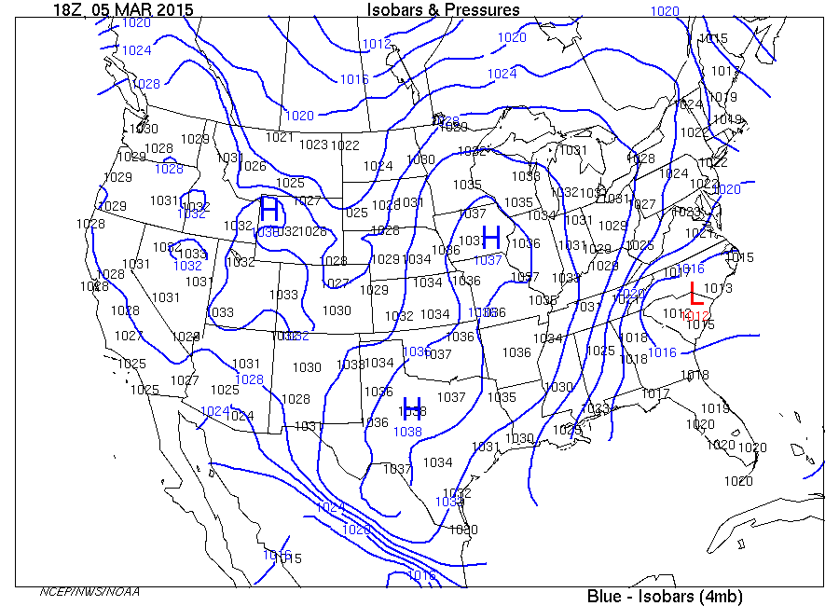
MAPPING AIR PRESSURE
Pressure readings that are alike are connected to form isobars – “iso” means “same”.
Every place on one of those lines has the SAME pressure.

Slide 9
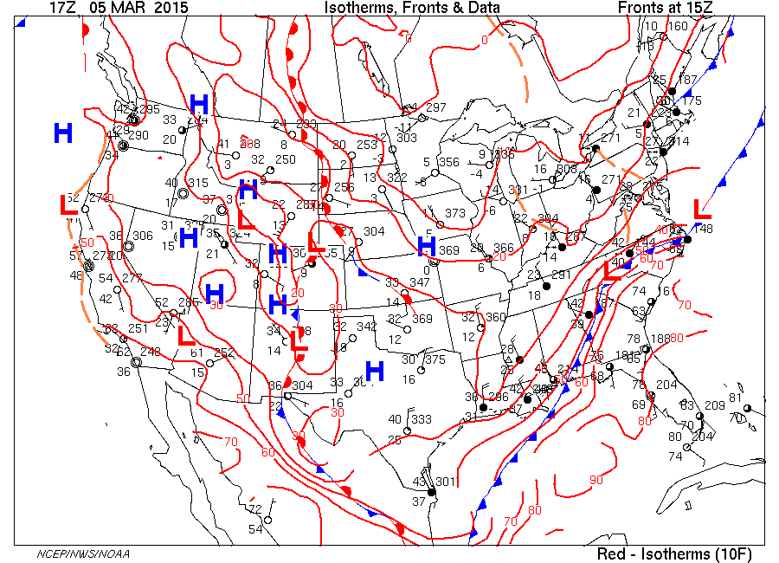
MAPPING AIR PRESSURE
From the isobars, scientists can determine where the low pressure and high pressure areas are.

Slide 10
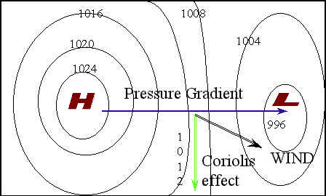
PRESSURE CHANGES CAUSE WIND
Air moves clockwise and OUT FROM high pressure.
Air moves counterclockwise and INTO low pressure.
Movement of air is wind.

Slide 11
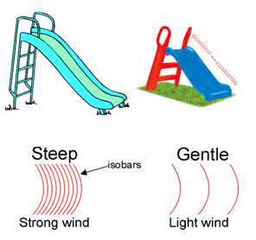
PRESSURE GRADIENTS
Pressure gradient is the change in pressure over a distance.
Steep change:
  Bigger difference in pressure
  Smaller distance, closer isobars, faster wind speed

Slide 12
PRESSURE GRADIENTS
Gentle change:
  Smaller difference in pressure
  Greater distance, farther isobars, slower wind speed

Slide 13
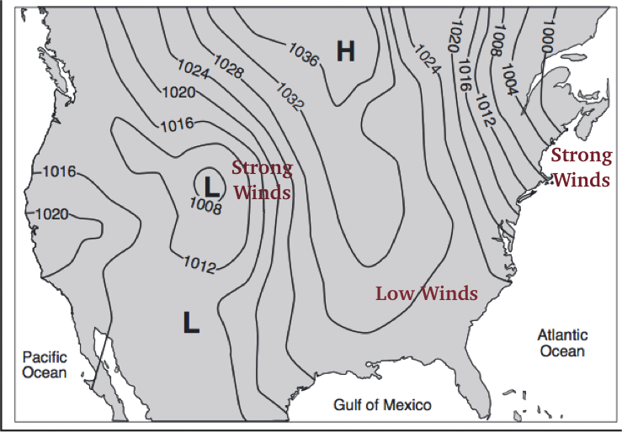
WINDS AND ISOBARS
Isobars close together - steep change, fast winds.
Isobars far apart – low change, low winds.

Slide 14
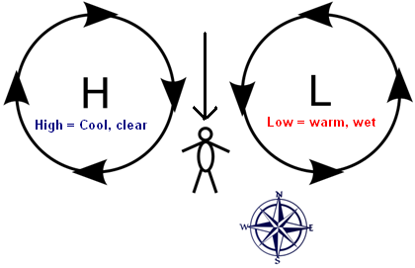
USING WIND TO PREDICT WEATHER
Stand facing wind.
Low pressure area will be on your right.
  Stormy, wet, warm to your right.
  If facing North, low has passed and cool, dry weather coming.
  If facing South, Low is approaching.

Slide 15
USING WIND TO PREDICT WEATHER
High pressure area will be on your left.
  Clear, cooler to the left.
  If west is the left, High has passed and warm, wet weather coming.
  If facing South, High is approaching.

Slide 16
USING WIND TO PREDICT WEATHER
Only works in the Northern Hemisphere – mid latitudes
Because:
  Counterclockwise wind around low pressure and clockwise around highs.
  Global Wind Belts – prevailing winds are Westerlies – air masses come from the west.

Slide 17
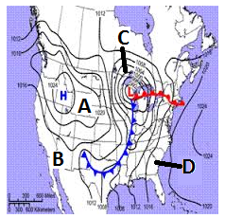
REVIEW
Which area is experiencing the GREATEST winds?
  A
  B
  C
  D
Now, can you tell me WHY?

Slide 18
LAB: MAPPING PRESSURE
We will do this map together…
Lightly draw lines connecting identical values of sea level pressure.
Isobars do not cross each other.
Isobars are usually drawn for every four millibars – starting at 1000 and go both up and down:
  996, 992, 988, etc.
  1000
  1004, 1008, 1012, 1016, 1020,etc.

Slide 19
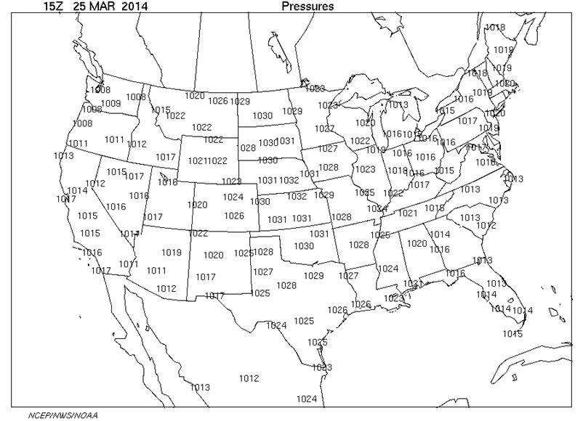
LAB: MAPPING PRESSURE

Slide 20
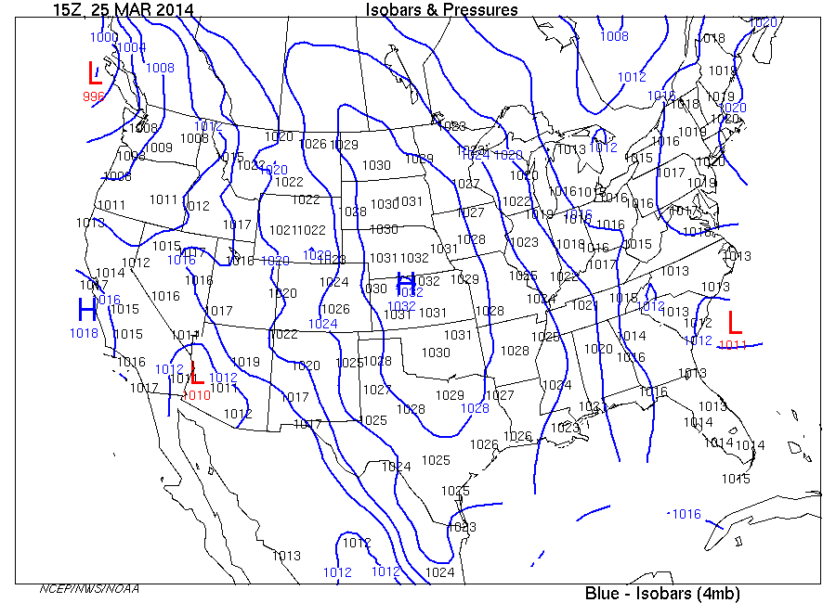
LAB: MAPPING PRESSURE

Slide 21
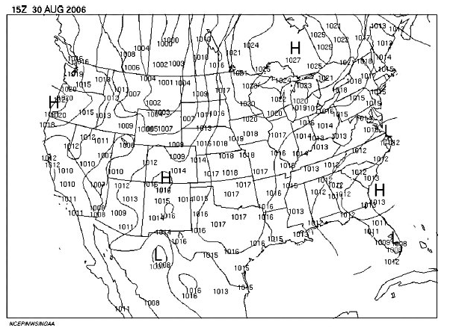
TO DO
Do the isobar lines on the back side.
Do Review #19 for homework – due Monday.

Slide 22
ANSWER

