Slide 1
DO NOW
Pick up notes and Review #7.

Slide 2
MIDTERM

Slide 3
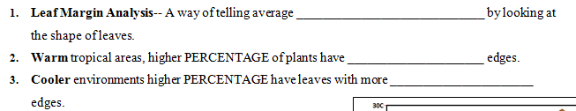
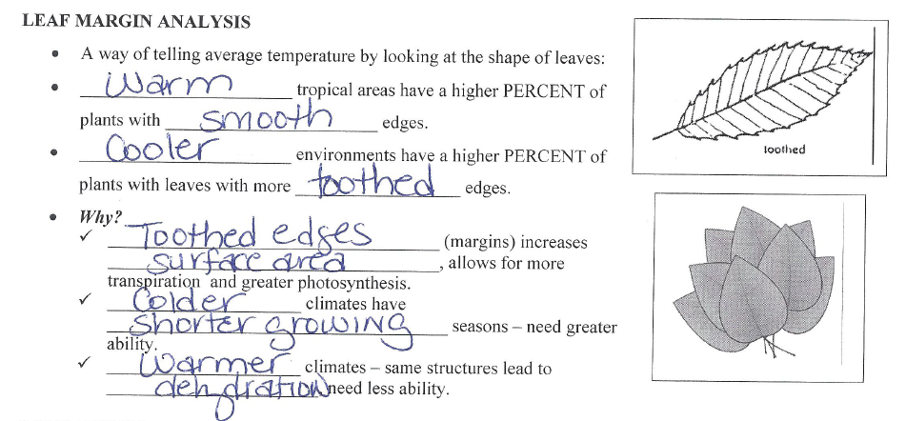
REVIEW #5

Slide 4
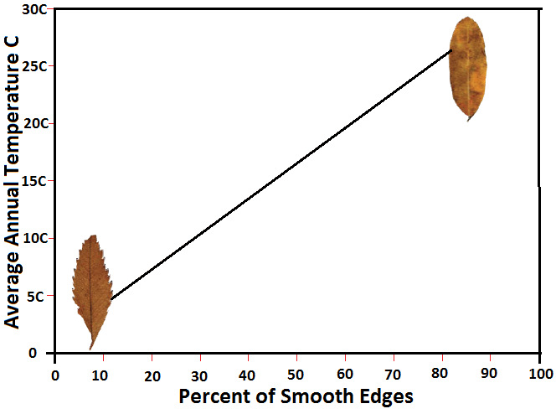
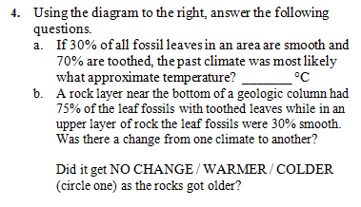
REVIEW #5

Slide 5
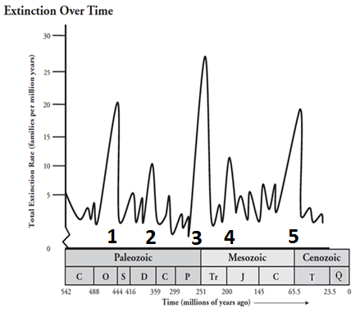
REVIEW
Which Mass Extinction Event was the most deadly?
What was it called?
Why do you think it was called that?

Slide 6
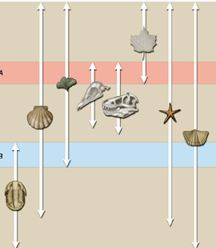
PRINCIPLE OF
FOSSIL SUCCESSION
SES4. Students will understand how rock relationships and fossils are used to reconstruct the Earth’s past.
d. Explain how sedimentary rock units are correlated within and across regions by a variety of methods including the principle of fossil succession.

Slide 7
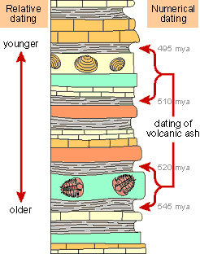
FOSSIL RECORD SHOWS US….
Fossil species appear and disappear throughout time.
Older fossils/rocks on bottom – youngest on top (Law of Superposition).
The Geologic Time Scale is based on appearances and disappearances of fossils.

Slide 8
FOSSIL RECORD SHOWS US….
Geologic eras and periods determined by appearance and extinction of species.
Extinction events are followed by appearances of new species.
Sequence of fossils help provide clues to Earth’s history and dating of rocks.

Slide 9
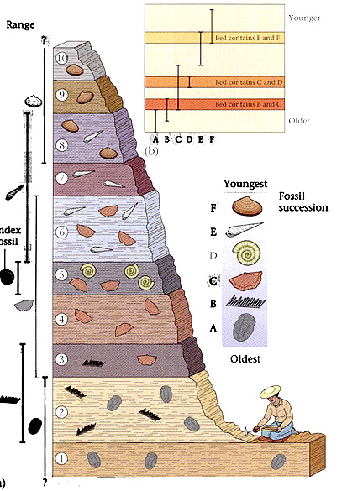
PRINCIPLE OF
FOSSIL SUCCESSION
Different species of fossil organisms appear in a definite order.
Oldest organisms are at the bottom – newest at the top.
Once a fossil species disappears in a sequence of strata, it never reappears higher in the sequence.

Slide 10
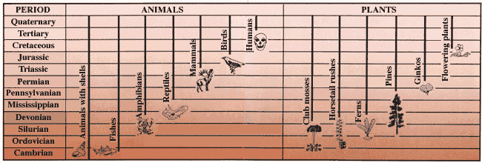
FOUNDATION FOR
PRINCIPLE OF SUCCESSION
Fossils represent the remains of once-living organisms.
Most fossils are the remains of extinct organisms; they belong to species that are no longer living anywhere on Earth.
The kinds of fossils found in rocks of different ages differ because life on Earth has changed through time.

Slide 11
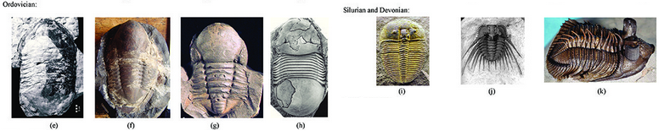
FOSSIL RECORD SHOWS
CHANGE OVER TIME
Animals and plants found as fossils change through time.
Changes in Earth’s environment over time results in changes in organisms.
Natural selection gives organisms best adapted to the environment an advantage.

Slide 12
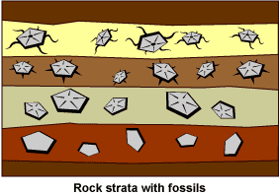
REVIEW
What conclusions can you make about the fossil record shown in the image?

Slide 13
SOLVE A SEDIMENTARY LAYERS PUZZLE
Did you know that the history of life on Earth is told through rocks? Over millions of years, sediments such as sand and silt were laid down and compressed to form sedimentary rock layers. They preserve a record of ancient landscapes, climates, and organisms.
Scientists often determine the correct sequence of sedimentary rock layers using the fossils found within them. They compare the fossils to ﬁgure out if two layers are from the same geologic time period or if one layer is older than the other.

Slide 14
SOLVE A SEDIMENTARY LAYERS PUZZLE
Purpose: Try reconstructing the layers below using the same strategy.

Slide 15
SOLVE A SEDIMENTARY LAYERS PUZZLE
Procedure:
Cut out the strips on the separate sheet. Each represent a sedimentary rock layer formed during a certain time period.
Place the layers in the correct order. Begin by placing “B”, the oldest layer” on the bottom. Then decide what layer comes next. It will have some of the same organisms as the older layer and some new ones. HINT: Organisms do NOT disappear for a layer and then reappear.
Once you have them in the correct order, glue/tape them to the blank paper provided.
Then answer the analysis questions.

Slide 16
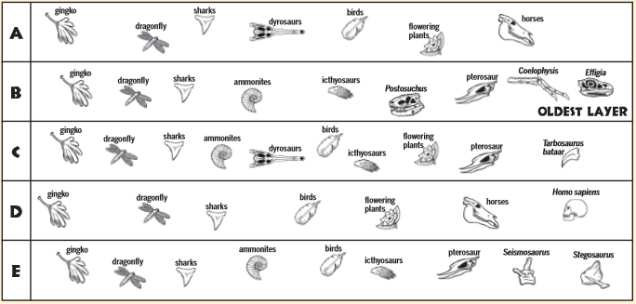
THE LAYERS

Slide 17
TO DO
Complete the puzzle.
One partner staple it to his/her lab.
Review #7 due Tuesday.

