Slide 1
DO NOW
Turn in Review #17
Pick up notes and Review #18.

Slide 2
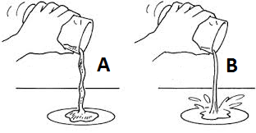
REVIEW
Which liquid is more “viscous?”
In lava, a greater viscosity means a rock has a higher silica content.
If these were lava, which would have the greatest silica?
Viscosity is directly related to how much silica is in the magma

Slide 3
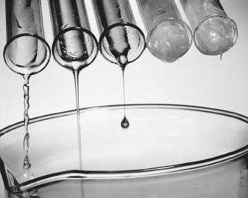
REVIEW
What is Viscosity?
How does it apply to Lava?

Slide 4
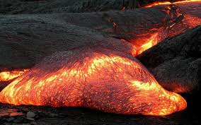
Igneous Rocks and
How they Form
SES2d: Associate specific plate tectonic settings with the production of particular groups of igneous and metamorphic rocks and mineral resources.

Slide 5
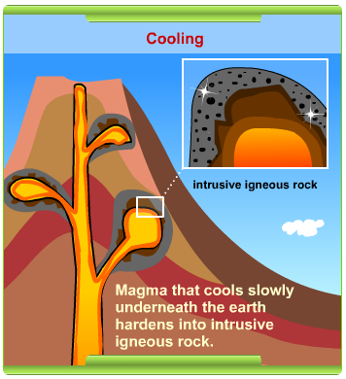
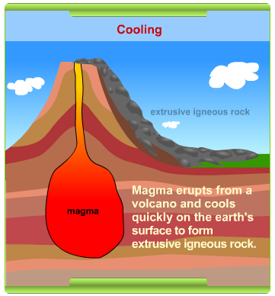
IGNEOUS: “FIRE BORN”
INTRUSIVE IGNEOUS
EXTRUSIVE IGNEOUS

Slide 6
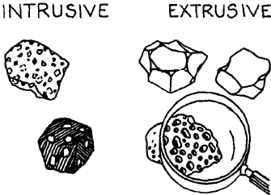
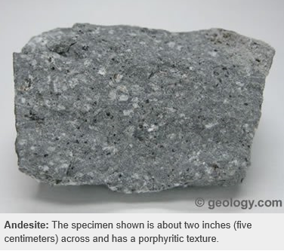
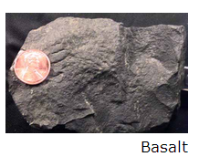
RATE OF COOLING EFFECTS CRYSTAL SIZE
Small crystals
  Quickly cools.
  Usually extrusive.
  Phaneritic texture
  Ex: Basalt

Slide 7
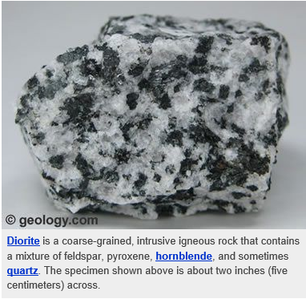
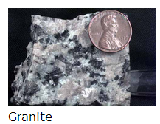
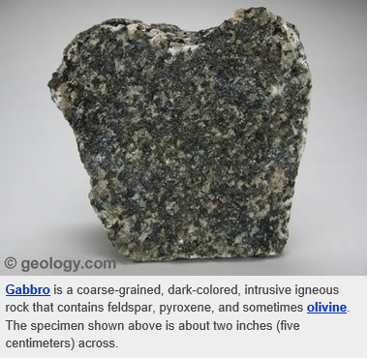
RATE OF COOLING EFFECTS CRYSTAL SIZE
Large Crystals
  Cools slowly.
  Usually intrusive.
  Aphanitic texture
  Ex: Granite

Slide 8
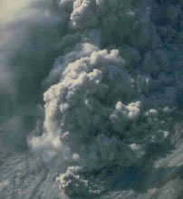
PYROCLASTIC MATERIALS
Volcanic Dust
< .25 mm
Volcanic Ash
.25 –2 mm
Volcanic Bombs
Large Blobs of Lava
Lapilli
Rounded or Spindle Shaped - Pebble Size
Cloud of ash, lava fragments and vapor
From volcanic explosion

Slide 9
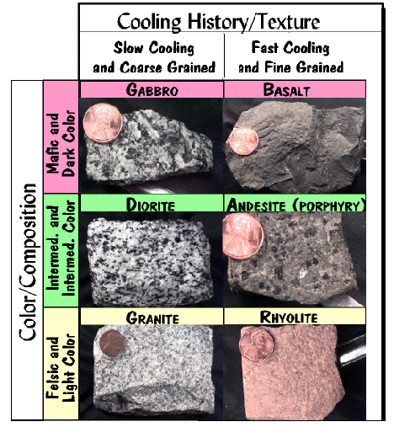
CHEMICAL COMPOSITION
Mafic
High amounts of iron (Fe) and magnesium (Mg).
High melting point.
Gabbro – Intrusive (cools slow).
Basalt – Extrusive (cools fast).

Slide 10
CHEMICAL COMPOSITION
Intermediate
Mixed Composition.
Unusual process of formation.
Diorite – Intrusive (cools slow).
Andesite – Extrusive (cools fast).

Slide 11
CHEMICAL COMPOSITION
Felsic
High amounts of silicon (Si), sodium (Na), aluminum (Al), and potassium, (K).
Low melting point.
Granite – Intrusive (cools slow).
Rhyolite – Extrusive (cools fast).

Slide 12
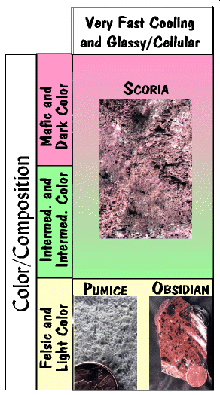
EXPLOSIVE VOLCANIC ROCKS
Quick cooling = bubbles trapped!
Mafic:
  Scoria – darker color, gassy with lots of air bubbles – cooler formation temperature – cools quickly

Slide 13
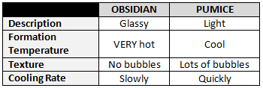
EXPLOSIVE VOLCANIC ROCKS
Felsic:
  Pumice – light, gassy with lots of air bubbles – cooler formation temperature – cools quickly
  Obsidian – dark, no gas bubbles – hotter formation temperature – cools slowly

Slide 14

QUICK COOLING = BUBBLES TRAPPED!
What happens when lava and ice meet?
Quick cooling and bubbles trapped.
Watch it in action! (Video link)

Slide 15
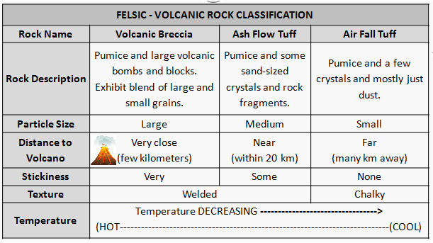
FELSIC - VOLCANIC ROCK CLASSIFICATION
THREE test questions from this chart!

Slide 16
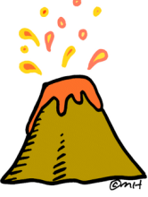
COMPARISON OF FELSIC VOLCANIC ROCKS
Breccia
Forms Close to Volcano
Forms Hotter
Larger Particles
Welded Texture
Sticky
Ash Flow Tuff
Forms Farther Away
Medium Particle Size
Welded Texture
Some Stickiness
Air Fall Tuff
Farthest Away
Forms at Cooler Temps
Chalky Texture
Distance gets farther away-----→

Slide 17
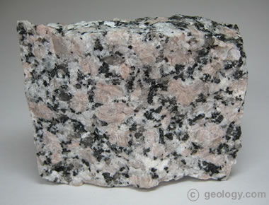
REVIEW
What can you tell about the cooling rate of the rock specimen shown?
How do you know?
Large crystals means slow cooling.

Slide 18
IGNEOUS ROCK LAB
Separate rocks by color and then by grain size.
Record information in the data table on your lab sheet.
Answer analysis questions.
# | Color | Size & Shape of Crystals | Texture | Other | Rock Name (Identification)
1
2
3
4
5
6
7

Slide 19
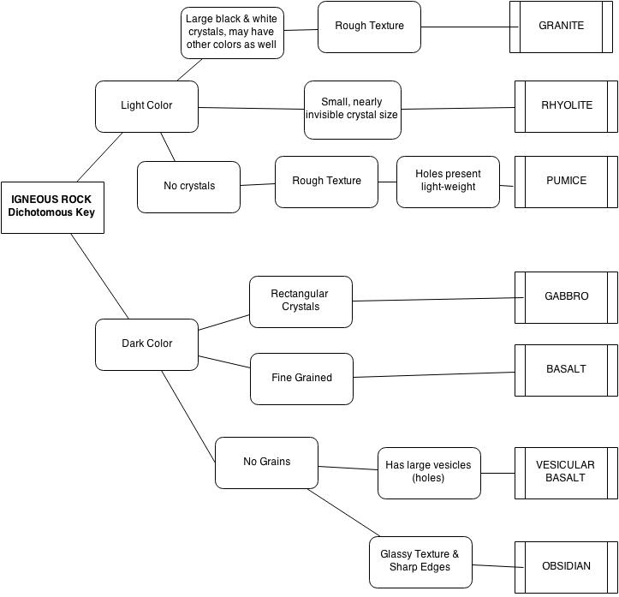

Slide 20
TO DO
Do Igneous Rock lab
Do Review #18 for tomorrow.

