Slide 1
DO NOW
Pick up notes
Get out homework, calculator, and periodic table

Slide 2
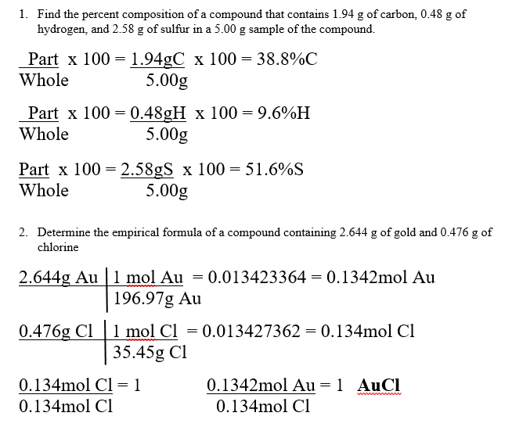
HOMEWORK

Slide 3
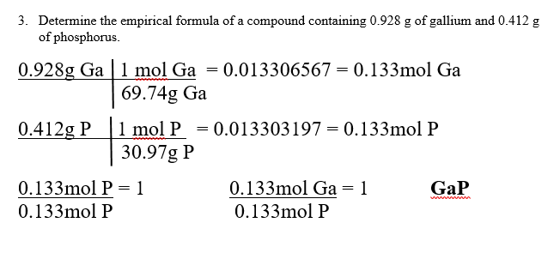
HOMEWORK

Slide 4
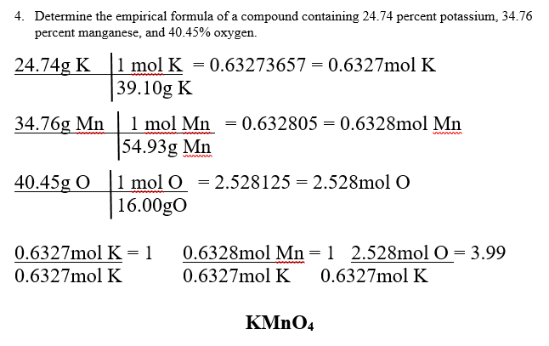
HOMEWORK

Slide 5
MOLECULAR FORMULA
If you know the empirical formula of a substance and its molecular mass, you can determine its MOLECULAR FORMULA.

Slide 6
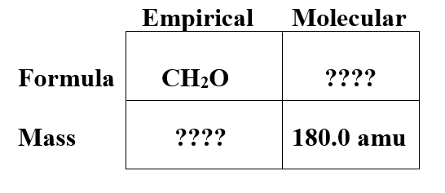
MOLECULAR FORMULA
EXAMPLE
The empirical formula of a substance is CH₂O. The mass of the molecule is 180.0 amu. What is the molecular formula?

Slide 7
STEP ONE
Calculate the empirical mass for the empirical formula (CH₂O) from the periodic table.
C 1 x 12.01 = 12.01amu
H 2 x 1.01 = 2.02amu
O 1 x 16.00 = 16.00amu
30.03 amu

Slide 8
STEP TWO
Divide the molecular mass by the empirical mass.
180.0 amu =
30.03 amu
6.000

Slide 9
STEP THREE
Multiply the empirical formula by the number in step two to get the molecular formula.
6 x CH₂O → C₆H₁₂O₆
So C₆H₁₂O₆ is the molecular formula.

Slide 10
STEPS
Calculate the empirical mass from the empirical formula.
Divide the molecular mass by the empirical mass to find the ratio.
Multiply the empirical formula by the number in step two.

Slide 11
PRACTICE
What is the molecular formula of a compound whose empirical formula is P₂O₃? The molecular mass of this compound is 220g.

Slide 12
TO DO
Backside of notes – Empirical and Molecular Formula Practice is due Tuesday.
Molar Quantities lab due Tuesday

