Slide 1
DO NOW
Pick up notes and Review #26

Slide 2
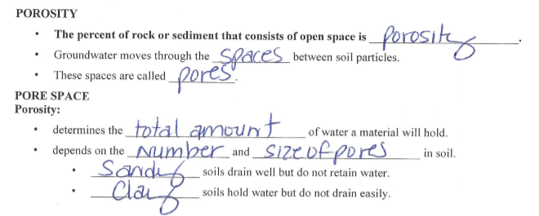
REVIEW #25
______________________- determines the total amount of water a material will hold; depends on the number and size of pores in soil.
Sandy soils drain well but do not ______________________.
Clay soils hold water but do not ______________________.

Slide 3
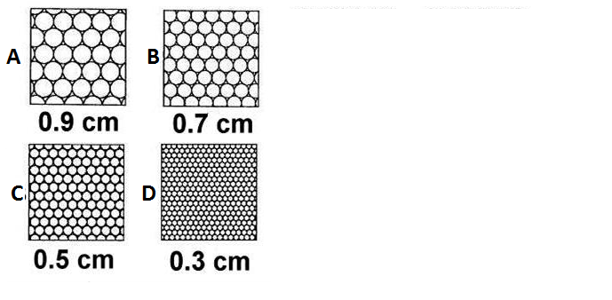
REVIEW #25
Using figures A-D, compare the clasts sizes and understand:
  Porosity is the percent of rock or sediment that consists of ______________________
  Porosity depends on the ______________________of pores in soil.
  The _______________________________ the greater the porosity.
Determine which sample has the greatest porosity _________and which sample has the least porosity _________.

Slide 4
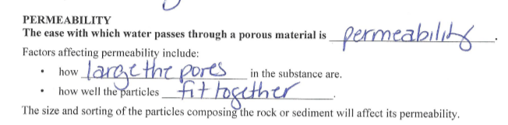
REVIEW #25
_____________________________– the ease at which water passes through material – affected by sorting.

Slide 5
NEED TO FINISH P and P LAB?
Get out your Porosity and Permeability lab.
If you need to collect data for the Porosity and Permeability lab, go to the lab desk now with your lab sheet and directions.
Otherwise, work on your Porosity and Permeability analysis.

Slide 6
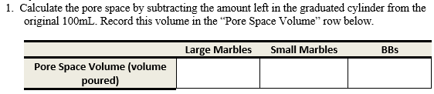
Porosity and Permeability Lab
ANALYSIS
Pore Space Volume = 100mL – amount left in graduated cylinder

Slide 7
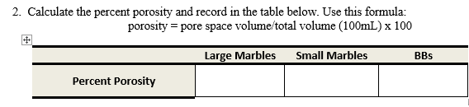
Porosity and Permeability Lab
ANALYSIS
Porosity = pore space volume x 100
100mL (total volume)

Slide 8
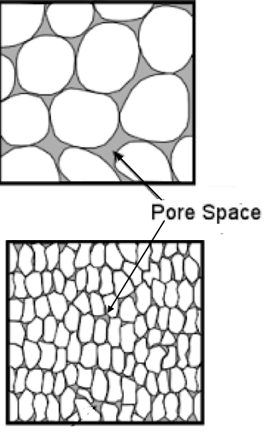
REVIEW
How did the size of the particles affect porosity?
The larger the particles, the greater the porosity.

Slide 9
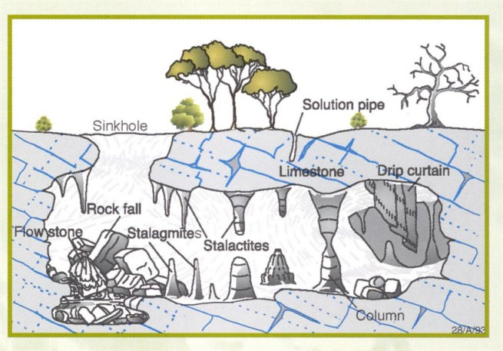
Weathering Landforms

Slide 10
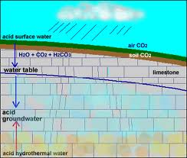
Weathering by Groundwater
Chemical Weathering:
Process where carbonic acid breaks down minerals in rock.
Carbonation:
Type of Chemical Weathering
Carbonic acid formed when water passes through soil.
  Dissolves minerals in rock.
  Chemically weathers rock.

Slide 11
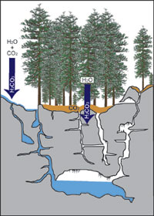
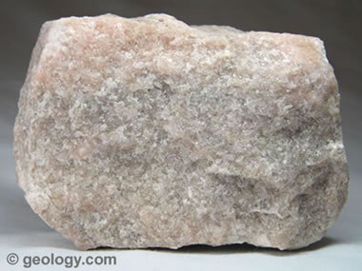
Calcite and Weathering
Calcite: Common mineral
  Limestone, chalk
  Organic – remains of shells and skeletons
  Sedimentary rock
  CaCO₃
Weathering from acid rain.
  Carbonic acid

Slide 12
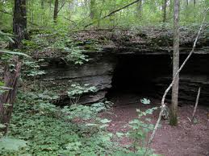
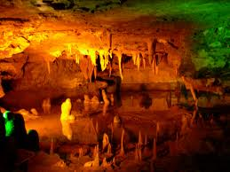
Caves and Caverns
Formations:
Cave: a natural opening, usually in rocks, that is large enough for human entry.
  Limestone – most common rock for cave formation.
Cavern: consists of connecting caves.

Slide 13
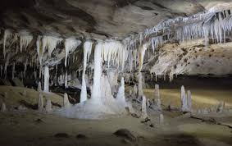
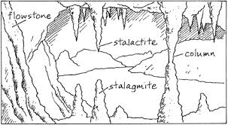
Cave and Cavern Features
  Formations from water containing dissolved calcite dripping include:
  Stalactites – suspended deposit
  Stalagmites – deposits that build up from the floor
  Columns – calcite deposit formed when a stalactite and stalagmite meet

Slide 14
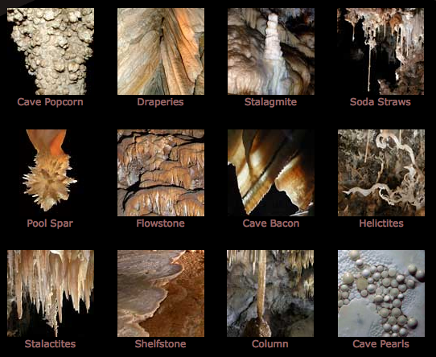
Cave and Cavern Features

Slide 15
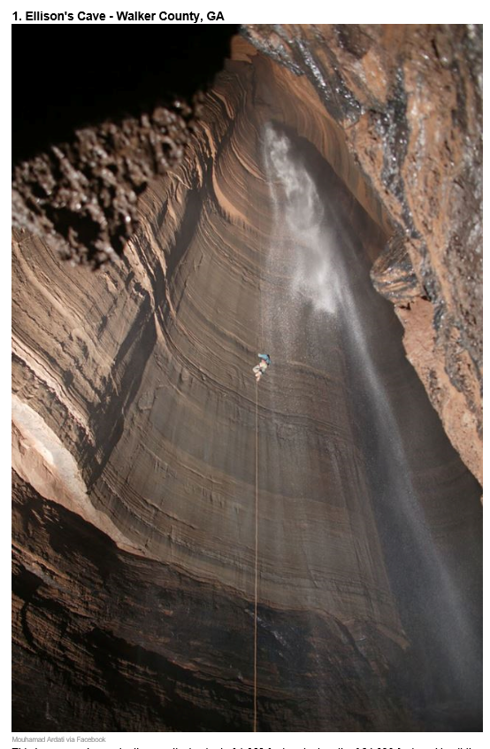
Five Caves in Georgia

Slide 16
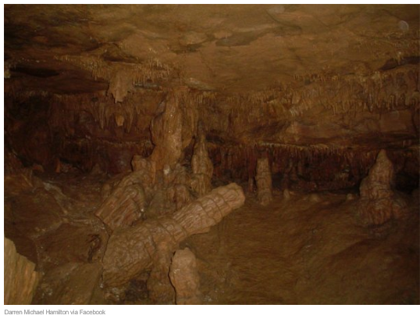
Five Caves in Georgia

Slide 17
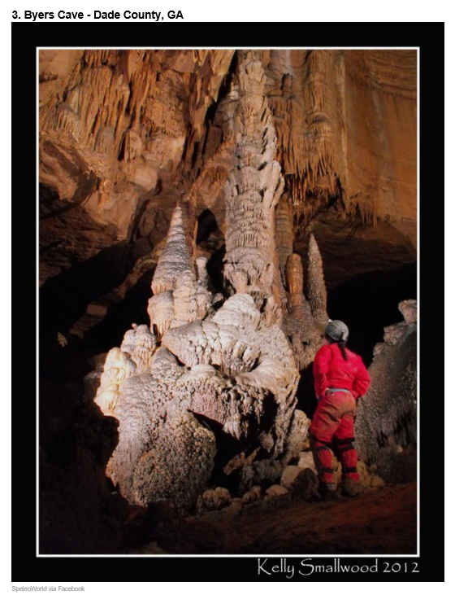
Five Caves in Georgia

Slide 18
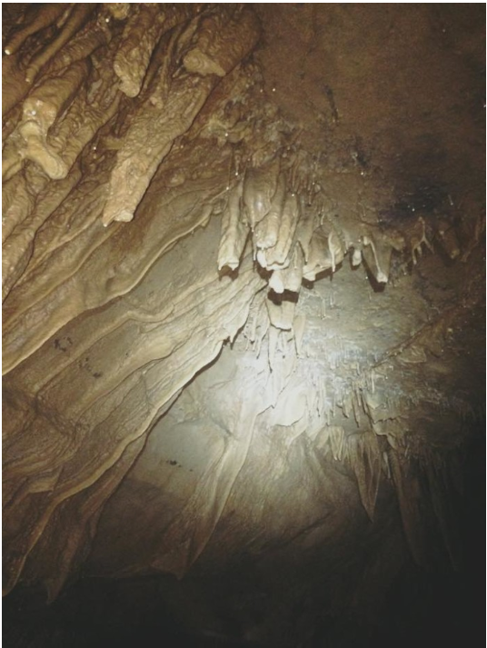
Five Caves in Georgia

Slide 19
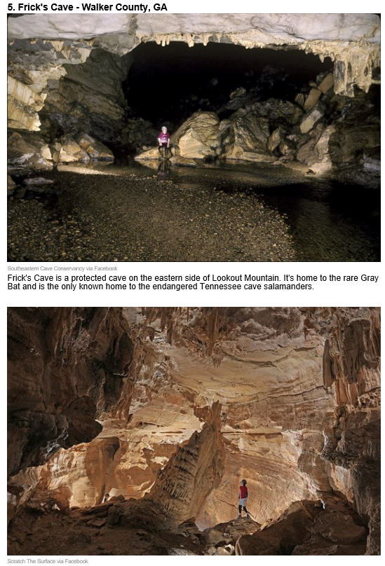
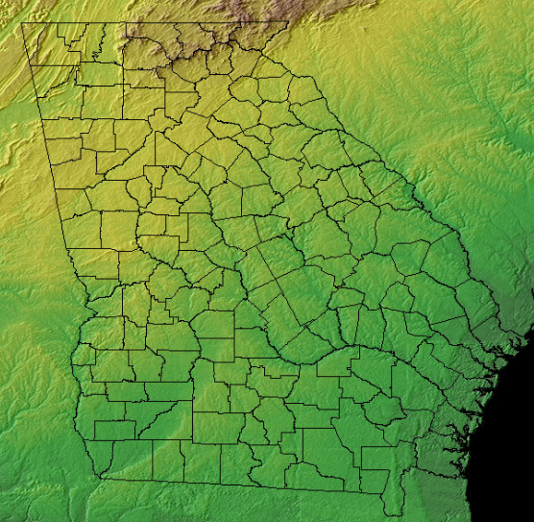
Five Caves in Georgia
Walker County, GA

Slide 20
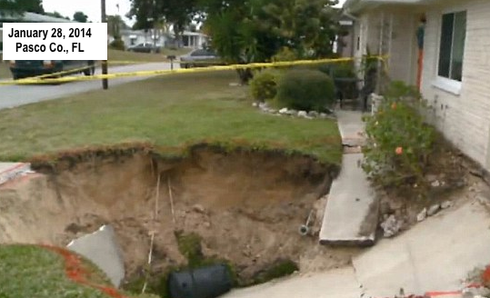
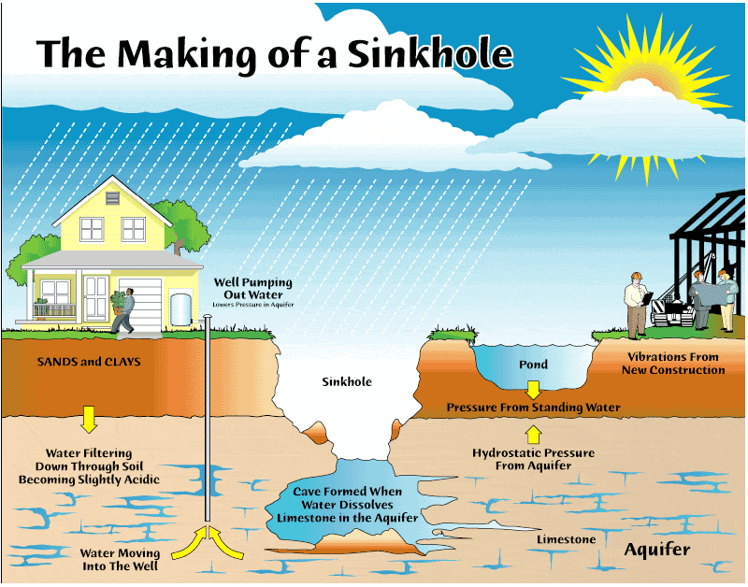
Sinkholes
A sinkhole is a circular depression that forms when rocks dissolve.
Sediment fills existing cavity, or caves / caverns collapse.

Slide 21
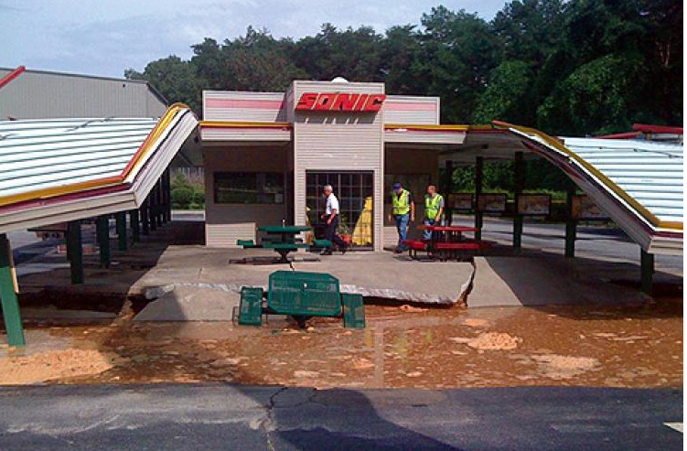
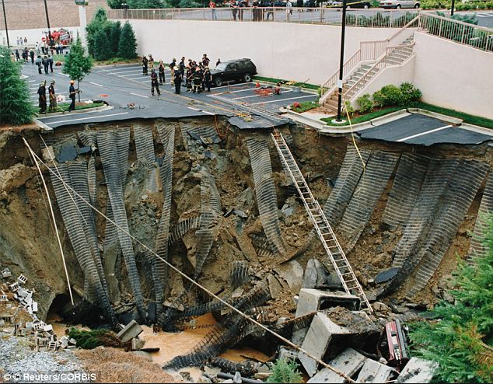
SINKHOLES IN GEORGIA
Downtown Atlanta
Cleveland, Atlanta

Slide 22
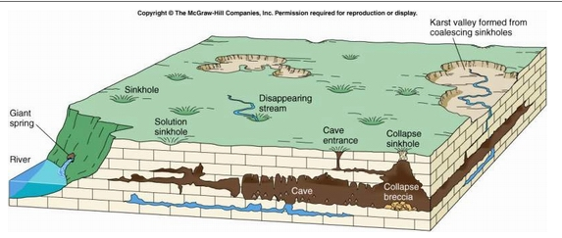
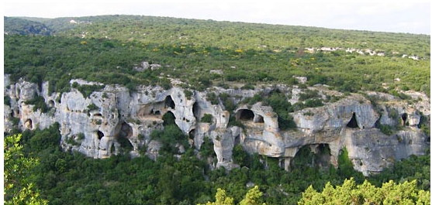
Karst Topography
Karst Topography is landscape that is characterized by numerous caves, sinkholes, fissures, and underground streams.

Slide 23
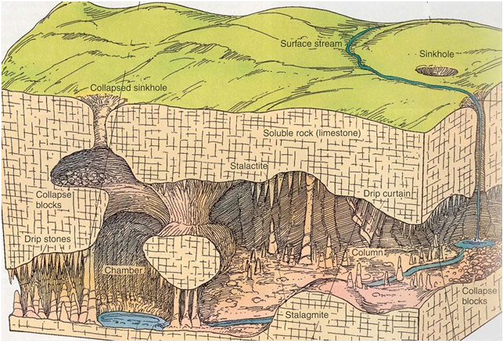
Karst Topography
  Generally forms in wet areas.
  Caused by chemical weathering of limestone by groundwater.
  Closely spaced sinkholes and caverns.
  Streams often disappear underground and emerge elsewhere.

Slide 24
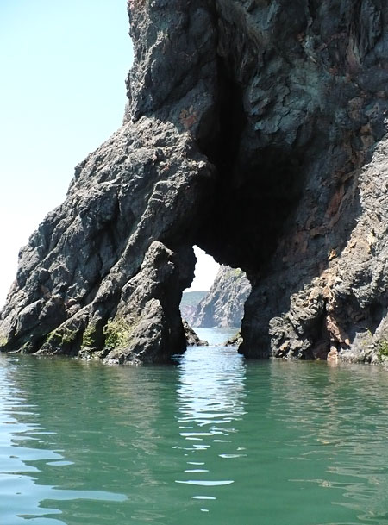
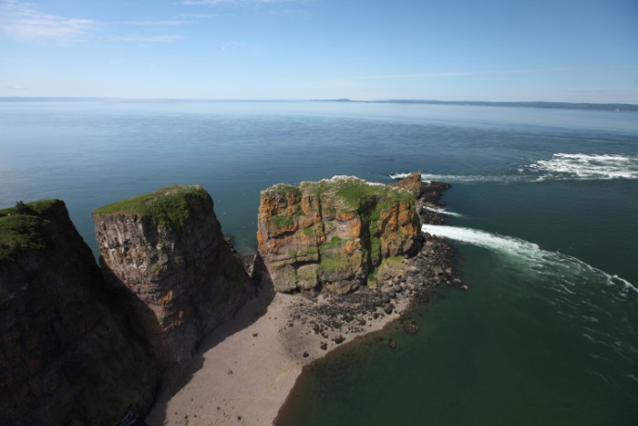
Coastal Weathering
Coastal Weathering is weathering by wind and water create landforms at coastal regions.
Type of Mechanical Weathering.
Different formations occur because of differential weathering – different materials in rock.

Slide 25
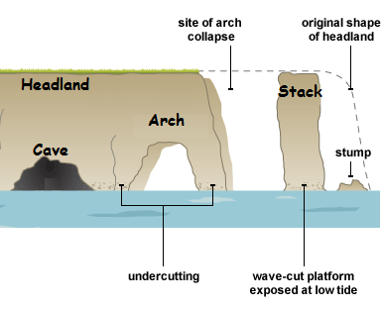
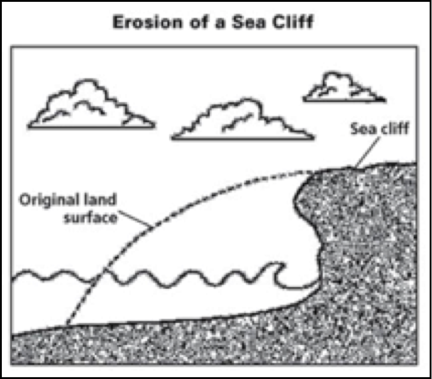
Coastal Weathering
Wave action cuts into coastal headlands to form:
  Arches
  Stacks
  Caves
Sea Cliffs are produced by waves and weather.

Slide 26
Review
What type of weathering forms Karst landforms?
Ice wedging
Wind abrasion
Carbonation
Oxidation

Slide 27
TO DO
Review #26
Complete any missing lab

