Slide 1
DO NOW
Pick up exam review.

Slide 2
KINETICS,
CHEMICAL EQUILIBRIUM,
AND ACIDS/BASES
FINAL EXAM REVIEW

Slide 3
REVIEW FOR FINAL
KINETICS
Define Kinetics.
Kinetics: The area of chemistry concerned with the speed at which reactions occur.
Some reactions are fast and some are slow.
Make sure you can make a distinction between rate and time.
If the rate of a reaction is high, the time of the reaction is low.

Slide 4
REVIEW FOR FINAL
KINETICS
Discuss the collision theory.
COLLISION THEORY:
The particles must collide.
The particles must collide with the correct orientation.
The particles must collide with sufficient energy to form an activated complex.

Slide 5
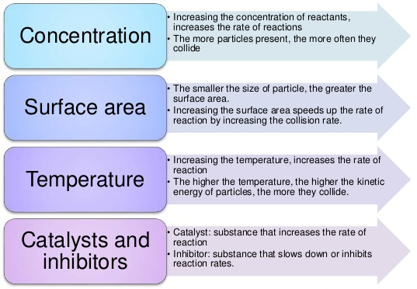
REVIEW FOR FINAL
KINETICS
List the factors (nature of reactants, concentration, temperature, surface area, and catalysis) that effect reaction rates and explain them according to collision theory.

Slide 6
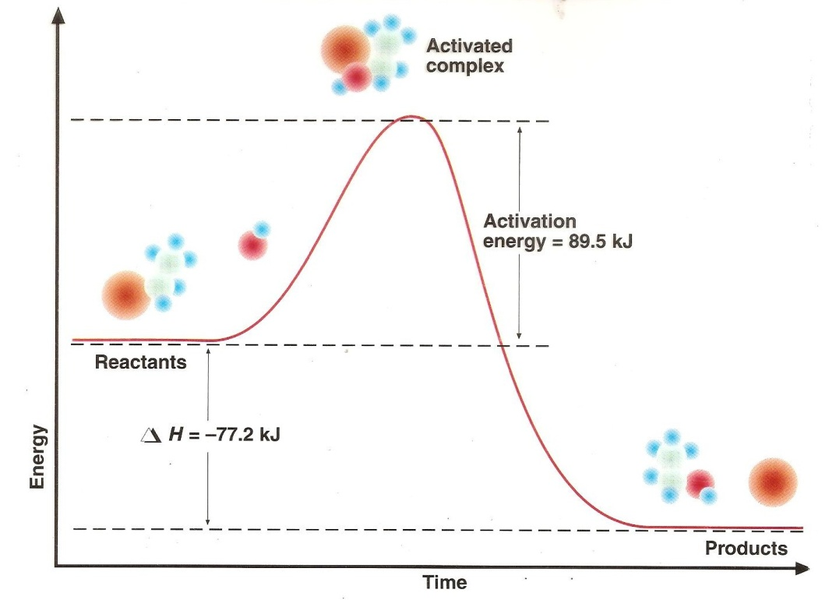
REVIEW FOR FINAL
KINETICS
Identify the parts of a potential energy diagram including activation energy, E_{a}, transition state, energy of reactants, energy of the activated complex, energy of products, and heat of reaction.

Slide 7
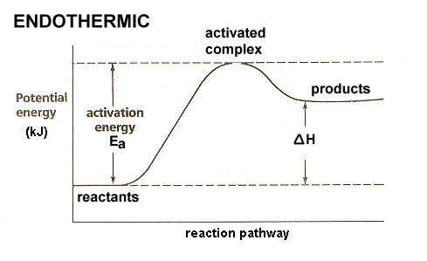
REVIEW FOR FINAL
KINETICS
Identify the parts of a potential energy diagram including activation energy, E_{a}, transition state, energy of reactants, energy of the activated complex, energy of products, and heat of reaction.

Slide 8
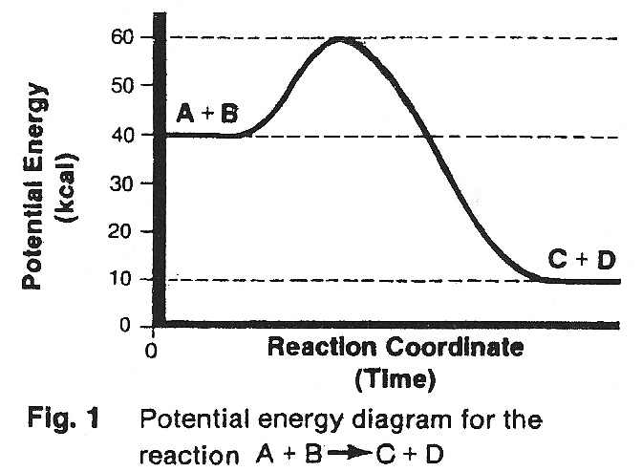
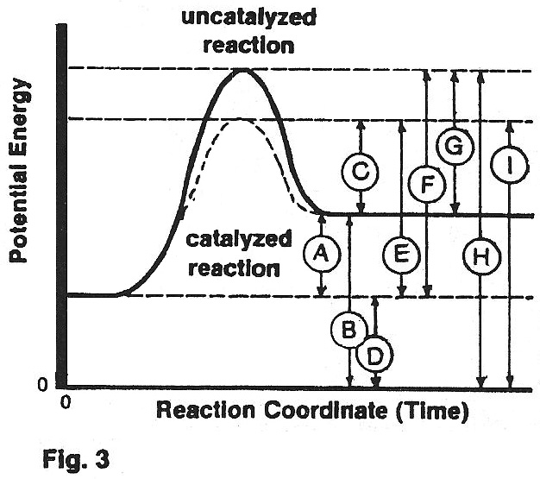
REVIEW FOR FINAL
KINETICS
Identify the parts of a potential energy diagram including activation energy, E_{a}, transition state, energy of reactants, energy of the activated complex, energy of products, and heat of reaction.

Slide 9
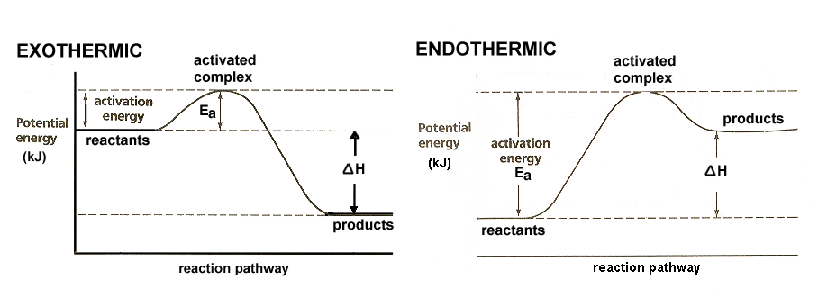
REVIEW FOR FINAL
KINETICS
Identify a potential energy diagram for an exothermic reaction and an endothermic reaction.

Slide 10
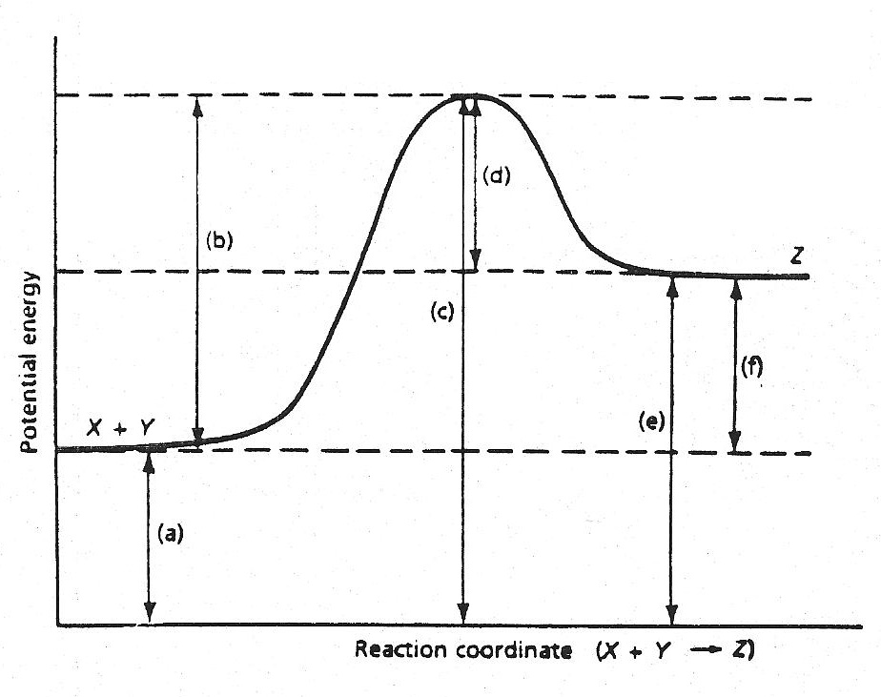
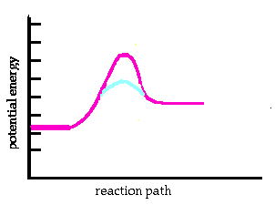
REVIEW FOR FINAL
KINETICS
Know what a catalyst is and how it affects a potential energy diagram.

Slide 11
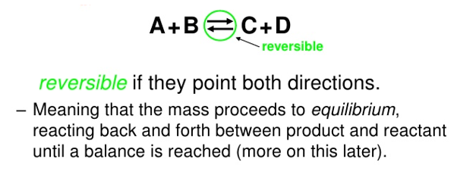
REVIEW FOR FINAL
CHEMICAL EQUILIBRIUM
Describe a reversible reaction.

Slide 12
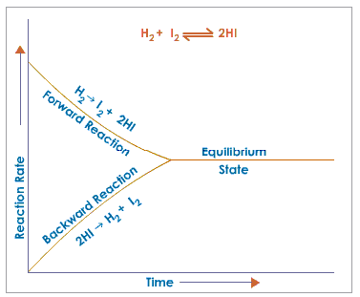
REVIEW FOR FINAL
CHEMICAL EQUILIBRIUM
Describe the state of dynamic chemical equilibrium and explain how it is achieved.

Slide 13
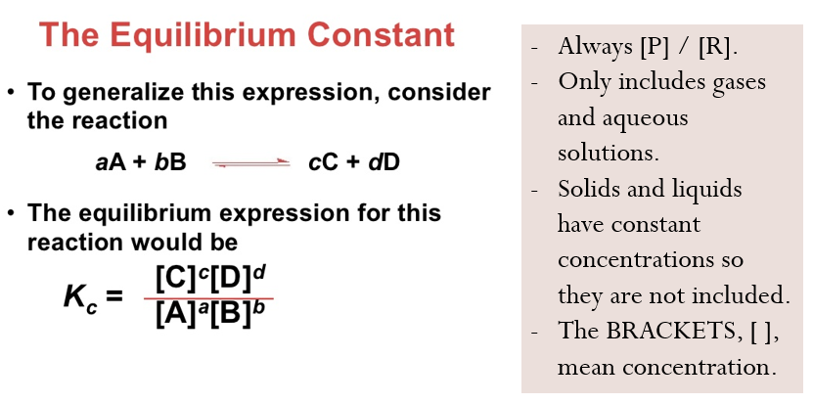
REVIEW FOR FINAL
CHEMICAL EQUILIBRIUM
Write the equilibrium expression for any system at equilibrium.

Slide 14
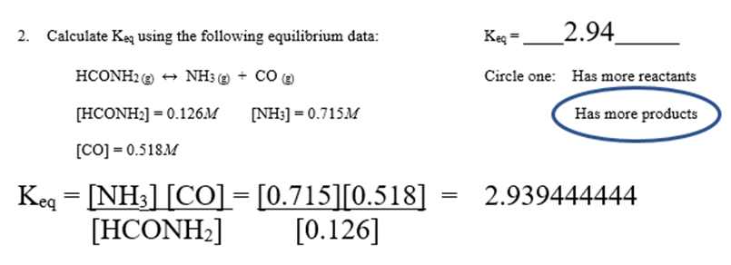
REVIEW FOR FINAL
CHEMICAL EQUILIBRIUM
Calculate K_{eq} given the concentrations of products and reactants at equilibrium.

Slide 15
REVIEW FOR FINAL
CHEMICAL EQUILIBRIUM
Describe the significance of the size of K_{eq} in an equilibrium system.
K_{eq < 1}
Reactants favored
“Lies to the left”
K_{eq > 1}
Products favored
“Lies to the right”

Slide 16
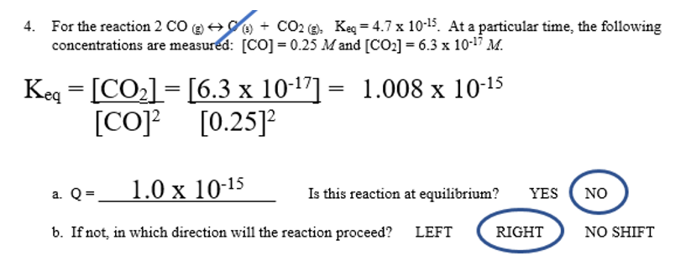
REVIEW FOR FINAL
CHEMICAL EQUILIBRIUM
Calculate the reaction quotient, Q, and relate it to K_{eq}. Determine in which direction the reaction will proceed (shift left, shift right, at equilibrium).

Slide 17
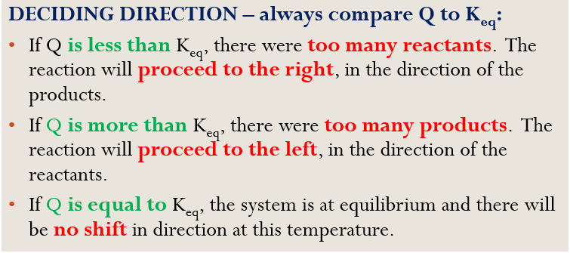
REVIEW FOR FINAL
CHEMICAL EQUILIBRIUM
Calculate the reaction quotient, Q, and relate it to K_{eq}. Determine in which direction the reaction will proceed (shift left, shift right, at equilibrium).

Slide 18
REVIEW FOR FINAL
CHEMICAL EQUILIBRIUM
Describe Le Chatelier’s Principle and the stresses that can alter equilibrium (concentration, pressure, and temperature).
If a change in conditions is imposed on a system at equilibrium, the equilibrium position will shift in the direction that tends to reduce that change in conditions.
A STRESS is any kind of change in a system at equilibrium that upsets the equilibrium.
A reaction system will shift in the forward or reverse direction to “undo” the altering factor.
The stresses are concentration, pressure (gases only) and temperature.

Slide 19
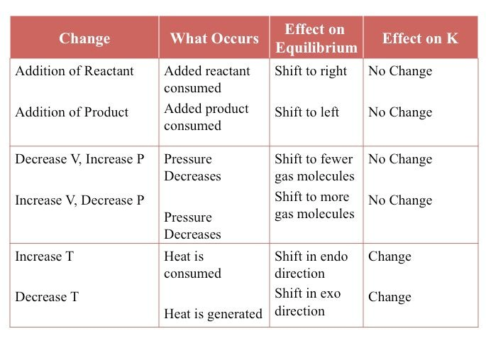
REVIEW FOR FINAL
CHEMICAL EQUILIBRIUM
Use Le Chatelier’s Principle to predict shift in equilibrium in terms of relative concentrations of products and reactants. Understand what changes in temperature, pressure (volume), concentration, and moles (pressure) can do.

Slide 20
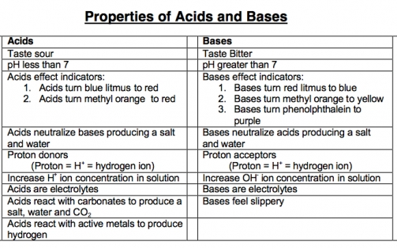
REVIEW FOR FINAL
ACIDS AND BASES
Describe the properties of acids and bases.

Slide 21
REVIEW FOR FINAL
ACIDS AND BASES
Compare and contrast Arrhenius’ and Bronsted-Lowry definitions.
Arrhenius
Brønsted-Lowry
Bases donate OH⁻
Bases accept H⁺
Acids donate H⁺

Slide 22
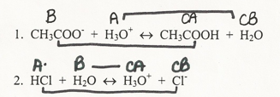
REVIEW FOR FINAL
ACIDS AND BASES
Describe and identify conjugate acids and bases.
A conjugate acid is the substance formed when a Brønsted-Lowry base accepts a hydrogen ion.
A conjugate base is the substance formed when a Brønsted-Lowry acid donates a hydrogen ion.

Slide 23
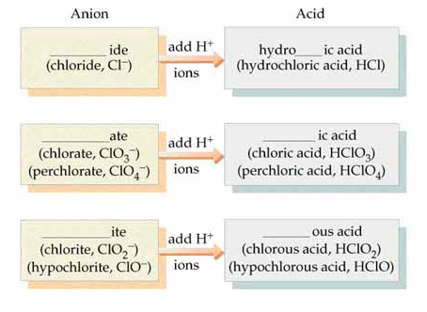
REVIEW FOR FINAL
ACIDS AND BASES
Write the name of an acid and a base from its formula and vice versa.

Slide 24
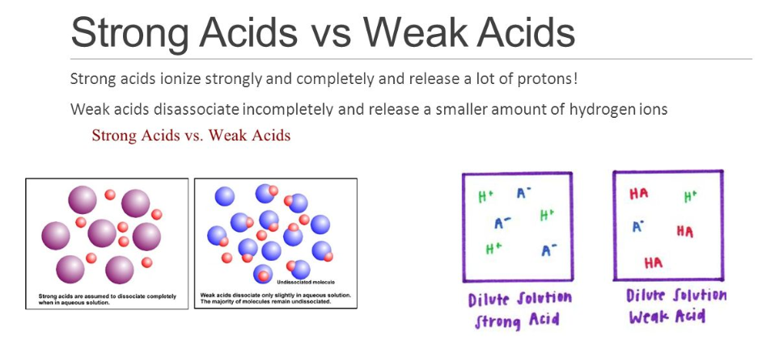
REVIEW FOR FINAL
ACIDS AND BASES
Describe how strong acids and weak acids differ.

Slide 25
REVIEW FOR FINAL
ACIDS AND BASES
Calculate pH if given [H₃O⁺] or [OH⁻].
Calculate [H₃O⁺] if given pH or pOH.
pH = -log [H₃O⁺] [H₃O⁺] = antilog-pH
pOH = -log [OH⁻] [OH⁻] = antilog-pOH
pH + pOH = 14.000 [H₃O⁺][OH⁻] = 1.00 x 10⁻¹⁴

Slide 26
REVIEW FOR FINAL
ACIDS AND BASES
Describe neutralization.
In chemistry, neutralization is a chemical reaction in which an acid and a base react quantitatively with each other.
HCl + NaOH → NaCl + H₂O
HCl + NH₃ → NH₄⁺ + Cl⁻

Slide 27
REVIEW FOR FINAL

Slide 28
REVIEW FOR FINAL

