Slide 1
DO NOW

Slide 2
THE MOLE AND STOICHIOMETRY
REVIEW

Slide 3
REVIEW FOR EXAM
Know the MOLE as the basic SI unit for measuring the amount of a substance.
Know Avogadro’s number (6.02 x 10²³) as it is related to a mole of any substance.
Calculate the molar mass from the periodic table for any substance.
Calculate the mole-mole, mole-mass, mass-mole, mole-particle, and particle-mole problems.
Use the mole to convert between mass and number of particles.

Slide 4
REVIEW FOR EXAM
6. Calculate empirical formulas, molecular formulas, and hydrate formulas from appropriate data.
7. Calculate mole-mole, mass-mole, mole-mass, and mass-mass problems.
8. Knowing the limiting reagent in a reaction, calculate the maximum amount of product(s) produced. Identify the limiting reagent in a reaction.

Slide 5
REVIEW FOR EXAM
4. Calculate the mole-mole, mole-mass, mass-mole, mole-particle, and particle-mole problems.
How many moles of oxygen atoms are present in 5.00 mol P₂O₅?
5.00 mol P₂O₅ 5 mol O = 25.0 mol O
1 mol P₂O₅

Slide 6
REVIEW FOR EXAM
4. Calculate the mole-mole, mole-mass, mass-mole, mole-particle, and particle-mole problems.
Calculate the number of molecules in 11.5 moles of H₂O.
11.5 mol H₂O 6.02 x 10²³ molecules H₂O 1 mole H₂O
= 6.923 x 10²⁴ = 6.92 x 10²⁴ molecules H₂O
Calculate the number of moles in 25.5g Ag.
25.5g Al 1 mol Al = 0.2363956
107.87g Ag = 0.236 mol Ag

Slide 7
REVIEW FOR EXAM
5. Use the mole to convert between mass and number of particles.
Calculate the number of atoms in 55.2g Li.
55.2g Li 1 mol Li 6.02 x 10²³ atoms Li
6.94g Li 1 mol Li
= 4.78824 x 10²⁴ = 4.79 x 10²⁴ atom Li
Calculate the mass in grams of 6.02 x 10²⁴ atoms Bi.
6.02 x 10²⁴atoms Bi 1mol Bi 208.98g
6.02 x 10²³ atoms Bi 1 mol Bi
= 2089.8 = 2090g Bi

Slide 8
REVIEW FOR EXAM
6. Calculate empirical formulas, molecular formulas, and hydrate formulas from appropriate data.

Slide 9
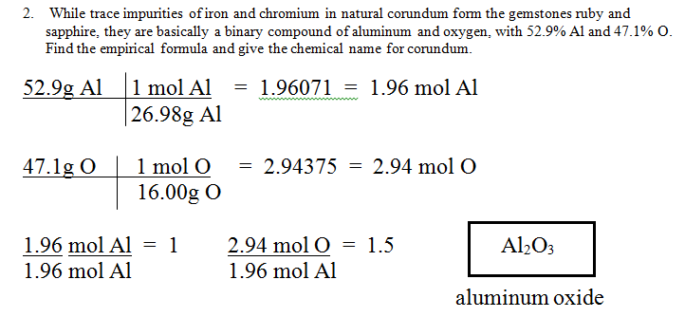
REVIEW FOR EXAM

Slide 10
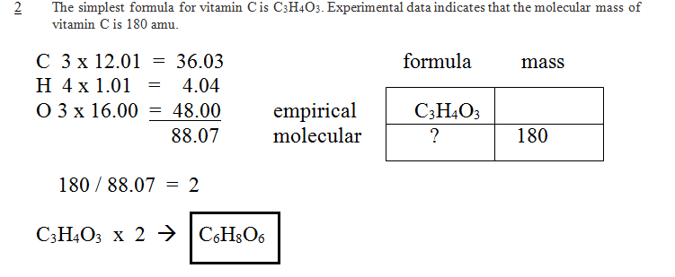
REVIEW FOR EXAM

Slide 11
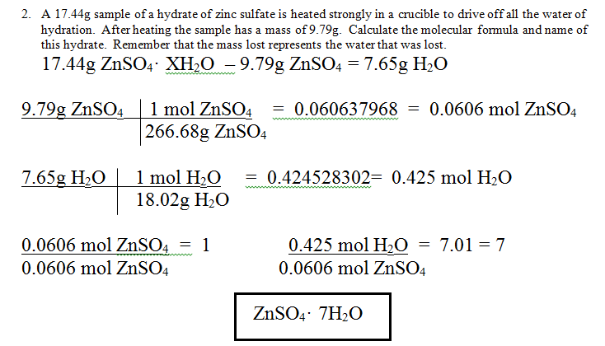
REVIEW FOR EXAM

Slide 12
REVIEW FOR EXAM
7. Calculate mole-mole, mass-mole, mole-mass, and mass-mass problems.
WYK: 0.020mol Cl₂ ? moles NaCl
EQN: 2Na + Cl₂ → 2NaCl
SOLVE:
0.020mol Cl₂ 2 mole NaCl = 0.040mol NaCl
1 mole Cl₂

Slide 13
REVIEW FOR EXAM
7. Calculate mole-mole, mass-mole, mole-mass, and mass-mass problems.
WYK: 0.020mol Cl₂ ? grams NaCl
EQN: 2Na + Cl₂ → 2NaCl
SOLVE:
0.020mol Cl₂ 2 mole NaCl 58.44gNaCl
1 mole Cl₂ 1 mol NaCl
= 2.3376 = 2.3g NaCl

Slide 14
REVIEW FOR EXAM
7. Calculate mole-mole, mass-mole, mole-mass, and mass-mass problems.
WYK: 45.0g Cl₂ ? mol NaCl
EQN: 2Na + Cl₂ → 2NaCl
SOLVE:
45.0g Cl₂ 1mol Cl₂ 2 mole NaCl
70.90g Cl₂ 1 mole Cl₂
= 1.26939 = 1.27mol NaCl

Slide 15
REVIEW FOR EXAM
7. Calculate mole-mole, mass-mole, mole-mass, and mass-mass problems.
WYK: 45.0g Cl₂ ? grams NaCl
EQN: 2Na + Cl₂ → 2NaCl
SOLVE:
45.0g Cl₂ 1mol Cl₂ 2 mole NaCl 58.44gNaCl
70.90g Cl₂ 1 mole Cl₂ 1 mol NaCl
= 74.1833568 = 74.2g NaCl

Slide 16

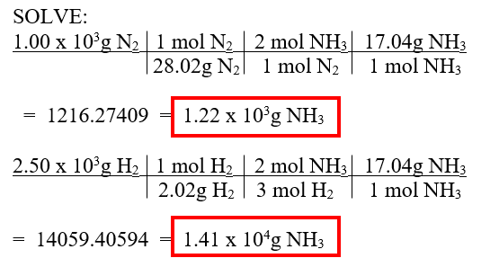

REVIEW FOR EXAM
8. Knowing the limiting reagent in a reaction, calculate the maximum amount of product(s) produced and the amount of any excess reagent. Identify the limiting reagent in a reaction.

Slide 17
WHAT I WILL LOOK FOR
Be sure to show all your work.
Be sure to use the correct number of significant digits.
Be sure to show all units and substances.
Remember the more you show me, the more credit I can give.

Slide 18
TO DO
Ten problem practice – answers will be available after tomorrow so you can check your work.

