Slide 1
Phases of Matter, Energy, Gases, and Solutions
Final Exam Review

Slide 2
DO NOW
Pick up the exam review.
You have seven days to get your make-up work in.
You have three days (including today) to get your $1, 100% cotton t-shirt, and bag to class.
If you have a pink test Redo slip, today is the deadline to get it turned in so you can take the test by May 15.

Slide 3
REVIEW FOR FINAL
PHASES AND ENERGY
Explain the behavior of solids, liquids, and gases in terms of the kinetic theory.
Differentiate between the three phases of matter.
Discuss a heating curve as a substance is taken from a solid to the vapor state.
Discuss a phase diagram and understand the significance of the terms associated with it (T_{m}, T_{b}, etc.).
Explain a phase change and interpret these changes based on graphs.
Determine the relationship between energy and change of state.
Be able to perform calculation for heat of fusion, heat of vaporization and heat changes.

Slide 4
REVIEW FOR FINAL
PHASES AND ENERGY
Explain the behavior of solids, liquids, and gases in terms of the kinetic theory.
All matter is composed of small particles.
The small particles are in constant, random motion.
All particles have perfectly elastic collisions – there is no change in total kinetic energy (KE).

Slide 5
REVIEW FOR FINAL
PHASES AND ENERGY
Differentiate between the three phases of matter.
 | Volume | Shape | Spacing | IMFs
SOLID | Definite | Definite | Vibrate along a fixed point | Stronger
LIQUID | Definite | No Definite | Slid past each other | Strong
GAS | No Definite | No Definite | Behave independently of each other | Very Weak

Slide 6
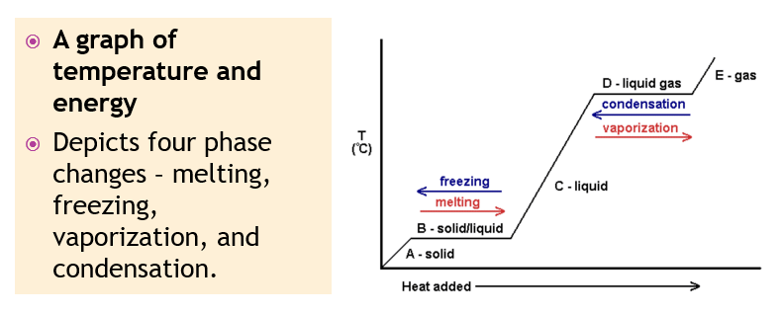
REVIEW FOR FINAL
PHASES AND ENERGY
Discuss a heating curve as a substance is taken from a solid to the vapor state.
  Know what happens on the diagonal as well as the plateaus to temperature and heat energy.
  Know what is on the X and Y axes.

Slide 7
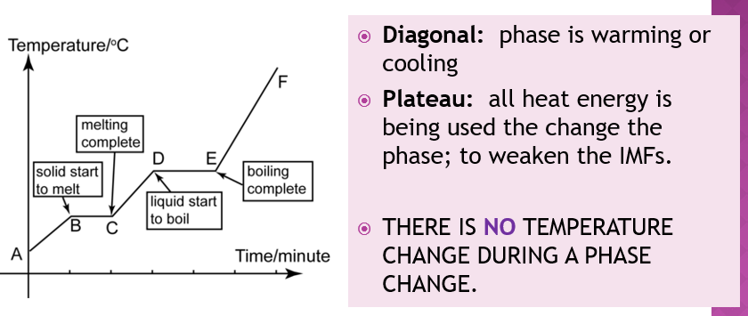
REVIEW FOR FINAL
PHASES AND ENERGY
Discuss a heating curve as a substance is taken from a solid to the vapor state.
  Know what happens on the diagonal as well as the plateaus to temperature and heat energy.
  Know what is on the X and Y axes.

Slide 8
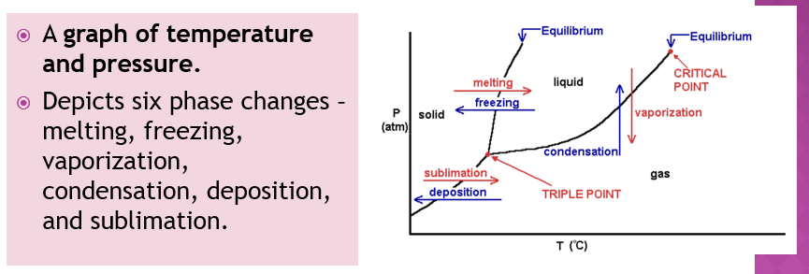
REVIEW FOR FINAL
PHASES AND ENERGY
Discuss a phase diagram and understand the significance of the terms associated with it (T_{m}, T_{b}, etc.).
  Know what each equilibrium line is, where the triple point is, the critical point, normal boiling point, and normal melting point.
  Know what is on the X and Y axes.

Slide 9
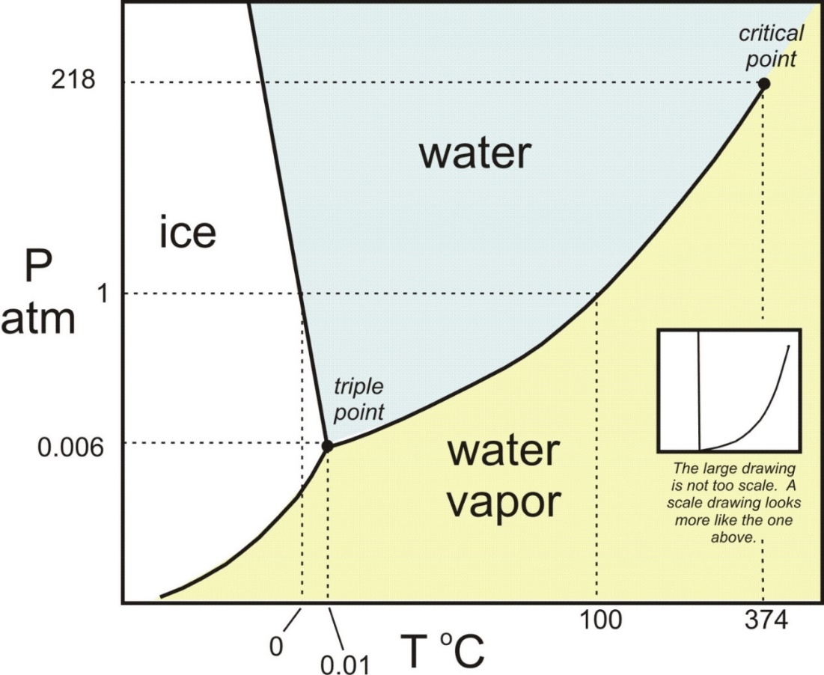
REVIEW FOR FINAL
PHASES AND ENERGY
Discuss a phase diagram and understand the significance of the terms associated with it (T_{m}, T_{b}, etc.).

Slide 10
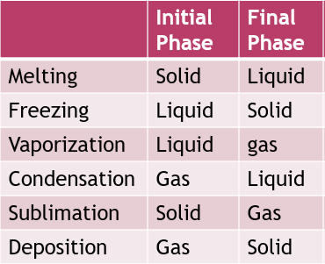
REVIEW FOR FINAL
PHASES AND ENERGY
Explain a phase change and interpret these changes based on graphs.
A phase change is an energy change that causes one phase to turn into another.

Slide 11
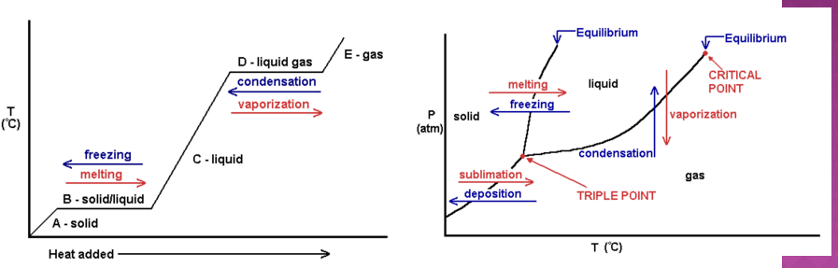
REVIEW FOR FINAL
PHASES AND ENERGY
Explain a phase change and interpret these changes based on graphs.
  A phase change is an energy change that causes one phase to turn into another

Slide 12
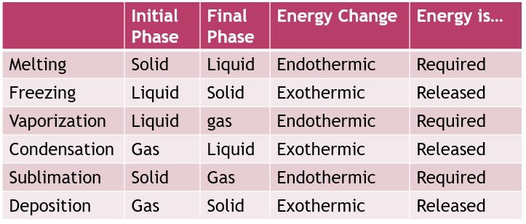
REVIEW FOR FINAL
PHASES AND ENERGY
Determine the relationship between energy and change of state.

Slide 13
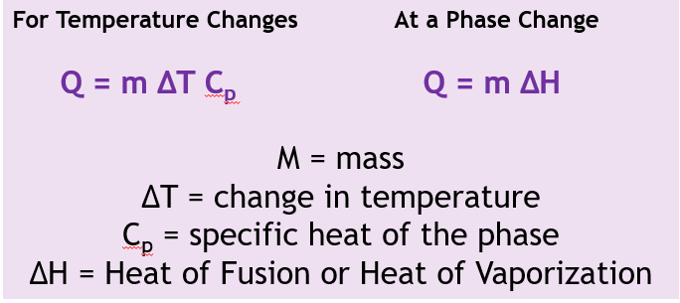
REVIEW FOR FINAL
PHASES AND ENERGY
Be able to perform calculation for heat of fusion, heat of vaporization and heat changes.

Slide 14
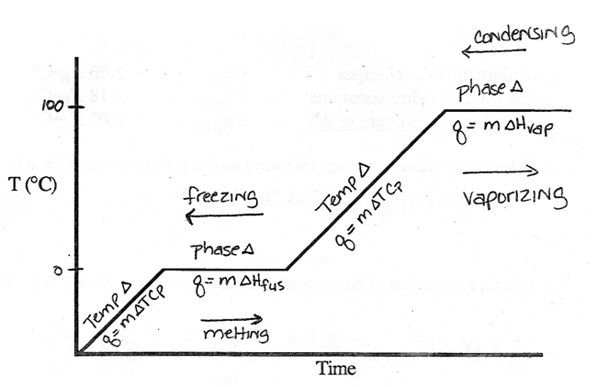
REVIEW FOR FINAL
PHASES AND ENERGY
Be able to perform calculation for heat of fusion, heat of vaporization and heat changes.

Slide 15
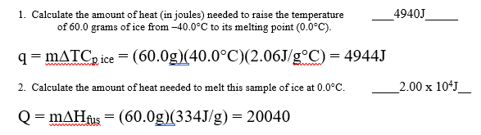
REVIEW FOR FINAL
PHASES AND ENERGY
Be able to perform calculation for heat of fusion, heat of vaporization and heat changes.

Slide 16
REVIEW FOR FINAL
Gases
Describe the effect on a gas by a change in the amount of gas (moles), the pressure of gas, the volume of gas, and the temperature of gas.
Perform calculations using Boyle’s Law, Charles’ Law, and Gay-Lussac’s Law.
Use Dalton’s Law of Partial Pressures in a calculation
Perform calculations using the ideal gas law and the combined gas law.
State and use Graham’s Law of Diffusion.
Calculate gas stoichiometry problems (volume – volume, mass – volume, volume – mass).

Slide 17
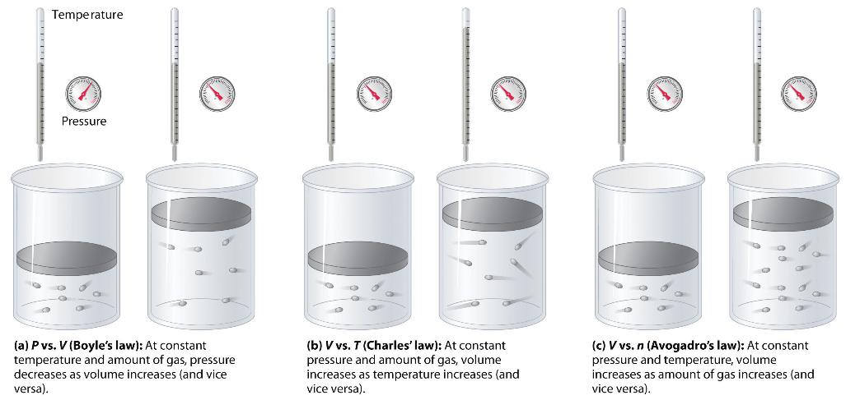
REVIEW FOR FINAL
Gases
Describe the effect on a gas by a change in the amount of gas (moles), the pressure of gas, the volume of gas, and the temperature of gas.

Slide 18
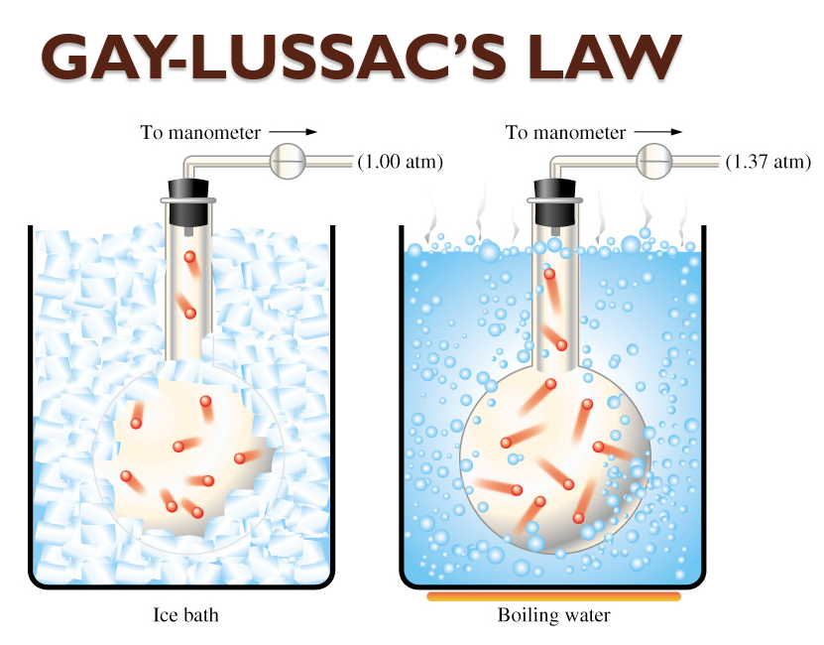
REVIEW FOR FINAL
Gases
Describe the effect on a gas by a change in the amount of gas (moles), the pressure of gas, the volume of gas, and the temperature of gas.

Slide 19
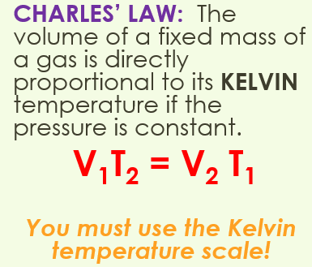
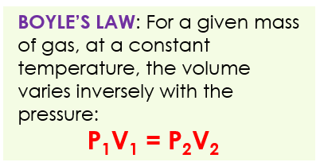
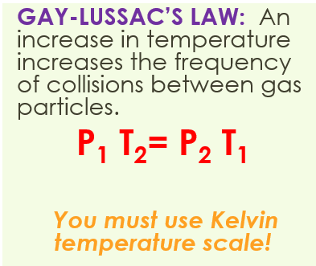
REVIEW FOR FINAL
Gases
Perform calculations using Boyle’s Law, Charles’ Law, and Gay-Lussac’s Law.

Slide 20
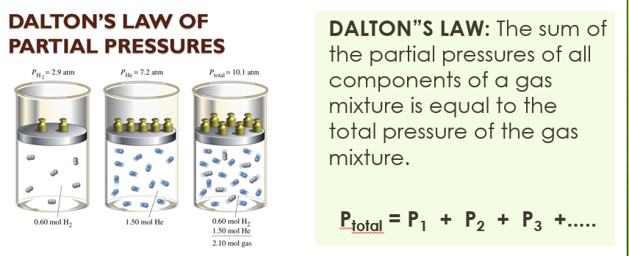
REVIEW FOR FINAL
Gases
Use Dalton’s Law of Partial Pressures in a calculation

Slide 21
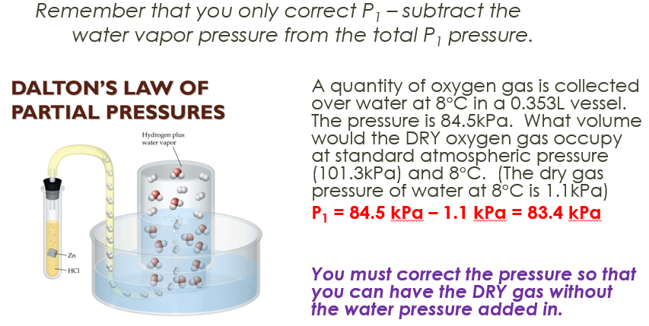
REVIEW FOR FINAL
Gases
Use Dalton’s Law of Partial Pressures in a calculation

Slide 22
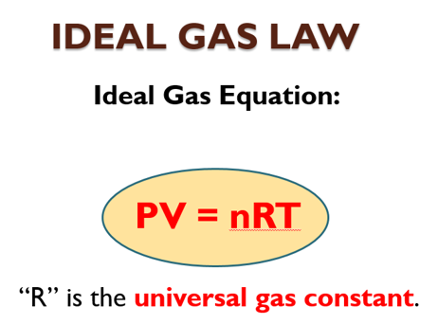
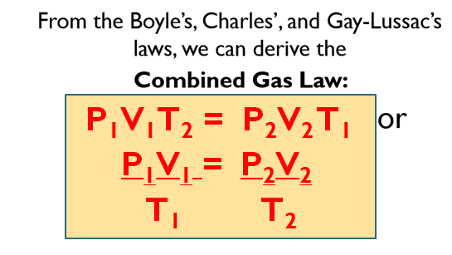
REVIEW FOR FINAL
Gases
Perform calculations using the ideal gas law and the combined gas law.

Slide 23
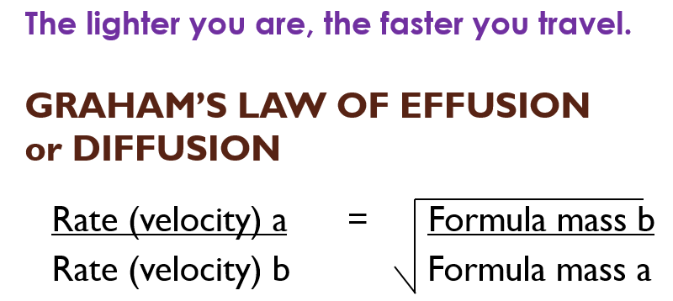
REVIEW FOR FINAL
Gases
State and use Graham’s Law of Diffusion.

Slide 24
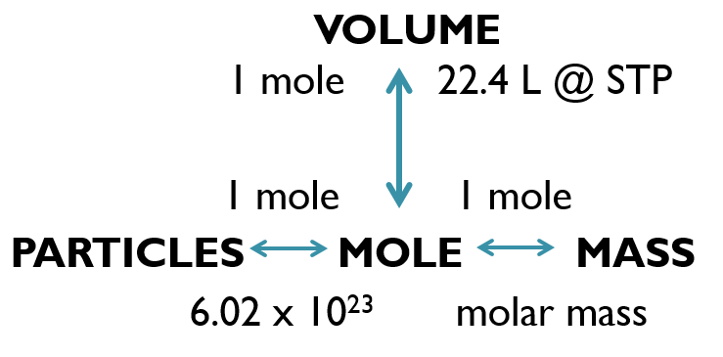
REVIEW FOR FINAL
Gases
Calculate gas stoichiometry problems (volume – volume, mass – volume, volume – mass).

Slide 25
REVIEW FOR FINAL
Solutions
Define solvent and solute and be able to identify them in a solution.
Describe the process of solvation, dissociation, and dissolving.
Differentiate between saturated, unsaturated, and supersaturated.
State and discuss the factors affecting the rate of solubility.
Be able to read a solubility curve graph.
Solve problems involving molarity, molality, and making solutions.
Describe the three colligative properties of solutions (vapor pressure reduction, freezing point depression, and boiling point elevation).
Relate the colligative properties to everyday situations.
Calculate the freezing point and boiling point using changes in temperature and molality.

Slide 26
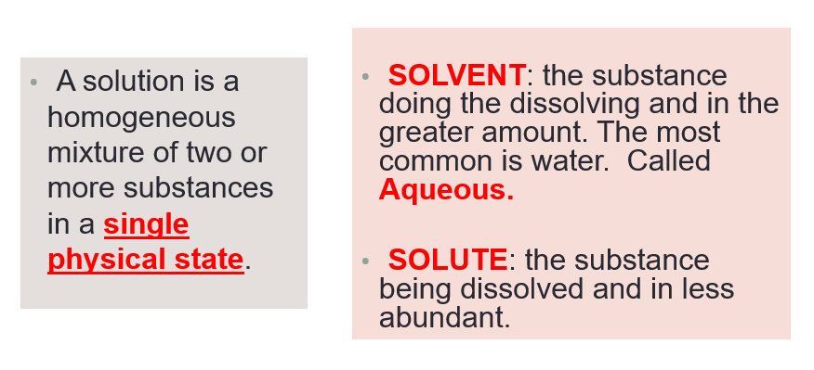
REVIEW FOR FINAL
Solutions
Define solvent and solute and be able to identify them in a solution.

Slide 27
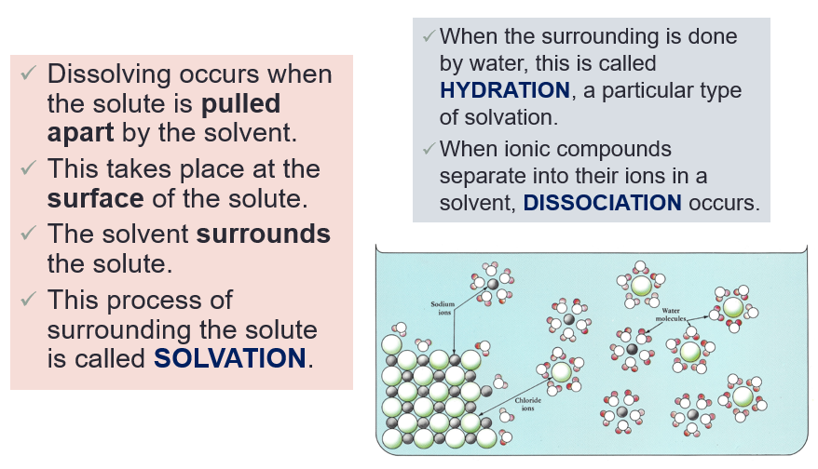
REVIEW FOR FINAL
Solutions
Describe the process of solvation, dissociation, and dissolving.

Slide 28
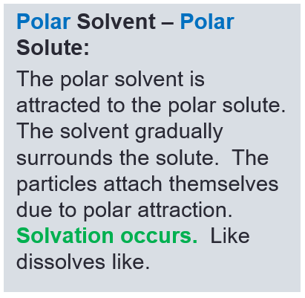
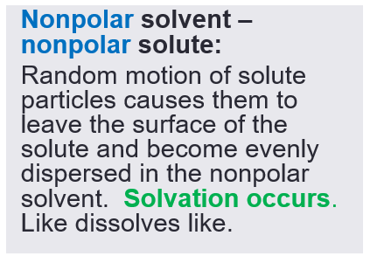
REVIEW FOR FINAL
Solutions
Be sure to study polarity of compounds to be able to predict solubility.

Slide 29
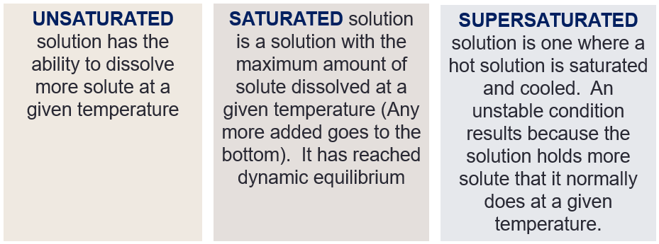
REVIEW FOR FINAL
Solutions
Differentiate between saturated, unsaturated, and supersaturated.

Slide 30
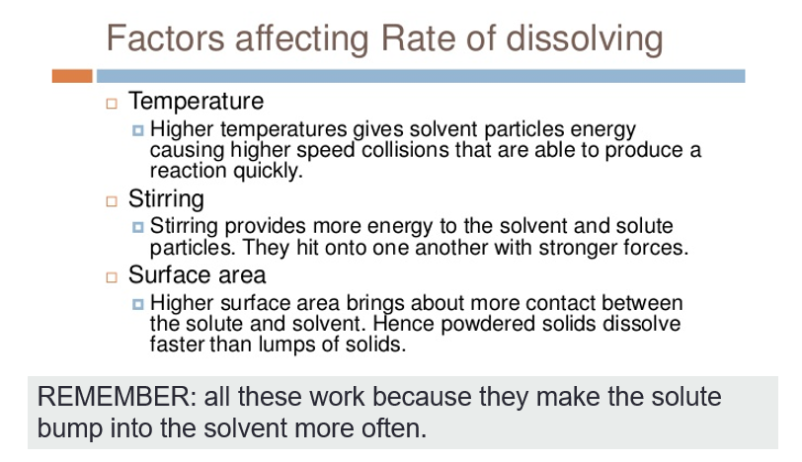
REVIEW FOR FINAL
Solutions
State and discuss the factors affecting the rate of solubility.

Slide 31
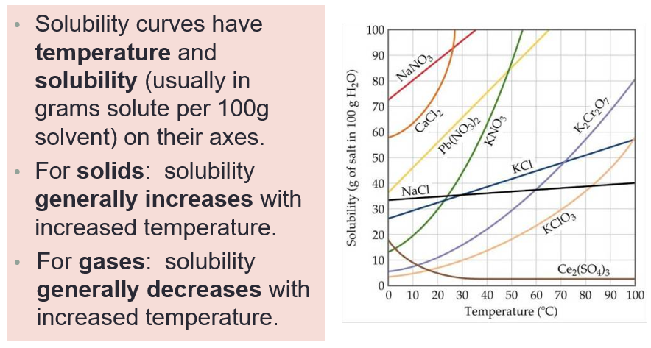
REVIEW FOR FINAL
Solutions
Be able to read a solubility curve graph.

Slide 32
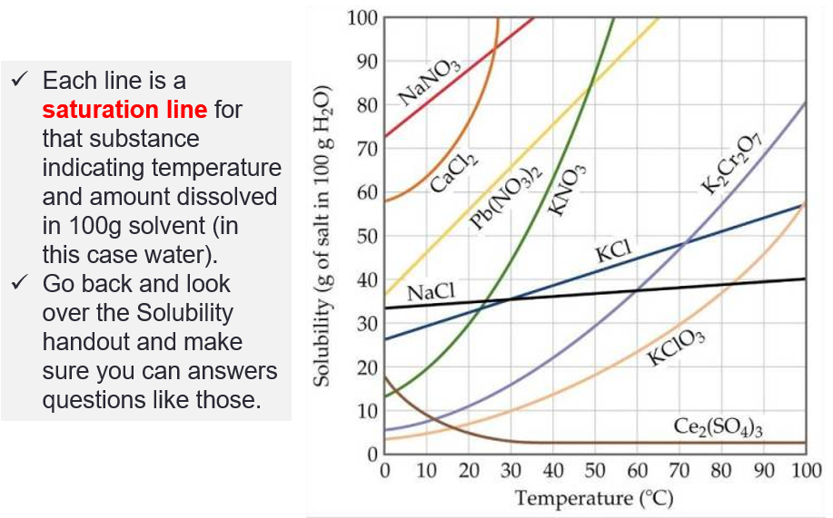
REVIEW FOR FINAL
Solutions
Be able to read a solubility curve graph.

Slide 33
REVIEW FOR FINAL
Solutions
Solve problems involving molarity, molality, and making solutions.
Sea water contains roughly 28.0 g of NaCl per liter. What is the molarity of sodium chloride in sea water?

Slide 34
REVIEW FOR FINAL
Solutions
Solve problems involving molarity, molality, and making solutions.
What is the molality when 0.75 mol is dissolved in 2.50 kg of solvent?

Slide 35
REVIEW FOR FINAL
Solutions
Solve problems involving molarity, molality, and making solutions.
100.0 mL of 2.500M KBr solution is on hand. You need 0.5500M. What is the final volume of solution which results?

Slide 36
REVIEW FOR FINAL
Solutions
Solve problems involving molarity, molality, and making solutions.
You want to make 500.0mL of a 1.0M KCl solution. How many grams do you need?

Slide 37
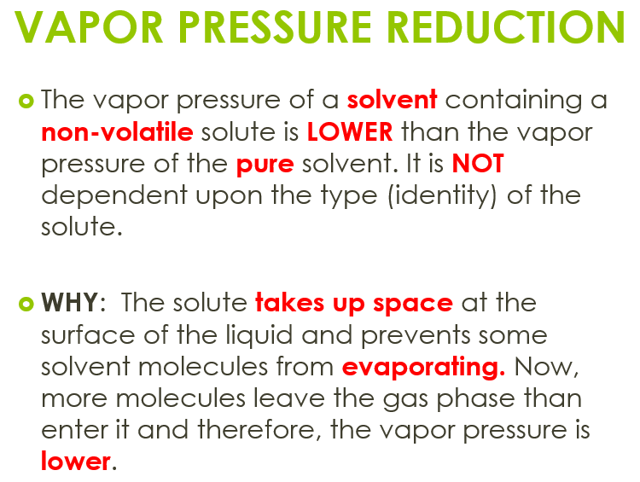
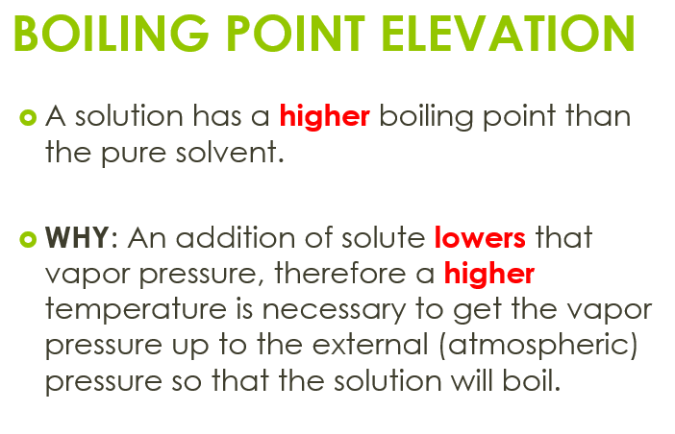
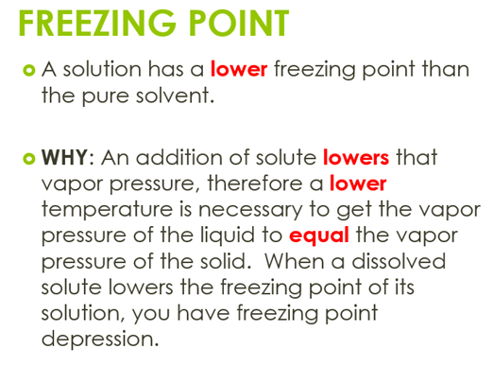
REVIEW FOR FINAL
Solutions
Describe the three colligative properties of solutions (vapor pressure reduction, freezing point depression, and boiling point elevation).

Slide 38
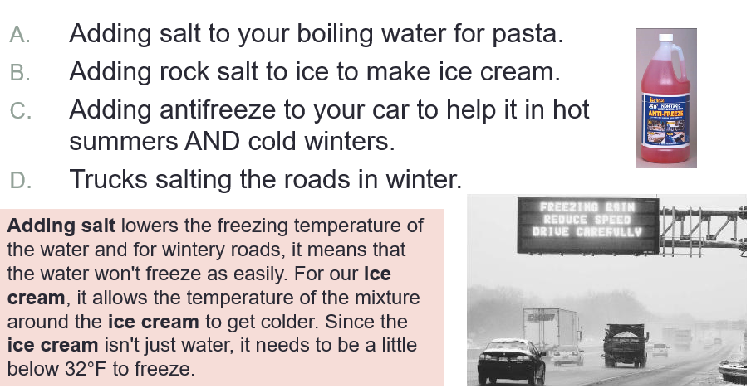
REVIEW FOR FINAL
Solutions
Relate the colligative properties to everyday situations.

Slide 39
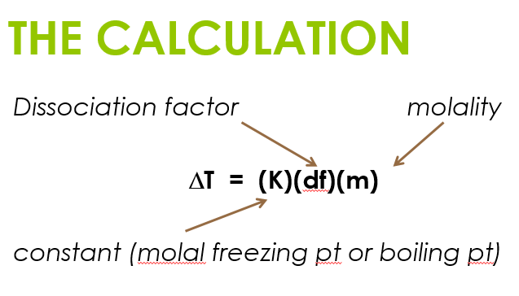
REVIEW FOR FINAL
Solutions
Calculate the freezing point and boiling point using changes in temperature and molality.
The dissociation factor, df, is how many particles the solute breaks up into.
For a non-ionic compound (nonelectrolyte, organic compound), the df = 1.
For an ionic compound, the df is equal to the number of ions it forms (not the number of atoms).

Slide 40
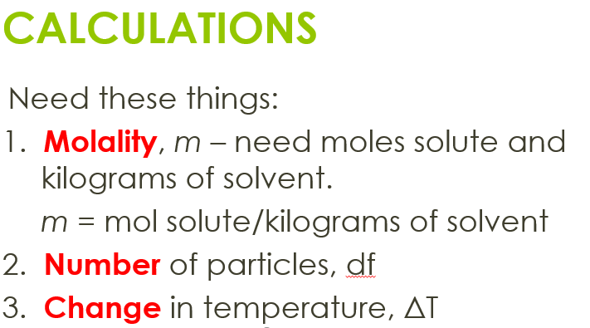
REVIEW FOR FINAL
Solutions
Calculate the freezing point and boiling point using changes in temperature and molality.

Slide 41
REVIEW FOR FINAL
Solutions
Calculate the freezing point and boiling point using changes in temperature and molality.
Calculate the freezing point and the boiling point of a solution that contains 15.0 grams of urea (CH₄N₂O) in 250. grams of water. Urea is a covalently bounded compound with a molar mass of 60.06g/mol.

Slide 42
TO DO
Work on Final Review.

