Slide 1
FINAL EXAM REVIEW
Geologic History and Stratigraphy

Slide 2
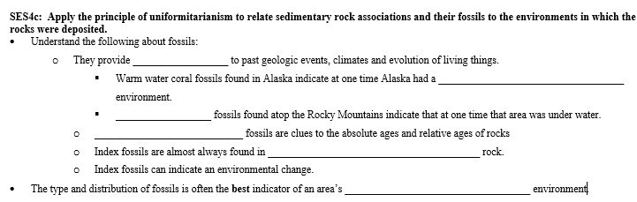
CHECK YOUR ANSWERS
clues
tropical marine
Fish
Index
sedimentary
ancient

Slide 3
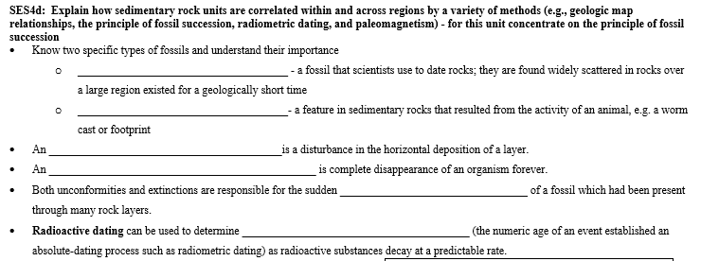
CHECK YOUR ANSWERS
Index Fossil
Trace Fossil
unconformity
extinction
absence
absolute age

Slide 4
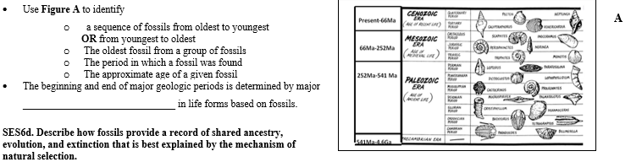
CHECK YOUR ANSWERS
changes

Slide 5
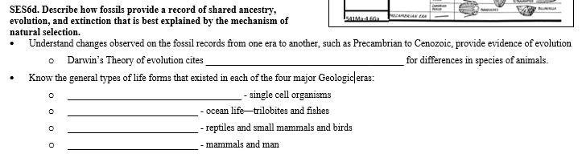
CHECK YOUR ANSWERS
natural selection
Precambrian
Paleozoic
Mesozoic
Cenozoic

Slide 6
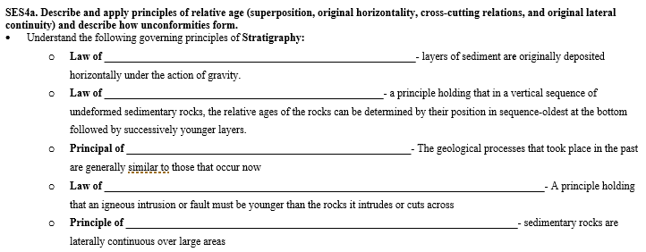
CHECK YOUR ANSWERS
Original Horizontality
Superposition
Uniformitarianism
Cross Cutting Relationships
Lateral Continuity

Slide 7
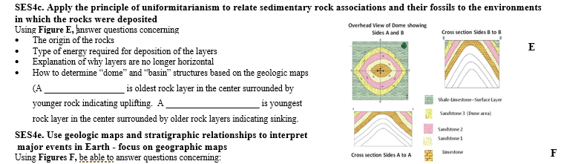
CHECK YOUR ANSWERS
dome
basin

Slide 8
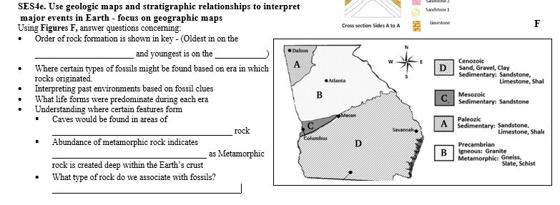
CHECK YOUR ANSWERS
bottom
top
sedimentary
uplifting
sedimentary

