Slide 1
FINAL EXAM REVIEW
WEATHER AND CLIMATE

Slide 2
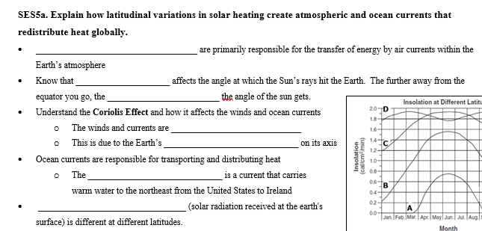
CHECK YOUR ANSWERS
Convection currents
clues
latitude
smaller
Fish
deflected
Index
rotation
Gulf Stream
Insolation

Slide 3
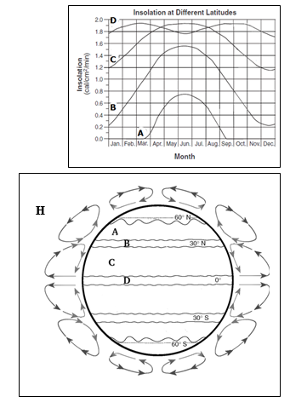
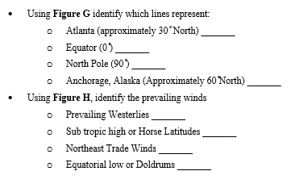
CHECK YOUR ANSWERS
C
D
A
B
A
B
C
D

Slide 4
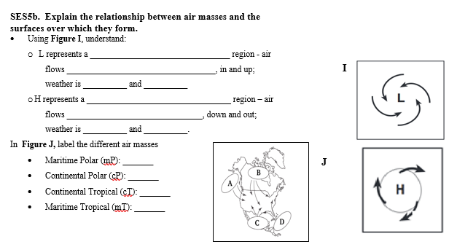
CHECK YOUR ANSWERS
Low pressure
counterclockwise
warm
wet
High pressure
clockwise
cool
dry
A
B
C
D

Slide 5
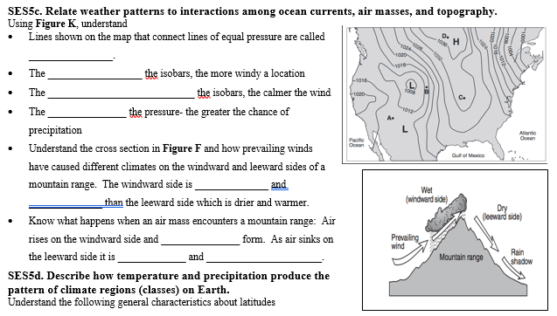
CHECK YOUR ANSWERS
isobars
closer
farther apart
lower
wetter
cooler
clouds
drier
warmer

Slide 6
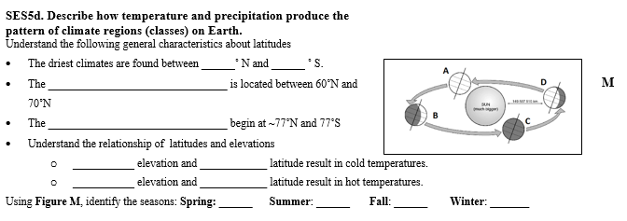
CHECK YOUR ANSWERS
30
30
Superposition
Superposition
High
high
Low
low
A
B
C
D

Slide 7
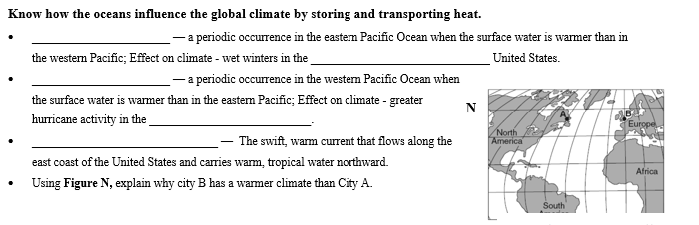
CHECK YOUR ANSWERS
El Nino
southeastern
La Nina
Atlantic
Gulf stream

Slide 8
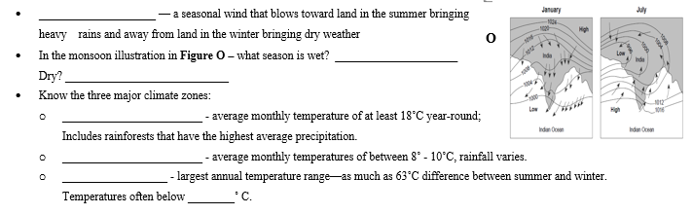
CHECK YOUR ANSWERS
Monsoon
July
January
Tropical
Temperate
Polar
0

