Slide 1
MIDTERM REVIEW
IN FOUR PARTS

Slide 2
MEASUREMENT
MEASUREMENT: Classify matter using appropriate measurement units and calculations
metric conversions (no factor-label method)
significant digits
scientific notation (converting to/from scientific notation)
rounding numbers

Slide 3
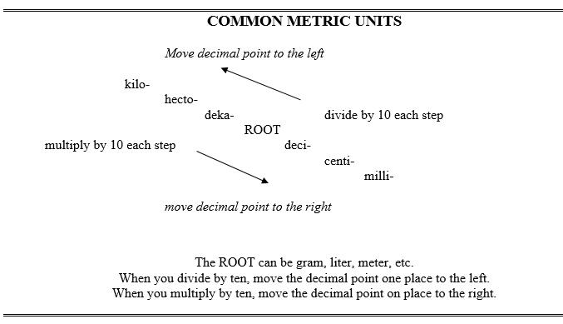
MEASUREMENT

Slide 4
MEASUREMENT
Try these conversions using the stair step method:
104 km = ___________________ m
2000 mg = ___________________ g
480 cm = ___________________ m
5.6 kg = ___________________ g

Slide 5
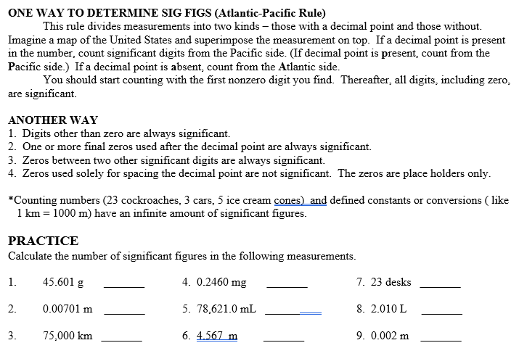
MEASUREMENT
SIGNIFICANT FIGURES

Slide 6
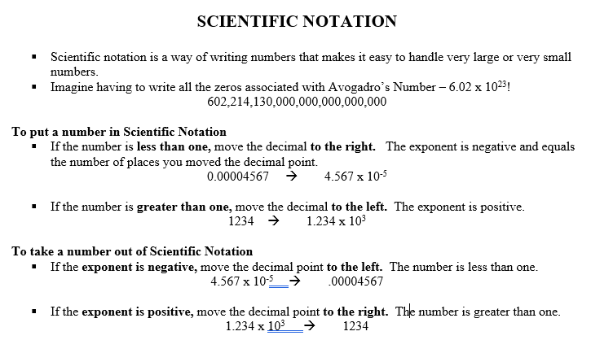
MEASUREMENT

Slide 7
MEASUREMENT
Convert the following numbers into standard notation or scientific notation.
44,500 ______________________
0.000643 ______________________
5.78 x 10⁴ ______________________
5.18 x 10⁻² ______________________

Slide 8
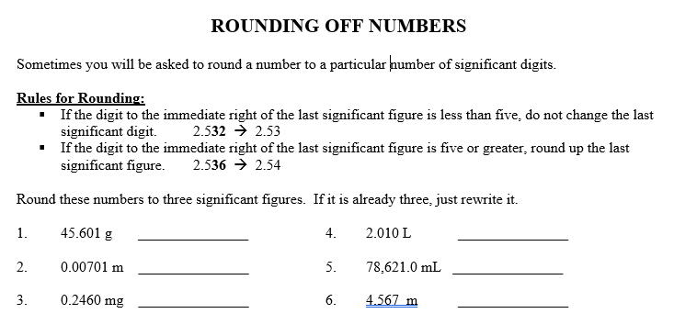
MEASUREMENT

Slide 9
MATTER
MATTER: Classify matter using physical and chemical characteristics.
describe physical and chemical changes of matter and give examples
calculate density
determine if something is a mixture, compound, element, or solution

Slide 10
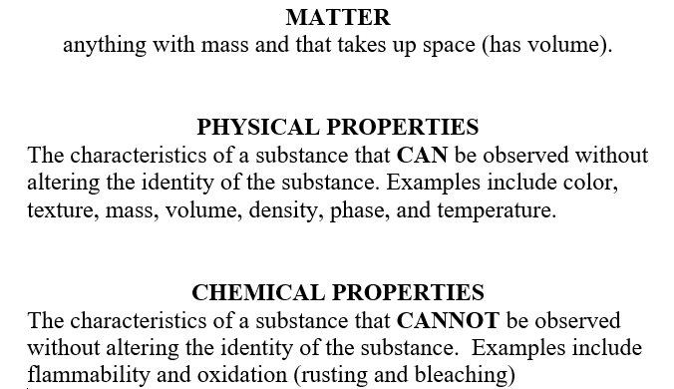
MATTER

Slide 11
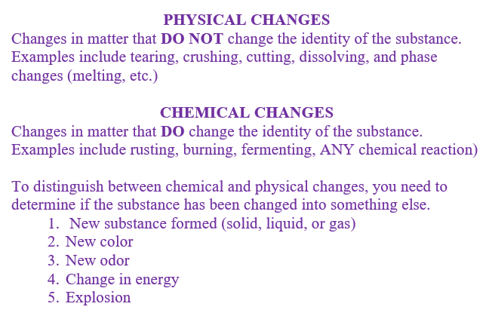
MATTER

Slide 12
MATTER
Calculating Density
If a liquid has a mass of 352g and a volume of 0.546L, what is the density of the liquid? Show the formula, set up the problem and units, and make sure the answer has the correct number of significant digits.

Slide 13
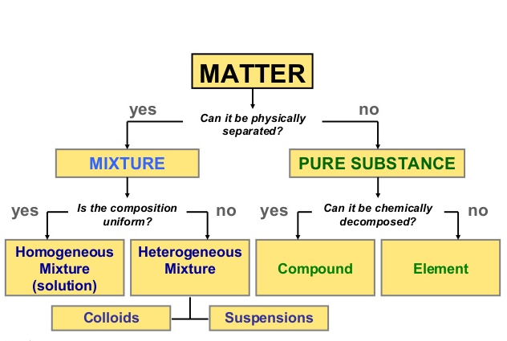
MATTER

Slide 14
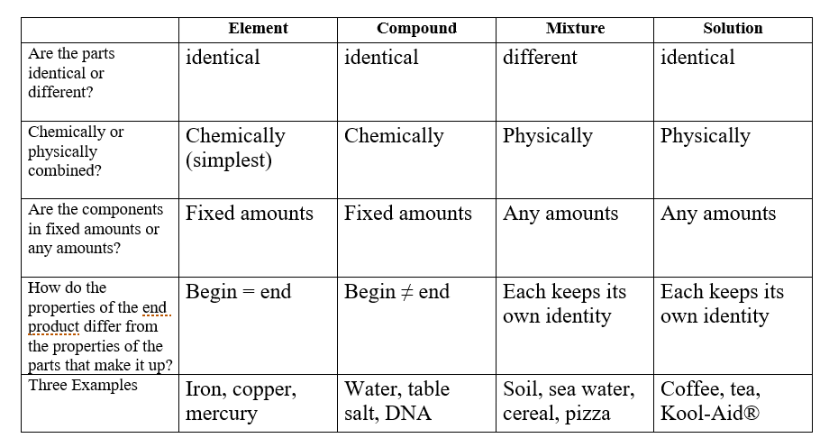
MATTER

