Slide 1
MIDTERM REVIEW
IN FOUR PARTS

Slide 2
THE ATOM
ATOM: Trace development of the modern atomic theory.
discuss the historical development of atomic theory
Know the parts of the atom, the atomic number, and the mass number of any given element.
calculate average atomic mass describe the quantum mechanical model of the atom
know the difference between and physical, chemical, and nuclear reaction
determine the electron configuration for an atom
determine the orbital diagram for an atom
determine the valence electrons for an atom
determine the electron dot diagram for an atom

Slide 3
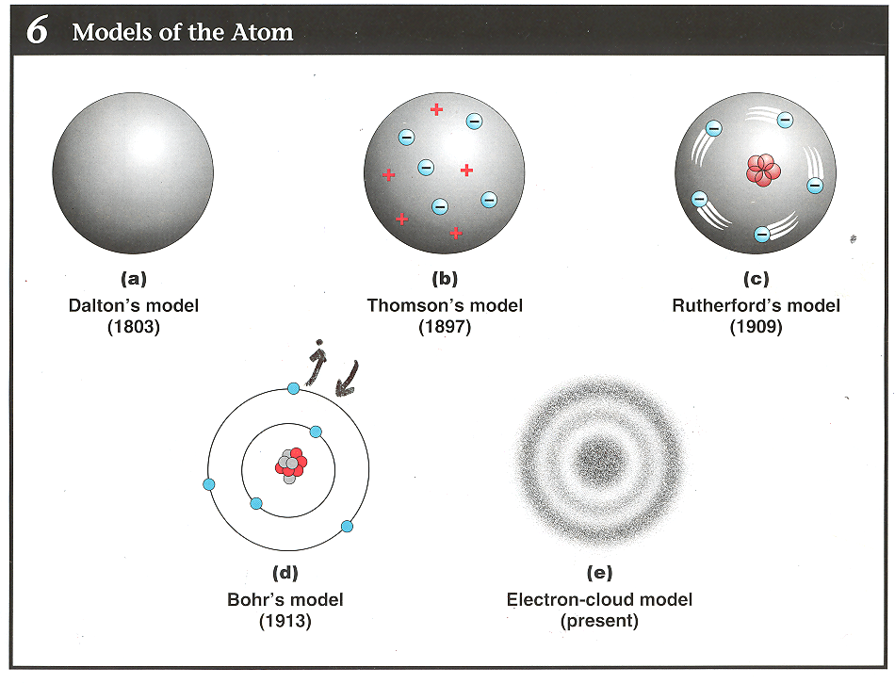
THE ATOM

Slide 4
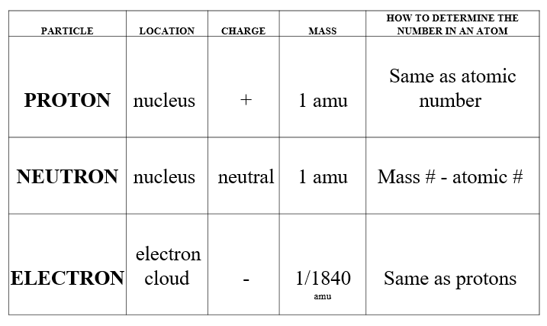
THE ATOM

Slide 5
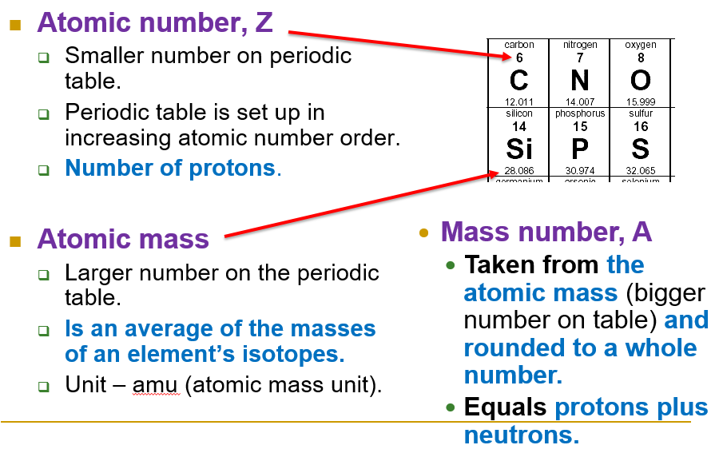
THE ATOM

Slide 6
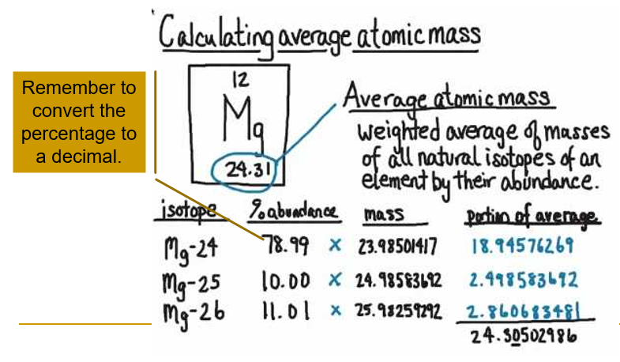
THE ATOM

Slide 7
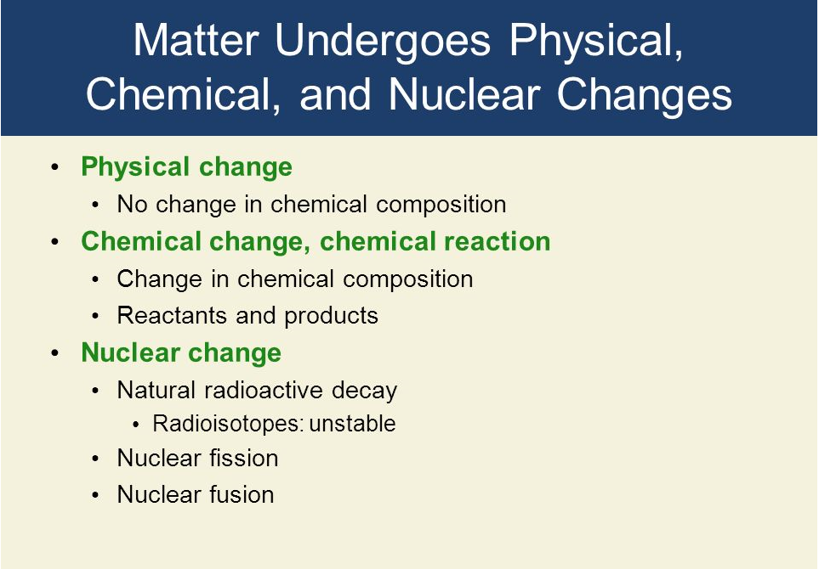
THE ATOM

Slide 8
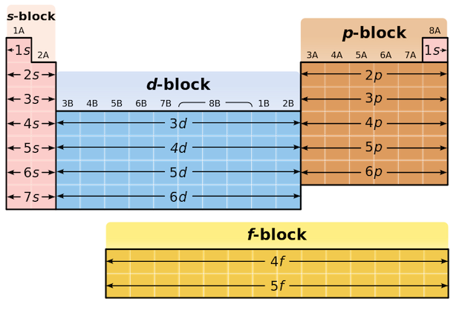
THE ATOM

Slide 9
PERIODICITY
PERIODICITY: use the organization of the Periodic Table to predict properties of elements.
know the time line for Mendeleev and Moseley with relation to the atomic theory timeline
define the periodic law
distinguish between metals, nonmetals, and metalloids
know the periodicity trends for ionization energy, atomic radii, ionic radii, electron affinity, and electronegativity.
Know basic general facts about the families
Given an element on the periodic table, be able to give information about its characteristics just by looking at the periodic table.

Slide 10
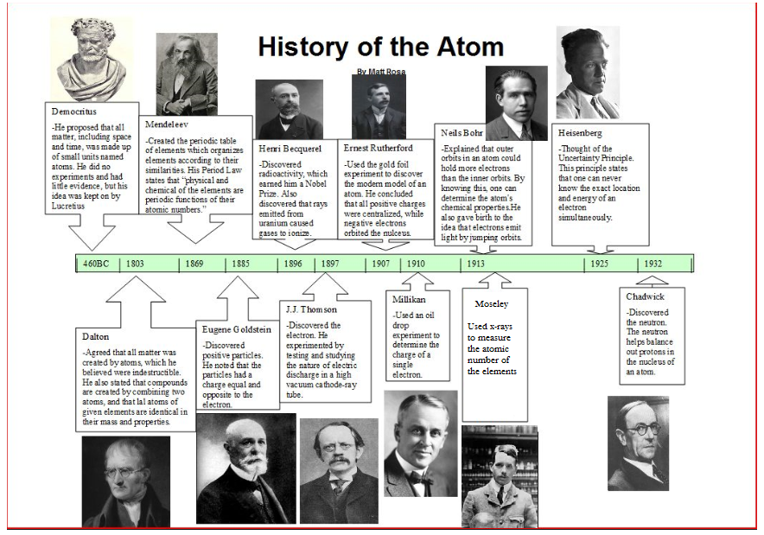
PERIODICITY

Slide 11
PERIODICITY
The physical and chemical properties of the elements are periodic functions of their atomic number.

Slide 12
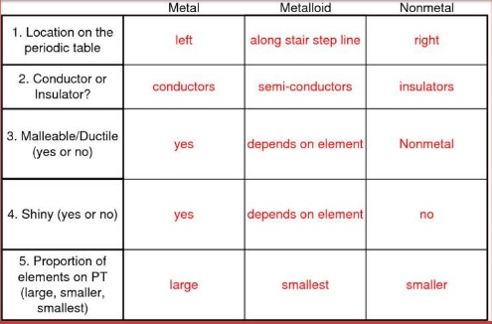
PERIODICITY

Slide 13
PERIODICITY
To your blank periodic table, do the following:
Using arrows and words - draw the trends for down a group and across a period for atomic radii, ionization energy, and electronegativity.
Indicate which set of elements experience low electron affinity.
Place a circle around the most electronegative element and a triangle around the most electropositive (least electronegative).
For the Halogen family, describe the following:
  Ionization energy (high or low)
  Electron affinity (high or low)
  Electronegativity (high or low)
  Which is larger, the atomic radius or the ionic radius for these atoms?

Slide 14


Slide 15
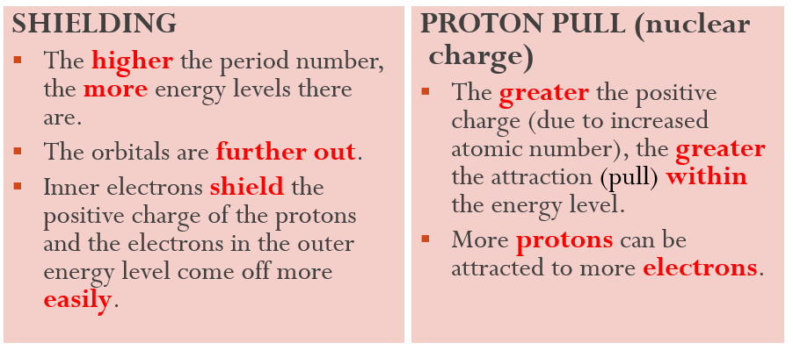
PERIODICITY

Slide 16
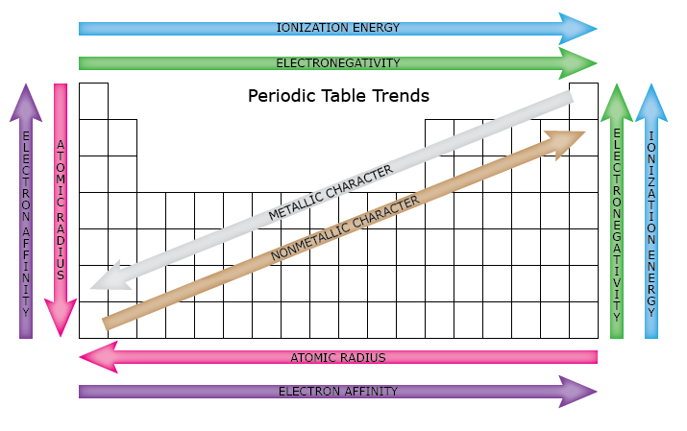
PERIODICITY

Slide 17
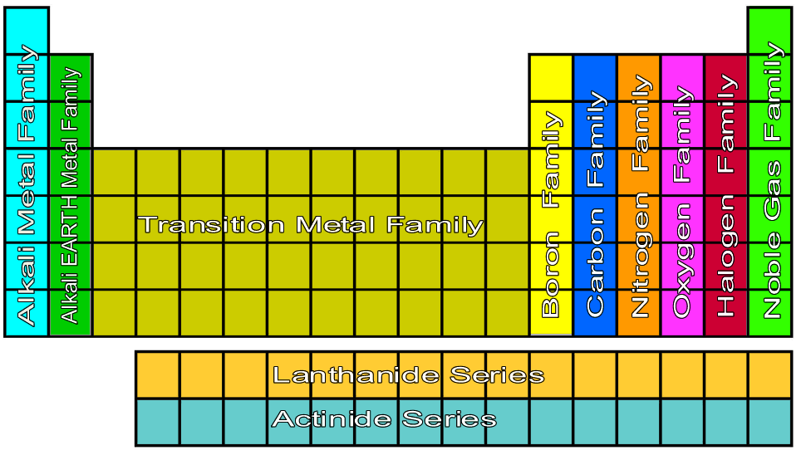
PERIODICITY

Slide 18
PERIODICITY
Periodic Trend | Alkali Metals | Alkaline Earth Metals | Halogens | Noble Gases
Ending electron configuration | s¹ | s² | s²p⁵ | s²p⁶
Ionization Energy | LOW | LOW | HIGH | HIGH
Electron Affinity | LOW | LOW | HIGH | LOW
Electronegativity | LOW | LOW | HIGH | LOW

Slide 19
PERIODICITY
Given an element on the periodic table, be able to give information about its characteristics just by looking at the periodic table. Do this for BROMINE.
Symbol |  | Family
Atomic Number |  | Block of the periodic table
Mass Number |  | Valence Electrons
Atomic Mass |  | Ion formed
Number of Protons |  | Electron Dot Diagram
Number of Electrons |  | Electron Configuration
Number of Neutrons |  | Metal, Nonmetal, or metalloid
Group |  | Ionic Radii compared to atomic radii
Period

Slide 20
PERIODICITY
For BROMINE, determine the following information on it using only the periodic table:
For the Periodic Trends, compare to the element POTASSIUM. Circle the correct choice.
Atomic radii BIGGER SMALLER
Ionization energy HIGHER LOWER
Electron affinity HIGHER LOWER
Electronegativity HIGHER LOWER

