Slide 1
MIDTERM REVIEW
IN FOUR PARTS

Slide 2
BONDING
BONDING: compare and contract types of chemical bonds
Discuss the various types of bonding (ionic, covalent, metallic)
Predict and define various types of bonding between elements using the understanding of bonding and periodic properties.
Predict various types of chemical bonds that form between the elements using the VSEPR theory (geometric shapes – linear, trigonal planar, tetrahedral, pyramidal, and bent).

Slide 3
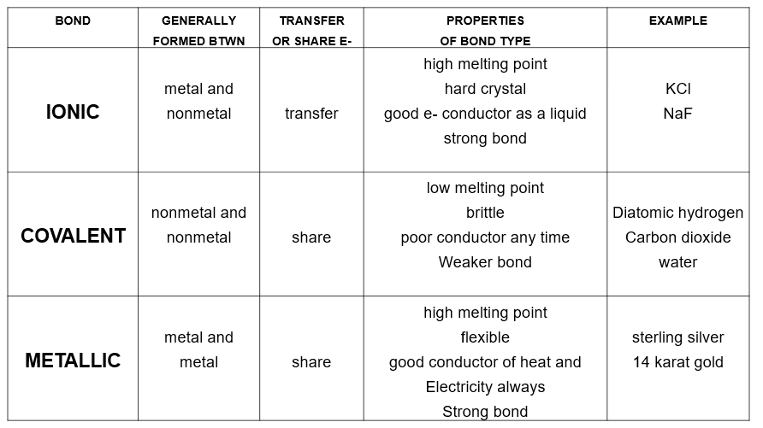
BONDING

Slide 4
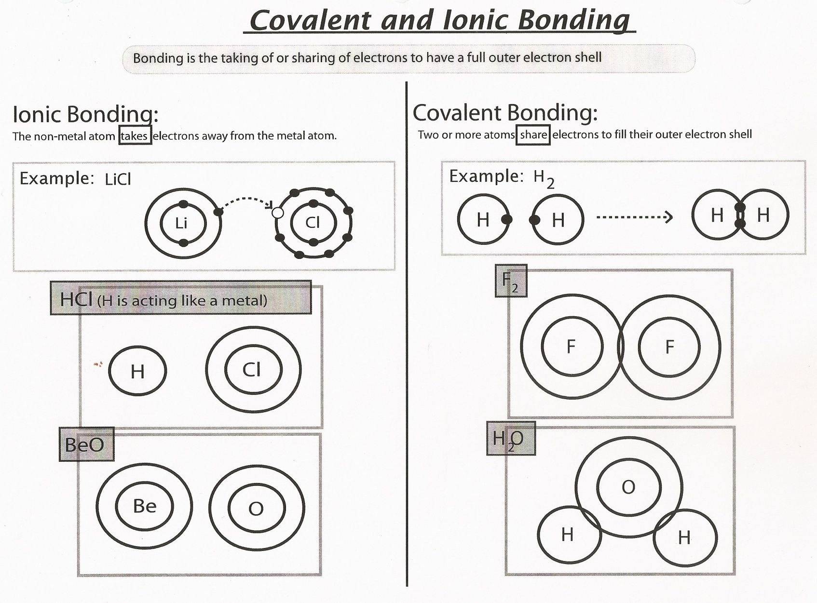
BONDING
REMEMBER:
The goal of an atom is to get an electron configuration like a Noble Gas.

Slide 5
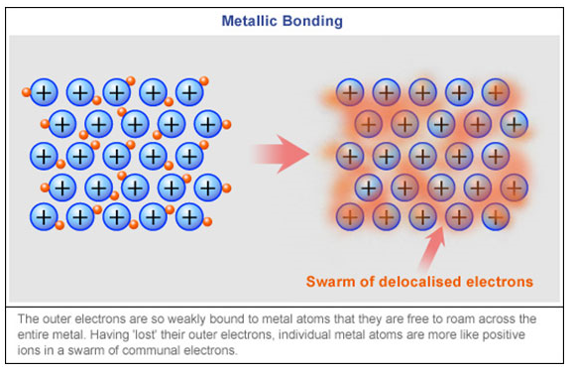
BONDING

Slide 6
BONDING
Determine if the bond is ionic or covalent using just the positions of the elements on the PERIODIC TABLE.
metal + nonmetal = ionic
nonmetal + nonmetal = covalent
metal + metal = metallic

Slide 7
BONDING
Predict the type of bond formed (ionic, polar covalent, nonpolar covalent) using ELECTRONEGATIVITY VALUES.
<0.5 nonpolar covalent
0.5 to 1.67 polar covalent
> 1.67 ionic

Slide 8
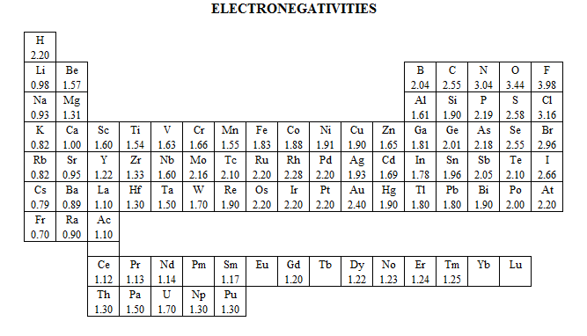
BONDING

Slide 9
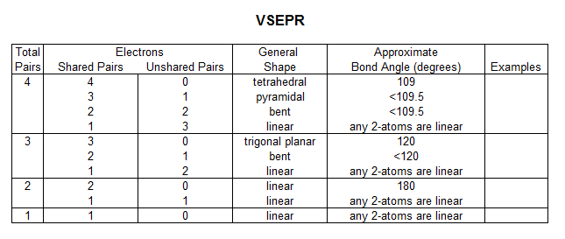
BONDING
Linear, Trigonal Planar, Tetrahedral, Pyramidal, Bent

Slide 10
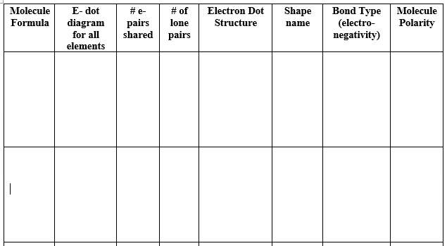
BONDING
CH₄
OF₂

Slide 11
NOMENCLATURE
CHEMICAL NOMENCLATURE: Predict formulas for stable ionic compounds based on balance of charges and use IUPAC nomenclature for both chemical names and formulas for ionic, covalent, and acid compounds.
Write the chemical formula of any ionic compound, molecular compound, or acid compound given its name.
Write the chemical name for any ionic compound, molecular compound, or acid compound given its chemical formula.

Slide 12
NOMENCLATURE - IONIC
NAME: To write the name, name the cation and then the anion. If it is a variable charge cation, place a Roman numeral after the metal name.
Na₂O
Al₂(SO₄)₃
Fe(NO₂)₃

Slide 13
INOMENCLATURE - IONIC
FORMULA: To write the formula, write the cation and then the anion. Use the crisscross method to determine the number of ions. Reduce if necessary.
Copper(I) oxalate
Potassium permanganate
Barium chloride

Slide 14
NOMENCLATURE - COVALENT
NAME: To name a covalent compound write the element names and the prefixes. The second element ends in –ide.
PCl₃
N₂O
SF₆

Slide 15
NOMENCLATURE - COVALENT
FORMULA: To write a covalent formula, just write out the element symbols with the correct number from the prefixes.
Diphosphorus pentoxide
Carbon dioxide
Tetraphosphorus decoxide

Slide 16
NOMENCLATURE - COVALENT
One – mono
Two – di
Three – tri
Four – tetra
Five – penta
Six – hexa
Seven – hepta
Eight – octa
Nine – nona
Ten - deca

Slide 17
NOMENCLATURE - ACIDS
NAME: Be sure to look at the ending of the anion to determine what kind of acid: -ic, -ous, hydro- -ic
HClO₂
HC₂H₃O₂
HF
Ion ends in –ite, acid ends in –ous.
Ion ends in –ate, acid ends in –ic.
Ion ends in –ide, acid starts with hydro- and ends in -ic

Slide 18
NOMENCLATURE - ACIDS
FORMULA: Be sure to look at the acid ending to determine the anion that goes in the formula.
Perchloric acid
Hydrocyanic acid
Chlorous acid
Acid ends in –ous; ion ends in –ite
Acid ends in –ic; ion ends in –ate
Acid starts with hydro- and ends in –ic; ion ends in –ide,

Slide 19
NOMENCLATURE - NAMES
The first thing you do is determine if the first element hydrogen and not H₂O or H₂O₂

Slide 20
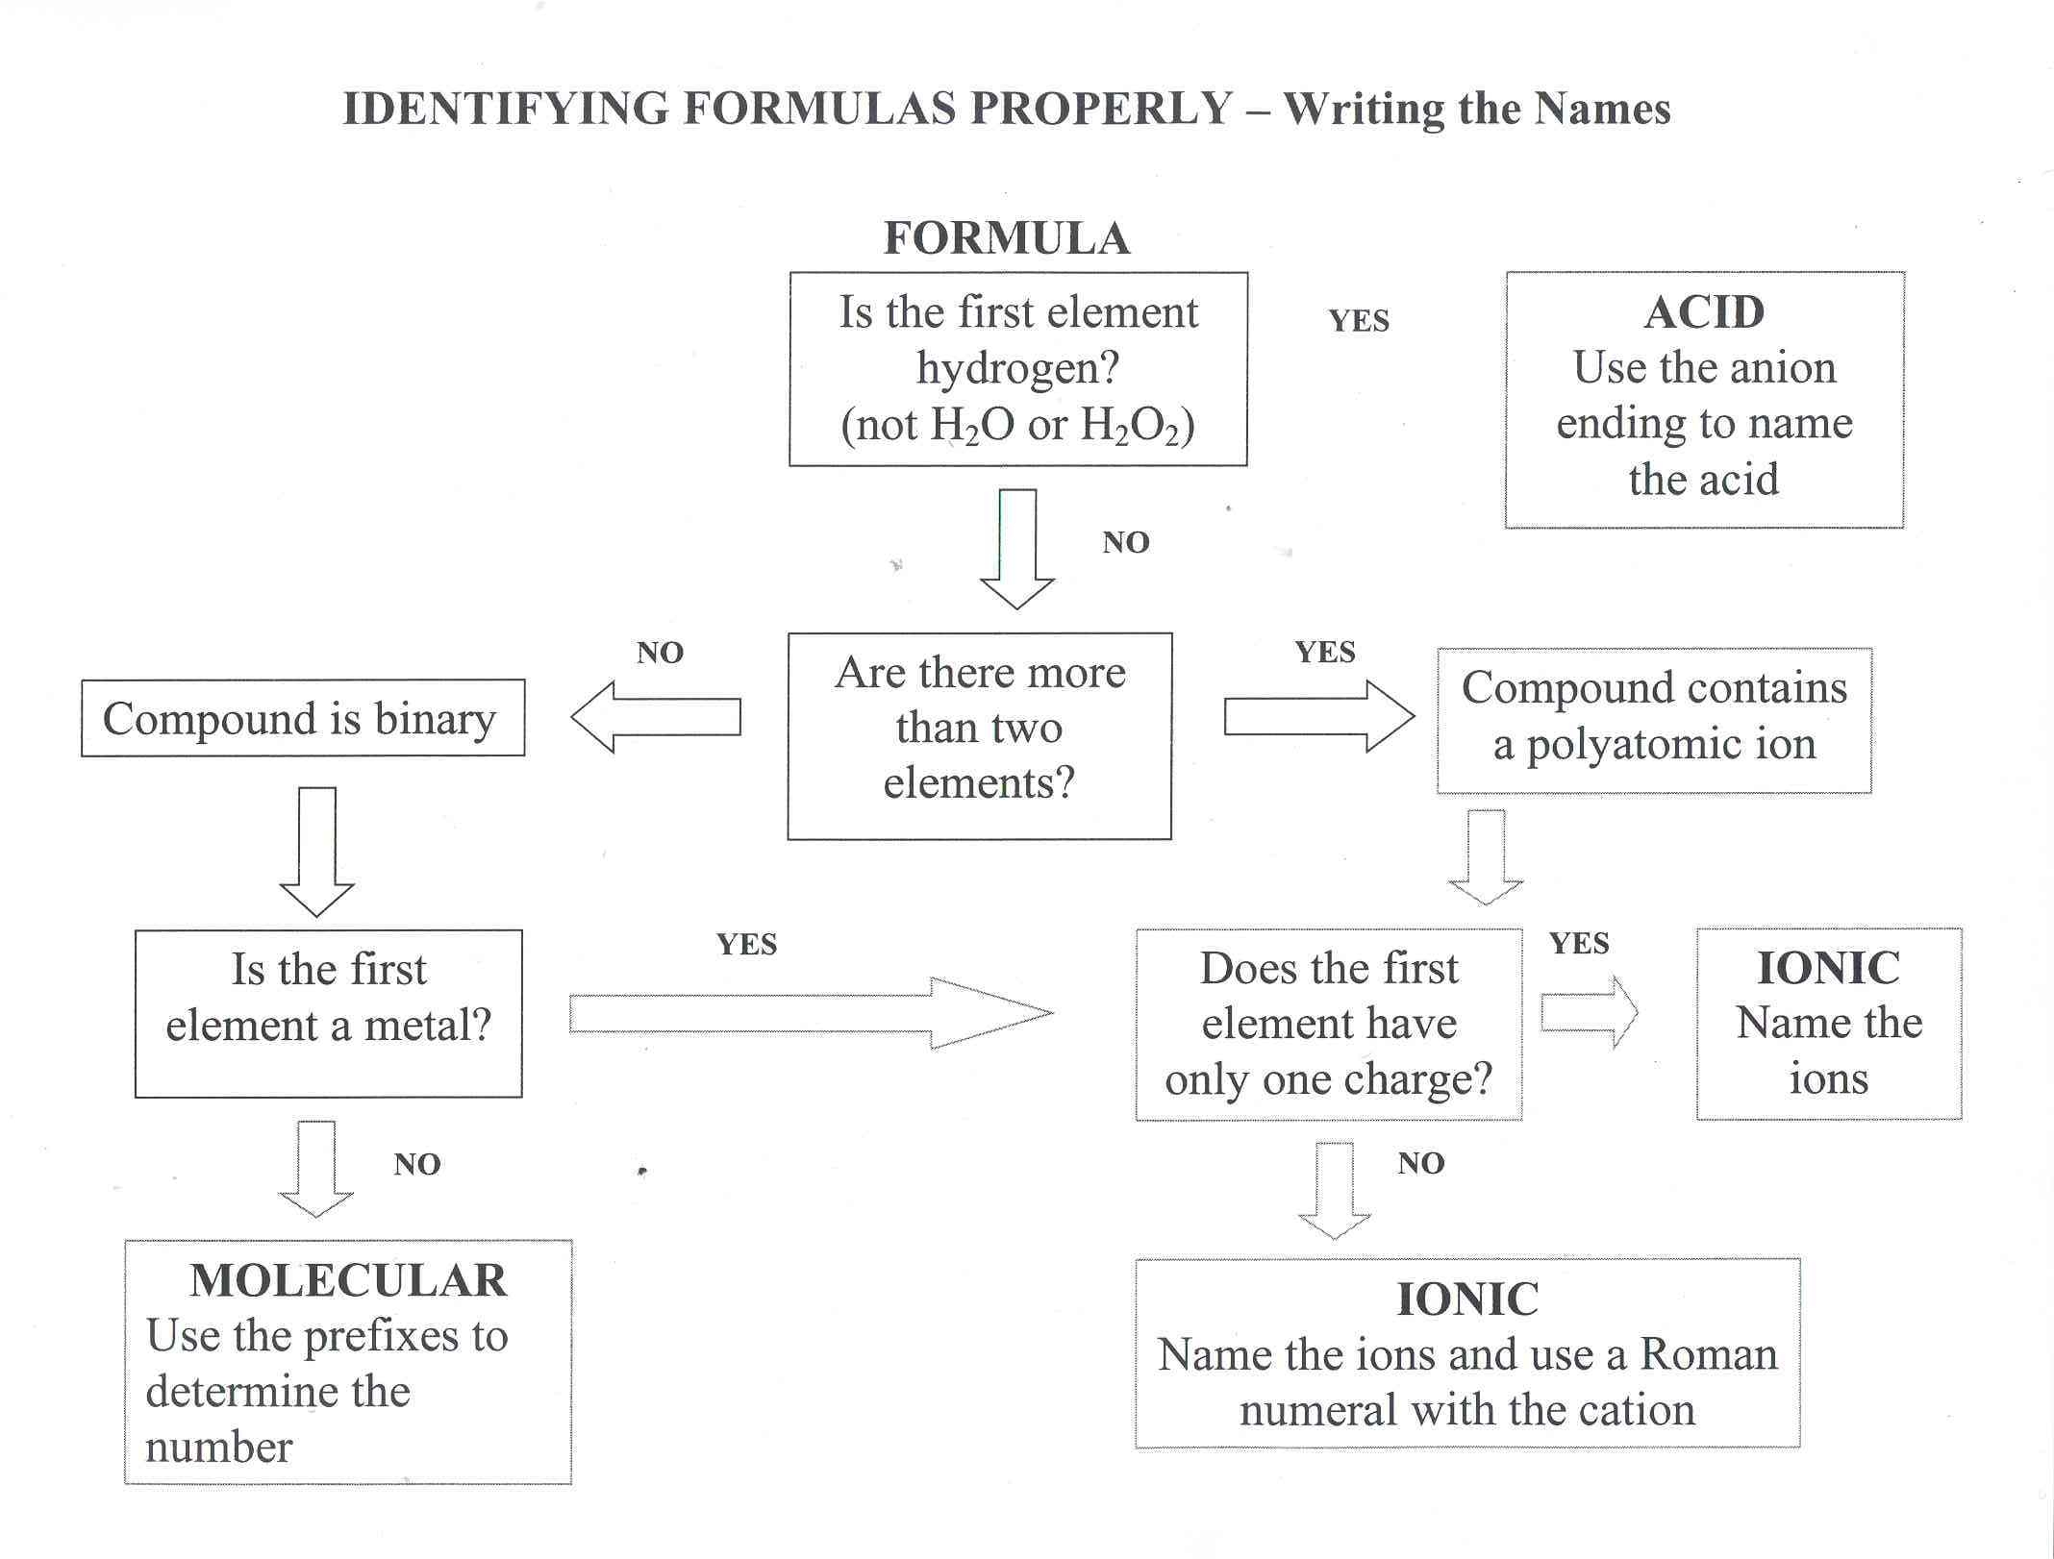

Slide 21
NOMENCLATURE - FORMULAS
Does the name end in acid? Is there a metal (or NH₄⁺) involved?

Slide 22
