Slide 1
MIDTERM REVIEW
PART TWO

Slide 2
UNIT TWO OBJECTIVES
SES1e: Rock Cycle (Identify the transformations and major reservoirs that make up the rock cycle)
SES2. Students will understand how plate tectonics creates certain geologic features, materials, and hazards. SES2. a. Plate tectonics: convergent, divergent, transform boundaries
SES2b. Relate modern and ancient geologic features to each kind of plate tectonic setting.
SES2. d. Tectonic settings with production of rocks and mineral resources

Slide 3
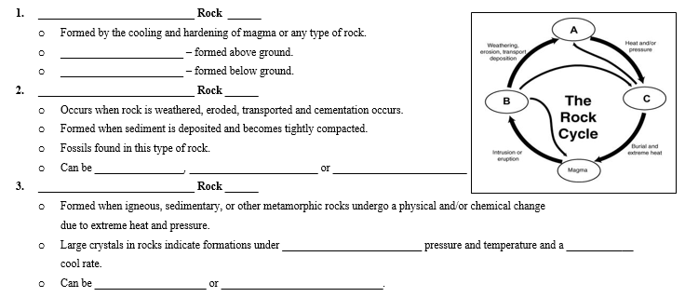
UNIT TWO REVIEW

Slide 4
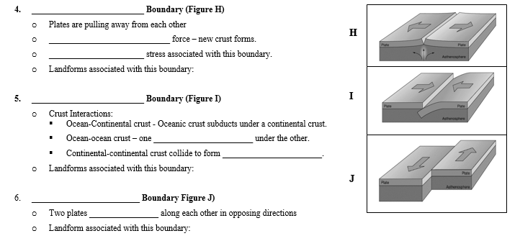
UNIT TWO REVIEW

Slide 5
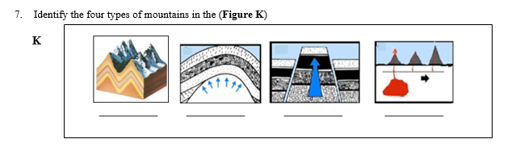
UNIT TWO REVIEW

Slide 6
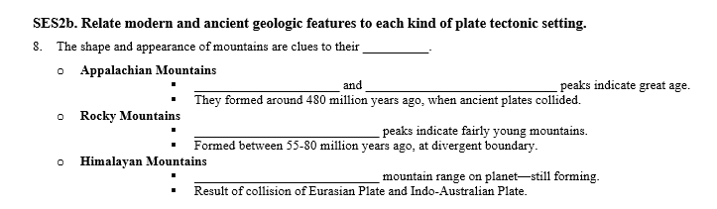
UNIT TWO REVIEW

Slide 7
UNIT THREE OBJECTIVES
SES2. Students will understand how plate tectonics creates certain geologic features, materials, and hazards. c. Relate certain geologic hazards to specific plate tectonic settings (earthquakes).

Slide 8
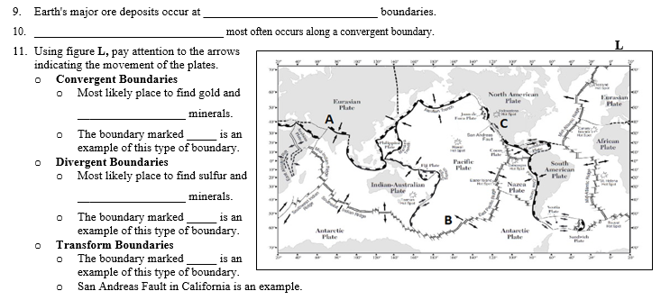
UNIT THREE REVIEW

Slide 9
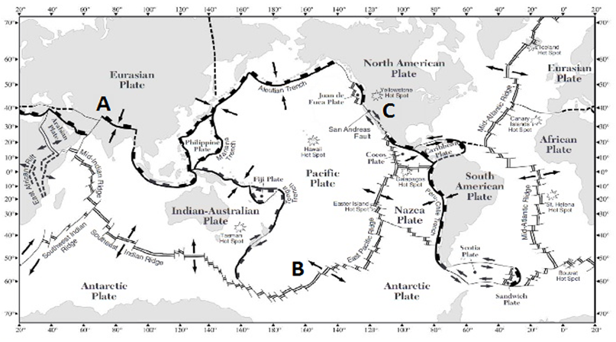
UNIT THREE REVIEW

Slide 10
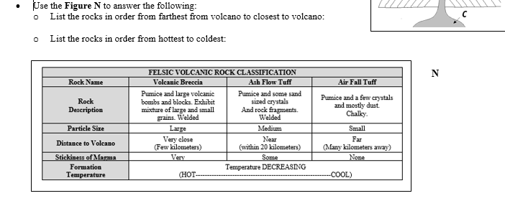
UNIT THREE REVIEW

