Slide 1
MIDTERM REVIEW
PART THREE

Slide 2
UNIT THREE OBJECTIVES
SES2. Students will understand how plate tectonics creates certain geologic features, materials, and hazards. c. Relate certain geologic hazards to specific plate tectonic settings. (earthquakes).

Slide 3
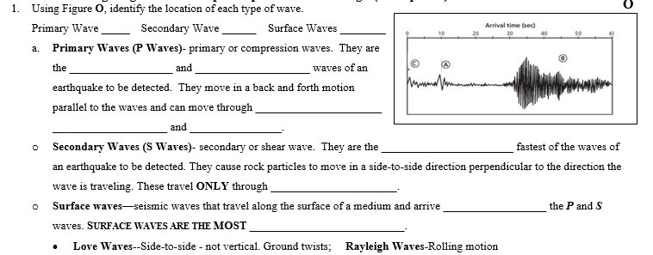
UNIT THREE REVIEW

Slide 4
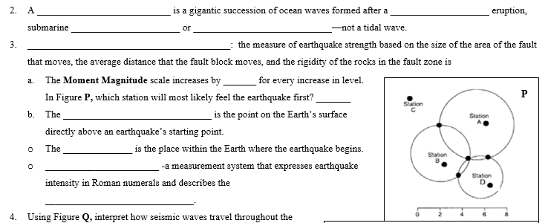
UNIT THREE REVIEW

Slide 5
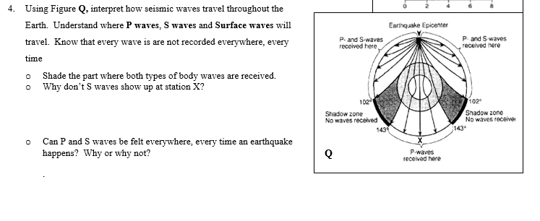
UNIT THREE REVIEW

Slide 6
UNIT FOUR OBJECTIVES
SES1e. Identify the transformations and major reservoirs that make up the rock cycle, hydrologic cycle, carbon cycle, and other important geochemical cycles.
SES3a. Describe how surface water and groundwater act as the major agents of physical and chemical weathering.
SES3b. Explain how soil results from weathering and biological processes acting on parent rock.
SES3d. Relate the past and present actions of ice, wind, and water to landform distribution and landscape evolution.

Slide 7
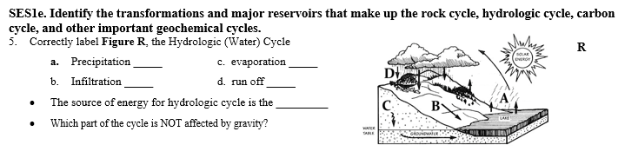
UNIT FOUR REVIEW

Slide 8
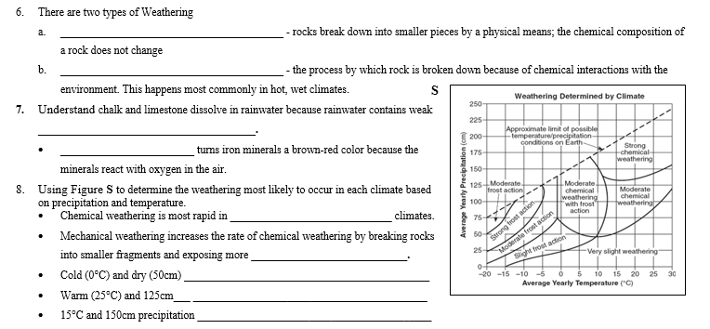
UNIT FOUR REVIEW

Slide 9
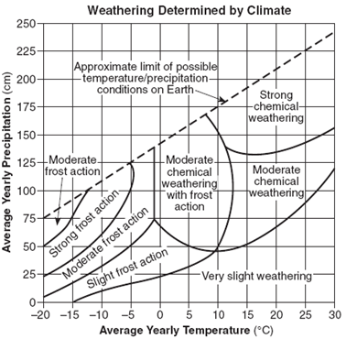
UNIT FOUR REVIEW

Slide 10
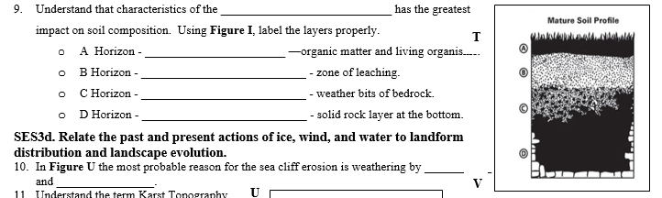
UNIT FOUR REVIEW

Slide 11
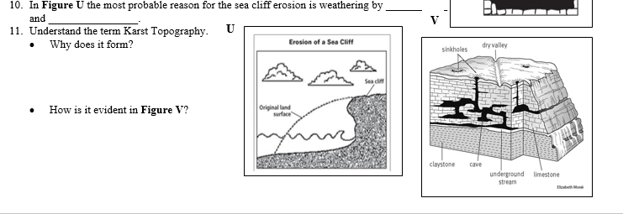
UNIT FOUR REVIEW

