Slide 1
MIDTERM REVIEW
PART FOUR

Slide 2
UNIT FIVE OBJECTIVES
SES3c. Describe the processes and hazards associated with both sudden and gradual mass wasting.
SES3d. Relate the past and present actions of ice, wind, and water to landform distribution and landscape evolution.

Slide 3
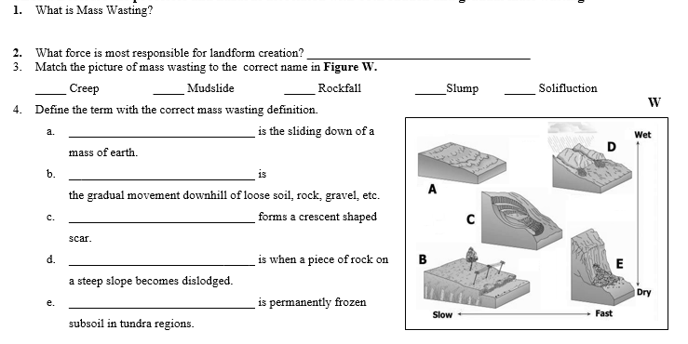
UNIT FIVE REVIEW

Slide 4
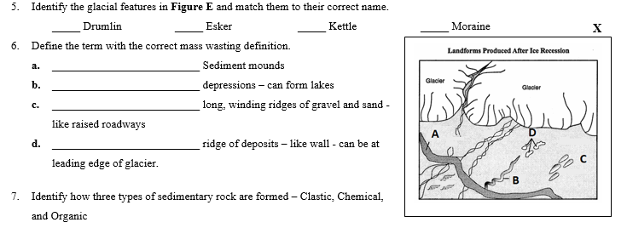
UNIT FIVE REVIEW

Slide 5
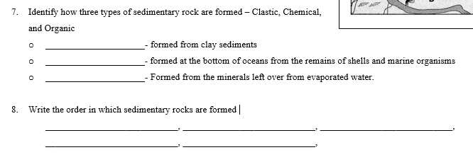
UNIT FIVE REVIEW

Slide 6
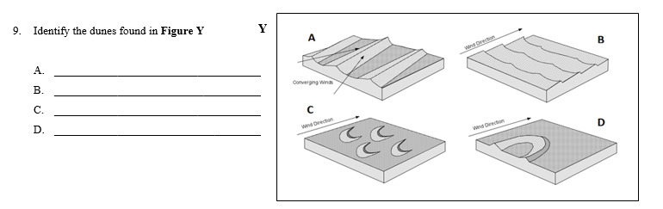
UNIT FIVE REVIEW

Slide 7
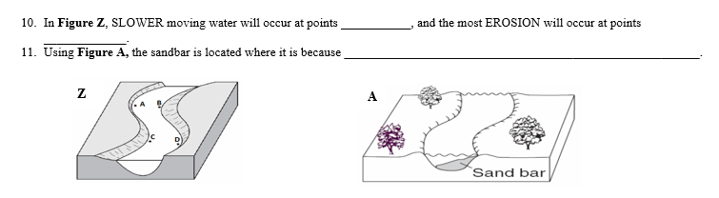
UNIT FIVE REVIEW

