Slide 1
ACIDS AND BASES
REVIEW

Slide 2
REVIEW
Identify acids and bases by their characteristics.
Acid and Base Properties (when dissolve in water):
ACIDS
Give off H⁺ ions
Taste sour
Change blue litmus to red
React with bases to neutralize their properties
React with active metals and carbonates to produce gases.
Conduct electricity.
BASES
Give off OH⁻ ions
Taste bitter
Feels slippery and smooth
Change red litmus to blue
React with acids to neutralize their properties.
Conduct electricity

Slide 3
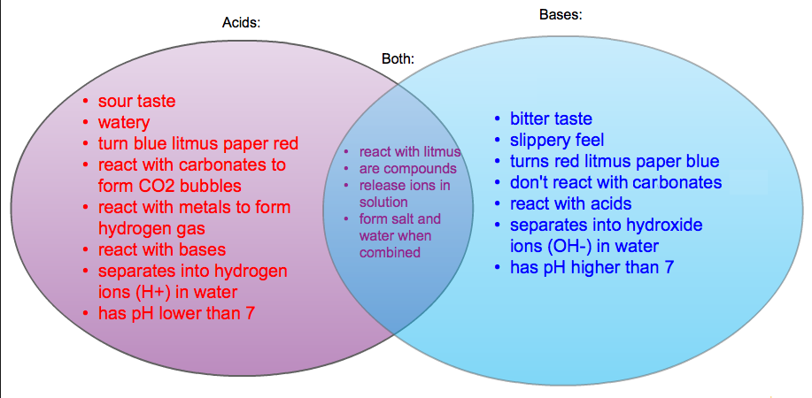
REVIEW
2. Compare and contrast acids and bases.

Slide 4
REVIEW
3. Define pH and be able to explain the structure of the pH scale.
Acids give off H⁺ (hydrogen) ion. That is what makes them an acid.
These can combine with water and form H₃O⁺ (hydronium) ion.
pH is a measure of the concentration of hydrogen/hydronium ions in a solution using a scale ranging from 0 to 14.

Slide 5
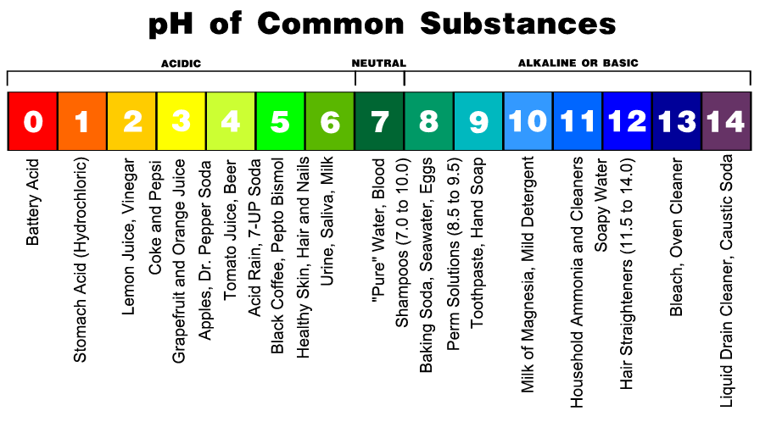
REVIEW
3. Define pH and be able to explain the structure of the pH scale.
0 is the most acidic.
14 is the most basic.

Slide 6
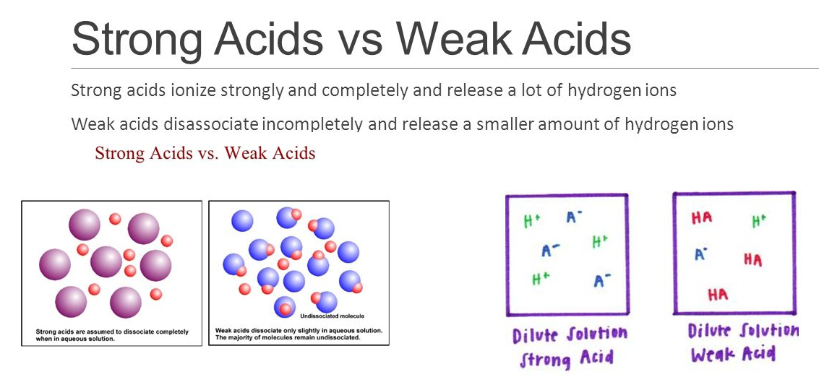
REVIEW
4. Differentiate between strong acids and bases and weak acids and bases.

Slide 7
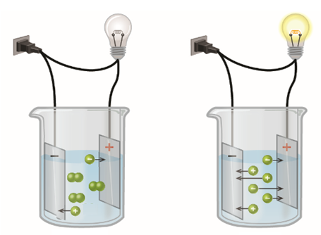
REVIEW
Know the relationship between strong acids/bases and electrolytes.
Weak Acid/Base Strong Acid/Base

Slide 8
REVIEW
Forms a salt and water – the salt is NOT always NaCl.
6. Identify a neutralization reaction.
NEUTRALIZATION REACTIONS
Acid-base reactions, or neutralization reactions, form water
and an ionic compound (salt).
HCl_{(aq)} + NaOH_{(aq)} → NaCl_{(aq)} + H₂O_{(l)}
acid base salt water
One way arrow because HCl is a strong acid

Slide 9
REVIEW
7. Know the purpose of a buffer.
A BUFFER is a solution containing ions that react with added acids or bases and minimize their effects on pH.
It resists a change in pH.

Slide 10
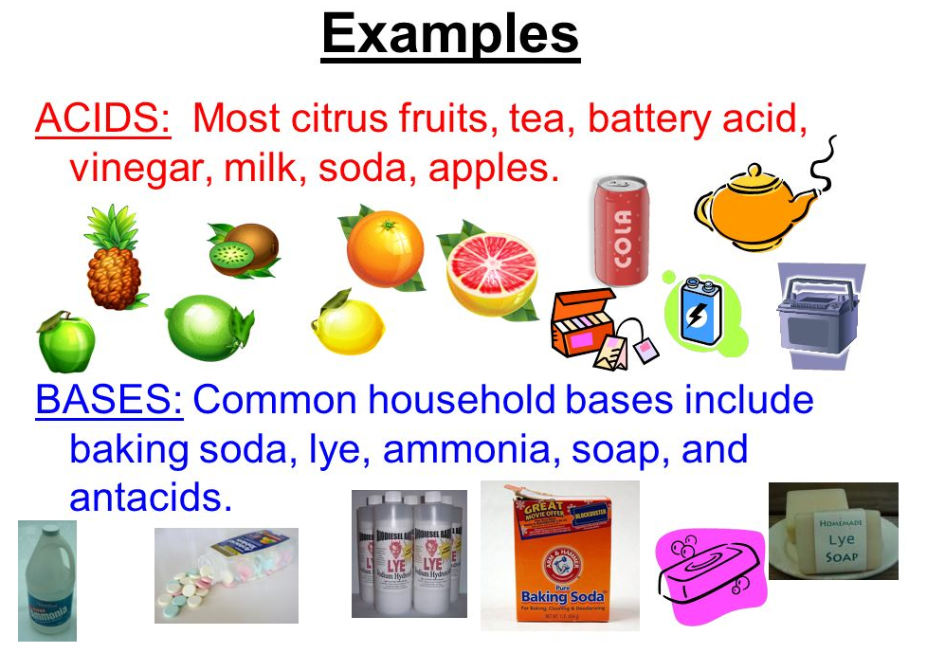
REVIEW
8. Identify some common household acids and bases.

Slide 11
REVIEW
8. Identify some common household acids and bases.
ACIDS we looked at/talked about this week:
HCl (stomach acid)
Lemon-Lime soda
Lemon juice
Vinegar
BASES we looked at/talked about this week:
Ammonia
Antacid tablet
Baking soda
Bleach
Drain cleaner

