Slide 1
MOTION AND SPEED
Kinematics

Slide 2
1
PHYSICS
“In science, there is only physics; all the rest is stamp collecting.”
-Ernest Rutherford

Slide 3

MOTION AND SPEED
Our study of physics begins with the concepts of mechanics: the study of motion.
We will first learn kinematics, or how we describe motion.
From there we will learn the causes of motion, or dynamics.
Kinematics is the branch concerned with the motions of objects without being concerned with the forces that cause the motion.
Dynamics is concerned with the forces that affect motion.

Slide 4
Describing
Motion

Slide 5
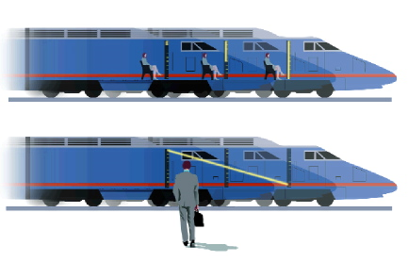
MOTION AND POSITION
Is person A moving?
Is person B moving?
  Relative to the train?
  Relative to the outside?
  Sitting at your desk, are you moving?
  Jump in a moving bus and you land in the same spot. Are you moving?
B
A

Slide 6
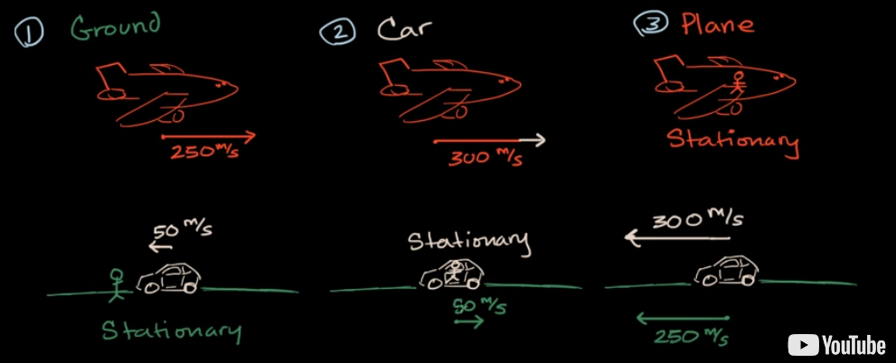
FRAME OF REFERENCE
The point of view from which you are measuring things.

Slide 7
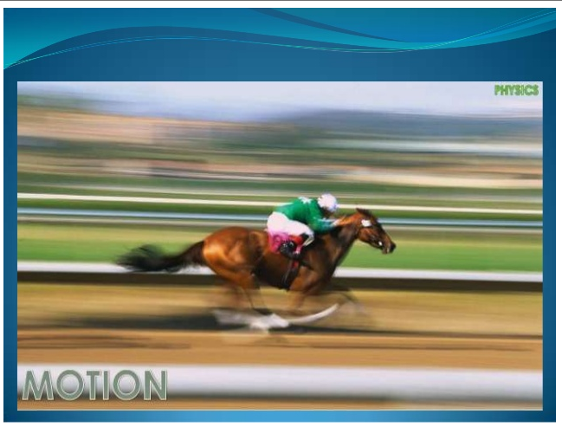
MOTION
  occurs when something changes position

Slide 8
MEASURING MOTION
Distance
  How far something has moved
  Measured in:
    meters, m or kilometers, km

Slide 9
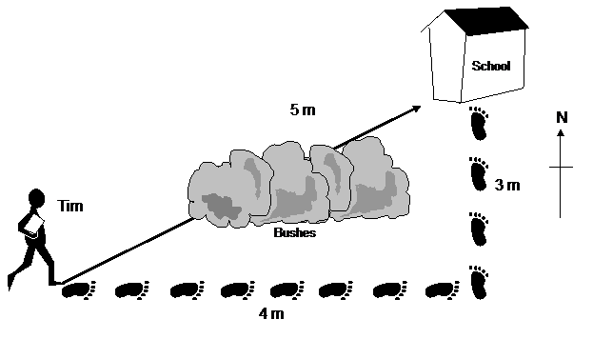
DISTANCE VS DISPLACEMENT
Distance is 3m + 4m = 7m.
Displacement is 5m.
Distance is how far an object has traveled.
Displacement is how far from the starting point an object actually moved.
Displacement does not equal distance traveled.

Slide 10
SPEED
SPEED is how fast something moves.
SPEED is the distance an object travels in a certain period of time.

Slide 11
CALCULATING SPEED
To calculate speed, you must know distance traveled and time.
FORMULA:
Distance
Speed
=
Time

Slide 12
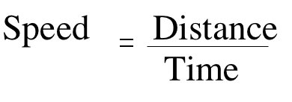

CALCULATING SPEED
30 km
Time= 30 min
What is his rate of speed?
Speed = distance/time
= 30km/30min = 1km/min

Slide 13
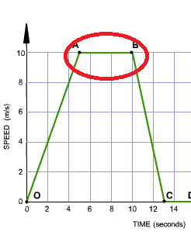
CONSTANT SPEED
When the speed of an object remains the same - it does not increase or decrease - we say it is moving at a constant speed.
The car is neither speeding up or slowing down from A to B.
This graph is speed versus time.

Slide 14
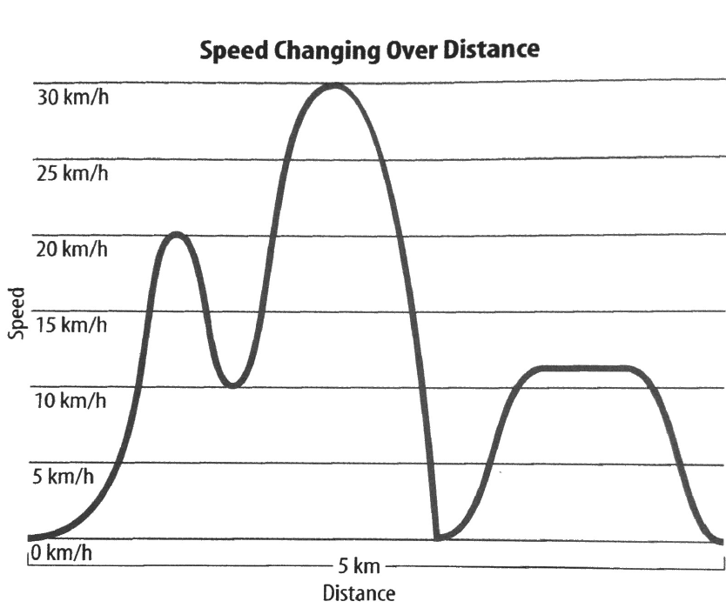
CHANGING SPEED
Often, your speed is not constant.
How do we describe this speed?
  Average speed over the entire motion
  Instantaneous speed at a given time
The cyclist is undergoing speed changes.

Slide 15
AVERAGE SPEED
Average speed describes speed of motion when speed is changing.
For the bicyclist, if it took him 15 minutes or 0.25hr to travel 5 km. What was his speed?

Slide 16
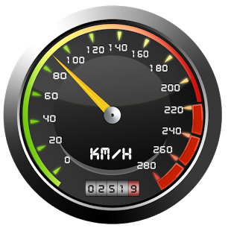
INSTANTANEOUS SPEED
This is the speed at any given instant.

Slide 17
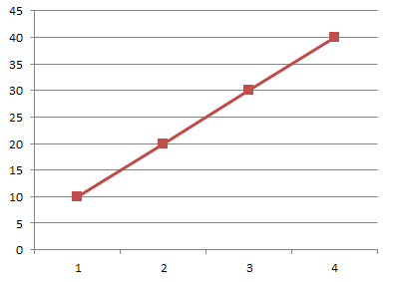


GRAPHING SPEED
X axis (horizontal axis): time
Y axis (vertical axis): speed or distance
Should always start at zero for both axes.
The steeper the line, the faster the speed.
This is constant speed. How can you tell?

Slide 18
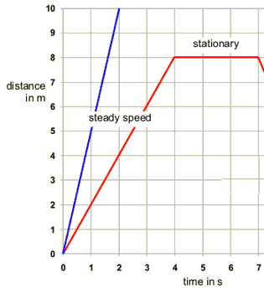
GRAPHING SPEED
The left (blue) line represents a constant speed of 10m in 2 seconds.
The right (red) line represents a constant speed of 8m in 4 seconds and then stopping for 3 seconds.

Slide 19
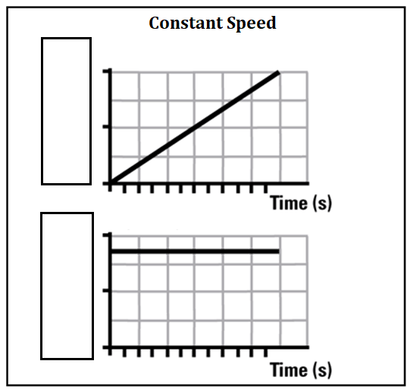


TWO GRAPHS
Constant speed can be depicted one of two ways in a graph:
1. Distance versus time. This graph shows a diagonal line.
2. Speed versus time. This graph shows a straight line.
Both show CONSTANT SPEED.

Slide 20
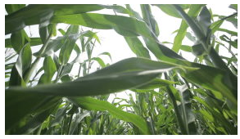
IMAGINE
You are standing in the middle of a field and you are told that if you walk 100 steps in one minute you will be out of the field.
What is wrong with these directions?

Slide 21
VELOCITY
Hurricanes, pilots, and boat captains need this.
In order to completely describe the motion of an object, we need to include not only the speed of the object, but also the direction.

Slide 22
The moon man moved 40 km.
Does that tell you where he is?
No, you need to know the direction.

Slide 23
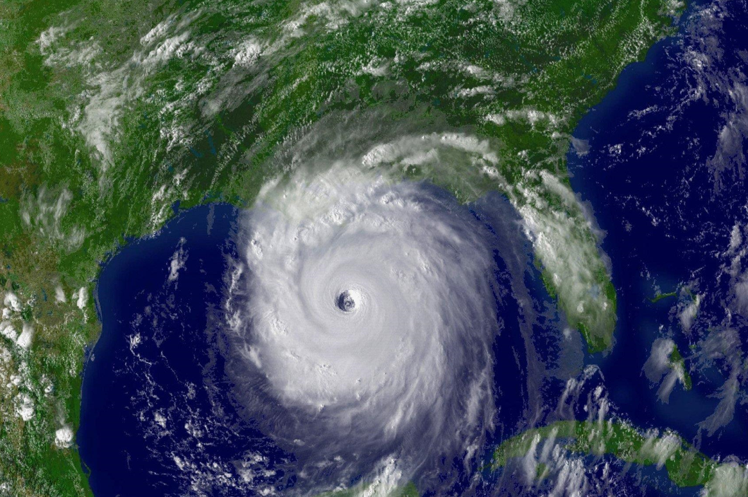
VELOCITY
When describing velocity, you need to state the direction.
For example, the hurricane is heading 40 km/hr northwest.

Slide 24
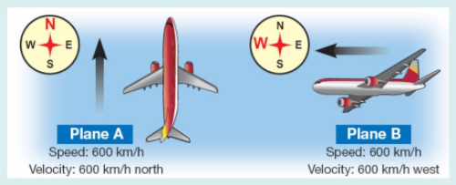
VELOCITY
Velocity is a vector quantity. It shows magnitude and direction.
The direction for velocity is shown with an arrow or vector.

Slide 25
WORD PROBLEMS
When you work motion problems, you need to do the following:
1. Write what you know and where you are going.
2. Write the formula.
3. Plug in the data given and solve.
4. Be sure your answer has the correct units.

Slide 26
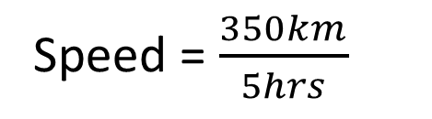
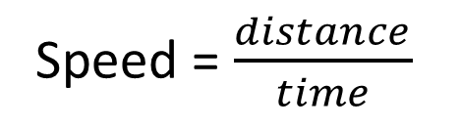
EOC TYPE QUESTION
What is the average speed of a car that travels 350 kilometers in 5 hours?
Distance = 350km
Time = 5hrs
Speed = ?
Speed = $\frac{distance}{time}$
Speed = $\frac{350km}{5hrs}$
Speed = 70km/hr

