Slide 1
Sometimes speed changes.
Changing Speed
Velocity
Time

Slide 2
ACCELERATION
Acceleration is changing speed or velocity
  It is how fast the speed is changing.
  Acceleration can be positive (speeding up) or negative (slowing down).

Slide 3


ACCELERATION
Formula:
Units: m/s²
  Velocity per second
  meters/second per second
OR

Slide 4
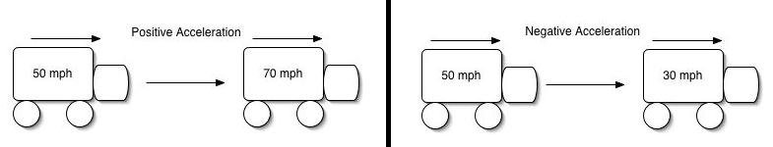
ACCELERATION
Acceleration can be positive or negative.
Negative acceleration shows that the object is slowing down. This is also called deceleration.

Slide 5
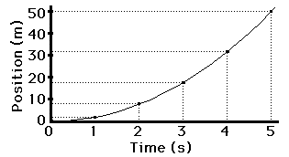

ACCELERATION
Acceleration is changing speed.
Covering more distance every second.

Slide 6
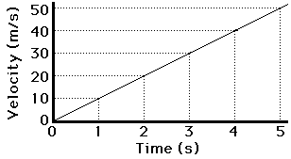
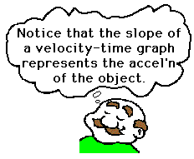
10 m/s²
The slope of a velocity-time graph represents the acceleration of the object.

Slide 7
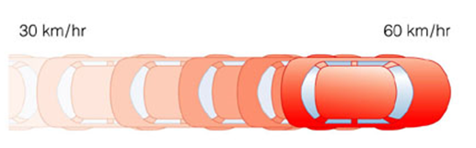
Three Cases of Acceleration
Increasing Velocity
- speed is changing so there is acceleration.

Slide 8
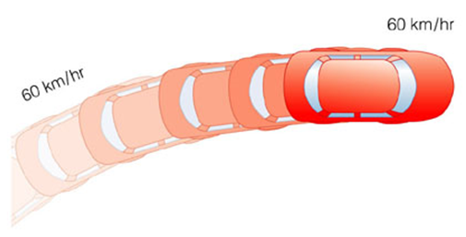
Three Cases of Acceleration
Changing Direction
- since the direction is changing, the velocity is changing even though the speed stays constant.

Slide 9
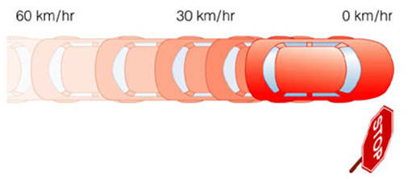
Three Cases of Acceleration
Decreasing Velocity
- speed is changing so there is acceleration. This is negative acceleration or deceleration.

Slide 10
ACCELERATION
If the acceleration is 10m/s², that means that the object is increasing its speed by 10m/s every second.
How fast is it going after 5 seconds?

Slide 11
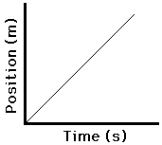
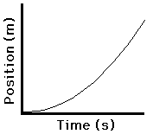
RECOGNIZING THE GRAPHS
Changing Velocity
Constant Velocity

Slide 12
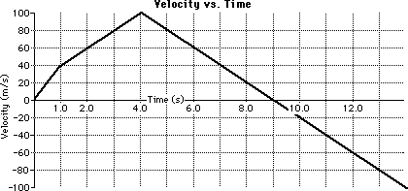
WHAT IS HAPPENING HERE?

Slide 13

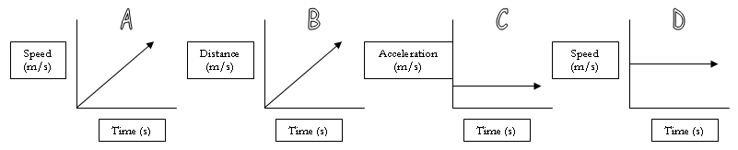
Which graph(s) show(s) constant speed?
Which graph(s) show(s) acceleration?
----- another
Acceleration
Constant
Speed
Acceleration
Constant
Speed

Slide 14
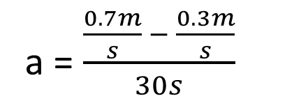
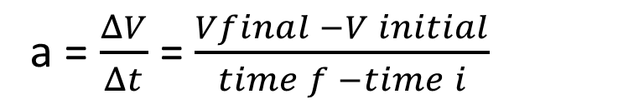
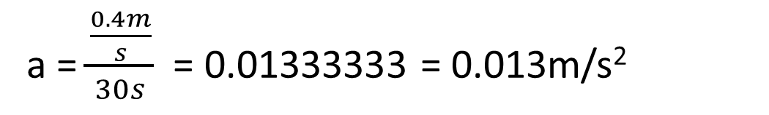
PRACTICE
Calculate acceleration of a turtle going from 0.3 m/s to 0.7 m/s in 30 seconds.
Velocity_{i} = 0.3m/s
Velocity_{f} = 0.7m/s
Time = 30s
a = $\frac{ΔV}{Δt}$ = $\frac{Vfinal −V initial}{time f −time i}$
a = $\frac{\frac{0.7m}{s} − \frac{0.3m}{s}}{30s}$
a = $\frac{\frac{0.4m}{s}}{30s}$ = 0.01333333 = 0.013m/s²

