Slide 1
ENERGY
The ability to cause change

Slide 2
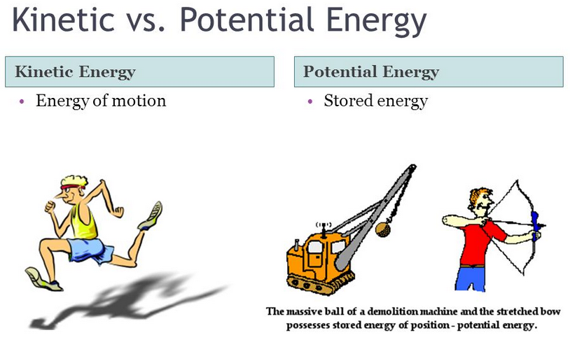
ENERGY
ENERGY is the ability to cause change.
Energy is divided into two classes:
  Kinetic Energy, KE
  Potential Energy, PE
Kinetic and Potential Energy

Slide 3
Kinetic ENERGY
Kinetic Energy, KE is energy possessed by an object in motion.
  The earth revolving around the sun, you walking down the street, and molecules moving in space all have kinetic energy.
  Kinetic Energy of an object depends upon two variables:
    the mass, m of the object
    the speed, v of the object.

Slide 4

KINETIC ENERGY
  To calculate Kinetic Energy, use the formula:
  Kinetic energy is usually measured in units of Joules (J); one Joule is equal to 1 kg m² / s².

Slide 5

POTENTIAL ENERGY, PE
Energy an object has because of its position relative to some other object.

Slide 6
POTENTIAL ENERGY, PE
Example: When you stand at the top of a stairwell you have more potential energy than when you are at the bottom, because the earth can pull you down through the force of gravity, doing work in the process.
Kinetic energy is usually measured in units of Joules (J); one Joule is equal to 1 kg m² / s².

Slide 7
TYPES OF ENERGY
Thermal (Heat) energy - energy involved in temperature changes or heat transfers.
Chemical Potential Energy - stored in chemical reactions and the energy involved in chemical reactions.
Nuclear energy - stored in the nucleus of the atom, energy released from nuclear reactions by converting mass to energy.
Electric energy – energy involved in electron movement.
Light energy – electromagnetic radiation in the forms of visible and invisible light.

Slide 8
TYPES OF ENERGY
Sound energy - energy associated with the vibration of matter.
Mechanical energy- The motion of some objects contains a combination of kinetic and potential energies.
  Mechanical energy is the sum of the kinetic energies and the forms of potential energies associated with a system.
  Therefore, Mechanical Energy equals Kinetic Energy plus Potential Energy.

Slide 9
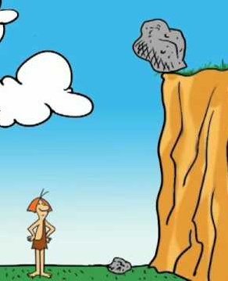
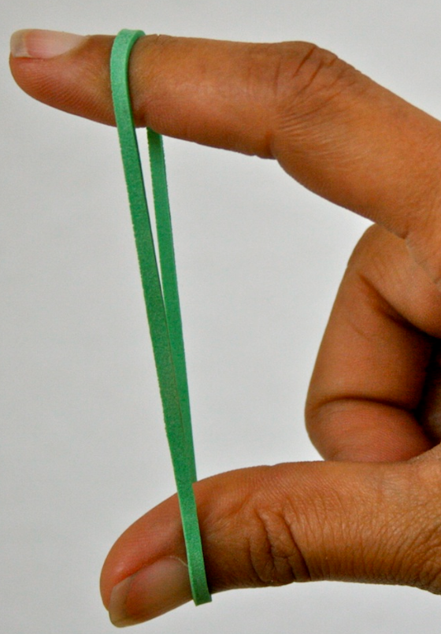
MORE ON potential energy
An object can store energy because of its position. These are all forms of potential energy.
  Gravitational Potential Energy
  Elastic Potential Energy
  Chemical Potential Energy

Slide 10
GRAVITATIONAL POTENTIAL ENERGY
Gravitational Potential Energy, GPE - energy stored in an object as the result of its position above Earth (i.e., height).
GPE is the energy stored in an object as the result of its vertical position.
Amount of GPE is dependent on two variables:
    mass
    height above the ground

Slide 11
GRAVITATIONAL POTENTIAL ENERGY
GPE Formula:
= mass ● gravity ● height
= mgh
m = mass in kg
g = acceleration due to gravity which is 9.8 m/s^{2.}
h = height above ground in meters

Slide 12
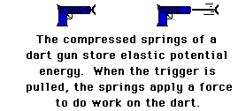
ELASTIC POTENTIAL ENERGY
Elastic Potential Energy - energy stored in something stretchy.
It is the energy stored in elastic materials as the result of their stretching or compressing.

Slide 13
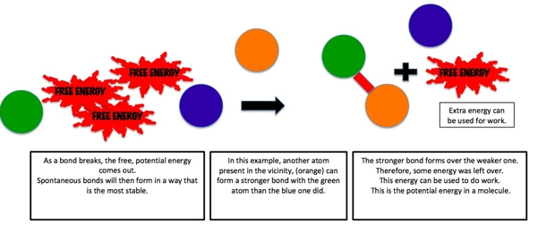
Chemical potential energy
Chemical Potential Energy – energy that is stored in the bonds of an atom or molecule.
It is a form of potential energy that can be absorbed or released during a chemical reaction.
It may also change during a phase change like melting.

Slide 14
CONSERVATION OF ENERGY
Energy cannot be created or destroyed…only changed from one form to another.
The total energy of an isolated system remains constant (isolated systems have no external forces and no mass changes).

Slide 15

CONSERVATION OF ENERGY
ENERGY before = ENERGY after
Energy can be changed from one form to another, but it does not disappear.

Slide 16
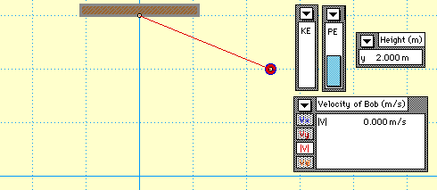
TOTAL ENERGY OF THE SYSTEM REMAINS THE SAME.
CONSERVATION OF ENERGY

Slide 17
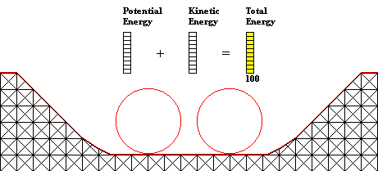
CONSERVATION OF ENERGY
TOTAL ENERGY OF THE SYSTEM REMAINS THE SAME.

Slide 18
Conservation of MECANICAL Energy
Conservation of Mechanical Energy only holds true when the only energies of the system are Kinetic Energy and Potential Energy.
Therefore, in the presence of friction, energy is transformed to other types of energies.

