Slide 1
CALENDAR
This Semester:
Forces
Energy, Work, and Power
Machines
Heat
Waves
Sound and Light
Electricity and magnetism
EOC Review
EOC – Friday, May 11

Slide 2
Forces
Remember Dynamics?
Dynamics is concerned with the forces that affect motion.
FORCEMAN

Slide 3
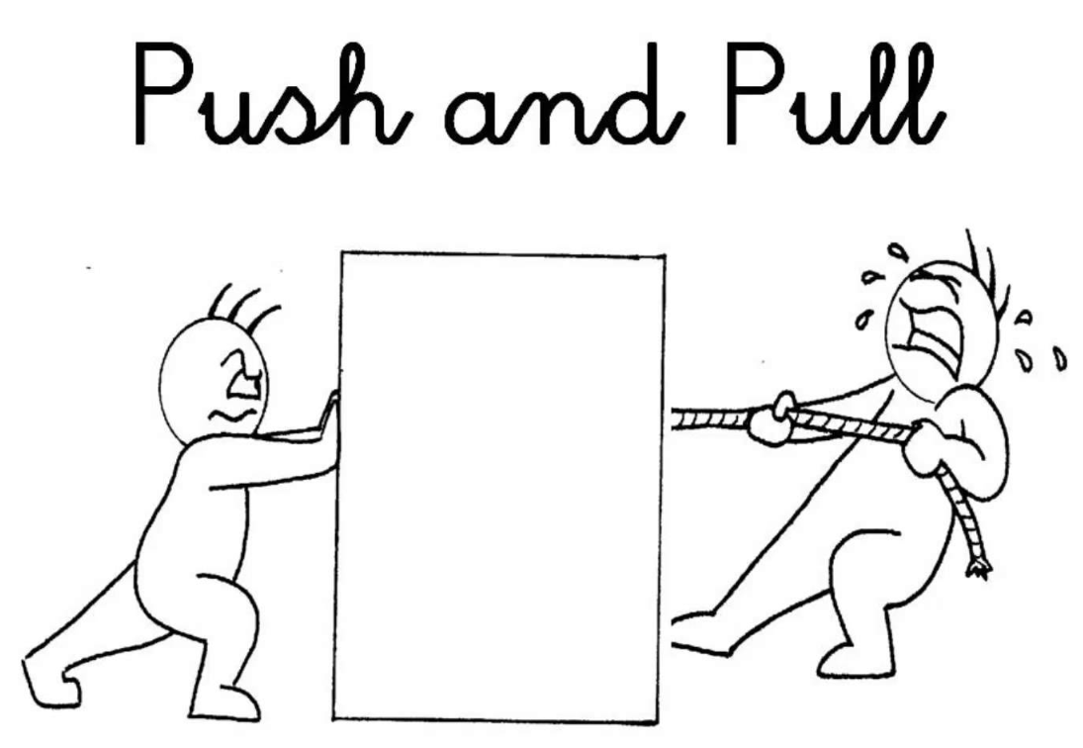
WHAT CAUSES OBJECTS TO MOVE?
FORCES!
What is a force?
  A push or a pull that one body exerts on another.
  Often the effect is a change in velocity called acceleration.

Slide 4


WHAT IS A FORCE?
It gives energy to an object and causes it to:
start moving
stop moving
change its motion.

Slide 5
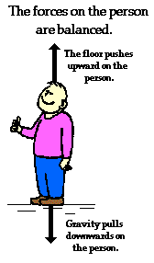


BALANCED FORCE
No change in motion
Has no acceleration

Slide 6
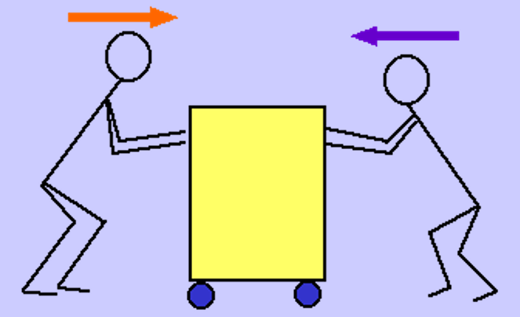
BALANCED FORCES
Are opposite and equal
act in opposite directions and cancel each other out
no motion occurs for the cart.
Example: Pushing against a wall, two persons pushing against the cart above.

Slide 7

UNBALANCED FORCES
There is a net or resultant force.
The body will do one of the following:
    Speed Up
    Slow Down
    Change the Direction of its Motion
In other words
- There is ALWAYS a change in motion!

Slide 8
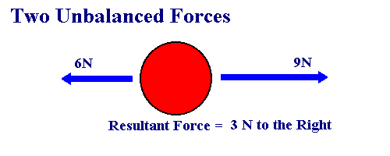
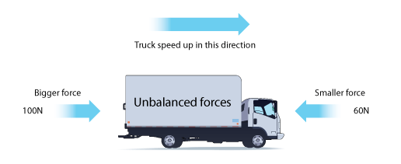

Slide 9
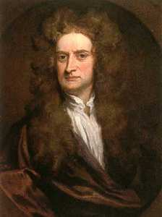
FORCE UNITS
SI unit of force is the Newton, N.
Defined as the amount of force that when acting on a 1 kg object produces an acceleration of 1m/s².
Therefore, 1N = 1 kg•m/s²

Slide 10
NEWTON’S FIRST LAW OF MOTION
Newton’s First Law of Motion states that an object in motion will continue to move at a constant speed in a straight line. Only an outside force can change the speed or direction. If the object is at rest, it will remain at rest until an outside force is exerted on it.

Slide 11
NEWTON’S FIRST LAW OF MOTION
Suppose you are standing in the aisle of a large airplane parked at the airport terminal. You jump straight up. Where will you land? That is an easy question to answer. You will land in the same place from which you jumped. Now suppose the airplane is moving at a speed of 600km/hr. You jump straight up again. Where will you land? Do the following and see if you can answer the question correctly.

Slide 12
NEWTON’S FIRST LAW OF MOTION
Procedure: Get a ball from your teacher. You and your lab partner(s) need to walk outside the classroom where you can walk in a straight line and throw the ball up without hitting anything.
You have ten minutes.

Slide 13
NEWTON’S FIRST LAW
Also known as the LAW OF INERTIA
An object at rest stays at rest and an object in motion stays in motion until acted on by a net external force.
In other words: Objects just keep doing what they are doing.
What do you mean by Net Force?
Net means Final Sum, so net external force is the sum of all the forces acting on the object.

Slide 14
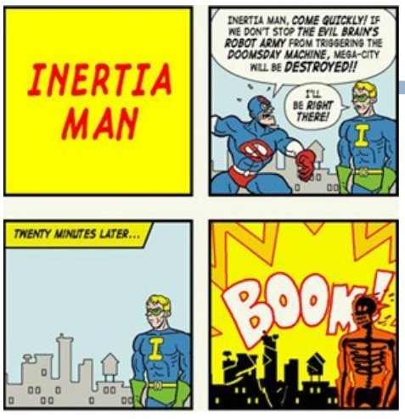
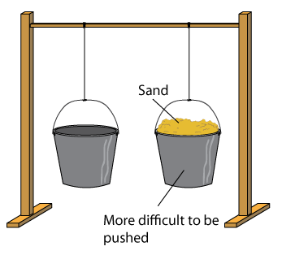
NEWTON’S FIRST LAW
Inertia - is the tendency of an object to resist any change in its motion.

Slide 15
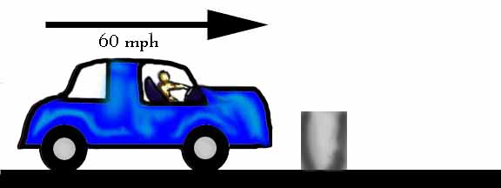

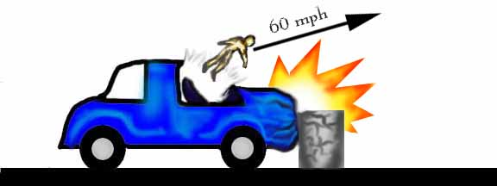
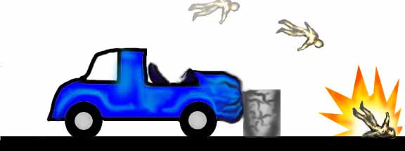
NEWTON’S FIRST LAW

Slide 16

Why does the ladder continue to move?
Inertia!

Slide 17

Why does the person continue to move?
Inertia!
Newton’s First Law

