Slide 1
DO NOW
Pick up “To the Finish Line”.
Complete and turn in – you have five minutes and then I will pick it up whether you are finished or not. It is for a grade.
Then get out your review packet.

Slide 2
REVIEW: MOTION AND FORCE
C 8. B 15. B
A 9. D 16. D
C 10. A 17. C
B 11. B 18. A
D 12. A 19. C
D 13. C 20. C
D 14. A

Slide 3
CIRCULAR MOTION REVIEW
Circular Motion

Slide 4
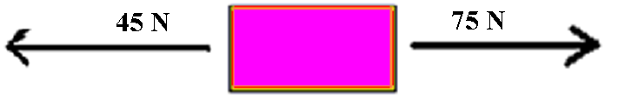
FORCES REVIEW
Know the thirteen vocabulary words
Define and explain force.
Define balanced forces and unbalanced forces. Know the motion involved. Be able to read a diagram with arrows and determine the net force.

Slide 5
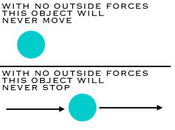
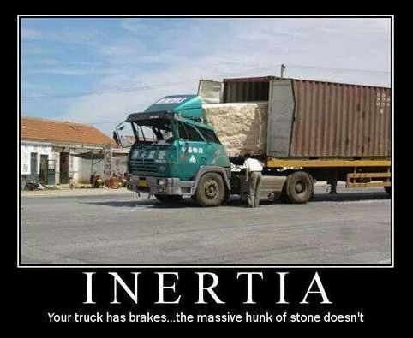
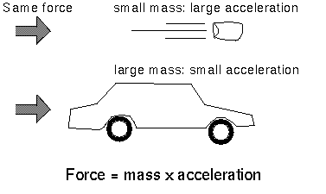
FORCES REVIEW
3. State Newton’s First Law and be able to identify examples.
4. Define Inertia and know the relationship between mass and inertia.
5. State Newton’s Second Law and be able to identify examples.

Slide 6
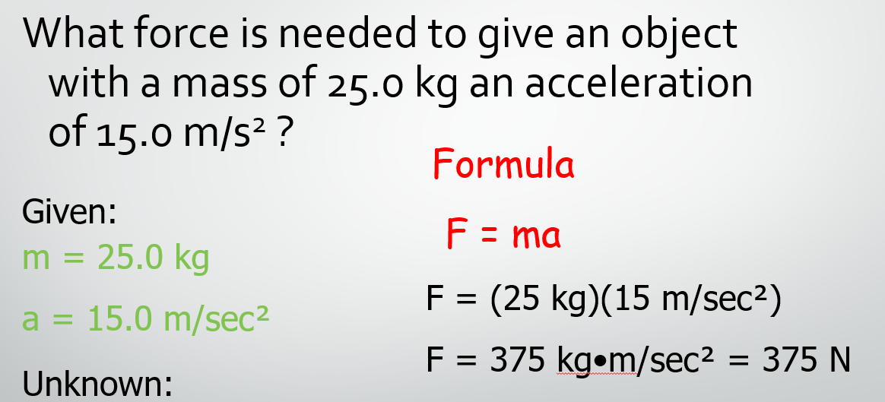
FORCES REVIEW
6. Be able to solve problems with F = ma. Write what you know, where you are going, the formula, plus in the numbers and give the correct answer with the correct units.

Slide 7
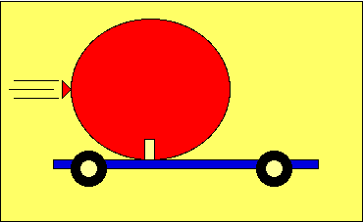
FORCES REVIEW
7. Know the unit for force.
8. State Newton’s Third law and be able to identify examples.

Slide 8
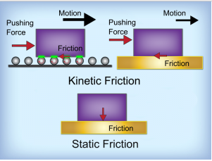

FORCES REVIEW
10. Define Friction, know the three types of friction, be able to identify examples of each, and know which requires the most and least force.
11. Identify examples of when friction is good or bad.

Slide 9
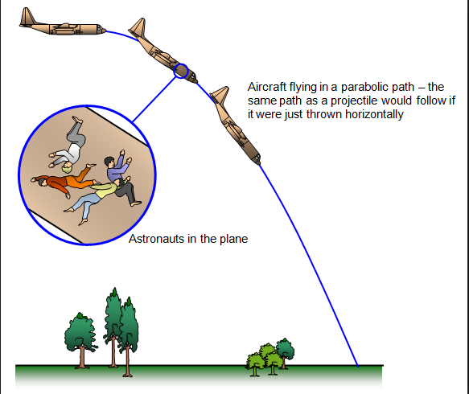
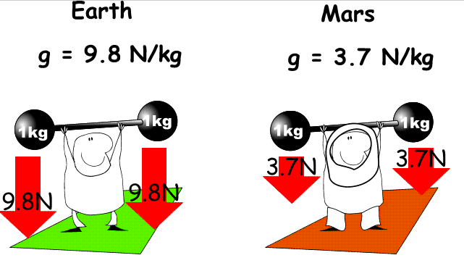
FORCES REVIEW
12. Define Gravity. Know the definition and the two factors that affect it.
13. Define weight and be able to discuss the difference between mass and weight and be able to define weightlessness.
14. Know what free fall is and what terminal velocity is.

Slide 10
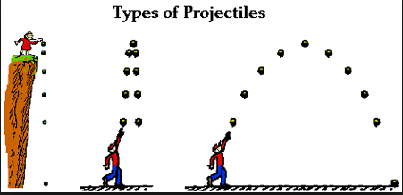
FORCES REVIEW
15. Know projectile and circular motion, their directions and the direction of acceleration.

Slide 11
TEST FORMAT
12 Multiple Choice
5 Matching
7 True and False – correct underlined word if false
10 Choosing the correct choice
3 Word problems
3 Short answer

Slide 12
FORCES REVIEW
Review is due tomorrow on time and complete, if you want the credit to build towards redoing a test.

Slide 13
DO NOW
Turn in Review packet if it is complete. You have one minute after the final bell rings to get it in to be considered on time.
Gorilla and Banana lab is due tomorrow
Prepare to take the test. Do you have a calculator? You need one and you cannot use your phone.

