Slide 1
NEWTON’S SECOND LAW OF MOTION
Newton’s Second Law of Motion states that the force on an object equals the mass of the object times the acceleration of the object. In other words, a force causes a mass to accelerate. The equation is:
Force = mass x acceleration, F = ma
With units as kilogram x meter/second² or Newton, N.

Slide 2
NEWTON’S SECOND LAW OF MOTION
Attach a paper clip to a rubber band.
With a thumb tack, attach the other end of the rubber band to a black block of wood.
Slowly pull on the paper clip. Carefully observe the length of the rubber band at the point where the block just starts to move. Describe it below.
Place a second block on top of the first block.
Slowly pull on the paper clip. Carefully observe the length of the rubber band at the point where the block just starts to move. Describe it below.
The farther the rubber band is stretched, the greater is the force being applied. Explain your observations using Newton’s Second Law of Motion.
You have 15 minutes.

Slide 3
NEWTON’S SECOND LAW OF MOTION
Turn in lab when both sides are complete or turn it in on Monday.

Slide 4
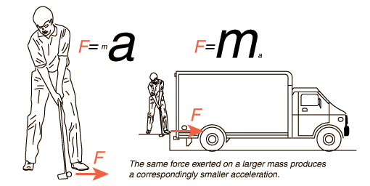
NEWTON’S SECOND LAW
The acceleration of an object is directly proportional to the net external force acting on the object and inversely proportional to the object’s mass.
2nd Law Clip

Slide 5
NEWTON’S SECOND LAW OF MOTION
The force on an object equals the mass of the object multiplied by the acceleration of the object.
In other words, a force causes a mass to accelerate.
EQUATION: Force = mass x acceleration
EQUATION: F = ma
UNITS: kilogram · meter/second² = kg · m/s² = Newton, N

Slide 6
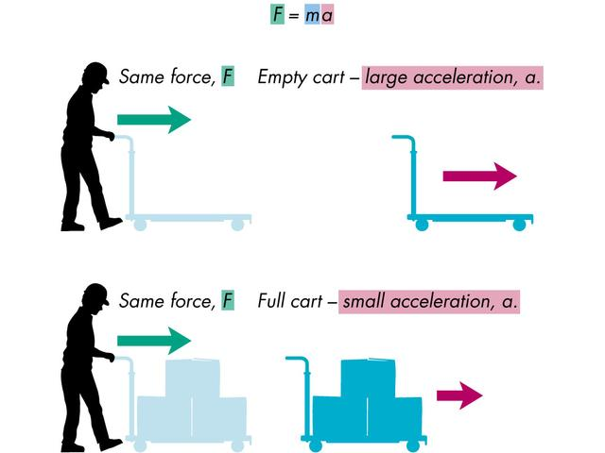
NEWTON’S SECOND LAW OF MOTION

Slide 7
FORCE PROBLEMS
What force is needed to give an object with a mass of 25.0 kg an acceleration of 15.0 m/s² ?
Formula
F = ma
Given:
m = 25.0 kg
a = 15.0 m/sec²
F = (25 kg)(15 m/sec²)
F = 375 kg•m/sec² = 375 N
Unknown:
F = ?

