Slide 1
REVIEW
Thermal (Heat) energy - energy involved in temperature changes or heat transfers.
Chemical Potential Energy - stored in chemical reactions and the energy involved in chemical reactions.
Nuclear energy - stored in the nucleus of the atom, energy released from nuclear reactions by converting mass to energy.
Electric energy – energy involved in electron movement.
Light energy – electromagnetic radiation in the forms of visible and invisible light.
Sound energy - energy associated with the vibration of matter.
Mechanical energy- The motion of some objects contains a combination of kinetic and potential energies.

Slide 2
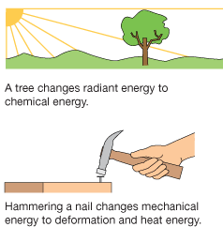
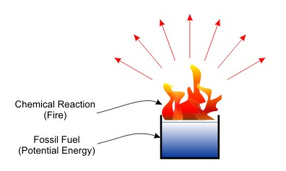
ENERGY CONVERSION
ENERGY CONVERSION: When one type of energy is changed or transformed into another type of energy.

Slide 3
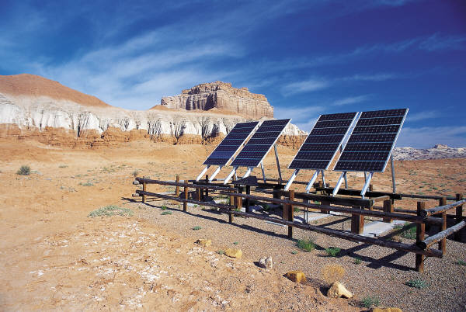
Energy Conversion
Law of Conservation of Energy says that energy cannot be created or destroyed, but only changed into another form.

Slide 4
EXAMPLES

Slide 5

What about a falling object?
What happens when it hits the ground?
Where did the energy all go?

Slide 6
Energy conversions OF A DROPPED OBJECT
As it is falling and when the object hits the ground, the energy is converted into other types of energy such as:
sound energy (waves)
light energy (sparks)
thermal energy due to friction (heat) in the ground and air
Mechanical energy in the earth (vibrations)
Elastic potential energy if the object bounces.

Slide 7
EOCT Question
Which statement about energy is true?
Energy can be increased in a closed system.
B. Energy cannot be conserved.
C. Energy can be decreased in a closed system.
D. Energy cannot be created nor destroyed.

