Slide 1
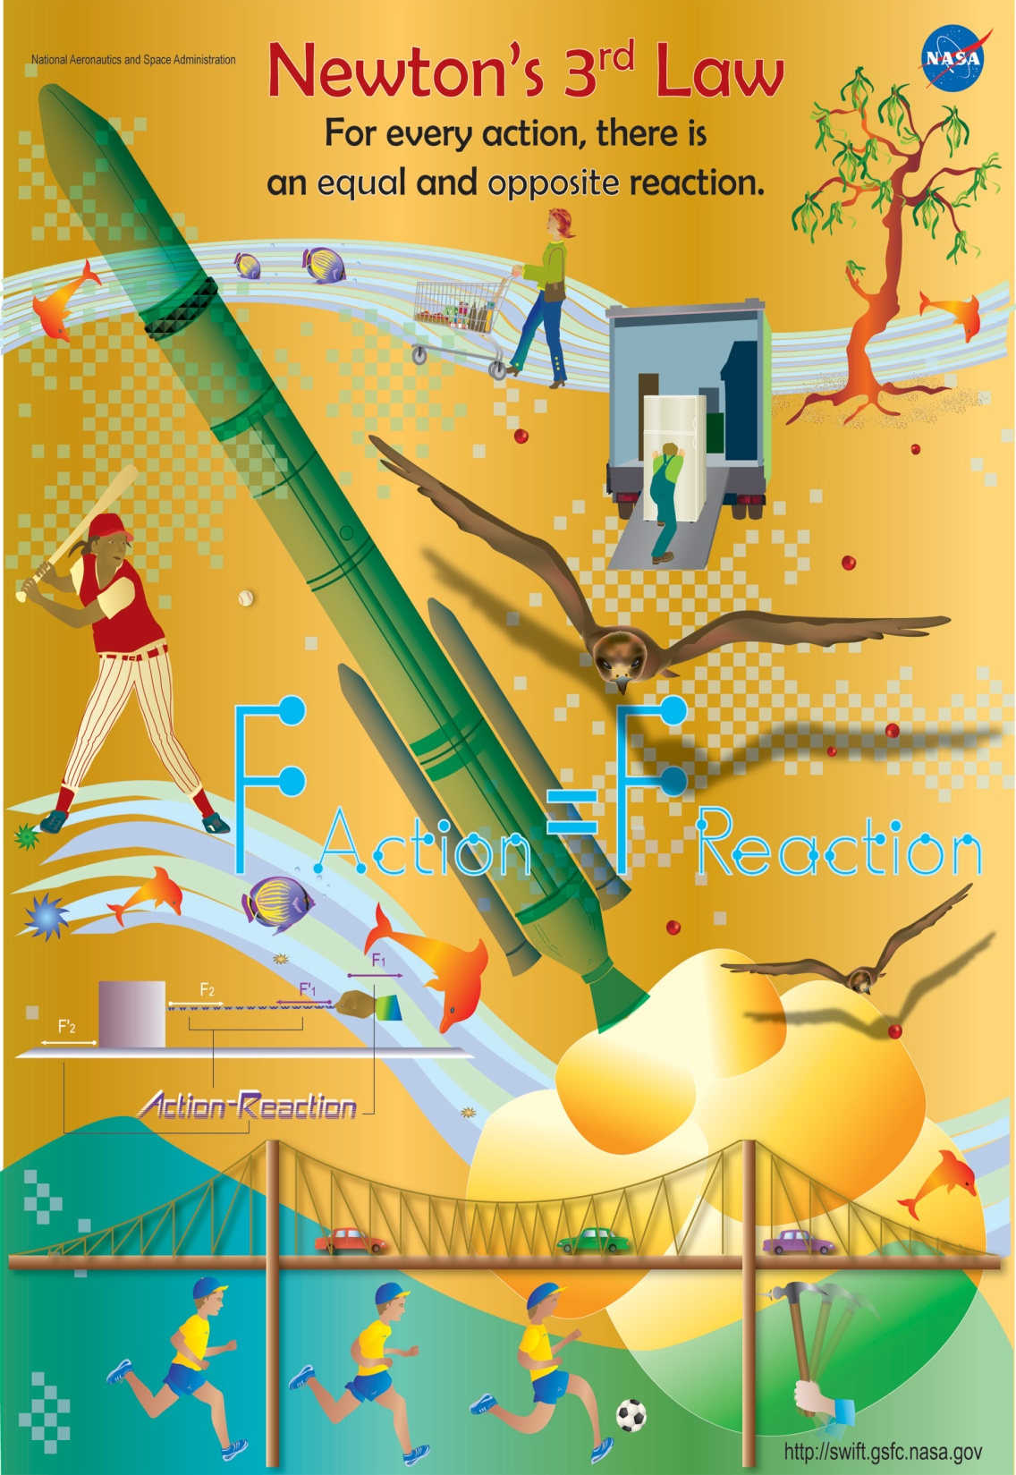
NEWTON’S THIRD LAW OF MOTION
Also known as
LAW OF ACTION-REACTION
For every action force, there is an equal and opposite reaction force.
Every action has an equal and opposite reaction.

Slide 2
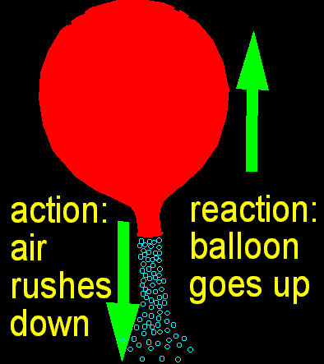
NEWTON’S THIRD LAW OF MOTION
Action-Reaction forces act on different objects

Slide 3
NEWTON’S LAWS OF MOTION
Remember: Forces come in pairs!
Revisiting Newton’s Laws

