Slide 1
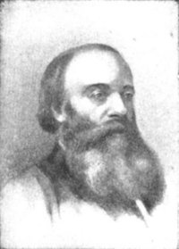
James Prescott Joule
an English physicist.
December 24, 1818 – October 11, 1889
Educated at home
sent to Cambridge at the age of 16 to study with the British chemist John Dalton.

Slide 2
James Prescott Joule
Shared in discovering the law of the conservation of energy.
1840 - stated a law, now called Joule's Law, that heat is produced in an electrical conductor.
The International unit of energy, the Joule (J), is named in his honor.
Among his many inventions are "arc" or electrical welding and the displacement pump.

Slide 3



WORK

Slide 4
WORK
WORK
VIDEO
For there to be work, there must be a displacement and the force must cause the displacement.
Must move in the direction of the force.

Slide 5
WORK
WORK
Formula:
Work = force x distance = fd
= (mass x acceleration) x distance
Unit: Newton • meter = Joule, J
W = F • d
VIDEO

Slide 6

Is work BEING done here?
pushing on a wall
pushing a boat out to sea
lifting up a box
walking while holding a box

Slide 7
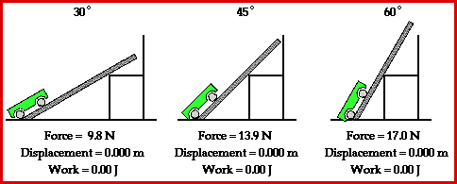
IS WORK BEING DONE HERE?

Slide 8


When doing a chin-up, a physics student lifts her body a distance of 0.25m in 2s using a force of 400N. How much work is done by the student's biceps?
Mass = 40kg
Distance = 0.25m
Time = 2s
W = F • d
= (400 N) • (0.25 m)
W = 100 J
CALCULATING WORK

Slide 9
Work has nothing to do with the amount of time that this force acts to cause the displacement.
Sometimes, the work is done very quickly and other times the work is done rather slowly.

