Slide 1
Forces that oppose motion

Slide 2
FRICTION
a force that opposes motion between two surfaces that are touching each other.
A force that brings an object to rest.
Acts between surfaces.

Slide 3
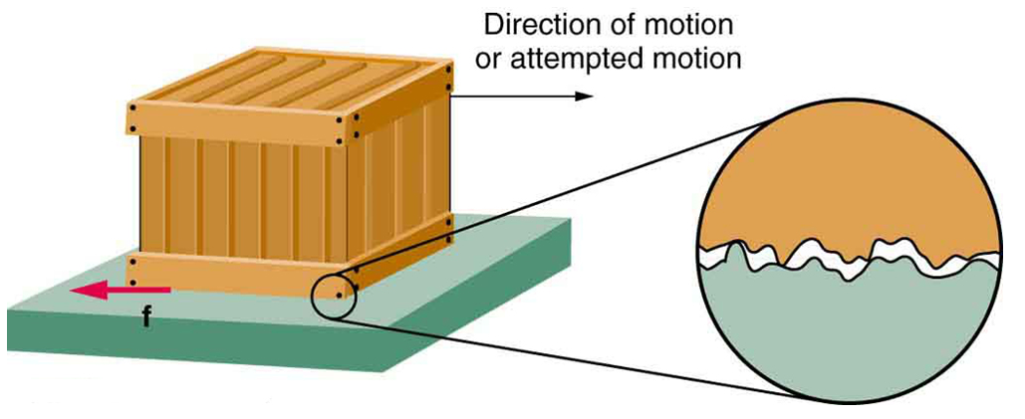
WHAT CAUSES FRICTION?
Caused by microscopic, electrostatic interactions between contacting surfaces

Slide 4
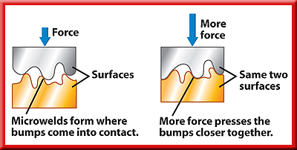
FRICTION
To move one surface over the other, a force must be applied to break the microwelds.

Slide 5
THREE TYPES OF FRICTION
Static Friction
Sliding Friction
Rolling Friction

Slide 6
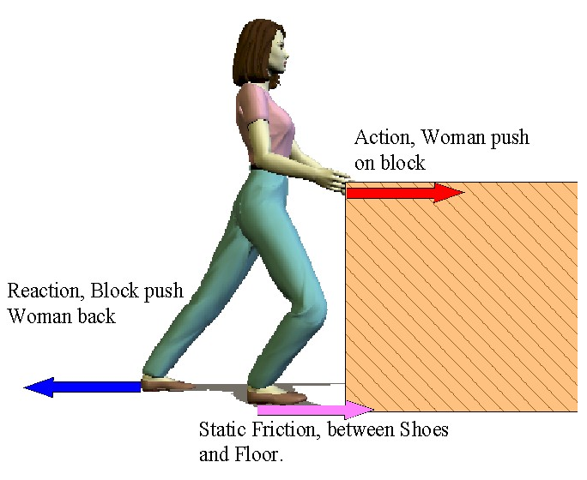
STATIC FRICTION
  The frictional force that prevents two surfaces from sliding past each other.
  force required to overcome inertia of a stationary object.

Slide 7
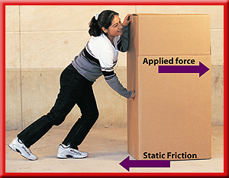
STATIC FRICTION
Suppose you have filled a cardboard box with books and want to move it.
It’s too heavy to lift, so you start pushing on it, but it doesn’t budge.
If the box doesn’t move, then it has zero acceleration.

Slide 8
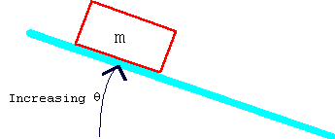
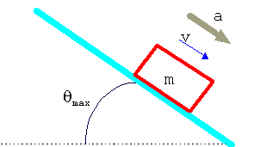
STATIC FRICTION CHANGES TO SLIDING FRICTION

Slide 9
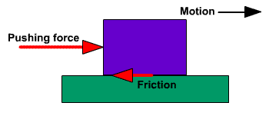
SLIDING FRICTION
The force that opposes the motion of two surfaces sliding past each other.
The force required to keep an object sliding at a constant speed
Depends on mass and surface and surface type.

Slide 10
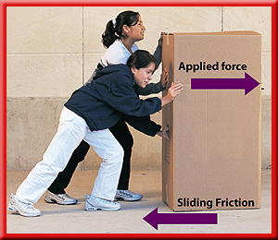
SLIDING FRICTION
You ask a friend to help you move the box.
Together you are able to supply enough force to break the microwelds between the floor and the bottom of the box.
Notes:
Pushing together, the box moves. Together you and your friend have exerted enough force to break the microwelds between the floor and the bottom of the box.

Slide 11
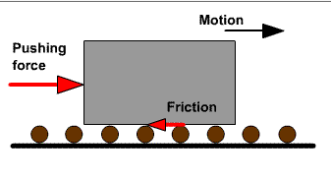
ROLLING FRICTION
    The frictional force between a rolling object and the surface it rolls on.
    force required to keep an object rolling at a constant speed
    Opposes motion less than sliding.

Slide 12
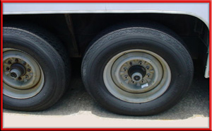
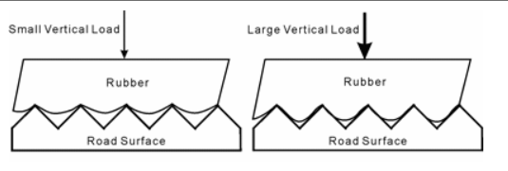
ROLLING FRICTION
As a wheel rolls over a surface, the wheel digs into the surface, causing both the wheel and the surface to be deformed.

Slide 13
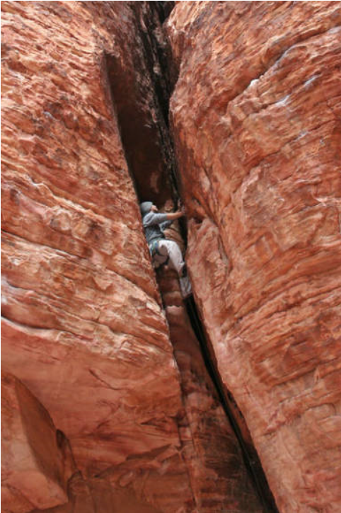
WAYS TO REDUCE FRICTION
Lubricants are used to help sliding friction.
Change static friction to sliding friction.
Change sliding friction to rolling friction.

Slide 14
HELPFUL FRICTION?
Friction can be helpful
  tire treads
  brakes
  walking
  climbing

Slide 15
IMPORTANT TO REMEMBER
  The amount of force required to overcome static friction is always greater than the force required to overcome sliding or rolling friction.

Slide 16
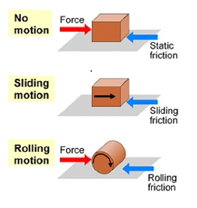
FRICTION
FRICTION

Slide 17
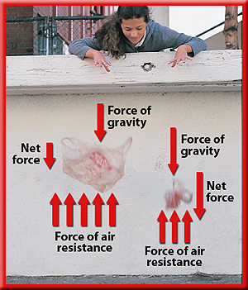
AIR RESISTANCE
a friction-like force that opposes the motion of objects that move through the air.
The amount of air resistance on an object depends on the speed, size, and shape of the object.
Notes:
Air resistance, not the object’s mass, is why feathers, leaves, and pieces of paper fall more slowly than pennies, acorns, and apples

Slide 18
AIR RESISTANCE
Air Resistance and Terminal Velocity

Slide 19
FREE FALL
A free falling object is an object that is falling under the sole influence of gravity.
Any object that is being acted upon only by the force of gravity is said to be in a state of free fall.
Be sure you can tell me why sky divers are NOT free falling.

Slide 20
FREE FALL
Two Important Characteristics:
Free-falling objects do not encounter air resistance.
All free-falling objects (on Earth) accelerate downwards at a rate of 9.8 m/s².

Slide 21
TERMINAL VELOCITY
Terminal velocity is the constant velocity of a falling object when the force of air resistance is equal in magnitude and opposite in direction to the force of gravity.

Slide 22
FREE FALL AND TERMINAL VELOCITY
The opposing force of air resistance increases with speed.
Objects accelerate towards the Earth until the force of gravity is cancelled or balanced by this air resistance.
This is the highest speed an object can reach.
Different objects have different terminal velocities.

