Slide 1
GRAVITY
The force of gravity is an attractive force between all objects in the universe.
The amount of GRAVITATIONAL FORCE between objects depends upon their:
  Masses (greater mass means more gravity)
  Distance apart (greater distance means less gravity)
Gravitational force is only observable when masses are large – like those of planets.

Slide 2
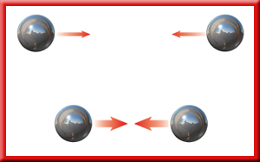
GRAVITY
Notes:
a friction-like force called air resistance opposes the motion of objects that move through the air.

Slide 3
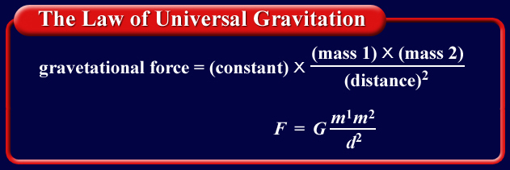
THE LAW OF UNIVERSAL GRAVITATION
Isaac Newton formulated the law of universal gravitation, which he published in 1687.
You do not need to memorize this.

Slide 4
GRAVITY
All objects fall toward the earth at the same rate of acceleration, regardless of their masses!
All objects accelerate at 9.8m/s² on earth
Acceleration is due to the force of gravity between objects and the earth.
Feather and hammer on the moon

Slide 5
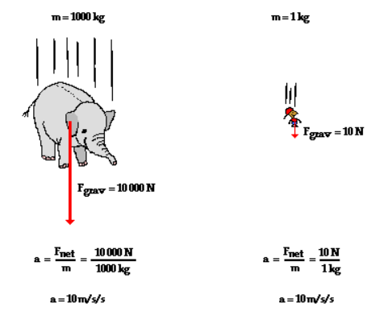
FREE FALL
Both an elephant and a mouse will fall at the same acceleration – 9.8m/s².
Their acceleration is due to GRAVITY.

Slide 6
WEIGHT AND MASS
Weight is a measure of the force of gravity on an object.
Force (weight) = mass x acceleration due to gravity (9.8m/s²)
Unit: Newton, N
REMEMBER:
  Mass never changes – it is the amount of matter in an object.
  Weight changes with gravity – it is a measure of the force of gravity.

Slide 7
WEIGHT AND MASS
Weight and mass are not the same.
Weight is a force and mass is a measure of the amount of matter an object contains.
Weight and mass are related. Weight increases as mass increases.

Slide 8
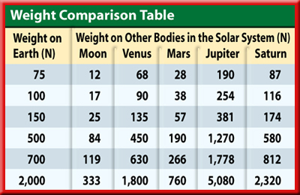
WEIGHT AND MASS
The table shows how various weights on Earth would be different on the Moon and some of the planets.

Slide 9
FREE FALL AND WEIGHLESSNESS
Why are the astronauts weightless in space?

Slide 10
WEIGHTLESSNESS
Weight is the force of gravity between the earth and a body on its surface.
Weight is not equal to mass!
Weight is measured in Newtons, N.
Weightlessness is lacking acceleration due to gravity.

Slide 11
GRAVITY AND WEIGHTLESSNESS
Gravity visualized
Weightlessness Visualized

Slide 12
CALCULATING WEIGHT
When the mass of an object and the acceleration due to gravity are known, the weight of an object can be calculated.
  Mass = 100kg Acceleration = 9.8 m/s²
  Weight = (mass, m)(accel. due to gravity, g)
  W = mg= (100kg)(9.8m/s²)
Weight = 980 N

Slide 13
CALCULATING WEIGHT
What is your weight if your mass is 4.52 kilograms?
Known: Unknown:
m = 4.52 kg W = ?
a = g = 9.8 m/s²
Formula: F = mg
F = (4.52kg)(9.8 m/s²)
F = 44.296 kg•m/s² = 44.3 N

