Slide 1
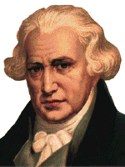
JAMES WATT
Son of a merchant, born in Greenock, Scotland, in 1736.
In 1757, he established his own mathematical instrument-making business.
Watt discovered how he could make the steam engine more efficient by cooling the used steam in a condenser that was separate from the main cylinder. This made them faster, safer, and more economical, resulting in steam overtaking water-power as the main source of energy.

Slide 2
JAMES WATT
Watt calculated that a horse exerted a pull of 180 pounds, therefore, when he made a machine, he described its power in relation to a horse, i.e. "a 20 horse-power engine".

Slide 3

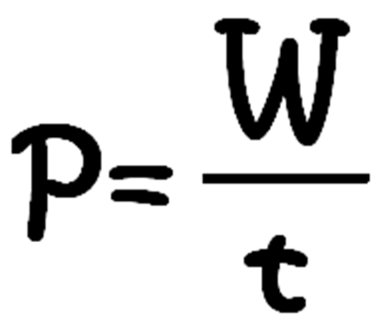
POWER
The rate of energy transfer.
How fast work is done.
Machines with different power ratings do the same amount of work...just in different amounts of time.

Slide 4
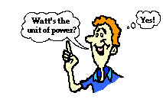
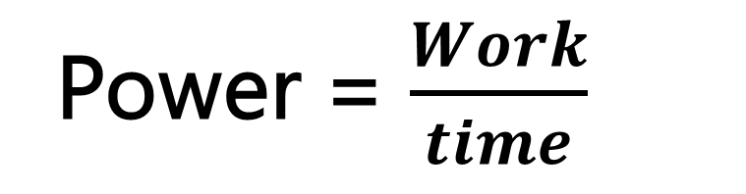
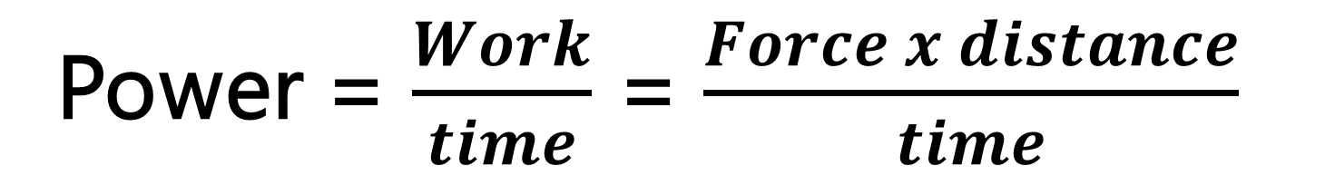
FORMULA
Power = $\frac{Work}{time}$
Power = $\frac{Work}{time}$ = $\frac{Force x distance}{time}$
CALCULATING POWER

Slide 5

POWER
Unit: watt, W
Also known as the Joule/s
One watt is equal to a power rate of one joule of work per one second of time.
watt (W)
1W = 1 J/s

Slide 6
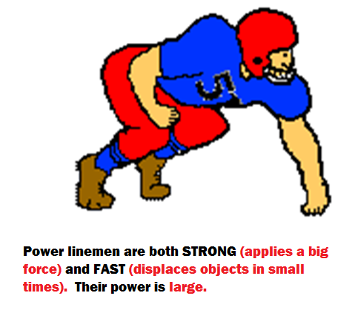
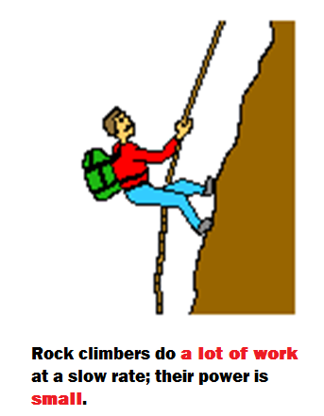
HOW MUCH POWER?

Slide 7


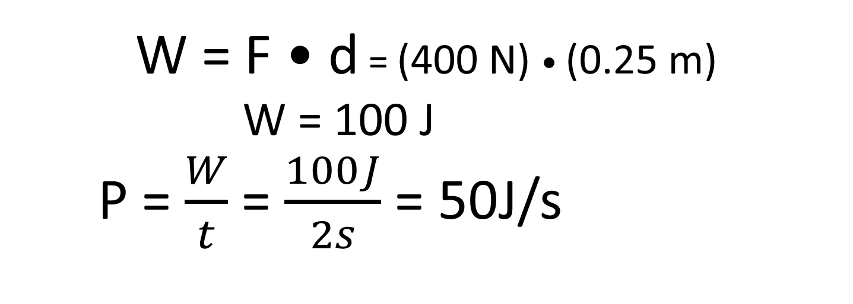
When doing a chin-up, a physics student lifts her body a distance of 0.25m in 2s using a force of 400N. How much work is done by the student's biceps?
Mass = 40kg
Distance = 0.25m
accel = 9.8m/s² Time = 2s
W = F • d = (400 N) • (0.25 m)
W = 100 J
P = $\frac{W}{t}$ = $\frac{100J}{2s}$ = 50J/s
CALCULATING POWER

Slide 8
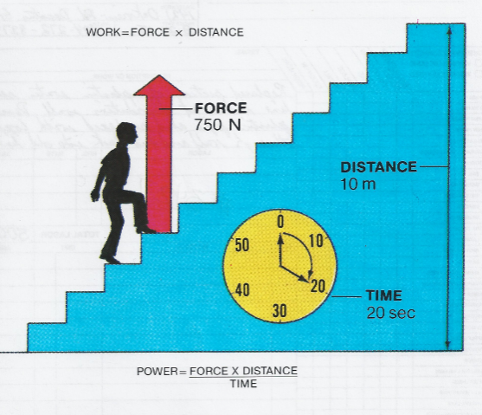
CALCULATING WORK AND POWER

