Slide 1
PROJECTILE MOTION
Thrown objects do not travel in a straight line. They tend to curve downward.
Anything that is thrown or shot through the air is a projectile.
Because of the Earth’s gravitational pull and the object’s own inertia, projectiles follow a curved path.

Slide 2
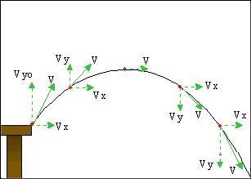
PROJECTILE MOTION
Projectiles follow a curved path because of the Earth’s gravitational pull.
They have two types of motion that are independent of each other:
1. Horizontal motion
  2. Vertical motion

Slide 3
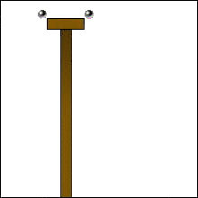
PROJECTILE MOTION
Which will hit the ground first?
A ball that is dropped straight down or a ball that is “shot” out horizontally?
* An object launched horizontally will land on the ground at the same time as an object simply dropped from the same height!
Mythbusters

Slide 4
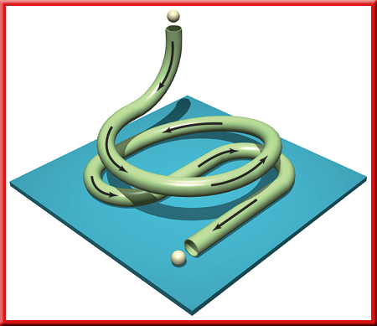
CIRCULAR MOTION
An object moving in a circular motion at the same speed is accelerating toward the center because its direction is constantly changing.
Centripetal acceleration is acceleration toward the center of a curved path.
'Centripetal' comes from the Latin word for 'center seeking‘.

Slide 5
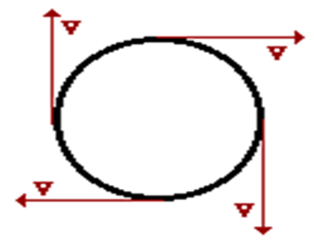
CIRCULAR MOTION
The direction of the velocity vector at every instant is in the direction tangent to the circle.
A TANGENT is a straight line or plane that touches a curve or curved surface at a point, but if extended does not cross it at that point.
Centrifugal 'force' is really a function of the inertia of the object being pushed into a circle. It is not really a force at all, it is simply the tendency of an object to go in a straight line.
Only centripetal is the real force.

Slide 6
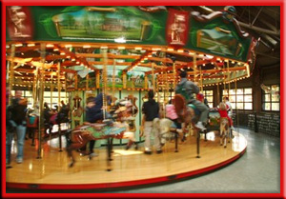
CIRCULAR MOTION
Anything that moves in a circle is doing so because a centripetal force is accelerating it toward the center.

Slide 7


CIRCULAR MOTION
Centripetal force is the force that causes a moving object to move in a curved path.
Without a centripetal force, an object in motion continues along a straight-line path.
With a centripetal force, an object in motion will be accelerated and change its direction.

Slide 8
