Slide 1
ENERGY
The capacity to do work
WORK
The transfer of energy
POWER
The time it takes to do work

Slide 2
WATCH
Energy, Work and Power

Slide 3
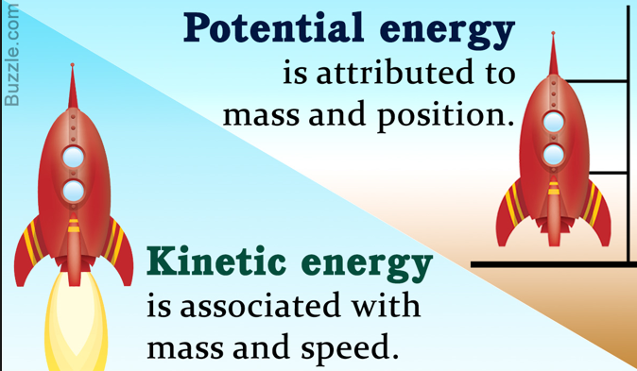
rEVIEW
1. Describe Kinetic and Potential energy and distinguish between them.

Slide 4
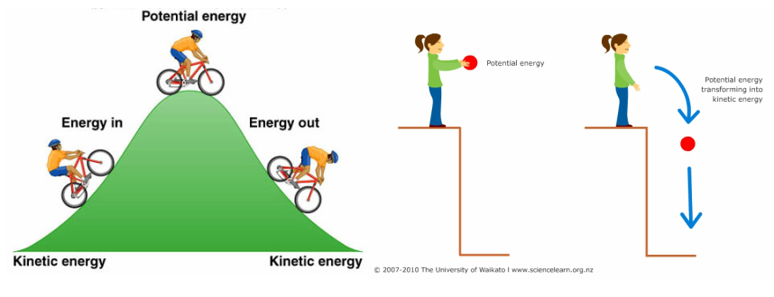
REVIEW

Slide 5
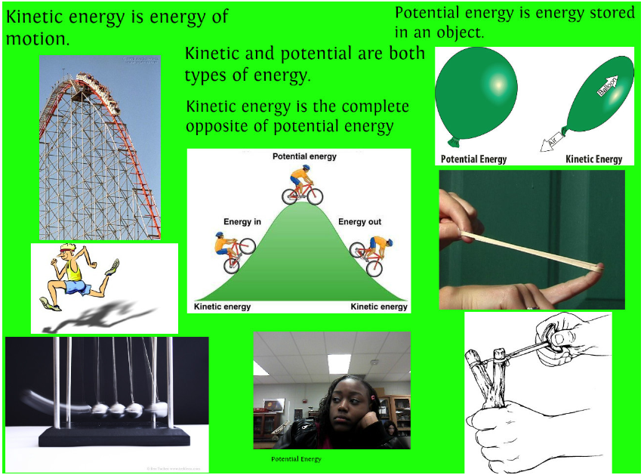
rEVIEW
2. State examples of objects with kinetic energy and potential energy.

Slide 6
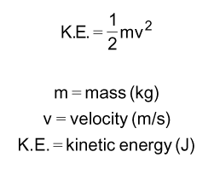
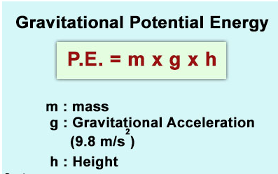
rEVIEW
3. Calculate the kinetic energy of a given mass at a given velocity.
4. Calculate the gravitational potential energy of a given weight at a given height.

Slide 7
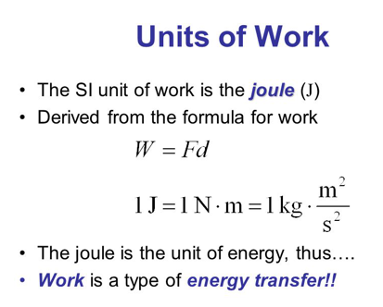
rEVIEW
5. Know the unit for energy.

Slide 8
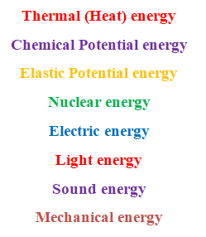
rEVIEW
6. Be able to identify the different types of energy and given examples.

Slide 9
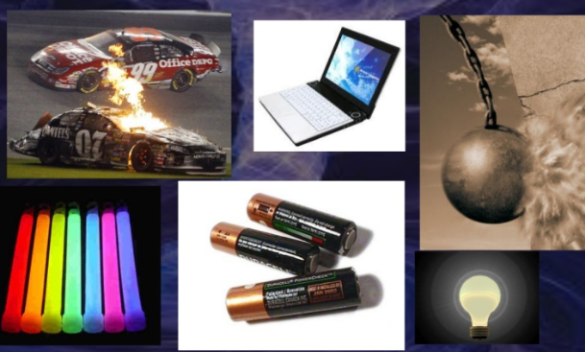
rEVIEW
7. Identify energy transformations/conversions within a system.

Slide 10
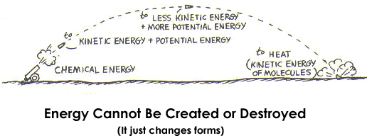
rEVIEW
8. State the Law of Conservation of Energy and be able to apply it to energy conversions.

Slide 11
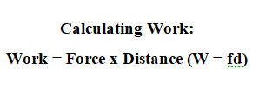
rEVIEW
9. Know the definition of work, the unit for work, and how to calculate it.
Work - a force causing the movement, or displacement, of an object.
Unit: Joule, J
(a Newton • meter)

Slide 12
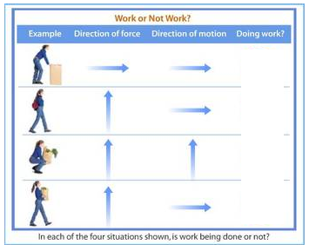
rEVIEW
10. Be able to identify work and non-work situations.

Slide 13
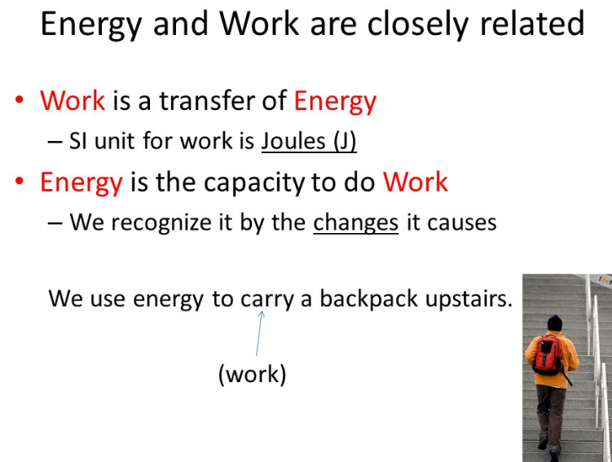
rEVIEW
11. Explain how energy and work are related and why they are measured in the same unit.

Slide 14
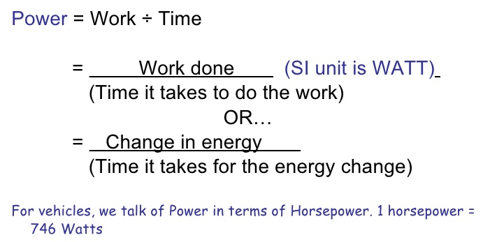
rEVIEW
12. Know the definition of power and how to calculate it.

Slide 15
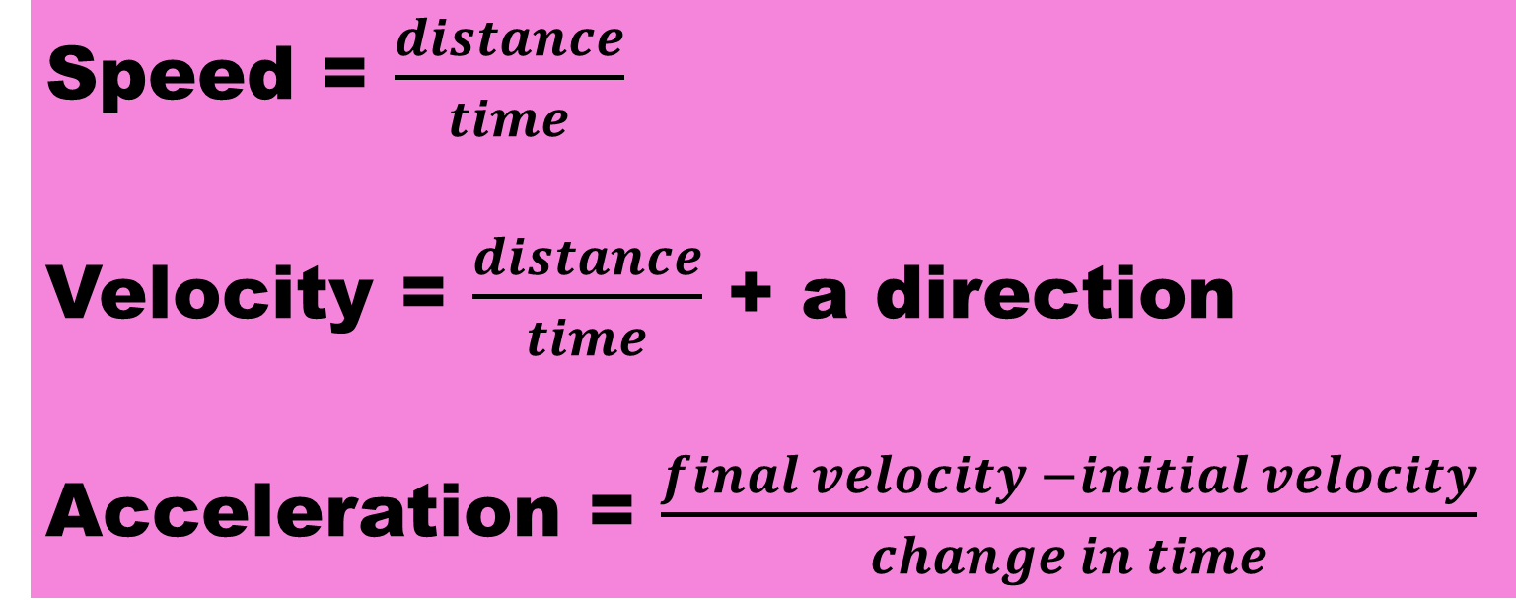
rEVIEW
13. Be able to calculate speed, velocity, and acceleration.
Speed = $\frac{distance}{time}$
Velocity = $\frac{distance}{time}$ + a direction
Acceleration = $\frac{final velocity −initial velocity}{change in time}$

Slide 16
TEST FORMAT
multiple choice
classify KE or PE
Energy types and examples
energy transformations
calculations on speed, velocity, acceleration, energy, work, and power

