Slide 1
THERMAL ENERGY
HEAT AS ENERGY

Slide 2
HOT HOT HOT!
Why does hot water burn your skin, but warm water does not? Molecules move faster and have more energy at higher temperatures. The energy of moving molecules is called kinetic energy.
You will observe and compare other effects of fast moving and slow moving water molecules.

Slide 3
HOT HOT HOT
Procedure:
Pour 200mL of room temperature water into a beaker.
Pour 200mL of water into a beaker and add 2 cubes of ice.
Note the time on the clock (second hand) and put one drop of food coloring in each beaker as close together in time as you can.
Compare how quickly the food coloring causes the color of water to change in each beaker.

Slide 4
HOT HOT HOT
Conclusion:
Write four sentences (a paragraph) describing the results you observed. Be sure to discuss why the food coloring spread throughout the two beakers at different rates.

Slide 5
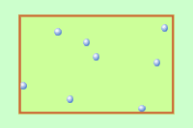

TEMPERATURE AND HEAT
Temperature is the measurement of the average kinetic energy of the molecules in a material.
Heat is the transfer of kinetic energy from one material to another.
EUREKA

Slide 6
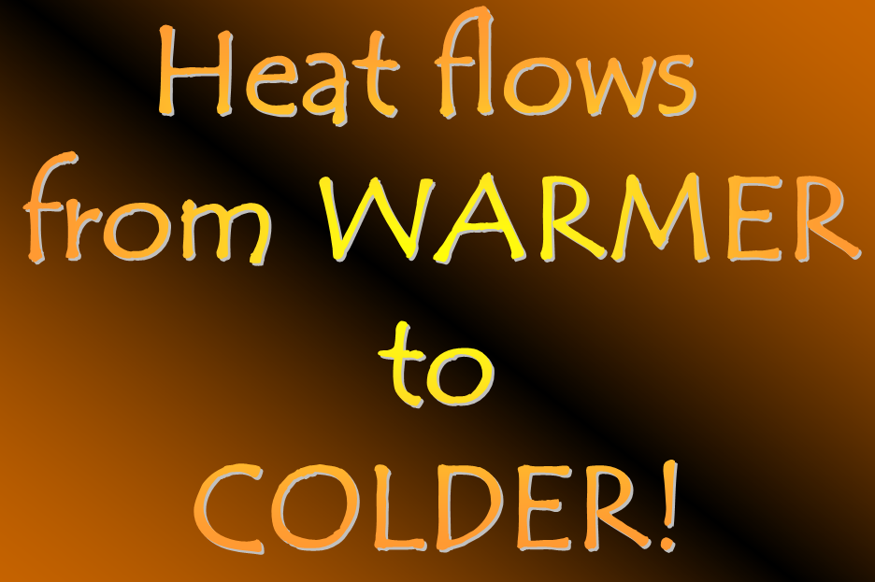
HEAT
HEAT is thermal energy that flows from an object with a higher temperature to an object with a lower temperature.
Heat is a form of energy.
Unit: joules, J
ALWAYS

Slide 7
Draw an arrow in the direction in which energy in the form of heat would flow.
Object 1 | Direction of heat flow | Object 2
Metal rod |  | Fire
Hat |  | Snowman
Ice cube |  | Glass of warm water

Slide 8
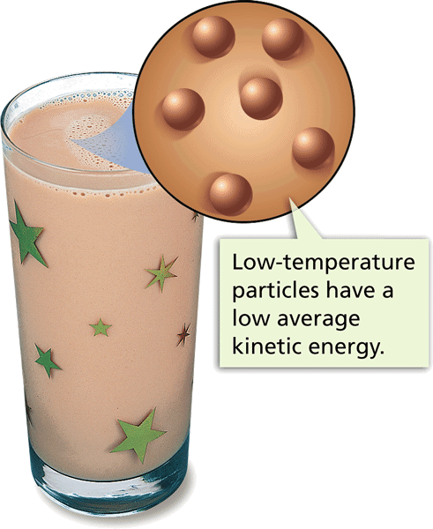
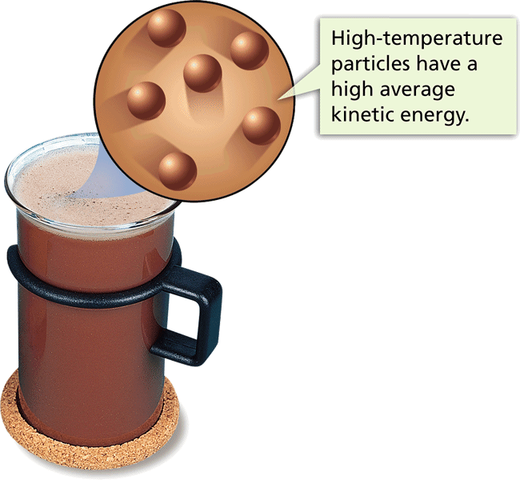
TEMPERATURE
All matter is made of tiny particles.
All these particles are in constant motion.
These particles have kinetic energy.
The faster they move, the more kinetic energy they have.

Slide 9
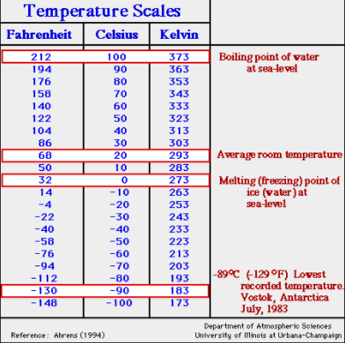
TEMPERATURE
Temperature is measured in:
SI unit: Kelvins, K
Metric: Celsius, °C

Slide 10
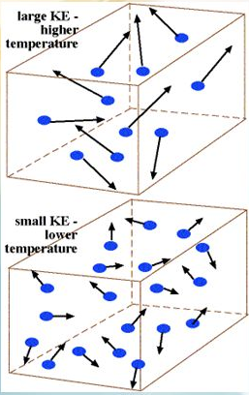
THERMAL ENERGY
Thermal energy is the total kinetic and potential energy of all particles in a substance.
It depends on mass, temperature, nature and state of matter.
Thermal energy is measured in joules (J).

Slide 11
THERMAL ENERGY AND TEMPERATURE
They are related!
When temperature goes up, the average Kinetic energy of the molecules increases.
Thermal energy also increases since it is the total kinetic energy and potential energy of a substance.

Slide 12
WHICH HAS MORE THERMAL ENERGY?
Bowl of Soup
Pot of Soup
Small balloon
Large balloon
Tiger
House cat

Slide 13
THERMAL ENERGY AND TEMPERATURE
Temperature is related to the average kinetic energy of particles.
Thermal energy is the total kinetic energy of all the particles.

Slide 14
THERMAL ENERGY AND MASS
If you have two glasses of water – one is half full and the other is full – and they are at the same temperature:
The particles have the same average kinetic energy since they have the same temperature.
BUT since there is more water in one glass, the total kinetic energy is twice the half full glass so there is twice as much thermal energy.
If there is no temperature change, the thermal energy of an object will increase if the mass of the object increases.

Slide 15
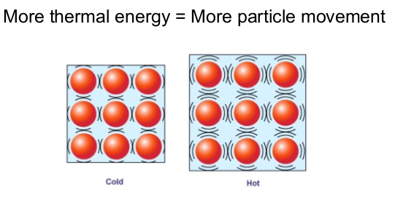
THERMAL ENERGY AND STATE OF MATTER
Remember particle motion in the phases of matter?

