Slide 1
REVIEW
WORK
Work is done whenever a force moves an object over a distance.
The amount of work done is represented by the equation:
Work = Force x Distance

Slide 2






Wheel and Axle
Lever
MACHINES
Pulley
Screw
Wedge
Inclined Plane

Slide 3
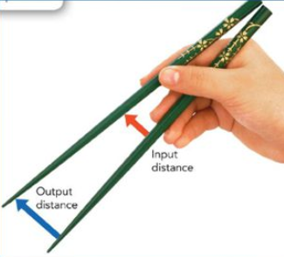
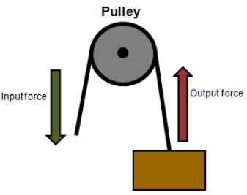
MACHINES
A machine is any device that makes work easier by changing a force.
Work is the transfer of energy that occurs when a force makes an object move.
So a machine makes that transfer of energy easier.

Slide 4
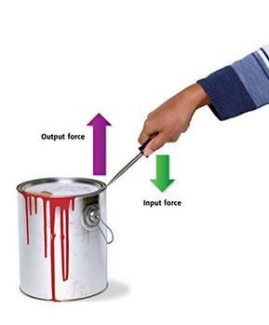
MACHINES
When you use a machine, you apply force to the machine. This force is called the input force.
The machine, in turn, applies force to an object. This force is called the output force.
The output force may or may not be the same as the input force.

Slide 5
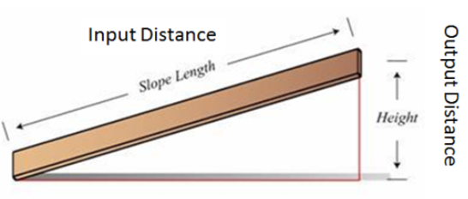
MACHINES
The force you apply to the machine is applied over a given distance, called the input distance.
The force applied by the machine to the object is also applied over a distance, called the output distance.
The output distance may or may not be the same as the input distance.

Slide 6
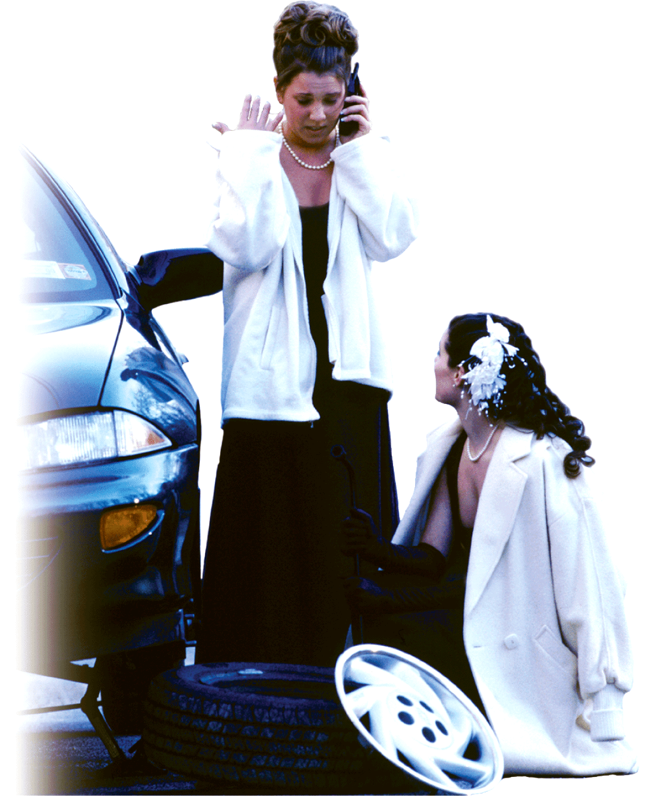
MAKING WORK EASIER
Work can be made easier by:
Increasing Force
Increasing Distance
Changing Direction

Slide 7
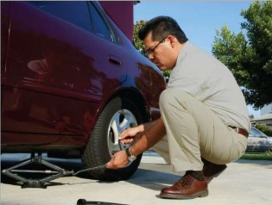
INCREASING FORCE
You can do the same amount of work by:
  Applying a small force over a long distance, OR
  Applying a large force over a small distance
Turning the jack handle allows the man to raise the car .

Slide 8
INCREASING FORCE
Each complete rotation of the jack handle applies a small force over a large distance.
A small force over a large distance (input force) becomes a large force over a small distance (output force).
Each rotation lifts the car only a short distance.

Slide 9
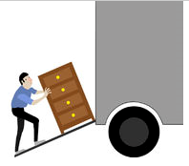
INCREASING DISTANCE
Work equals force multiplied by distance so if you increase the distance, less force is needed for the same amount of work.
Just lifting the dresser straight up would take more force.
A machine that decreases the distance through which you exert a force increases the amount of force required.

Slide 10
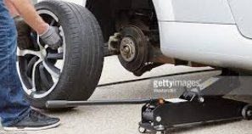
CHANGING DIRECTION
Some machines change the direction of the force applied.
When you use a car jack, you are pushing down but the jack is pushing the car up.

Slide 11
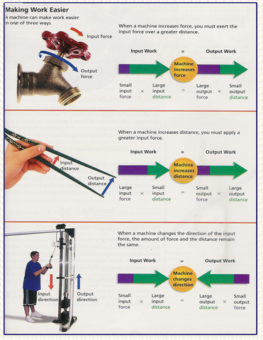

Slide 12
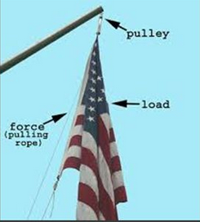
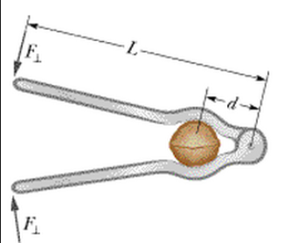
IMPORTANT!
Machines do not increase the amount of work that is done.
They just change how the work is done.

Slide 13
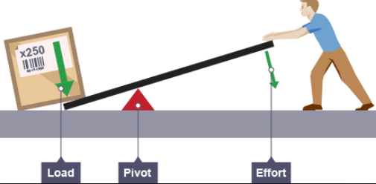
THE WORK DONE BY MACHINES
There are two forces involved when a machine is used to do work:
  The force applied to the machine is the EFFORT FORCE, F_{e}.
  The force applied by the machine to overcome resistance is called the RESISTANCE FORCE, F_{r}.

Slide 14
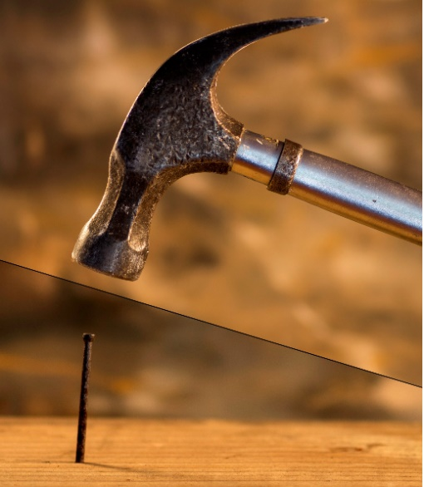
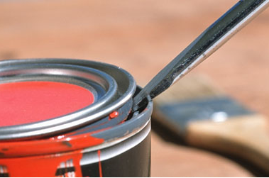
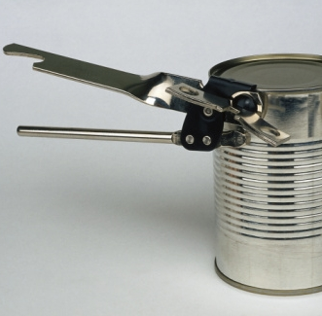
EXAMPLES
a. Hammer and nail
  Effort force:
  Resistance force:
b. Screwdriver and paint can
  Effort force:
  Resistance force:
c. Can opener
  Effort force:
  Resistance force:

Slide 15
TWO KINDS OF WORK
  You need to consider the work done by you and the work done by the machine.
  The work done by you on the machine is called INPUT WORK, W_{in}.
  The work done by the machine is called the OUTPUT WORK, W_{out}.

Slide 16
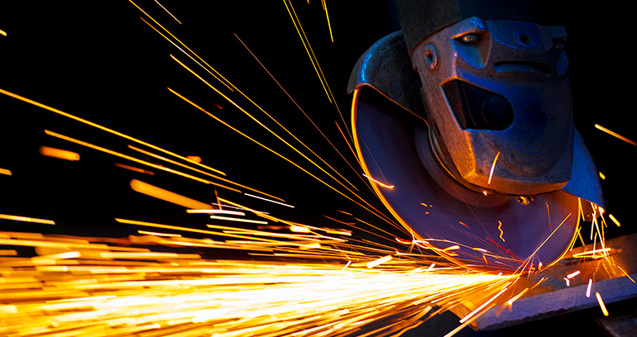
CONSERVING ENERGY
Energy is ALWAYS conserved.
When you do work on the machine, you transfer energy to the machine.
The machine then transfers energy to the object.

Slide 17
CONSERVING ENERGY
A machine cannot create energy, so output work, W_{out}, is always less than input work, W_{in}.
Energy can be lost to heat due to friction.

Slide 18
EFFICIENCY
Efficiency is a measure of how much of the work put into a machine is changed into work done by the machine.
It compares output work and input work of a machine.
It is expressed as a percentage.
Efficiency = (Output work) x 100
(Input work)

Slide 19
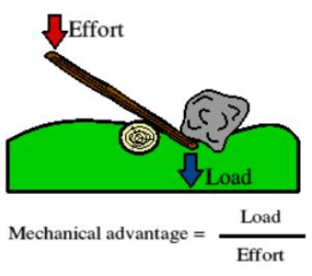
MECHANICAL ADVANTAGE
The number of times a machine multiplies the effort force is the mechanical advantage (MA) of the machine.

Slide 20
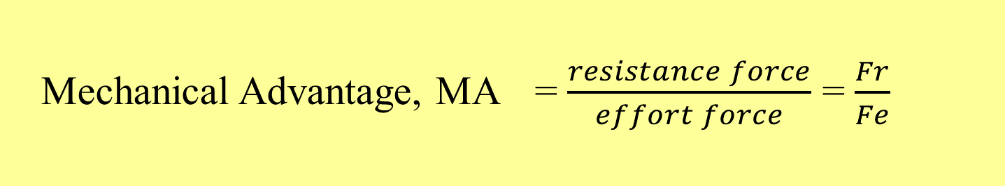
MECHANICAL ADVANTAGE
Mechanical Advantage, MA = resistance force divided by the effort force.
Mechanical Advantage, MA = $\frac{resistance force}{effort force}$ = $\frac{Fr}{Fe}$

Slide 21
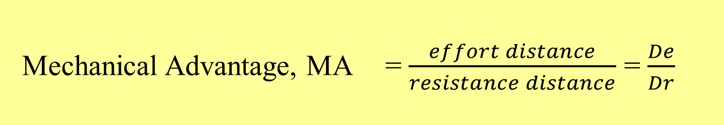
MECHANICAL ADVANTAGE
Mechanical Advantage, MA = effort distance divided by the resistance distance.
Mechanical Advantage, MA = $\frac{effort distance}{resistance distance}$ = $\frac{De}{Dr}$

Slide 22
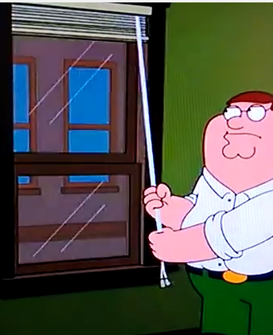
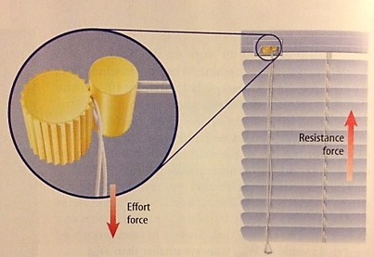
EXAMPLE
Miniblinds
  You pull down on the cord and the blinds go up the same amount.
  Effort force equals resistance force
  MA = 1

Slide 23
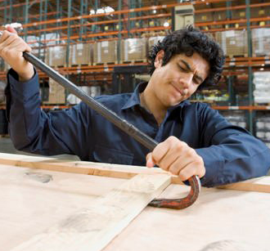
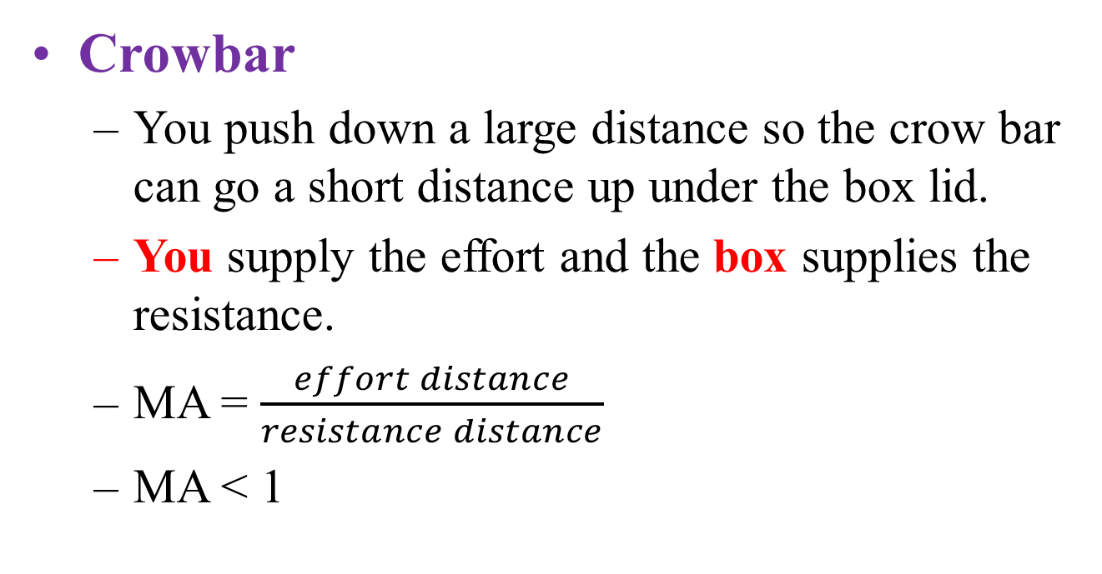
EXAMPLE
Crowbar
  You push down a large distance so the crow bar can go a short distance up under the box lid.
  You supply the effort and the box supplies the resistance.
  MA = $\frac{effort distance}{resistance distance}$
  MA < 1

Slide 24

Watch for this in all Simple machines:
Machines are a “give and take relationship.” If you get your force multiplied, then you must go a greater distance.
Mechanical Advantage

