Slide 1
HEAT TRANSFER
Have you ever needed to touch a very hot object? What did you use to touch it without burning yourself?
Make a list…….
Have you ever needed to protect yourself from being cold? What sorts of things did you use?
Make a list…..
What do these two lists have in common?

Slide 2
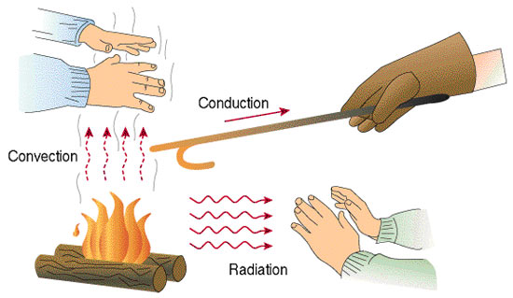
HEAT TRANSFER
Heat can be transferred from one object to another in one of three ways:
Conduction
Convection
Radiation

Slide 3

HEAT TRANSFER
What type of HEAT TRANSFER is occurring in the pictures? Conduction, convection or radiation?
CONDUCTION:
The transfer of thermal energy through matter by direct contact of the particles.

Slide 4
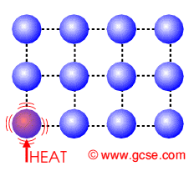
CONDUCTION
How it Happens:
The warmer object has faster moving particles.
The cooler object has slower moving particles.
The faster moving particles run into the slower moving particles (direct contact) and cause the slower moving particles to speed up.
As long as two objects are in contact, conduction continues until the temperatures of the objects are equal.

Slide 5
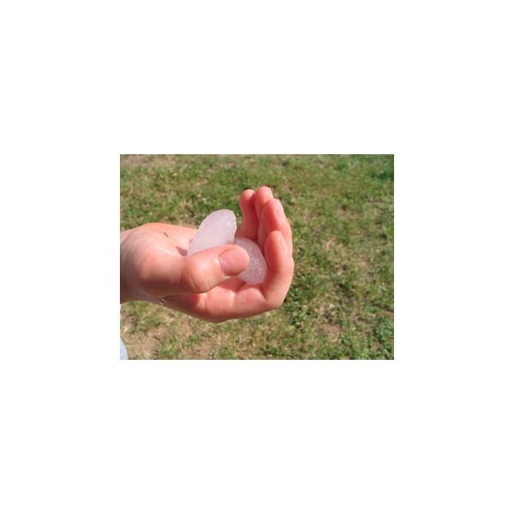
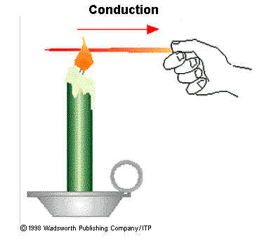
CONDUCTION
CONDUCTION REQUIRES MATTER!

Slide 6
Flannel Shirt
conductor
insulator
Iron skillet
conductor
insulator
Copper pipe
conductor
insulator
Oven Mitt
insulator
conductor
Copyright © Houghton Mifflin Harcourt Publishing Company

Slide 7
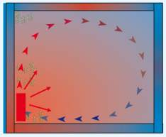
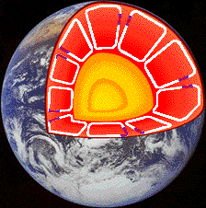
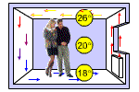
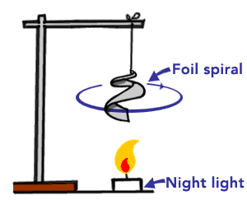
HEAT TRANSFER
What type of HEAT TRANSFER is occurring in the pictures? Conduction, convection or radiation?
CONVECTION
The transfer of thermal energy in a fluid (liquid or gas) by the movement of heated particles.

Slide 8
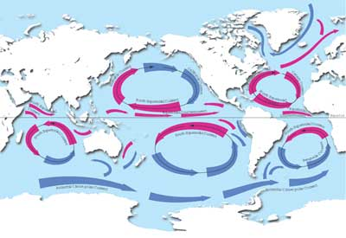
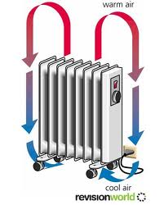
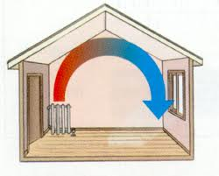
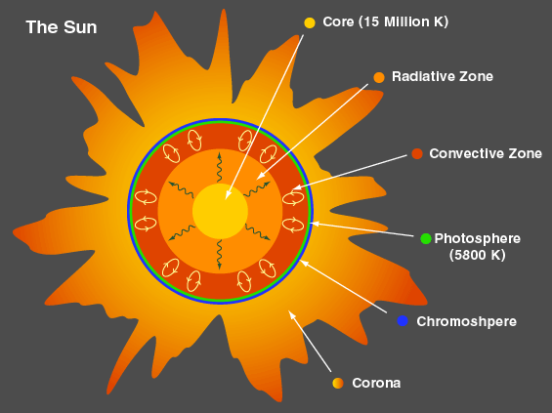
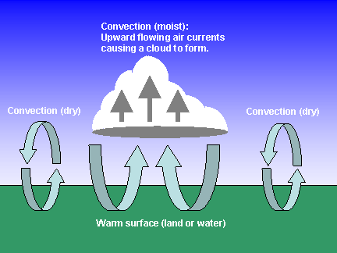
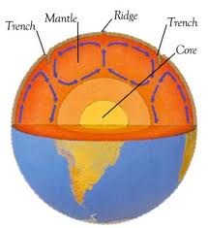
CONVECTION

Slide 9
CONVECTION
How it Happens:
Convection occurs when a cooler, denser mass of gas or liquid replaces a warmer, less dense mass of gas or liquid by pushing it upward.
CONVECTION REQUIRES MATTER!

Slide 10
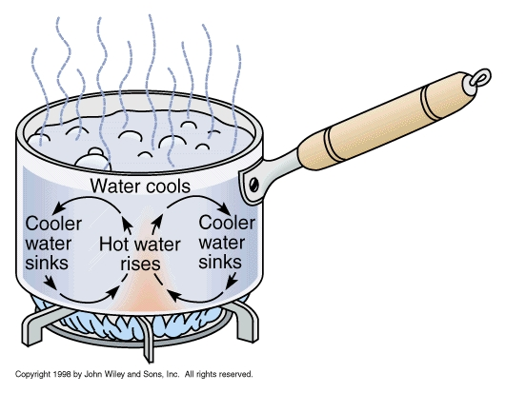
CONVECTION
When water is boiled, the water moves in roughly circular patterns because of convection.
The motion is called a convection current.
EUREKA

Slide 11



HEAT TRANSFER
What type of HEAT TRANSFER is occurring in the pictures? Conduction, convection or radiation?
RADIATION:
The transfer of thermal energy by electromagnetic waves moving through space.
EUREKA: RADIATION

Slide 12
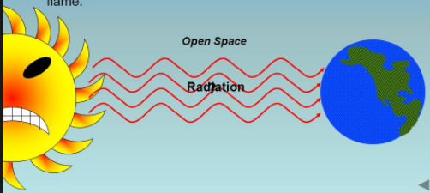
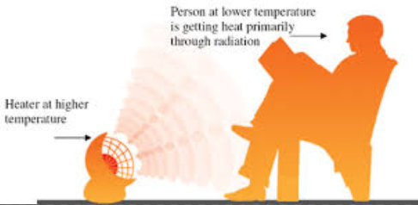
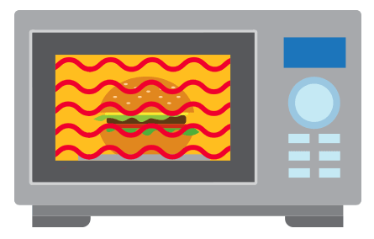
EXAMPLES
From the sun
From a heater
From a microwave

Slide 13
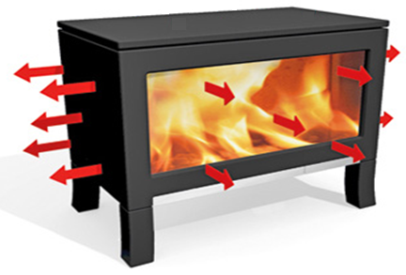
RADIATION
ALL OBJECTS radiate energy!
When radiation is emitted from one object and then absorbed by another, the result is the transfer of heat.
Radiation can travel through empty space.
NO MATTER REQUIRED!

Slide 14
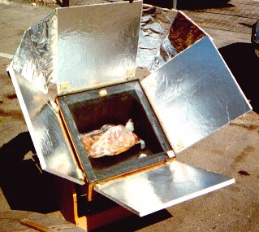
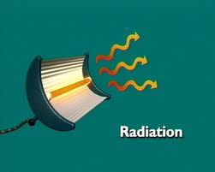
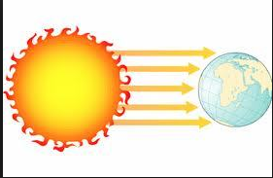
PRACTICAL USES OF RADIATION
A solar cooker is a device that cooks food using mirrors that concentrate radiation from the sun.
In parts of the world that are far from electricity and clean water, solar cookers are a cheap and portable way to sterilize water for drinking. They do not require any fuel and do not release harmful emissions.

Slide 15
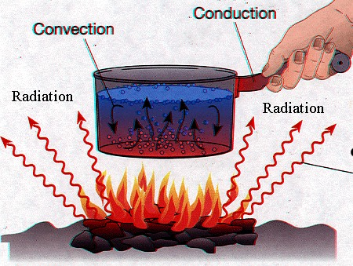

Slide 16
CAN YOU TELL WHICH IS WHICH?
Example | Conduction, convection or radiation
When you put some food in the microwave, it gets hot.
 | CONDUCTION
A heater on the first floor of the school makes the air on the second floor warm.
RADIATION
A hot burner warms a cold pot
CONVECTION

Slide 17
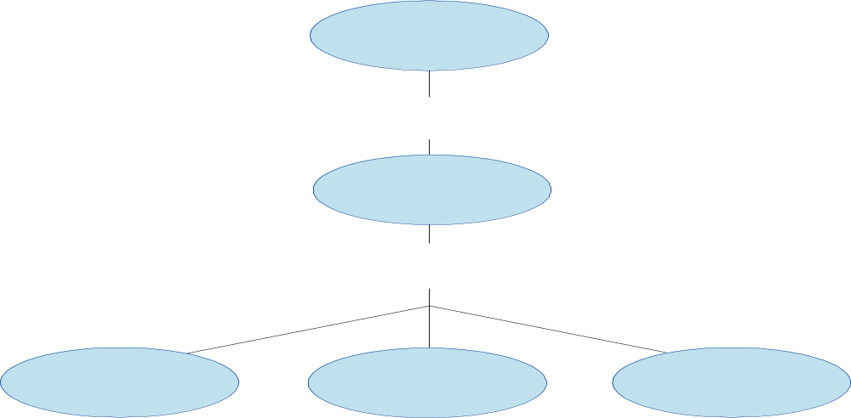
Heat
is the transfer of
Thermal energy
by
Conduction
Convection
Radiation

Slide 18
HEAT TRANSFER
How do we control heat flow?
There are a variety of mechanisms (list three):
  Thick coat of fur
  Scaly skin
  Thick layer of blubber
  Thick closely grown feathers
  Layers of clothing

Slide 19
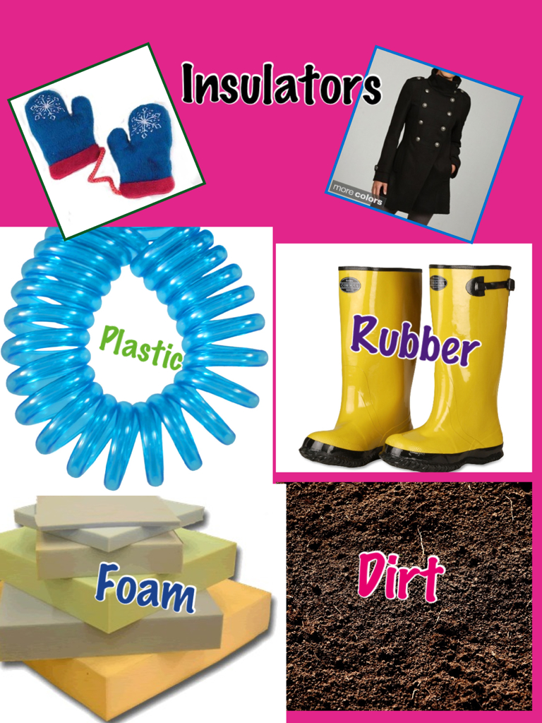
HEAT TRANSFER
An insulator is a material that is a poor conductor of heat.
Examples of good insulators: Wood, paper, and plastic foam

Slide 20
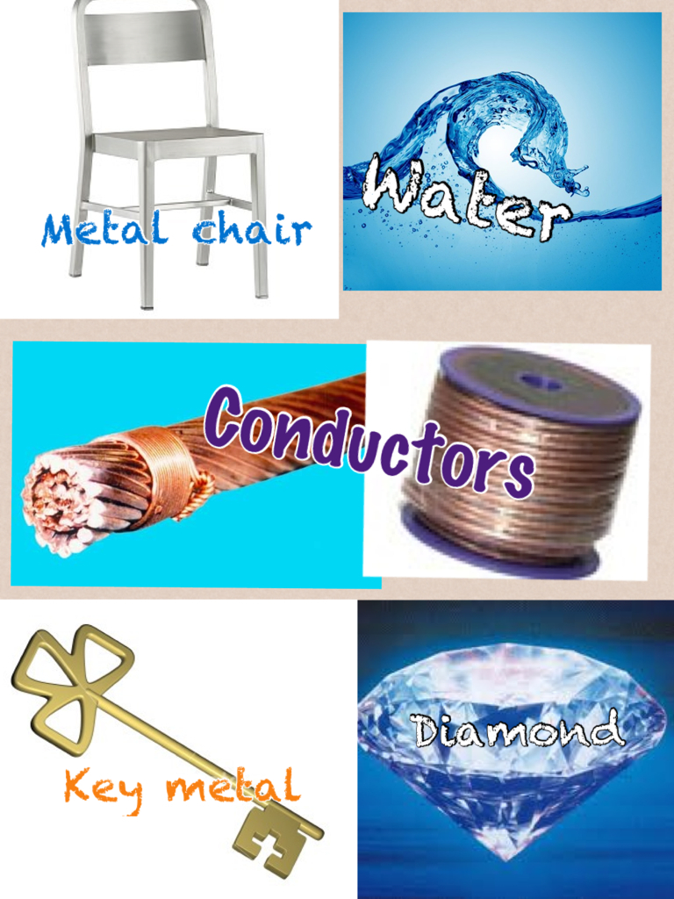
HEAT TRANSFER
A conductor is a material that transfers heat very well.
Examples of good conductors: Metals and ionic solutions

