Slide 1
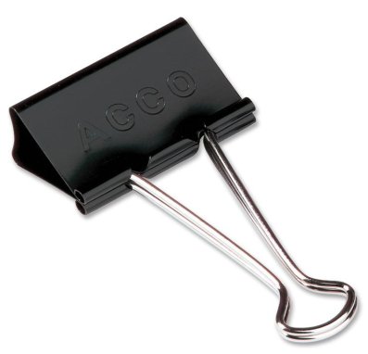
A SIMPLE MACHINE
Using a ruler, binder clip, and a small book, explore levers.
Place your finger under a book and raise it slightly, testing its weight.
Place one end of the ruler under the book.

Slide 2
A SIMPLE MACHINE
3. Place the binder clip, folded like the diagram at the right, under the ruler about 8 centimeters from the end of the ruler closest to the book.
4. Press down on the end of the ruler with your finger. Note whether it was easier to raise the book by means of your finer or by pressing done on the ruler.
5. Move the binder clip to the 15 centimeter mark of the ruler. Press down on the ruler again.

Slide 3
A SIMPLE MACHINE
Answer the two questions.
Turn this in by tomorrow.

Slide 4

WHY SIMPLE MACHINES?
Simple machines are useful because they can make a physical job easier by changing the magnitude or the direction of the force exerted to do work.

Slide 5
WHY SIMPLE MACHINES?
There are six simple machines, divided into two groups:
    Incline Planes: Inclined plane, Screw, Wedge
    Levers: Lever, Pulley, Wheel and Axle

Slide 6

Example
Have you ever tried to unscrew a nut, bolt, or screw from something with your bare hands and discovered that it was just too tight to loosen even if you had a good grip?

Slide 7

What Did You Do?

Slide 8
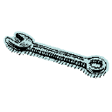
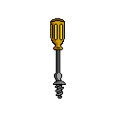
You got the proper tool, such as a screw driver
or wrench,
and unscrewed it!

Slide 9

Why is it that it is so easy to unscrew with a tool when you can't with your bare hands?

Slide 10
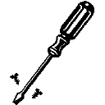
The wrench and screw driver are examples of a wheel and axle, where the screw or bolt is the axle and the handle is the wheel. The tool makes the job easier by changing the amount of the force you exert.
Wheel
Axle

Slide 11

All of the simple machines can be used for thousands of jobs from lifting a 500-pound weight to making a boat go.
The reason why these machines are so special is because they make difficult tasks much easier.

Slide 12
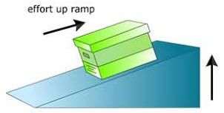
Inclined Plane

Slide 13
Inclined Plane
A sloping surface, like a ramp, that reduces the amount of force needed to lift something by increasing the distance over which the force is applied.
In other words, it reduces the amount of force needed.

Slide 14
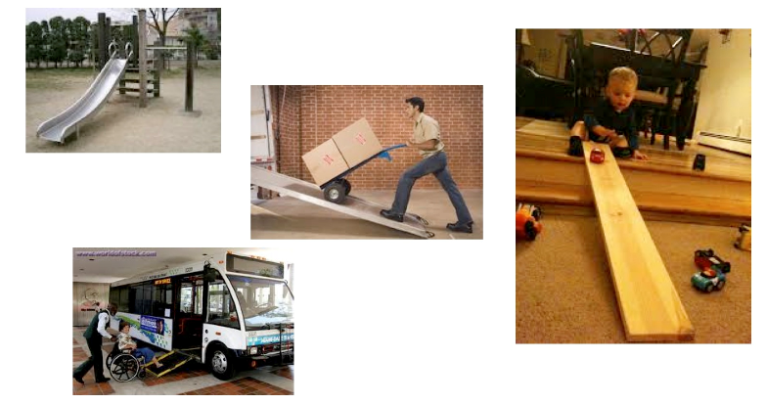
EXAMPLES

Slide 15
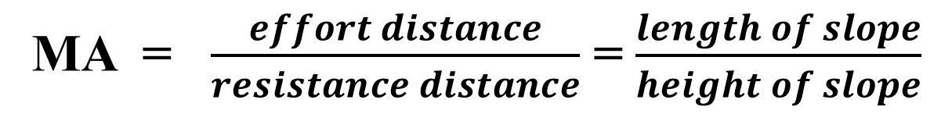
MECHANICAL ADVANTAGE
Reduces the amount of force by
  Increasing the distance over which the force is applied.
  As the ramp is made longer and less steep, less force is required.
MA = $\frac{effort distance}{resistance distance}$ = $\frac{length of slope}{height of slope}$

Slide 16
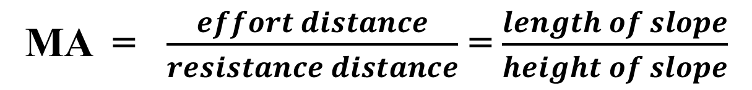
MECHANICAL ADVANTAGE
MA = $\frac{effort distance}{resistance distance}$ = $\frac{length of slope}{height of slope}$

Slide 17
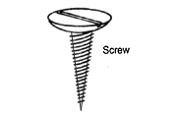
Screw
An inclined plane wrapped in a spiral around a cylindrical post.
As you turn the screw, the threads pull the screw into the wood.
The inclined plane slides
through the wood.

Slide 18
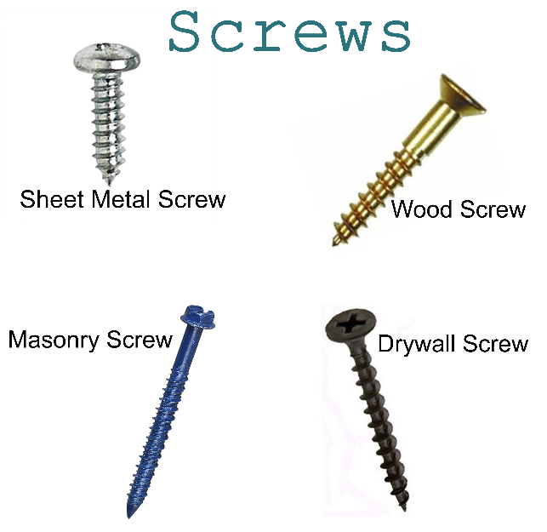
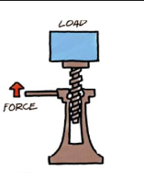
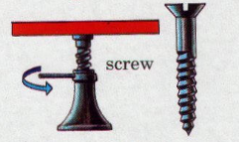
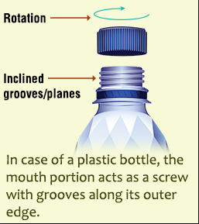
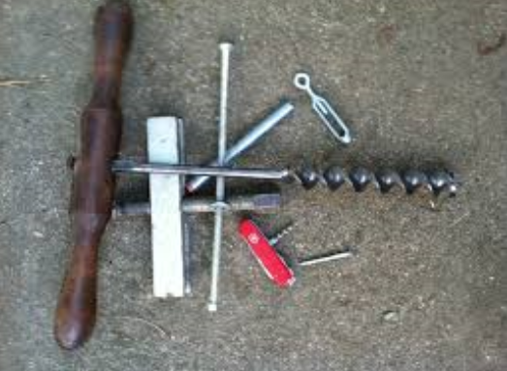
EXAMPLES

Slide 19
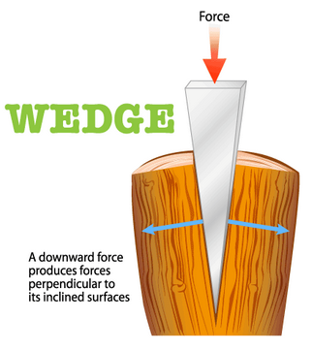
Wedge
An inclined plane with one or two sloping sides.
Two inclined planes make a wedge.
Wedges change the direction of the force.

Slide 20
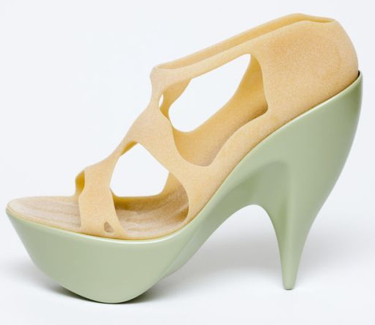
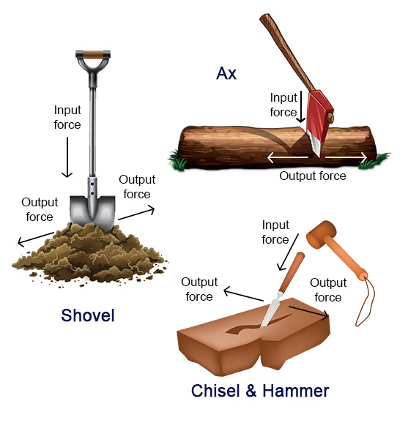
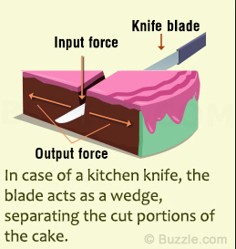
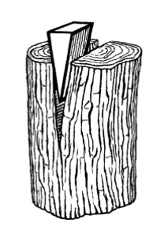
EXAMPLES

Slide 21
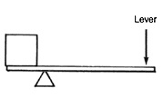
Levers
A bar that is free to pivot or turn around a fixed point.
Lever
Load
Fulcrum – fixed point

Slide 22
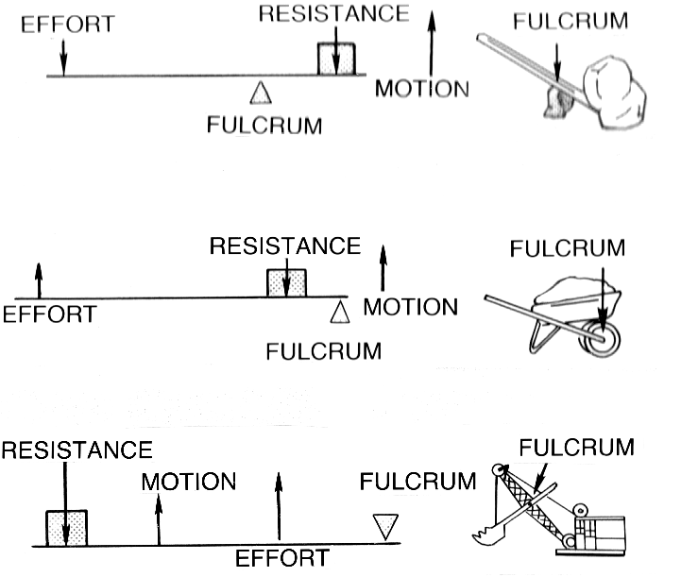
LEVERS
There are three classes of levers and each is based on the position of the fulcrum.

Slide 23
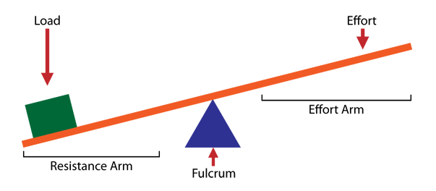
LEVERS
A fulcrum is the point around which a lever pivots.

Slide 24
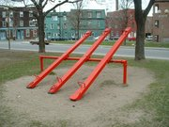
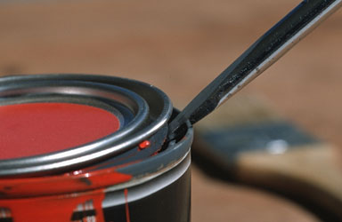
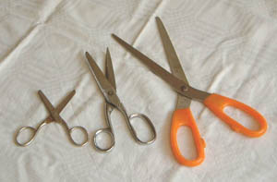
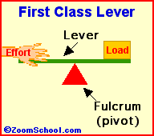
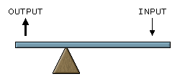

1st Class
Examples: Crowbars, pliers, scissors, seesaw
The fulcrum is between the resistance force and the effort force.
The closer the fulcrum to the resistance force, the more the lever multiplies the force.

Slide 25

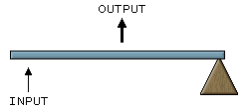
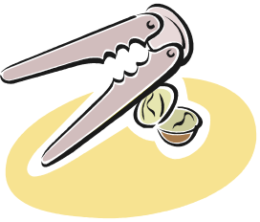
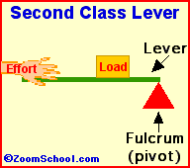
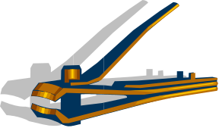
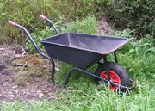
2nd Class
The resistance force is between the effort force and the fulcrum.
Examples:
Wheelbarrow
Nutcrackers
Crowbar (forcing two objects apart)
The handle of a pair of nail clippers

Slide 26

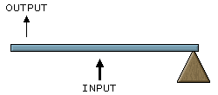
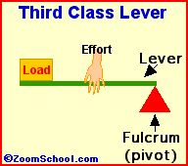


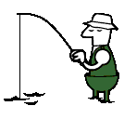
The effort force is between the resistance force and the fulcrum.
3rd Class
Examples:
Garden Hoe
Your arm
Catapult
Fishing rod
Tongs (double lever - when hinged at one end)

Slide 27
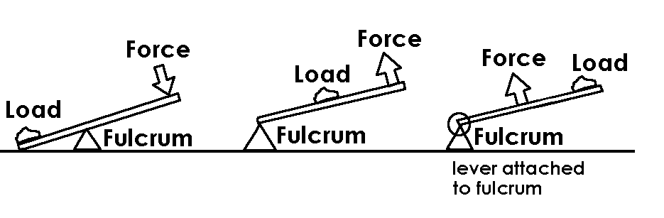
CLASSES OF LEVERS
Class: First
In the middle: Fulcrum
Class: Second
In the middle: resistance force,F_{r}
Class: Third In the middle: Effort force, F_{e}

Slide 28
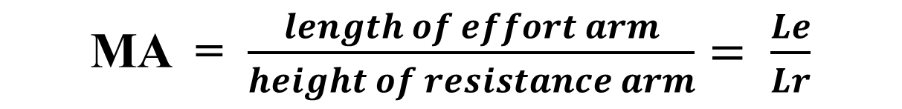
MECHANICAL ADVANTAGE
LEVER
  Makes work easier by:
  Multiplying your effort force and changing the direction of your force
MA = $\frac{length of effort arm}{height of resistance arm}= \frac{Le}{Lr}$

Slide 29
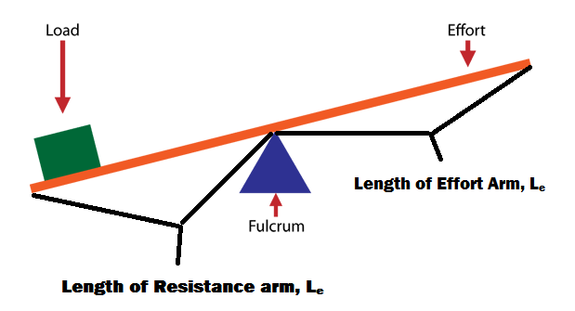
LEVERS

Slide 30
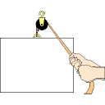
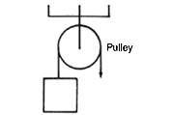
PULLEYS
A grooved wheel with a rope, chain, or cable running along the groove.
The two sides of the pulley are the effort arm and the resistance arm.
Wheel
Rope

Slide 31
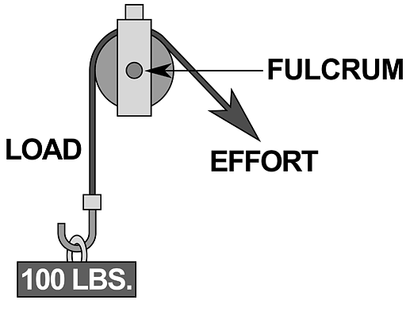
FIXED PULLEY
A modified first class lever; the axle of the pulley acts as the fulcrum.
Cannot multiply the effort force, only changes the direction of the effort force.

Slide 32
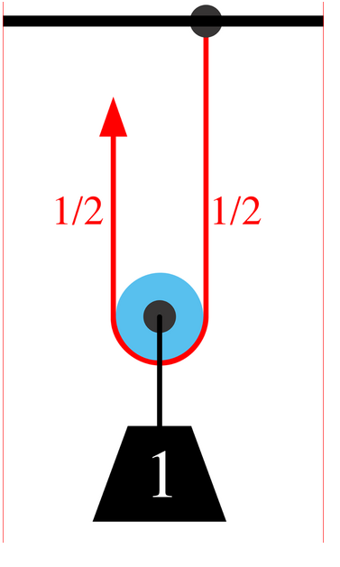
MOVEABLE PULLEY
One end of the rope is fixed and the pulley or wheel is free to move.
Can multiply the effort force and change the direction of the effort force.
Because effort force increases, the distance must increase to conserve energy. You pull more.
Pulleys

Slide 33
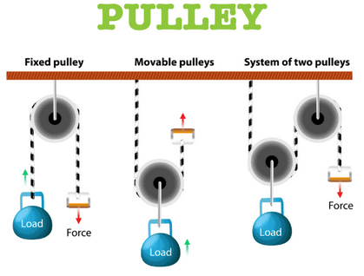
PULLEYS

Slide 34
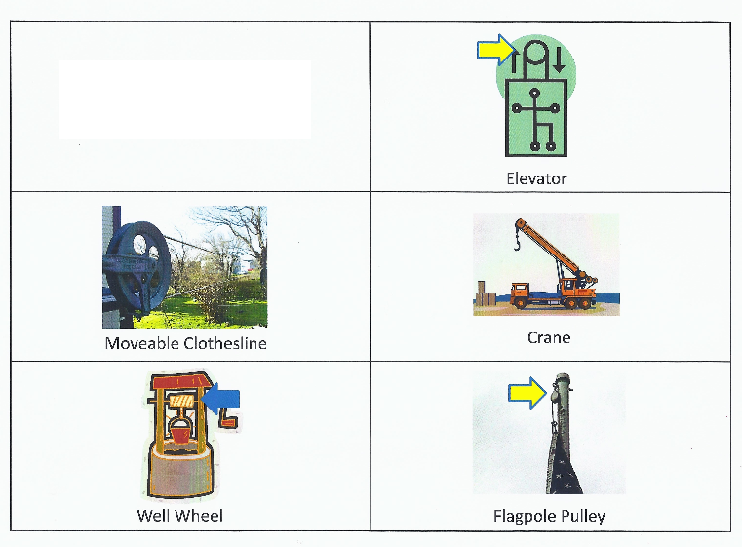
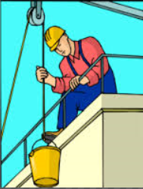
EXAMPLES

Slide 35
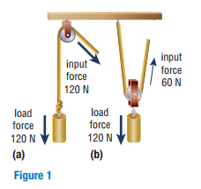
MECHANICAL ADVANTAGE
    Count the number of lengths of rope between pulleys that support the load. Do not count of the rope that is attached to the effort.
    In Figure 1(a), only one segment of rope supports the load. Therefore, the mechanical advantage is 1.
    In Figure 1(b), two segments of rope support the load, so the mechanical advantage is 2.

Slide 36
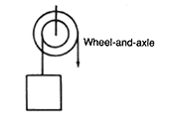
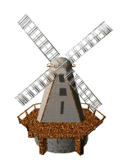

Wheel and Axle
A machine consisting of two wheels of different sizes that rotate together.
Wheel
Axle

Slide 37
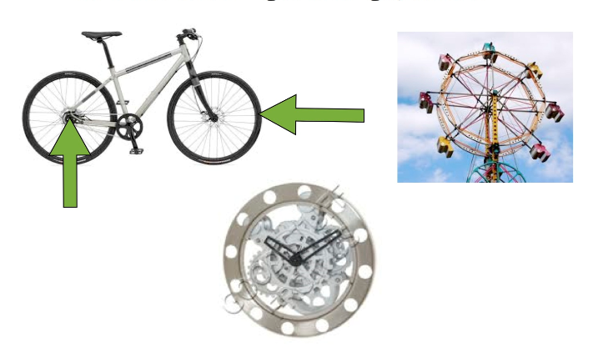
WHEEL AND AXLE
Usually the effort is exerted on the larger wheel. Then the smaller wheel (axle) exerts the resistance force.
A modified lever.

Slide 38
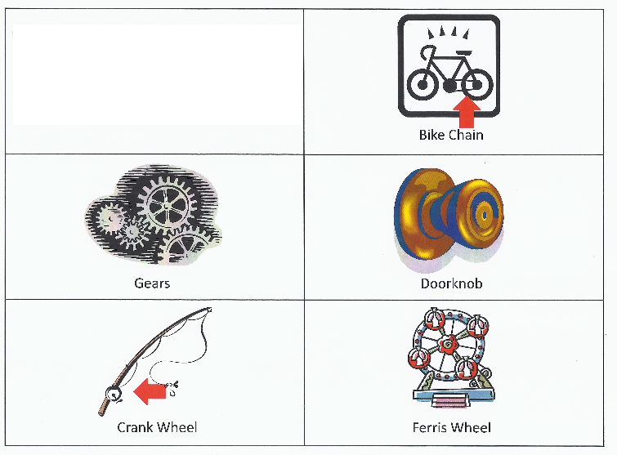

EXAMPLES

Slide 39


MECHANICAL ADVANTAGE
  The effort arm is the radius of the (bigger) wheel.
  The resistance arm is the radius of the axle (smaller wheel).
  The mechanical advantage of a wheel and axle can be increased by making the radius of the wheel larger.
MA = $\frac{radius of wheel}{radius of axle}= \frac{rw}{ra}$

Slide 40

COMPOUND MACHINES
When two or more simple machines are used together.
The overall mechanical advantage (MA) of the compound machine is related to the MA of all the machines involved.

Slide 41

EXAMPLES

