Slide 1
SPECIFIC HEAT
Adding energy to a material causes the temperature to go up.
Taking energy away from a substance causes the temperature to go down.

Slide 2
SPECIFIC HEAT
Have you ever noticed that on a hot summer day the pool is cooler than the hot cement?
OR maybe that the ocean is cooler than the hot sand?
Why?
The sun has been beating down on both of them for the same amount of time...........
It takes more thermal energy to raise the temperature of water that it does the cement!

Slide 3
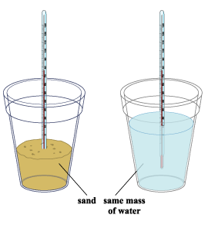
SPECIFIC HEAT
Water absorbs a lot of heat energy before its temperature changes while sand needs little heat energy before its temperature increases.

Slide 4
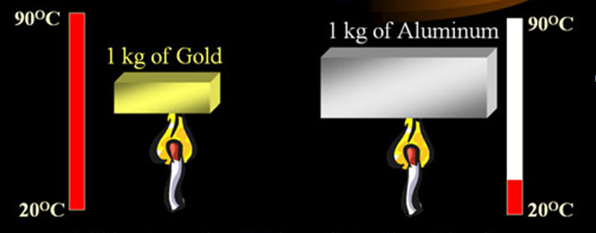
SPECIFIC HEAT
Different materials heat up at different rates.
Gold heats up seven times faster than aluminum.

Slide 5
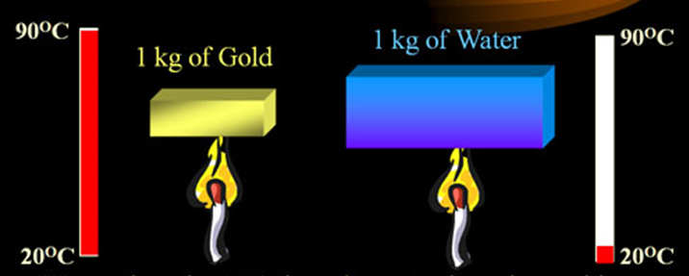
SPECIFIC HEAT
Different materials store different amounts of energy.
Water takes about 30 times longer to heat than gold which means it stores about 30 times more calories.

Slide 6
SPECIFIC HEAT
Specific Heat: the amount of energy that is required to raise the temperature of 1 kg of a material (substance) by one degree Celsius.
It takes different amounts of energy to make the same temperature change in different substances.
UNIT: J/g °C or J/kg K
SYMBOL: C_{p} or C

Slide 7
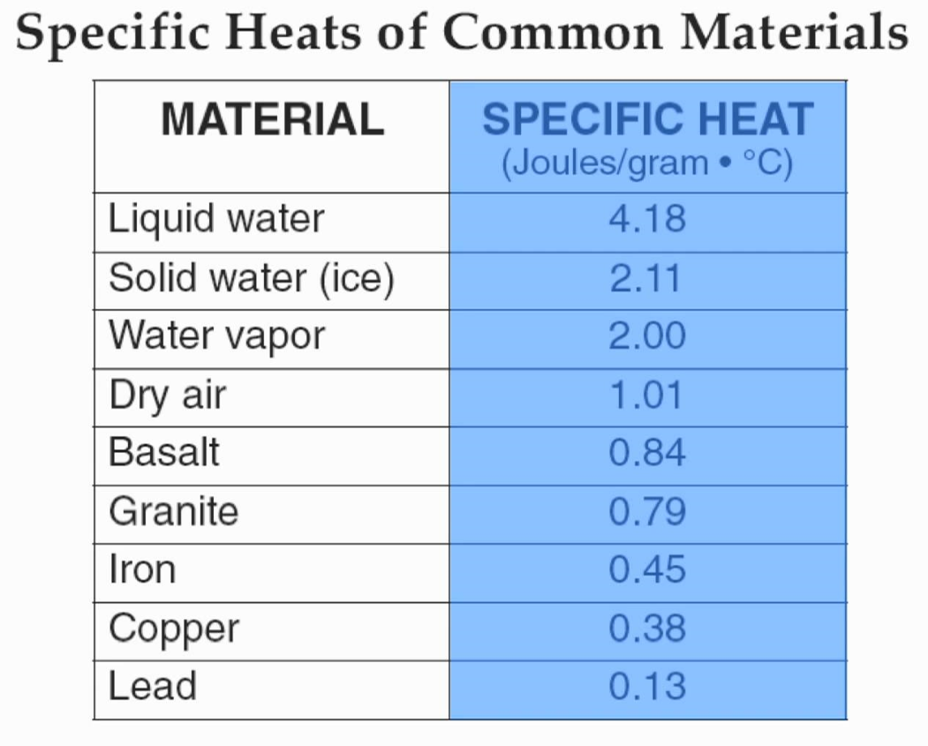

Slide 8
SPECIFIC HEAT: WATER
The C_{p} is high because water molecules form strong bonds with each other – this is called hydrogen bonding.
It takes a lot of energy to break the bonds so that the molecules can then start to move around faster (HEAT UP).

Slide 9
SPECIFIC HEAT: WATER
C_{p} = 4,184 J of energy to raise the temperature of 1kg 1°C.
Why C_{p}?
C_{p} Stands for “Heat Capacity”

Slide 10
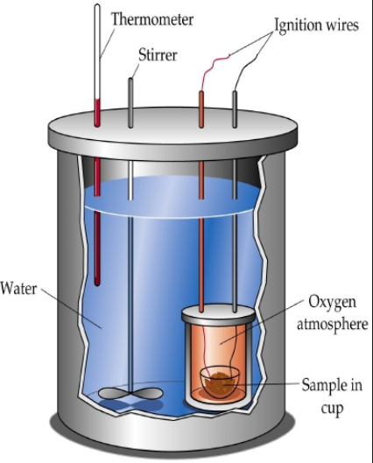
CALORIMETER
A calorimeter is a device used to measure the quantity of heat transferred to or from an object.
A bomb calorimeter includes a reaction chamber where the reaction (usually a combustion reaction) takes place.
The reaction chamber is surrounded by a layer of water with a thermometer inserted.
The heat released from the chamber warms the water-filled layer, allowing the quantity of energy released by the reaction to be determined.

Slide 11
CALCULATING CHANGES IN THERMAL ENERGY
Q = mΔTC_{p}
SPECIFIC HEAT
HEAT
CHANGE IN TEMPERATURE
MASS

Slide 12
CALCULATING CHANGES IN THERMAL ENERGY
Q = mΔTC_{p}
J /g ºC or
J /kg K
Joules
ºC or K
grams

Slide 13
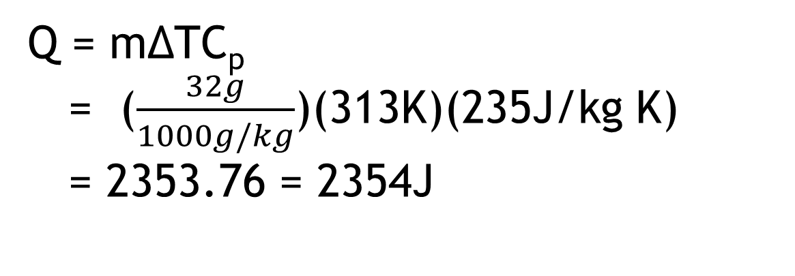
PRACTICE:
The temperature of a 32g silver spoon increases from 20°C to 60°C. If silver has a specific heat of 235J/kg K. what is the change in thermal energy (heat) of the spoon?
Mass = 32g
C_{p} = 235J/kg K
ΔT = 60°C - 20°C
= 40°C
K = 273 +°C = 313K
Q = ?
Q = mΔTC_{p}
= ($\frac{32g}{1000g/kg}$)(313K)(235J/kg K)
= 2353.76 = 2354J

Slide 14
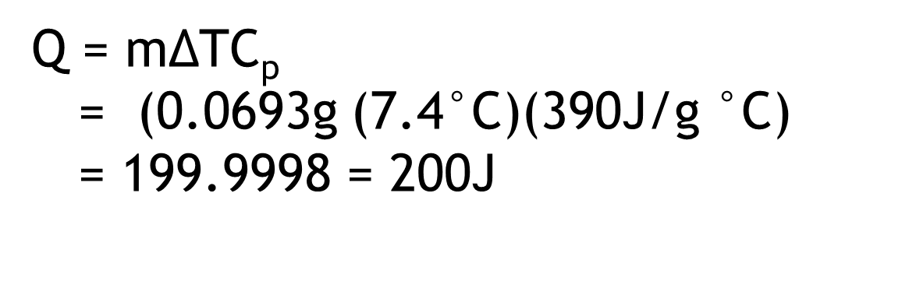
PRACTICE:
A copper ornament has a mass of 0.0693 kg and changes from a temperature of 20.0°C to 27.4ºC. How much heat energy did it gain?
Mass = 0.0693g
C_{p} = 390J/g °C
ΔT = 27.4°C – 20.0°C
= 7.4°C
Q = ?
Q = mΔTC_{p}
= (0.0693g (7.4°C)(390J/g °C)
= 199.9998 = 200J

Slide 15
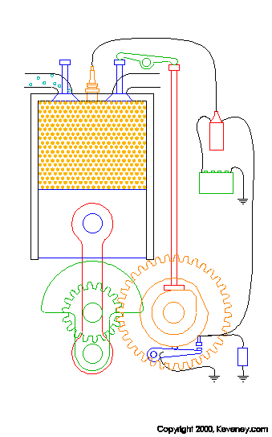

USING HEAT – HEAT ENGINES
The two main types of heat engines are External Combustion and Internal Combustion.
External = power plants
Internal = car engine

Slide 16
USING HEAT – EXTERNAL COMBUSTION
External combustion – produces electricity at power plants.
Water is heated by a fuel and the pressurized steam spins a turbine.

Slide 17
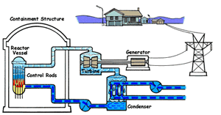
USING HEAT – EXTERNAL COMBUSTION
HEAT ENGINES
External combustion example – nuclear power plants.

Slide 18
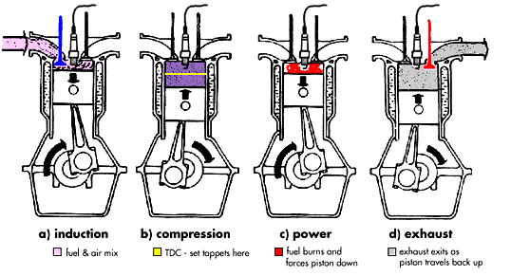
USING HEAT – INTERNAL COMBUSTION
Internal combustion – car engines.
The fuel (gas) is compressed and ignited (lit) to drive a piston.

