Slide 1
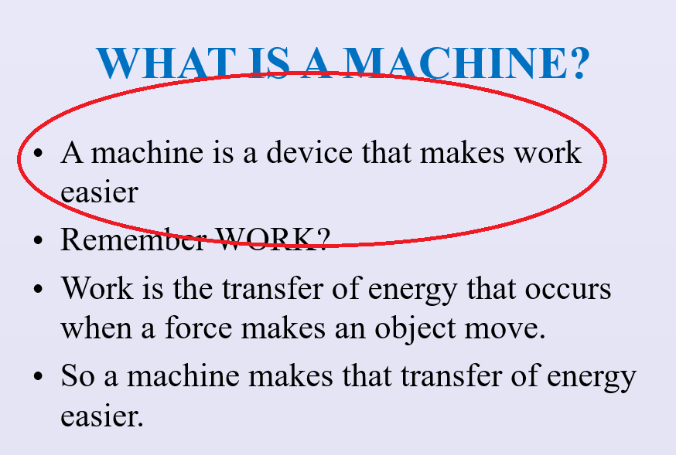
REVIEW
1. Be able to tell what a machine does for us.

Slide 2
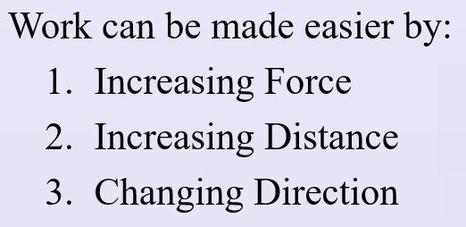
REVIEW
2. Know the three ways works can be made easier and be able to give an example of each.
shovel
ramp
mini blind

Slide 3
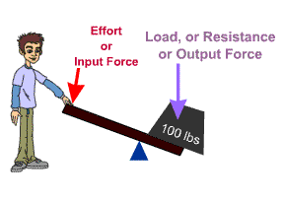
REVIEW
Know the two forces involved: Effort Force, F_{e}, and Resistance Force, F_{r}.

Slide 4
REVIEW
4. Understand how energy is transferred in a machine and that W_{out} is always smaller than W_{in}.
W_{out} is Work Output – the amount of work the machine puts out.
W_{in} is Work Input – the amount of work YOU put into the machine.
Friction/heat means W_{out} is less than W_{in}.

Slide 5
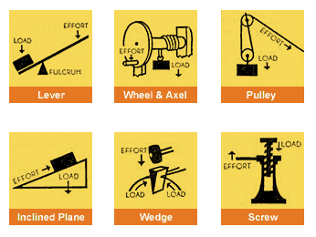
REVIEW
5. Define the six simple machines and be able to identify an example of each.

Slide 6
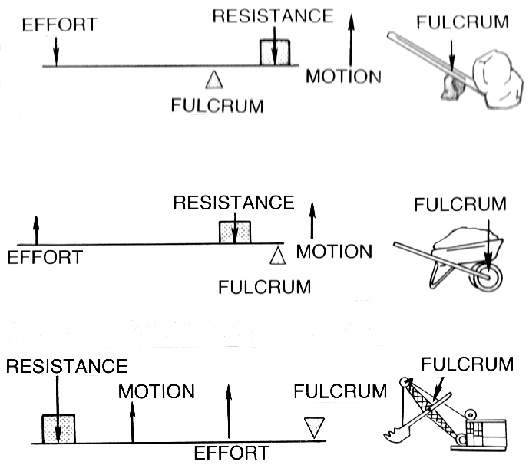
REVIEW
6. Describe and identify the three types of levers.

Slide 7
REVIEW
7. Define mechanical advantage and be able to calculate for all the simple machines both with distance and force.
The number of times a machine multiplies the effort force is the mechanical advantage of the machine.

Slide 8
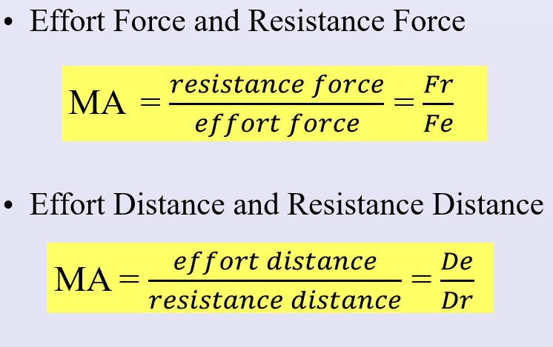
REVIEW

Slide 9
REVIEW
8. Define a compound machine and be able to recognize examples.
A compound machine is a machine consisting of two or more simple machines operating together.

Slide 10
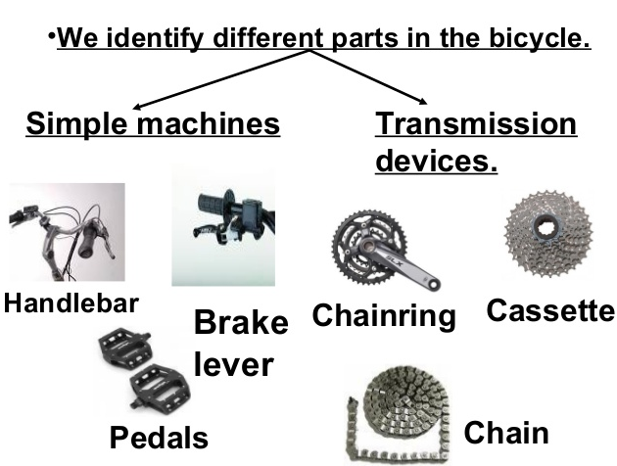
REVIEW

