Slide 1
DO NOW
Pick up handout
Turn in any missing work..

Slide 2
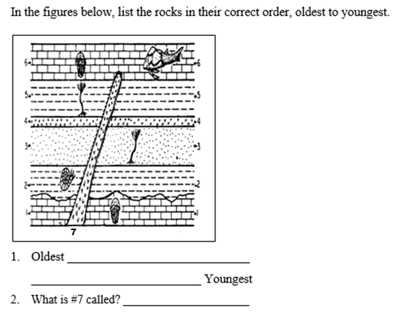
REVIEW #11

Slide 3
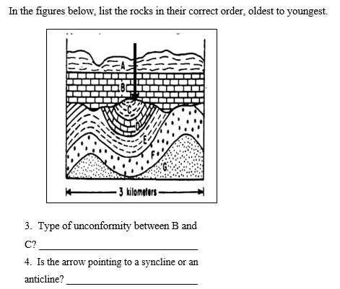
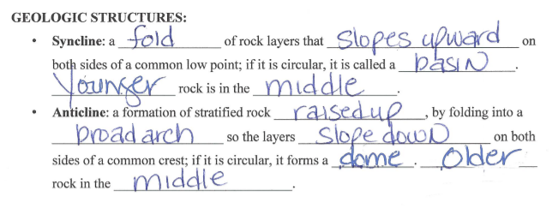
REVIEW #11

Slide 4
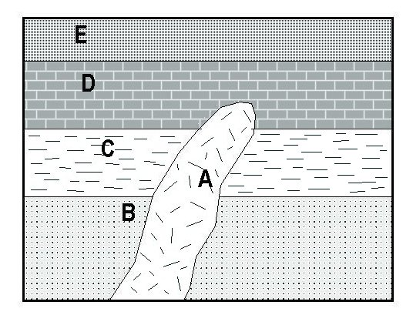
REVIEW: WHAT IS THE ORDER? (Oldest to Youngest)
Youngest
E
A
D
C
B
Oldest

Slide 5
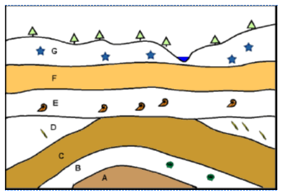
TODAY’S ACTIVITY
This drawing shows a cross-section, or a side view, of the rock layers below the Earth’s surface. The trees and water show where the surface is. Each rock layer is identified by a letter. Some of the rock layers contain fossils. Using the principles of stratigraphy, answer the following questions about the cross section.

Slide 6
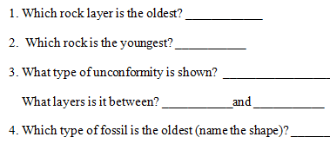

Slide 7
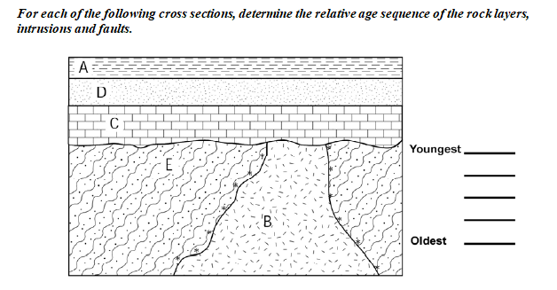

Slide 8
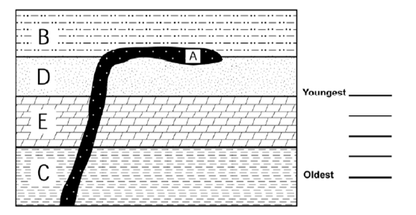

Slide 9
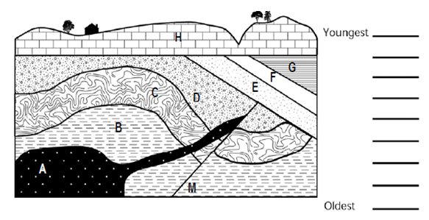

Slide 10
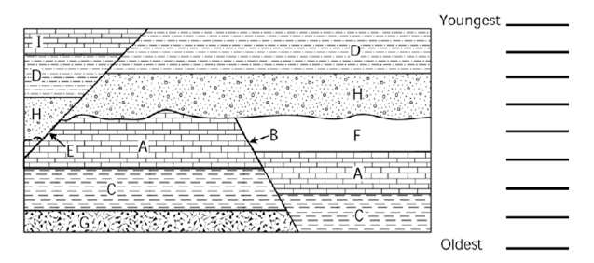

Slide 11
TO DO
When finished with the Stratigraphy handout, get the “Stratigraphy Practice” and:
Complete it for a grade.
Work on How Do you Stack Up Lab (last Friday) FIRST
Then work on other missing work.

