Slide 1

SOUND

Slide 2
REVIEW
Waves transport ENERGY, not matter.
Waves are mechanical (matter) or non-mechanical (no matter).
Sound is mechanical.
Light is non-mechanical.
Transmission of Sound

Slide 3

SOUND WAVES
Sound waves are compressional waves.
The vibrations of the molecules are parallel to the direction of the wave.
Produced by the compressions and rarefactions of matter.

Slide 4
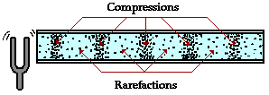
SOUND WAVES
LABEL YOUR DIAGRAM

Slide 5


SOUND WAVES
Sound is produced by a vibrating object.
As one individual particle is disturbed, it transmits the disturbance to the next interconnected particle.
This disturbance continues to be passed on to the next particle.
The result is that energy is transported without the actual transport of matter.

Slide 6
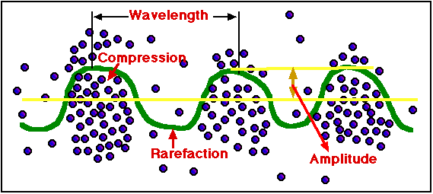
SOUND WAVES
Visualizing Sound

Slide 7
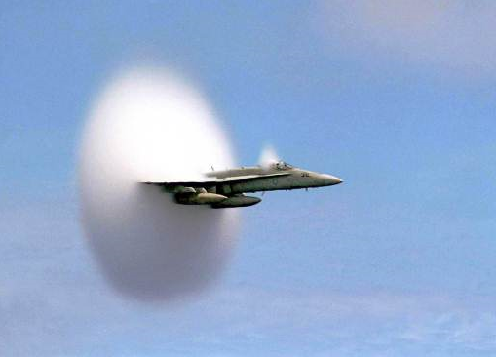

SPEED OF SOUND
Speed depends upon how fast one particle can transfer its motion to another particle.
Speed of sound depends on the
  Elasticity
  Medium (Density)
  Temperature

Slide 8

SPEED OF SOUND
ELASTICITY
  the ability of an object to bounce back to its original shape.
  Sound travels faster in more elastic objects.
  Typically gases are the least elastic, liquids are next and solids are the most elastic.
Example: A rubber band is more elastic than modeling clay – it bounces back into shape whereas modeling clay stays stretched.

Slide 9
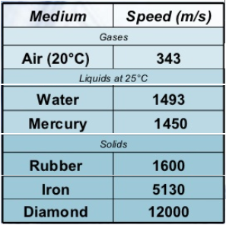
SPEED OF SOUND
DENSITY
  generally speaking, in material of the same state of matter (solid, liquid or gas) the denser the medium, the slower the sound travels.
  Sound travels slower in lead than it does in steel.

Slide 10
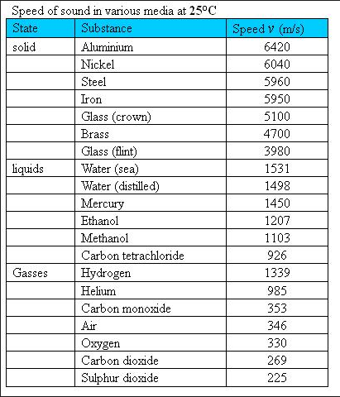
SPEED OF SOUND

Slide 11
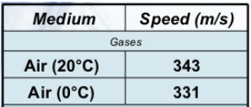
SPEED OF SOUND
TEMPERATURE
  Generally speaking the higher the temperature, the faster the speed of sound.
  Since the molecules vibrate faster, sound waves can travel more quickly.

Slide 12
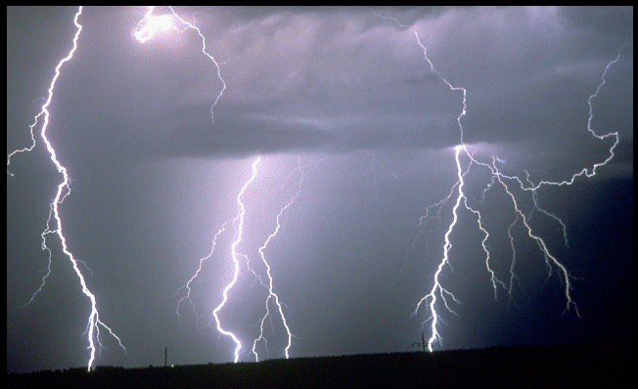
SPEED OF SOUND
Speed of Sound – on average
  Air (22°C): 346 m/s (765mph) – about 1 mile per 5s.
  Air (0°C): 331 m/s (740mph).
  Water is 1,482 m/s(3,315 mph) about 1 mile per 1.1s.
  Steel is 5,960m/s(13,330 mph) about 1 mile per 0.27s or 3.7mile per 1s.

Slide 13
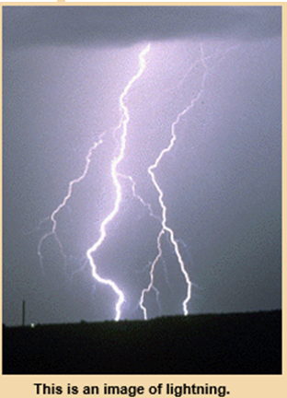
SPEED OF SOUND
LIGHNING VS THUNDER, LIGHT VS SOUND
You see a flash of lightning across the sky. Five seconds later, you hear a rumble of thunder.
They occur at the same time. However, light travels extremely fast (300,000,000m/s) and sound much slower (343m/s).
Sound has a disadvantage because it tends to bounce off molecules in the sir. This makes sound travel in all different directions. The further away the source of the sound it, the more sound gets distorted.
So if the thunder is rumbling, the lightning was far away. If the thunder cracked or boomed, the lightning bolt was close to you (less than 100m)

Slide 14


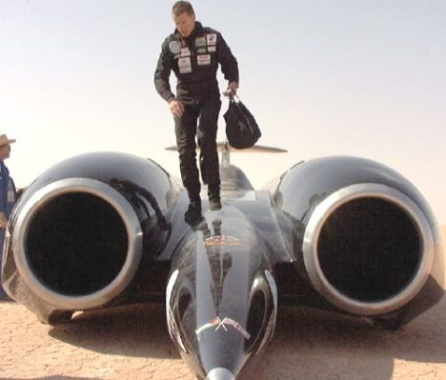
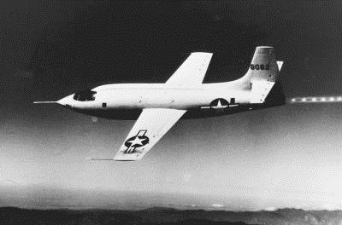
BREAKING THE SOUND BARRIER
Chuck Yeager – first man to fly faster than the speed of sound
Andy Green – first man to drive a land vehicle faster than the speed of sound.
October 14, 1947 –
in X1 “Glamorous Glennis”
October 15, 1997 –
in SuperSonic Car
“Thrust SSC”
763 MPH

Slide 15

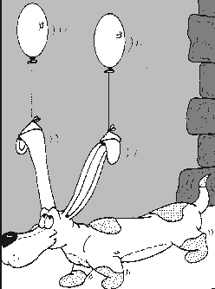
HOW WE HEAR

Slide 16
HOW WE HEAR
When a sound wave reaches the ear, a series of high and low pressure regions hit the eardrum.
The arrival of a compression or high pressure region pushes the eardrum inward; the arrival of a low pressure region serves to “pull” the eardrum outward.
The continuous arrival of high and low pressure region sets the eardrum into motion.

Slide 17
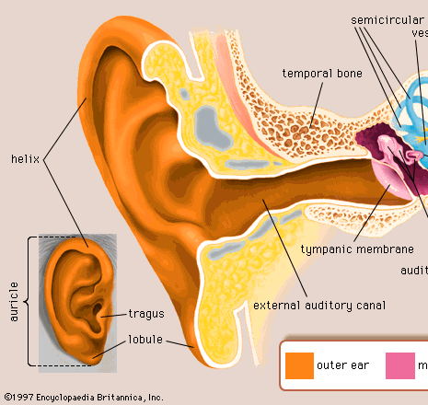
HOW WE HEAR
Auricle (Pinna-the ear flap) – used to focus the sound waves into the ear canal
Ear Canal (Auditory Canal) – focuses the sound onto the ear drum.
Ear Drum (Tympanic membrane) – Sound starts the ear drum vibrating.

Slide 18
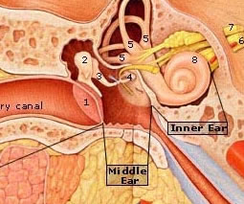
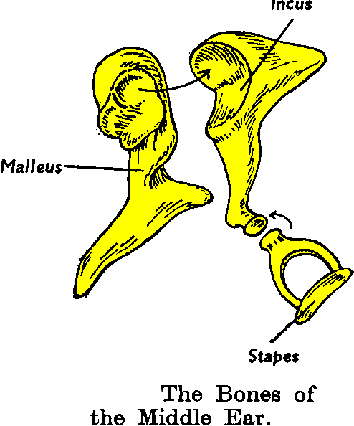
HOW WE HEAR
Three smallest bones vibrate, one after the next.
  Hammer (Malleus) is touching the ear drum & vibrates first.
  Next is the Anvil (Incus).
  Last is the Stirrup (Stapes).
  Eustachian Tube: tube that connects the middle ear with the throat. This allows the pressure on both sides of the ear drum to equalize.

Slide 19
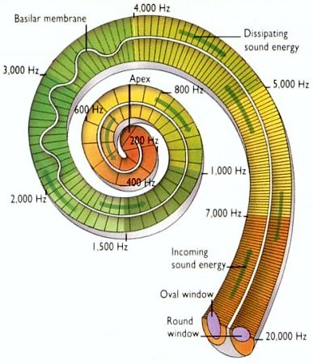
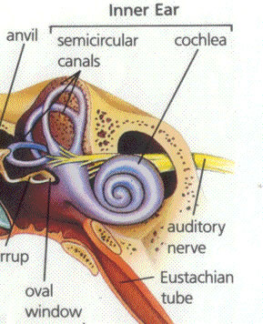
HOW WE HEAR
The Stirrup vibrates the oval window of the cochlea.
Cochlea is a long fluid filled tube, folded in half and the coiled up like a snail shell. The entire inner surface is lined with cilia, little hairs.
Once cilia are vibrated, the attached nerves are stimulated and send signal to the brain.
Balance is achieved by the semicircular canals.
Three canals in three different planes are able to determine the body’s position in space.

Slide 20
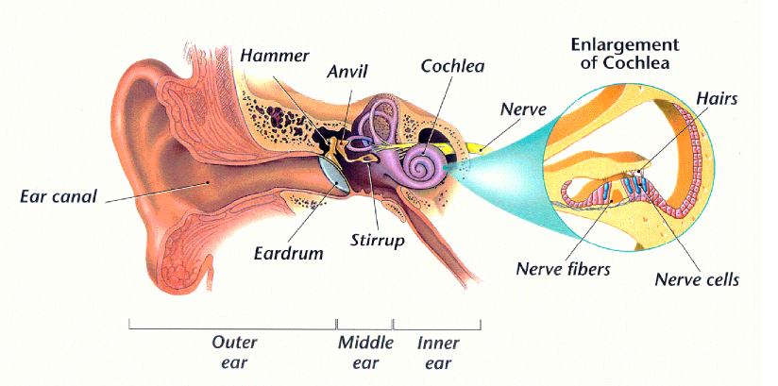
HOW WE HEAR
Need to know these structures & their function: Outer Ear, Middle Ear, Inner Ear, Auricle, Ear canal, Ear drum, Hammer, Anvil, Stirrup, Oval Window, Cochlea, Auditory Nerve, Semicircular Canals, Eustachian Tube.
How We Hear

