Slide 1
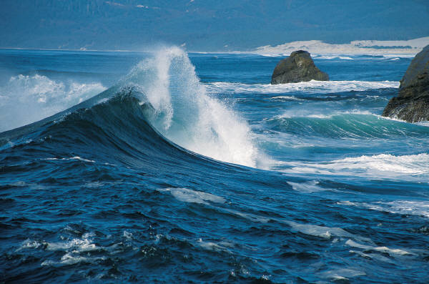
WAVES
Waves

Slide 2
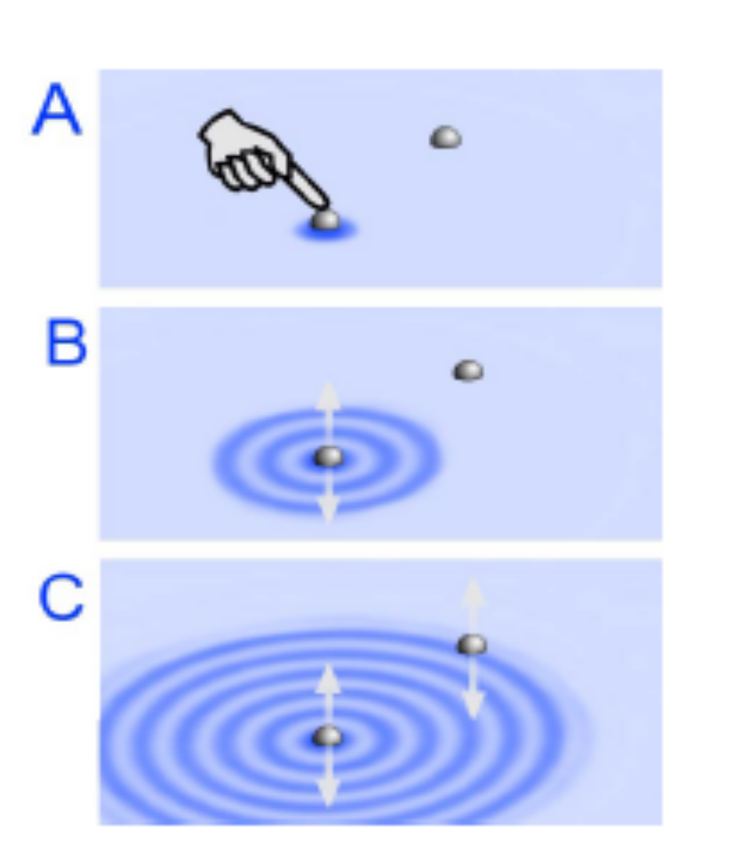
WAVES
A WAVE is a repeating disturbance or movement that transfers energy through matter or space.
The energy is transferred to nearby particles and they move, causing other particles to move.
Energy is transferred from one place to another.

Slide 3
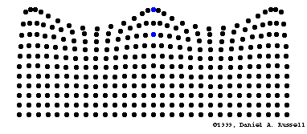
WAVES
Energy is transferred;
NOT THE MATTER!

Slide 4
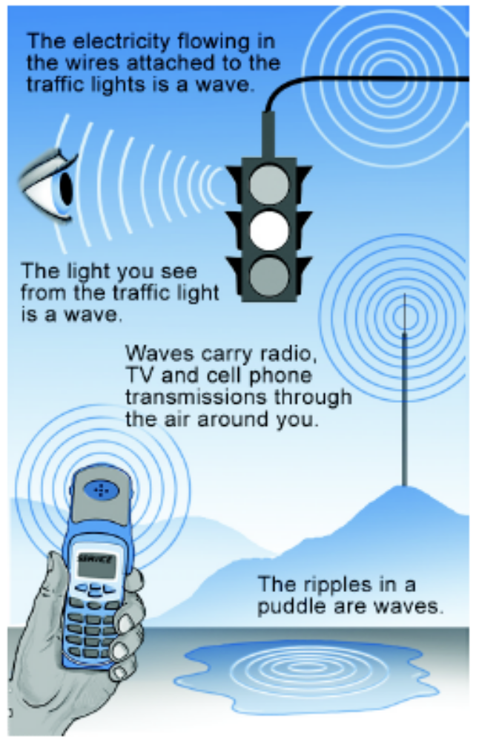
WAVES
Waves carry useful information and energy.
Waves are all around us:
  light from the stoplight
  ripples in a puddle of water
  electricity flowing in wires
  radio and television and cell phone transmissions

Slide 5
WAVES
Anytime you see a vibration that moves...
Anything that makes or responds to sound...
Anything that makes or responds to light ...
Anything that transmits information through the air (or space) without wires...
  cell phones, radio, and television.
Anything that allows you to “see through” objects...
  ultrasound, CAT scans, MRI scans, and X rays

Slide 6
TYPES OF WAVES
Two types of waves:
    Mechanical
    Non-Mechanical
Mechanical: waves need a medium in order to travel.
    Examples: Sound, water
Non-mechanical: waves do not need a medium to travel.
    Examples: light, gamma waves, microwaves, x-rays

Slide 7
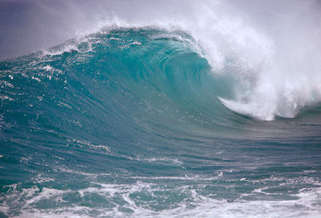
MECHANICAL WAVES
Waves that require a medium to travel.
A medium is the material a wave travels through.
Examples: sound and water.
Light waves are NOT Mechanical Waves.

Slide 8
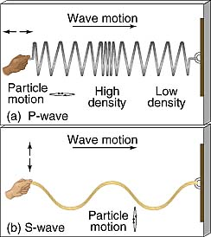
TYPES OF WAVES
Transverse Wave
  oscillations are perpendicular
  to the direction of motion .
  Example: light, water
Longitudinal wave
  oscillations are in the same
  direction of motion.
  (parallel to the motion)
  Example: sound

Slide 9
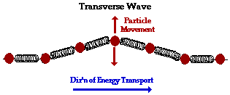
TRANSVERSE WAVE
Transverse waves are up and down movements.
The displacement of individual particles is perpendicular (at right angles) to the direction of the wave.
Examples: water waves, radio waves (all electromagnetic waves)

Slide 10
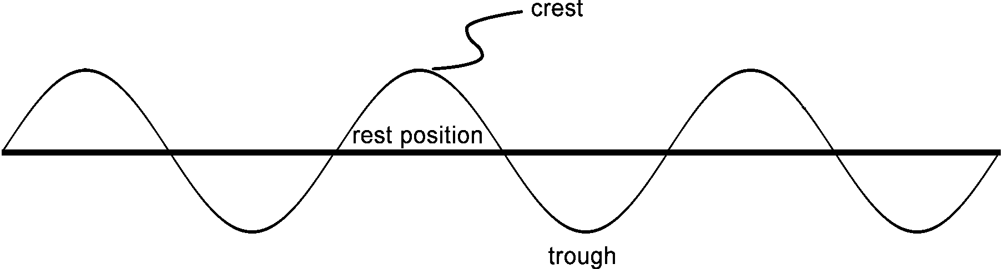
TRANSVERSE WAVES
Crest: the highest point of a transverse wave.
Trough: the lowest point of a transverse wave
Rest Position: the position of the wave with no energy.

Slide 11
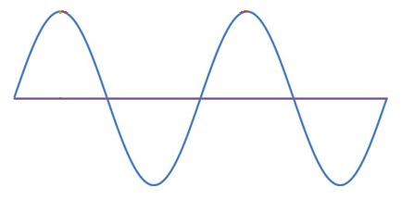
TRANSVERSE WAVE

Slide 12
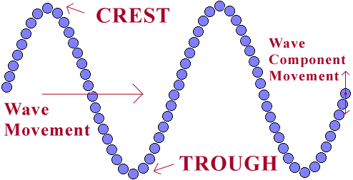
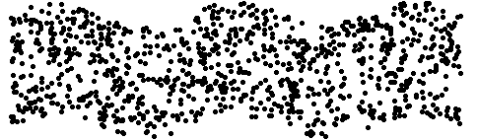
MOVEMENT OF A TRANSVERSE WAVE

Slide 13

COMPRESSIONAL WAVE
Compressional waves are a series of PUSHES and PULLS in which the motion of the medium is in the same direction that the wave travels.
Example: sound

Slide 14
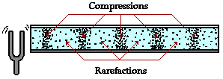
COMPRESSIONAL WAVE
Rarefaction is a place where the material is the least dense (atmospheric pressure is the lowest).
Compression is where the material is the most dense (atmospheric pressure is the highest).

Slide 15
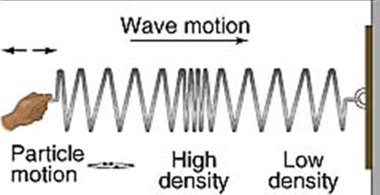
COMPRESSIONAL WAVE
Rarefaction
Compression

Slide 16
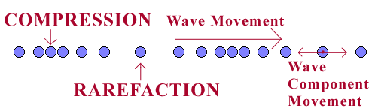

CHARACTERISTICS OF A COMPRESSIONAL WAVE

