Slide 1
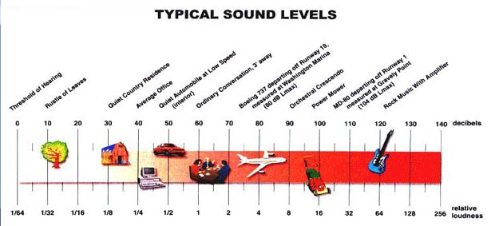
PROPERTIES OF SOUND
Sound Applications
Intensity – the amount of energy the wave carries; sound level is measured in decibels (dB); it influences how far away a sound can be heard.

Slide 2
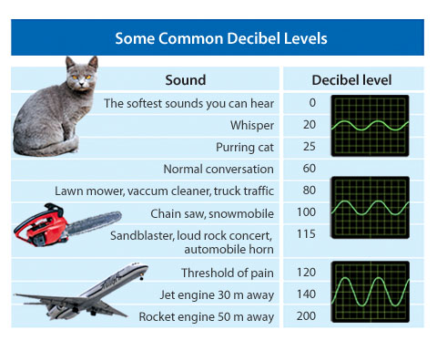



Slide 3
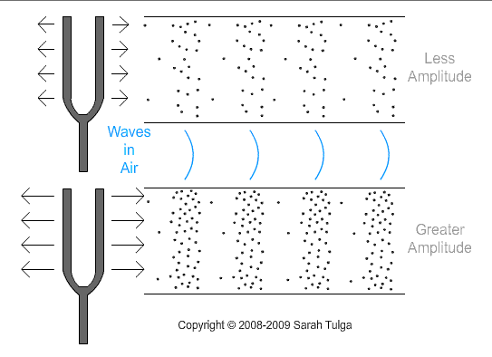
PROPERTIES OF SOUND
Loudness – how we perceive intensity.
  depends on the amplitude.
  Larger amplitude means more pressure.
  Remember: amplitude is a measure of the amount of energy in the wave.

Slide 4


PROPERTIES OF SOUND

Slide 5
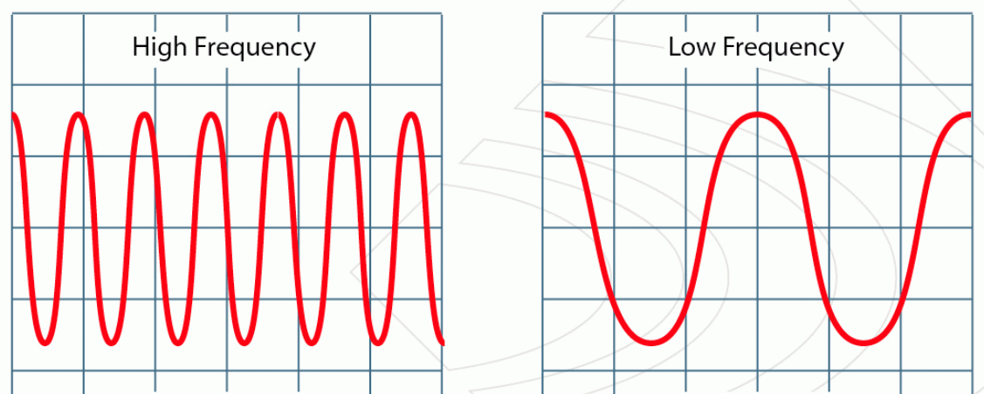
PROPERTIES OF SOUND
Frequency – the number of wavelengths that pass a particular point (vibrations) per second, Hz.
  Human Hearing – between 20 Hz – 20,000 Hz.
    Below 20 Hz is called infrasound.
    Above 20,000 Hz is called ultrasound.

Slide 6
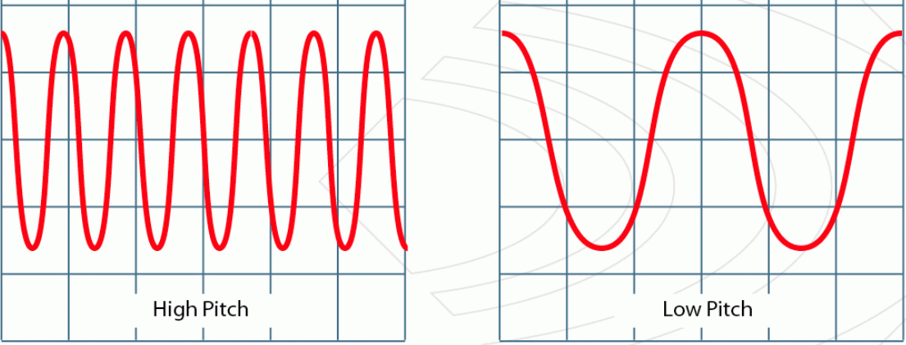
PROPERTIES OF SOUND
Pitch - determined by frequency; the highness or lowness of sound.
  High frequency yields high pitch sounds
  Low frequency yields low pitch

Slide 7


PROPERTIES OF SOUND
Low Pitch
High Pitch
Low to High Frequency Pitch and Frequency

Slide 8
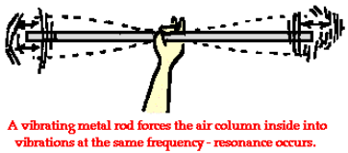
PROPERTIES OF SOUND
Resonance – when the frequency of sound matches the natural frequency of an object.

Slide 9
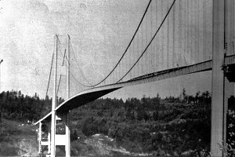
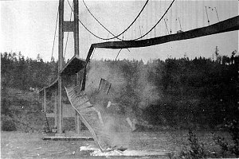
EXAMPLE: TACOMA NARROWS BRIDGE COLLAPSE
Nov. 7, 1940
Galloping Gertie
On a day of high winds, Gertie took on a 30-hertz transverse vibration (by moving the end up and down) with an amplitude of 1½ feet! It later took on a twisting motion of about 14-hertz and quickly tore itself in two.

Slide 10
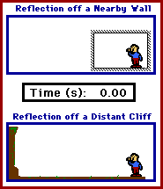
PROPERTIES OF SOUND
Sound waves can be reflected.
A reverberation is perceived when the reflected sound wave reaches your ear in less than 0.1 second after the original sound wave.
An echo takes longer.

Slide 11
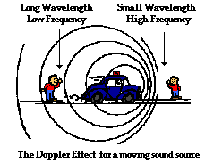
PROPERTIES OF SOUND
Doppler effect
Variation in the perceived pitch of a sound due to a moving sound source.
Bunches up in front of the source
Spreads out behind the source

Slide 12
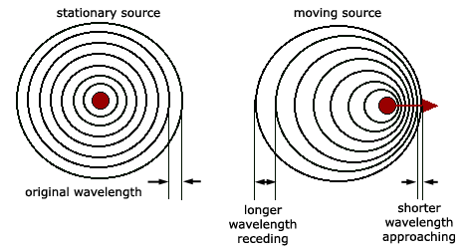
PROPERTIES OF SOUND
Doppler Effect
Doppler Shift on a train

Slide 13
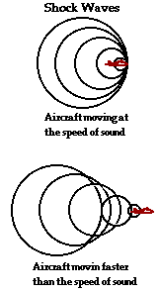
PROPERTIES OF SOUND
A sonic boom is the sudden onset and release of pressure after the buildup by a sound shock wave.
Sonic Boom

Slide 14
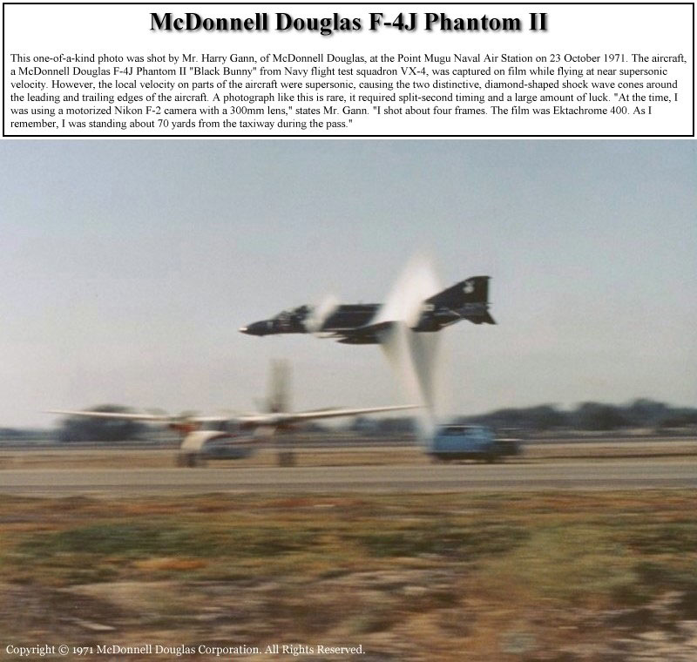

Slide 15
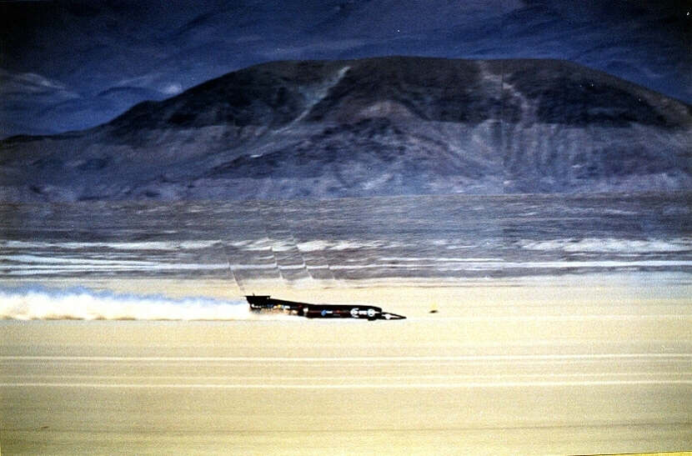
This picture shows a sonic boom created by the THRUST SSC team car as it broke the land speed record and broke the sound barrier on land.

