Slide 1
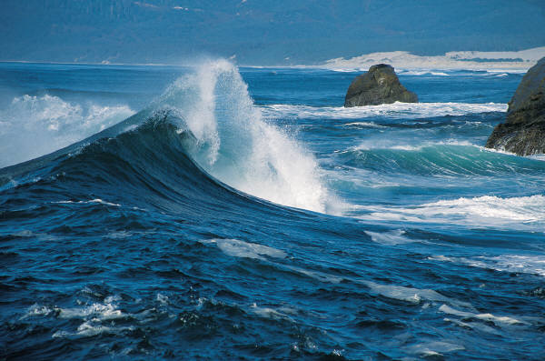
WAVES

Slide 2
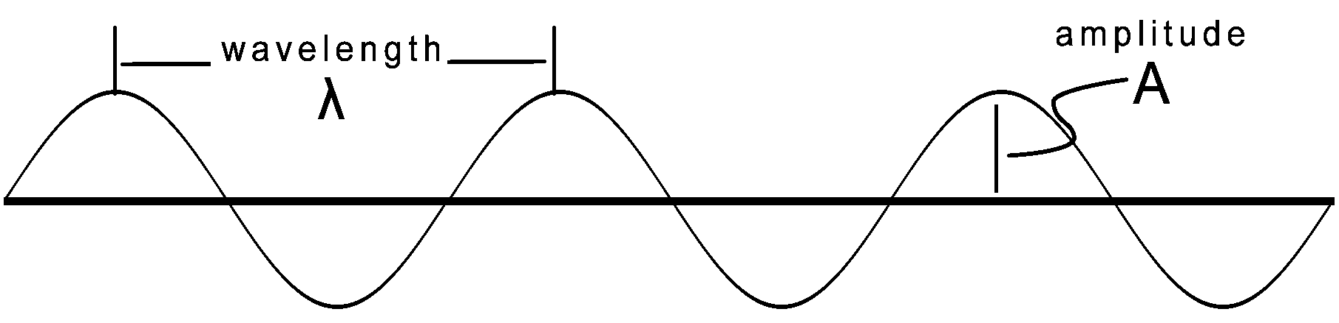
WAVE CHARACTERISTICS
Wavelength, λ:
Distance between two identical points on adjacent waves. Usually measured in meters.

Slide 3
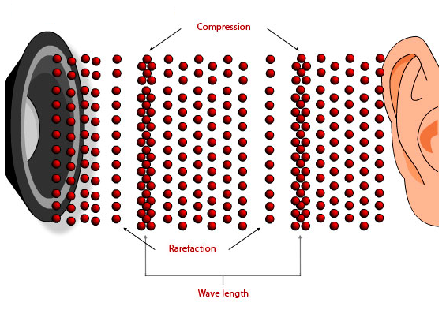
WAVE CHARACTERISTICS

Slide 4
WAVE CHARACTERISTICS
5
10
15
20
25
30
35
40
(nm)
Measure from any two identical successive points.

Slide 5
WAVE CHARACTERISTICS
5
10
15
20
25
30
35
40
(nm)
30nm – 10nm = 20nm
Measure from any identical two successive points

Slide 6
WAVE CHARACTERISTICS
5
10
15
20
25
30
35
40
(nm)
22.5nm - 2.5nm = 20nm
Measure from any identical two successive points

Slide 7
WAVE CHARACTERISTICS
Amplitude: the amount of energy carried by the wave.
The higher the amplitude, the more energy the wave is carrying.

Slide 8
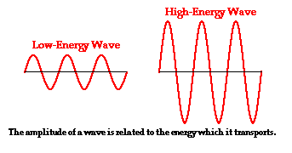
WAVE CHARACTERISTICS
High energy, higher amplitude; low energy, lower amplitude

Slide 9
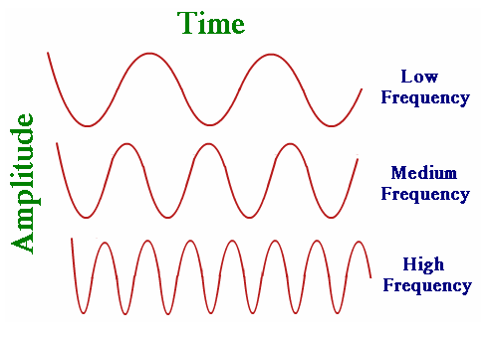
WAVE CHARACTERISTICS
Frequency, F
The number of WAVES passing a fixed point per second.
Unit: Hertz, Hz

Slide 10
WAVE CHARACTERISTICS
Wavelength and frequency are related.
As the wavelength decreases the frequency increases.

Slide 11
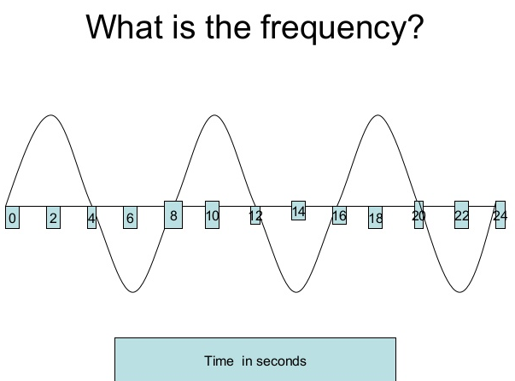
WAVE CHARACTERISTICS

Slide 12
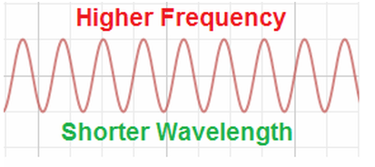
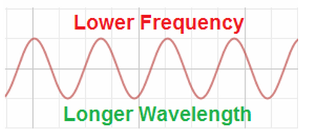
WAVE CHARACTERISTICS
Frequency increases
Energy increases
Wavelength decreases
Frequency decreases
Energy decreases
Wavelength increases

Slide 13
SPEED OF A WAVE
Wave speed depends on the wavelength and frequency.
  ν is the velocity/speed (m/s)
  f is the frequency (hertz)
  λ (lambda) is the wavelength (m)
Speed = wavelength x frequency
v = (λ)(f)

Slide 14
SPEED OF A WAVE
The speed of a mechanical wave is constant for any given medium.
The speed of a wave changes as it moves through different media (mediums).

Slide 15
PRACTICE
Calculate the speed of a wave whose wavelength is 1.5 meters and whose frequency is 280 hertz.
λ = 1.5m
f = 280Hz
v = ?
v = λf = (1.5m)(280Hz)
= 420m/s

Slide 16
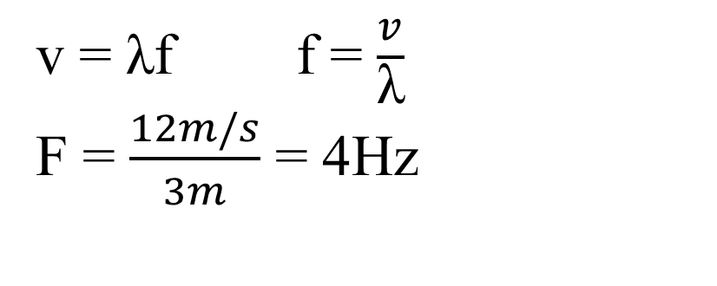
PRACTICE
A wave is traveling at a speed of 12m/s and its wavelength is 3m. Calculate the wave frequency.
λ = 3m
f = ?
v = 12m/s
v = λf f = $\frac{v}{\text{λ}}$
F = $\frac{12m/s}{3m}$ = 4Hz

