Slide 1
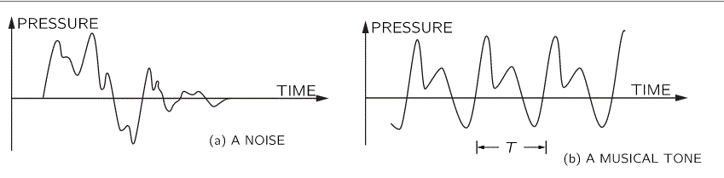
MUSIC VS NOISE
Music is sounds that are deliberately used in a repeated pattern.
Noise has random patterns and pitches.

Slide 2
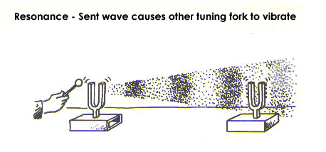
MUSIC VS NOISE
Materials have their own natural frequencies.
    Examples: guitar strings, wine glass, other musical instruments
Resonance is the ability of an object to vibrate by absorbing energy at its natural frequency.
Wine glasses

Slide 3
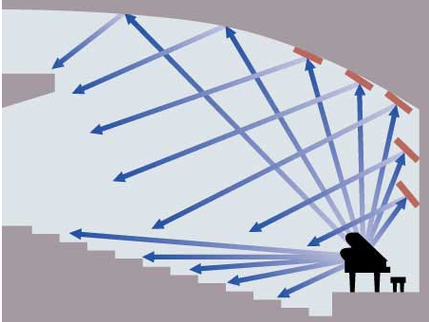
USING SOUND
Acoustics is the study of sound.
Sound is studied so that concert halls, classrooms, theaters, etc. can be constructed to minimize destructive interference and diffuse reflection.

Slide 4
ECHOLOCATION
The use of sound waves and echoes to determine where objects are in space.
Bats send out sound waves using their mouth or nose.
When the sound hits an object, an echo comes back.
They can tell the distance between themselves and the object .
They can identify an object by the sound of the echo.

Slide 5
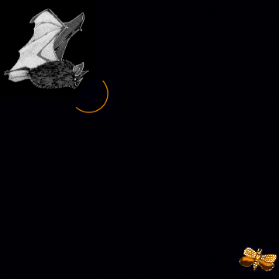
ECHOLOCATION
They can even tell the size, shape and texture of a tiny insect from its echo.
Most bats use echolocation to navigate in the dark and find food.
ECHOLOCATION

Slide 6

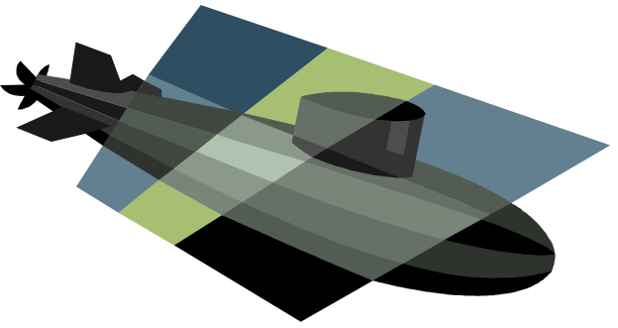
SONAR
Sonar - Sound Navigation and Ranging
Sonar uses sound waves to 'see' in the water
It is helpful for exploring and mapping the ocean because sound waves travel farther in the water than do radar and light waves.

Slide 7
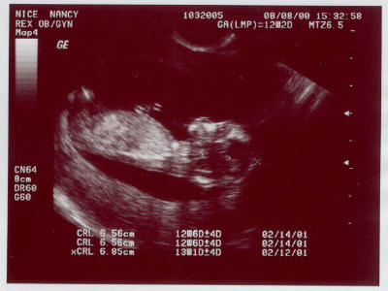
ULTRASOUND
a device that uses high frequency sound waves to create an image of some part of the inside of the body, such as the stomach, liver, heart, tendons, muscles, joints and blood vessels.

Slide 8
BIOACOUSTICS
Bioacoustics is a branch of science concerned with the production of sound and its effects on living systems.
Animals that generate infrasound include elephants, whales, alligators, hippos, rhinos, giraffe, lions, tigers and several birds.
Animals that generate ultrasound include dolphins, bats, many birds and insects.

Slide 9
CYMATICS
from Greek meaning “wave”.
Typically a surface is vibrated and regions of maximum and minimum displacement are made visible in a thin coating of particles, paste, or liquid.
Different patterns emerge as the surface vibrates.
Cymatics

